Slide 1
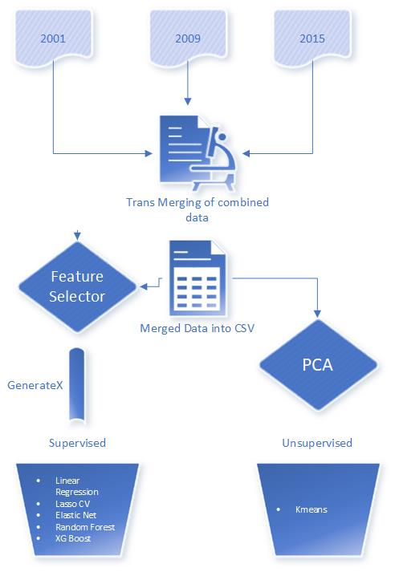
Predicting Energy Consumption
We are visualizing and predicting the usage of energy across the US. Our resource used was from the Residential Energy Consumption Survey(RECS).
Using Machine learning tools and techniques, we aim at predicting
Total Consumption of Energy in residential homes
Total Cost in dollar for the energy consumed
RECS data for 2001, 2009, 2015 were used to train and test our ML Models.
Data extracted from US eia site ( https://www.eia.gov/consumption/residential/index.php) was cleaned and merged into one CSV file.
Using Feature Engineering tools such as Feature Selector and PCA we determined the amount of features necessary to predict total consumption and cost.
Post determining important features, an array of ML modeling techniques were used for prediction

Slide 2
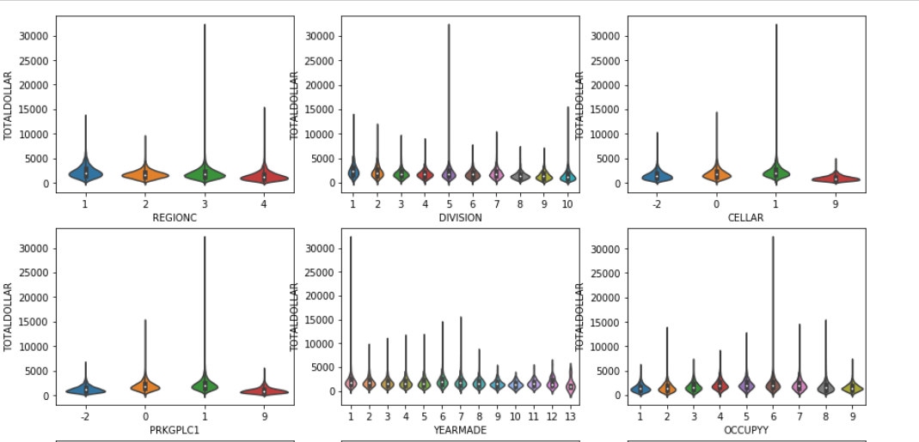
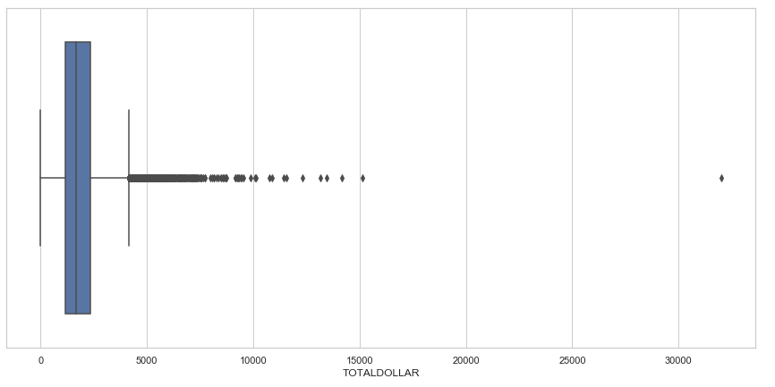
u The RECS survey data consisted of 500+ variables collected across housing characteristics, appliances used, fuel types, annual consumption and cost of consumption.
u Data Exploration was done using Violin, Box-whisker and Distribution plots to understand type, distribution and correlation of variables
u Based on the data Exploration, we applied transformation on data such as, dropping unnecessary columns, converting all to one unit and creation of calculated columns.
u MISSING VALUES TREATMENT :
u Categorical values – Mode used to fill missing values
u Numerical values – median used to fill missing values
u OUTLIER TREATMENT: Using Box plots, outlier were identified and dropped. For example, rows with Total BTU (> 210000) and Total Dollar (> 4000) columns were dropped.

Slide 3
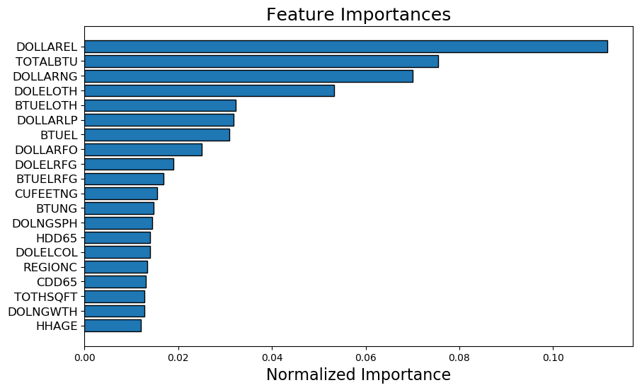
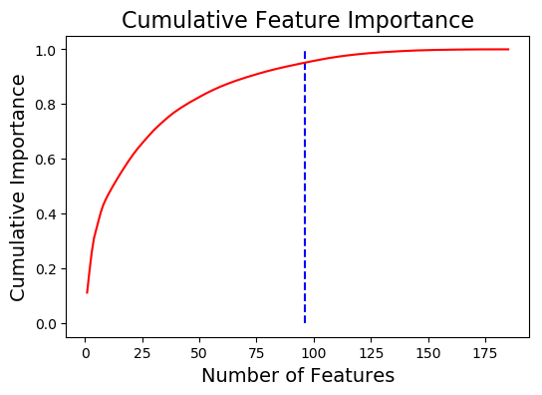
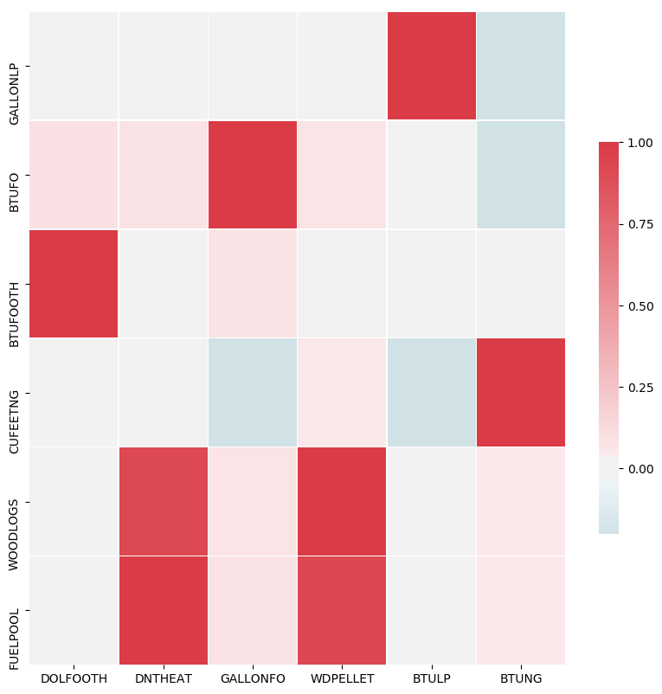
Feature Selector
There are five methods used to identify features to remove:
Missing Values – Any feature with 60% of data missing is removed
Single Unique Values- Any constant Values across the dataset is removed.
Collinear Features-Identify features with 98% correlation.
Zero Importance Features – Identify zero importance features after one hot encoding.
Low Importance Features-Identify features with Low importance (i.e. where cumulative importance is below the threshold of 95%)
After transformation and merging initial set of features to begin with was 185 and with feature selection, the number of features that were identified as having an impact to the pricing or BTU was determined to be 91

Slide 4
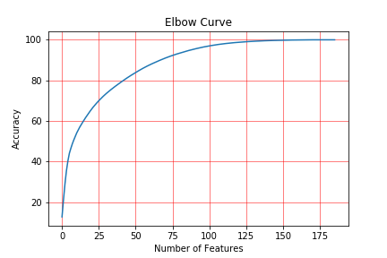
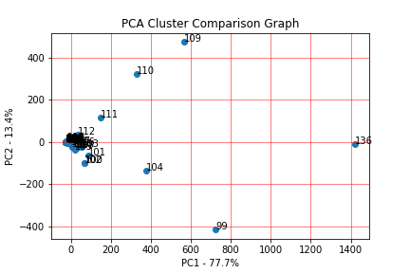
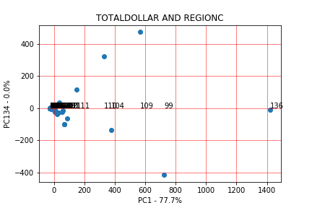
PCA Breakdown
Principle Component Analysis (PCA) is a dimension-reduction tool. Plugging in the data from the combined set through PCA an elbow curve is created to show how many features can be used to predict model accuracy.
Creating a scree plot of the results shows which components has a higher percentage of explained variance.
The columns names from the RESC plot are represented as PC1, PC2, etc. A comparison can then be made between two components to further analyze the relationship between their data and the other features.

Slide 5
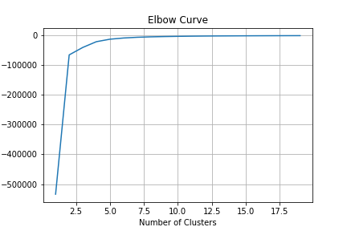
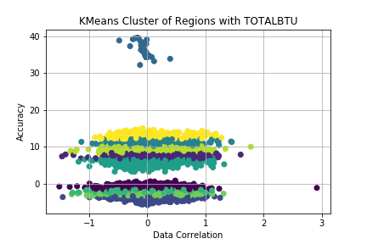
KMeans with PCA components
After exporting the PCA components, we reimport the new CSV to use for KMeans Clustering. KMeans can be used to determine clusters of data and make decisions based off the clusters which values you can exclude to increase accuracy.
Using the variable REGIONC and TOTALBTU, the KMeans elbow curve shows the clusters needed to group the data is between 8 and 10, when the curve flattens at 0 score value.
Creating a scatter plot of 10 clusters with the PCA transformed x and y plots (REGIONC and TOTALBTU), the graph shows alot of the data in general correlates to predicting the values of x and y, with another cluster that does not correlate and can be reduced from the data set.

Slide 6
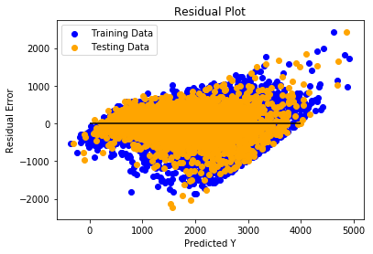
Linear Regression Models :
RESULTS for $ | Linear | LassoCV | RidgeCV | Elastic Net
Test RMSE | 346.4495 | 346.2505 | 346.4495 | 346.4526
Test r² | 81.08% | 81.11% | 81.08% | 81.08%
Creating base Model for Linear Regression
(Linear, Lasso, Ridge, ElasticNet)
Base Model
Fine Tune models by optimizing alpha using
LassoCV for Lasso
RidgeCV for Ridge
GridsearchCV for ElasticNet
Tune Models
Compare different models for accuracy
Compare Models

Slide 7
Linear Regression Models :
Step 1 – Creating base Model for Linear Regression
(Linear, Lasso , ElasticNet)
Step2 – Fine Tune model using LassoCV ( for Lasso Model) and determining the best alpha, and performing GridsearchCV for ElasticNet for range of alphas
Step3 – Compare different models for accuracy
RESULTS for $ | Linear | LassoCV | Elastic Net
Test RMSE | 346.4495 | 346.2505 | 346.4526
Test r² | 81.08% | 81.11% | 81.08%

Slide 8
Random Forest method is used to classify the data into classes and predict the mean (regression) of the forest trees to predict Total Dollar
Step 1 – Creating a based Random Forest model and predict Y.
Step2 – Fine Tune model using RandomForestRegressor to determine optimum hyper-parameters for the best r2 score
Step3 – Finalize model by comparing r2 scores against base and fine tuned models Obtain Root Mean Square Error (RMSE) and r2
Split into attributes and label sets
Training and Testing Data
RESULTS for $ | Base Model | After 1st Tuning (n_estimators=25) | After 2nd Tuning (n_estimators=50) | Final Tuning (max_depth= 11, (n_estimators=75)
Test RMSE | 332.25 | 338.02 | 335.61 | 334.20
Test r² | 82.59% | 81.98% | 82.24% | 82.39%
Notes:
Random Forest method is used to classify into classes and predict the mean (regression) of the each individual tree.
We started with Base/Default model. The following steps were taken to create a final model.
The first step was to divide data into 'attributes' and 'label' sets.
The output data is then divided into training and test sets.
Step 2: Tuning and train algorithm to solve regression problems via random forest
Tuned the model using the RandomForestRegressor class by adjusted n_estimators parameter.
This max_depth parameter defines the number of trees in the random forest.
We started with base model and continue to fine tune the n_estimator by 20 and ended up with final tune of n_estimator=50 as there we no significant change when we increase n-estimator or max_depth.
Advantages:
Random forest corrects for decision tree habit of overfitting to the training data.

Slide 9
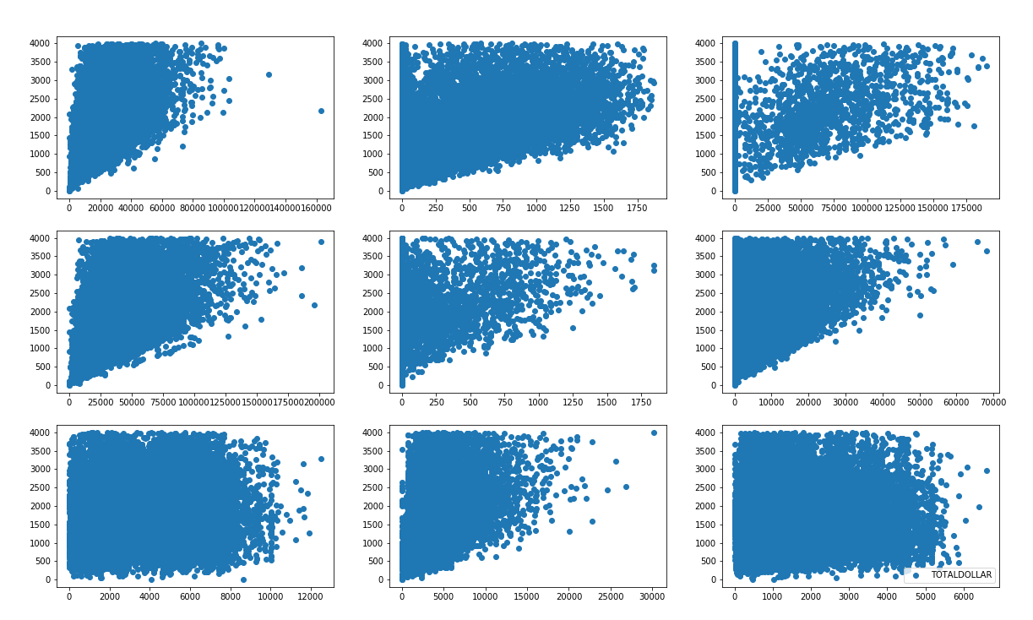

Slide 10
Random Forest method is used to classify the data into classes and predict the mean (regression) of the forest trees to predict Total BTU and Dollar
Creating base Model Random Forest
(default n_estimator = 10)
Base Model
Random Forest Regressor
Fine Tune model with different n_estimators and max_depth for best r²
Tune Models
Compare all the models (base and tuned) and choose the one with low RMSE and high r²
Compare Models
RESULTS for $ | Base Model | After 1st Tuning (n_estimators) | After 2nd Tuning (learning_rate & alpha) | Final Tuning (max_depth & min_child_weight)
Test RMSE | 578.14 | 478.54 | 464.93 | 459.51
Test r² | 74.3% | 82.39% | 83.38% | 83.77%
Notes:
Random Forest method is used to classify into classes and predict the mean (regression) of the individual tree.
Random forest corrects for decision tree habit of overfitting to the training data.
We started with Base/Default model. The following steps were taken to create a final model.
The first step was to divide data into 'attributes' and 'label' sets.
The output data is then divided into training and test sets.
Step 2: Tuning and train algorithm to solve regression problems via random forest
Tuned the model using the RandomForestRegressor class by adjusted n_estimators parameter.
This parameter defines the number of trees in the random forest.
We started with n_estimator=20 and end up to n_estimator=50 to see how our algorithm performs

Slide 11
Final Model
Final tuning for max_depth and min_child_weight
3rd Tuning
Tune to get best alpha(L1 regularization)
2nd Tuning
With GridSearchCV arrive at Learning_rate
1st Tuning
Using xgBoostCV obtain best n_estimators
Base Model as linear Regressor

Slide 12
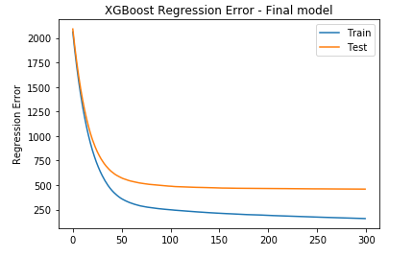
XGBoost (“Extreme Gradient Boosting”) used as regressor for predicting Total BTU and Dollar
Step 1 – Creating a base XG boost model and predict Y. Obtain Root Mean Square Error (RMSE) and r2
Step2 – Fine Tune model using GridsearchCV to determine optimum hyper-parameters for the best r2 score
Step3 – Finalize model by comparing r2 scores against base and fine tuned models
RESULTS for $ | Base Model | After 1st Tuning (n_estimators) | After 2nd Tuning (learning_rate & alpha) | Final Tuning (max_depth & min_child_weight)
Test RMSE | 360.56 | 295.44 | 257.61 | 252.76
Test r² | 79.07% | 85.95% | 89.32% | 89.67%

Slide 13
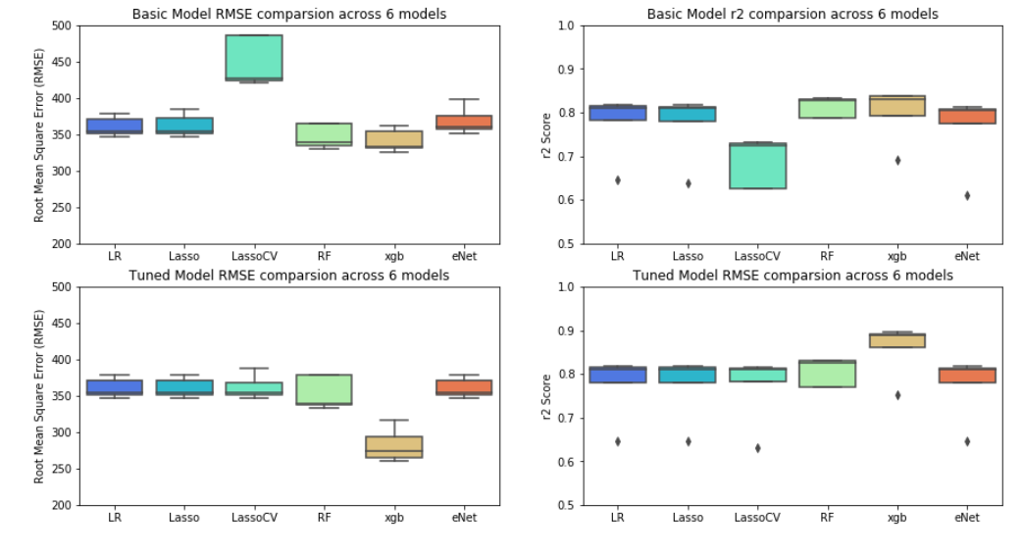

Slide 14
Low Importance Features
Identify features where cumulative importance is below 98 %
Zero Importance Features
Identify zero importance features after one hot encoding
Collinear
Identify features with 98% correlation.
194 features
86
features
Single Unique values
Remove features with single unique values
Missing
Remove any feature with > 60% missing value

