Slide 1
Random Forest method is used to classify the data into classes and predict the mean (regression) of the forest trees to predict Total Dollar
Step 1 – Creating a based Random Forest model and predict Y.
Step2 – Fine Tune model using RandomForestRegressor to determine optimum hyper-parameters for the best r2 score
Step3 – Finalize model by comparing r2 scores against base and fine tuned models Obtain Root Mean Square Error (RMSE) and r2
Split into attributes and label sets
Training and Testing Data
RESULTS for $ | Base Model | After 1st Tuning (n_estimators=25) | After 2nd Tuning (n_estimators=50) | Final Tuning (max_depth= 11, (n_estimators=75)
Test RMSE | 334.30 | 338.02 | 335.61 | 334.51
Test r² | 82.38% | 81.98% | 82.24% | 82.36%

Slide 2
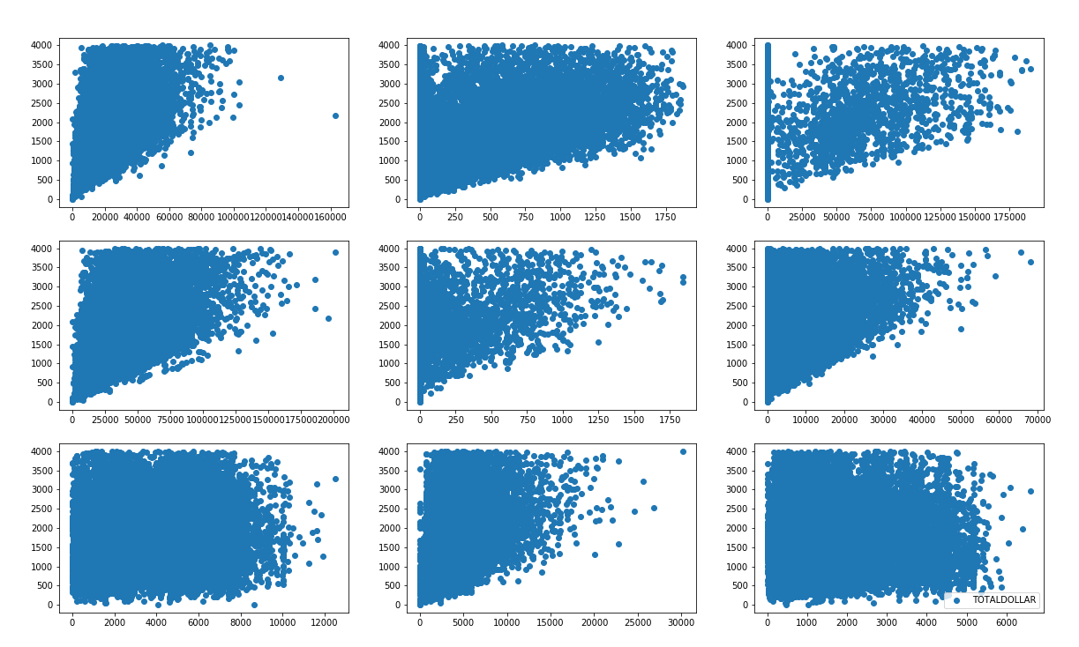
Feature Importances
Features importance is used to select features that have strong impact to the model (after training). Top 10 features that were key in the model prediction show a strong correlation to the TOTAL DOLLAR

Slide 3
What is Random Decision Forest
A random Forest algorithm comprises of random collection of decision trees. Random Forest algorithm does creates multiple decision trees and merge them together to obtain a more robust/stable and accurate prediction. The more tree, the more robust the prediction and accuracy.
One interesting thing about Random Forest is that it can be used for both classification and regression algorithm.
Advantages/WHY
Random forest algorithm can be used for both classifications and regression task.
It provides higher accuracy.
Random forest classifier will handle the missing values and maintain the accuracy of a large proportion of data.
If there are more trees, it won’t allow overfitting trees in the model (Random forest corrects for decision tree habit of overfitting to the training data)
It has the power to handle a large data set with higher dimensionality.
Disadvantage:
With correlated features, strong features can end up with low scores and the method can be biased towards variables with many categories
Our Approach
We started with Base/Default algorithm/model. The following steps were taken to create a final model.
Step 1: The data was divided into 'attributes' and 'label' sets.
The output data is then divided into training and test sets.
Step 2: Tuned the algorithm/model using the RandomForestRegressor by adjusted n_estimators parameter and max_depth or number of decision Trees( nodes and subsets).
This max_depth parameter defines the number of trees in the random forest.
We started with and algorithm/model to fine tune the n_estimator by 20 and ended up with final tune of n_estimator=50 as thbase model ere we no significant change when we increase n-estimator or max_depth.

