Slide 1
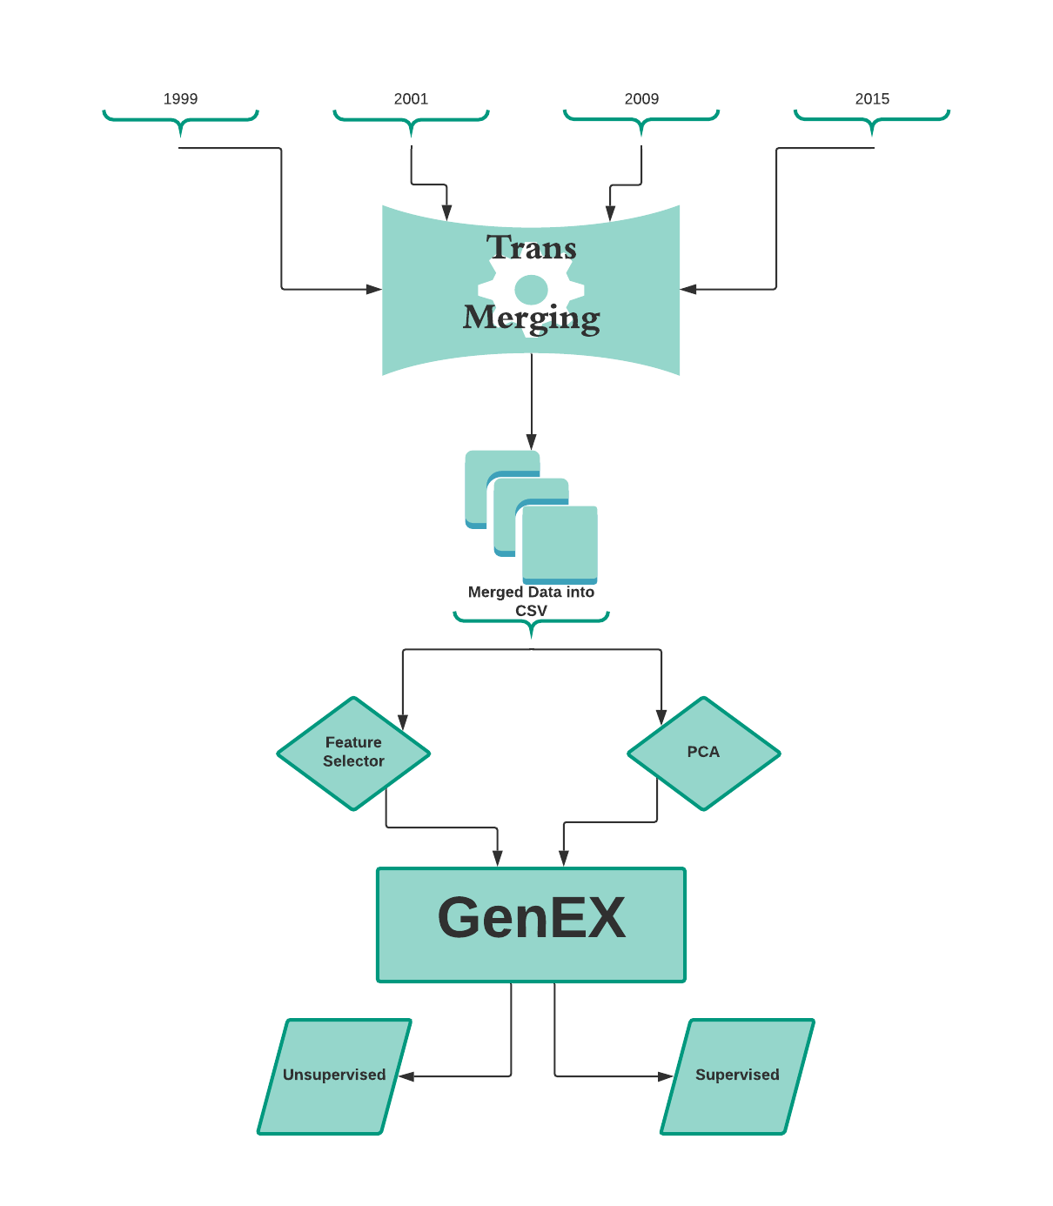
Energy Consumption
Pulled in the data from 1999, 2001, 2009, 2015. We then matched all corresponding column names across these collection of years. We dropped the 1999 set of data as the majority of the columns did not align with the other sets. After our data cleaning, we merged into one CSV file the remaining years’ worth of data. We were then able to run Machine Learning tools such as Feature Selector and PCA to determine the amount of columns(features) necessary to predict how much of the gathered data is required for accurate model predicting.

