Slide 1

Electronic store website
project members :
Anusha Madhineni
Thiru Venkatesh Chitturi
kavya keyura pasumarthi
Venkatesh Goli
under the guidance of
Mr.Harikrishnan
trainer

Slide 2
Contents:
Problem Statement
Objective
Cloud services
Project Overview
Architecture
Application Flow
Technology and Tools Used
Conclusion

Slide 3
Problem statement
The online electronic shop is a project developed to make the purchase of electronics easy. This application makes the need for the sales and purchase of electronics safe.
This application will reduce the manual operation required to maintain all the records of sales and purchases.
This system allows to search number of stock details of electronic items. Different types of electronic items will be available to the users in this application

Slide 4
Objectives:
Our objective is to provide best user experience to users so that user can order electronic goods through online without stepping outside.

Slide 5
Cloud services
Elastic beanstalk
Aws s3
Dynamo db
Cloud watch
Code commit

Slide 6
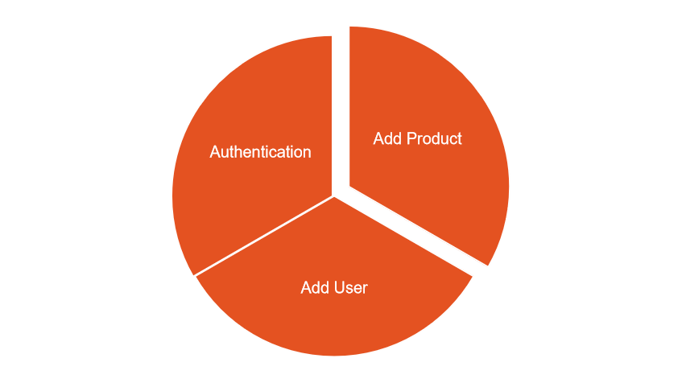
MICRO SERVICES

Slide 7
Project overview

Slide 8
Project Overview
Authentication API
product API
Login
Products
Home
Register
Admin
EBS
Server
Dynamo
Db
External API

Slide 9
Architecture
Login/Register
Authentication API
JWT validator
POST request
SQL Server
Token generated
Front End
Angular
POST /GET/
DELETE
Add products
GET/DELETE
dynamo Db

Slide 10
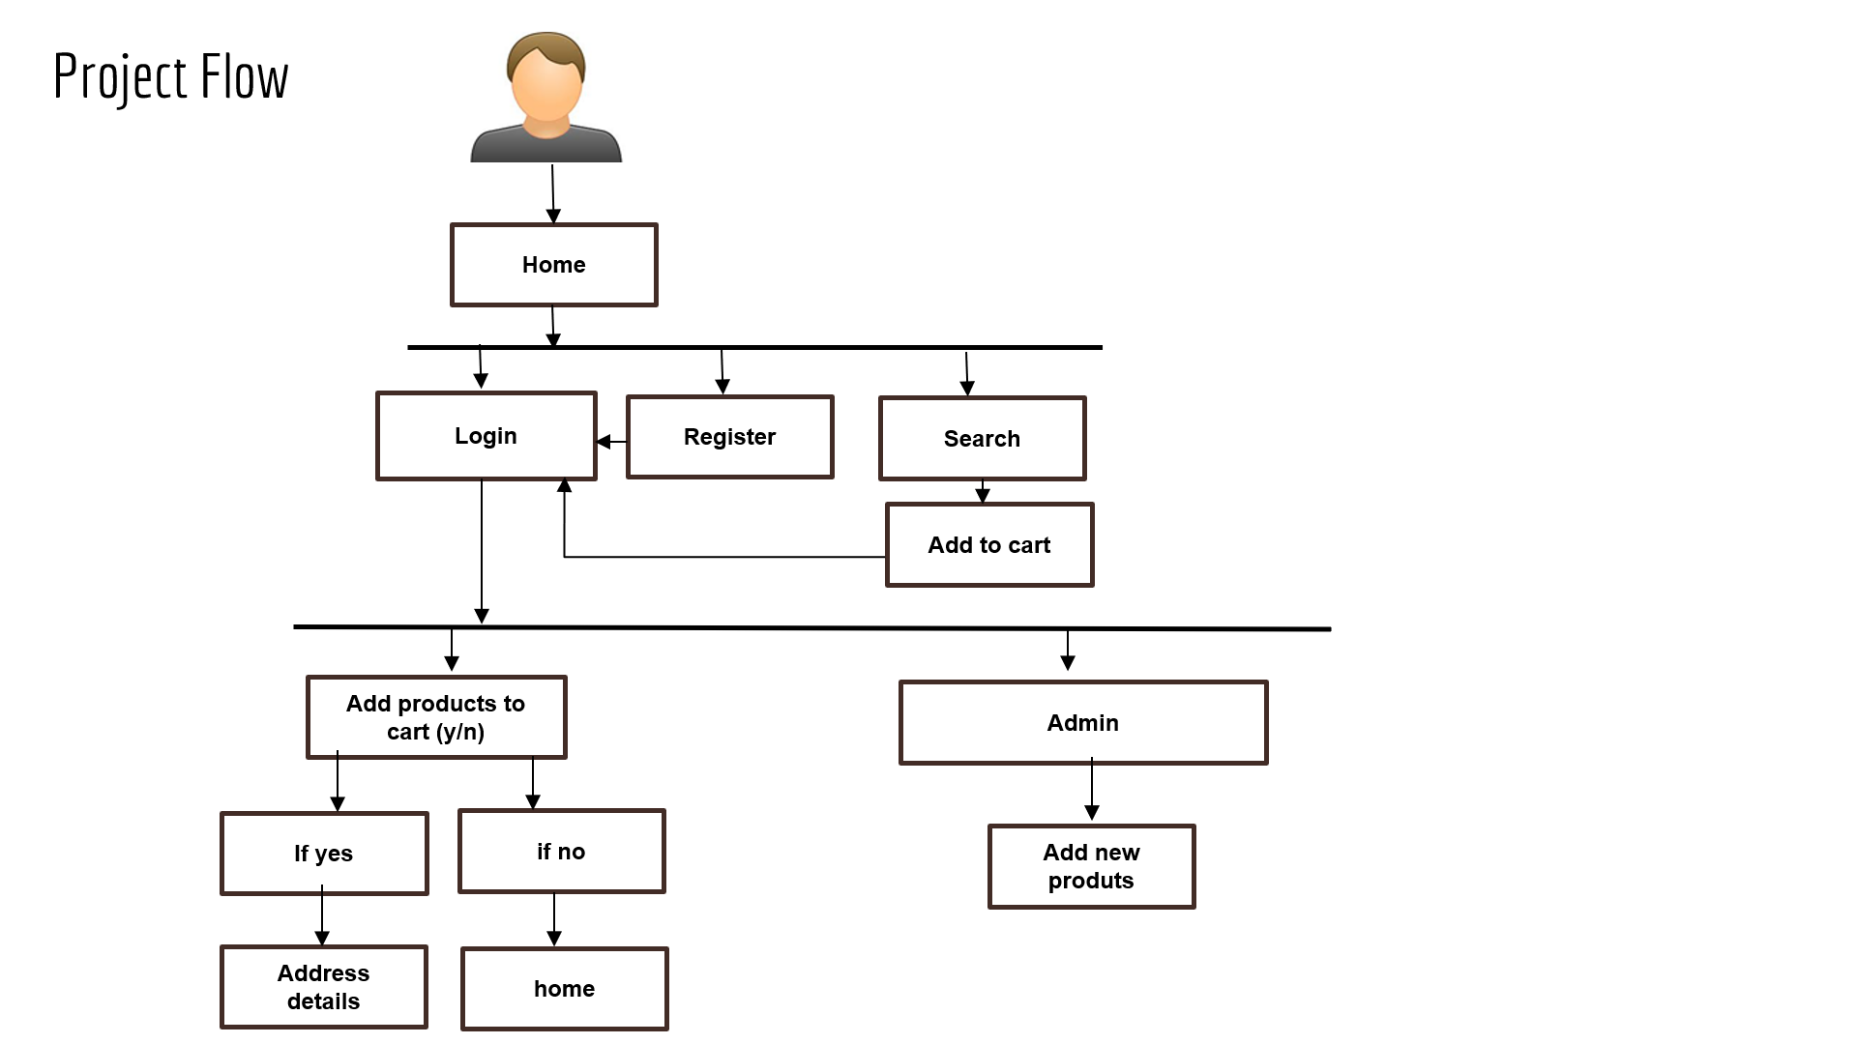

Slide 11



Technologies and Tools used
Angular
Node.js
Dynamo db
Vs code
Postman
Git lab

Slide 12
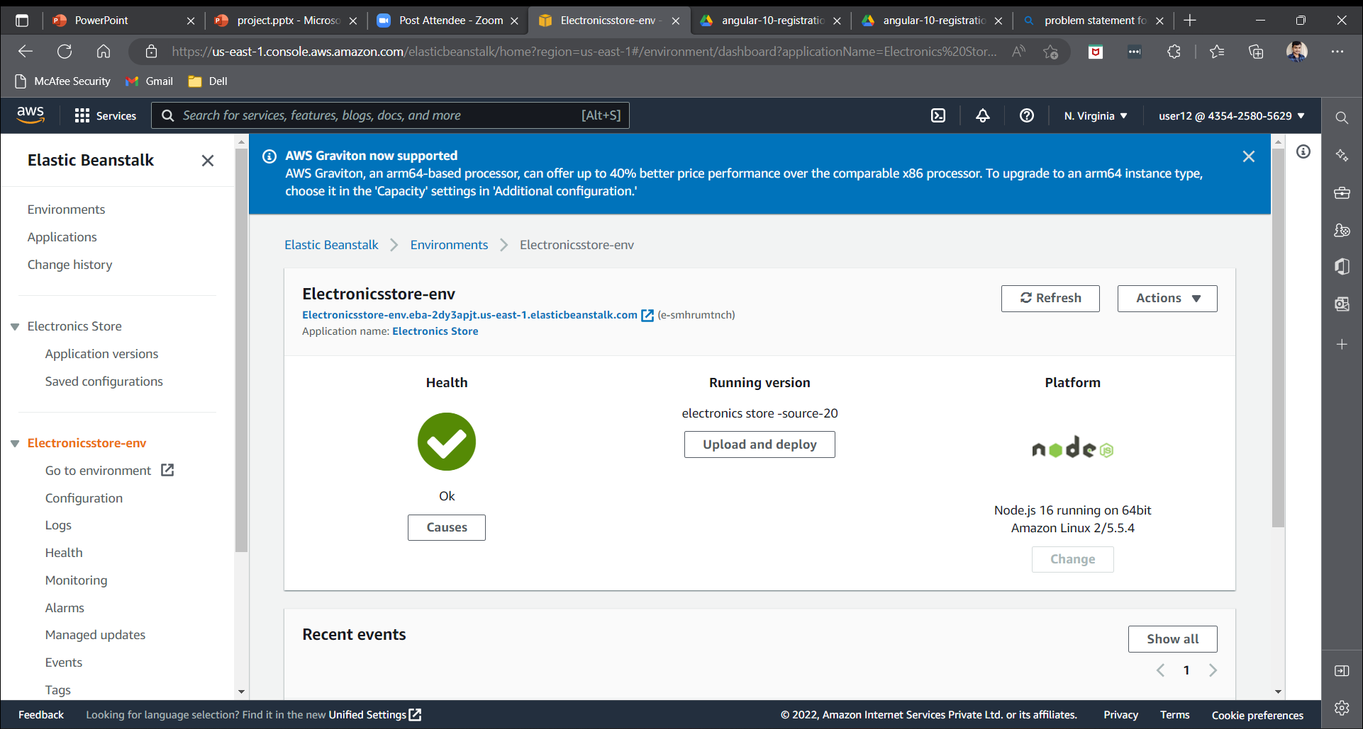
Elastic beanstalk

Slide 13
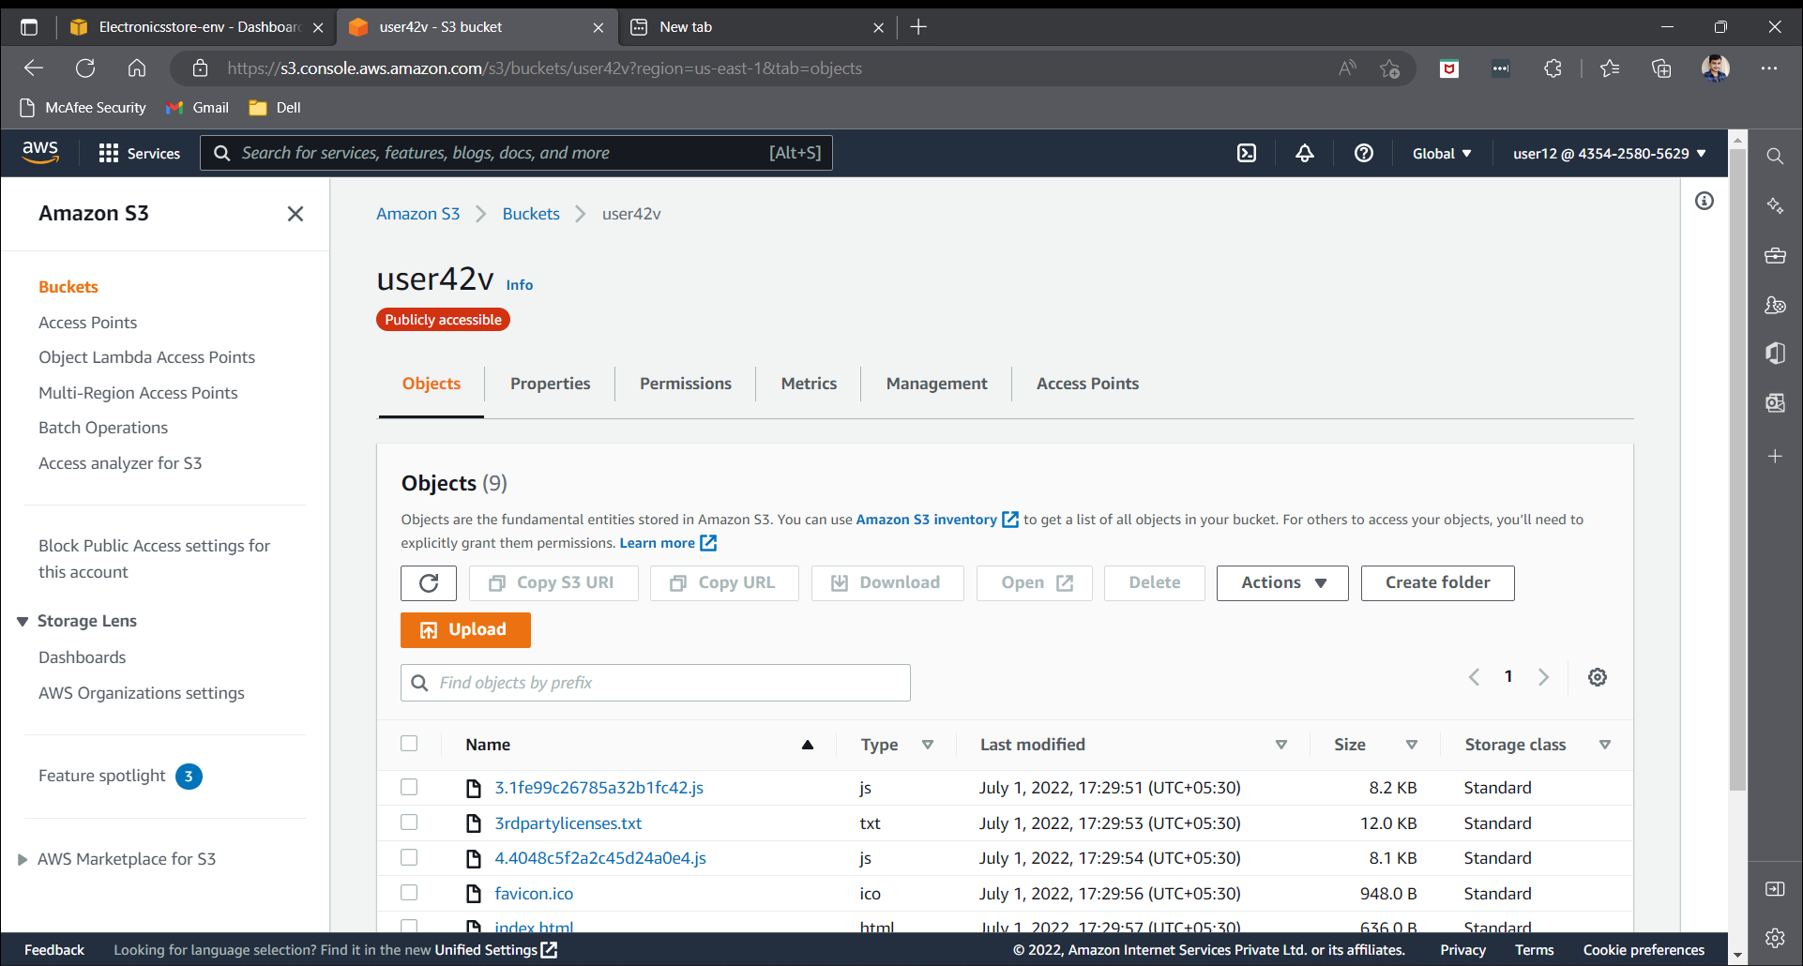
S3 Bucket

Slide 14
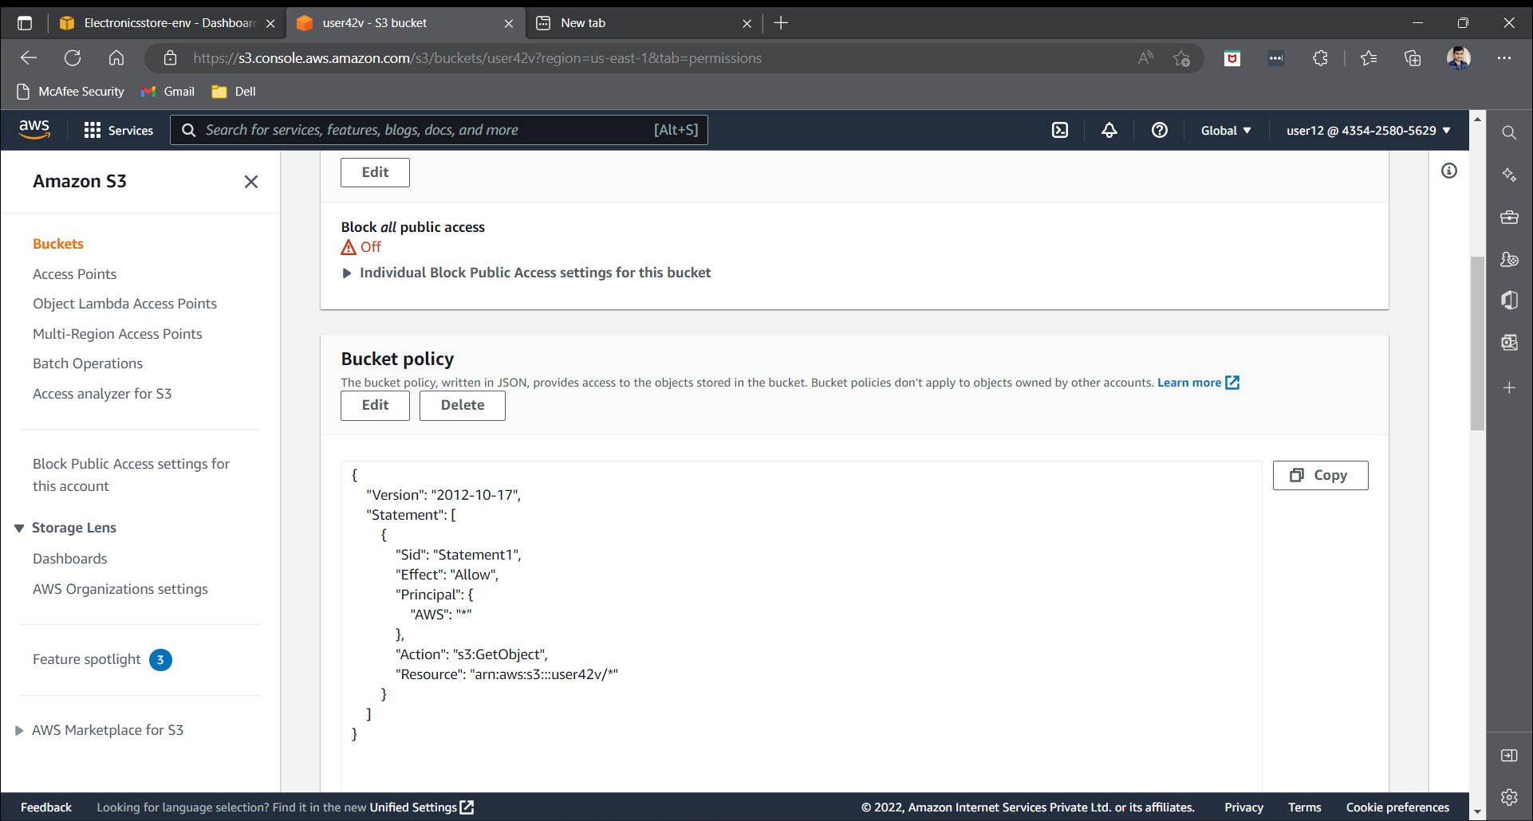

Slide 15
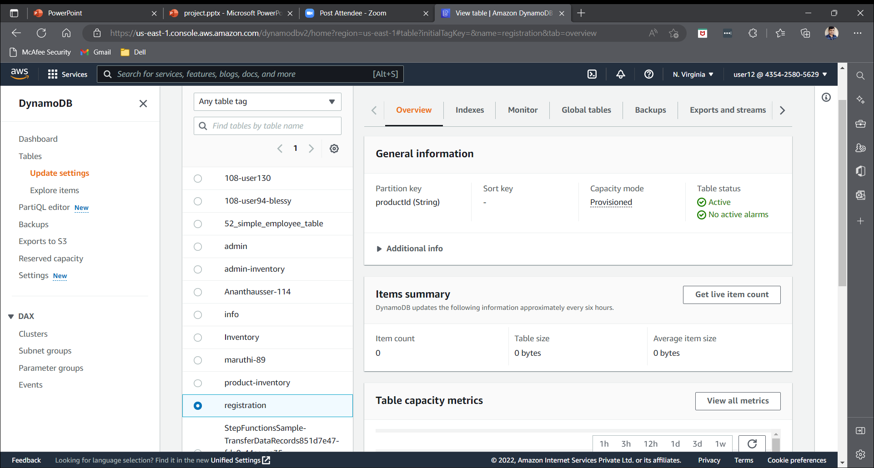
Dynamo db

Slide 16
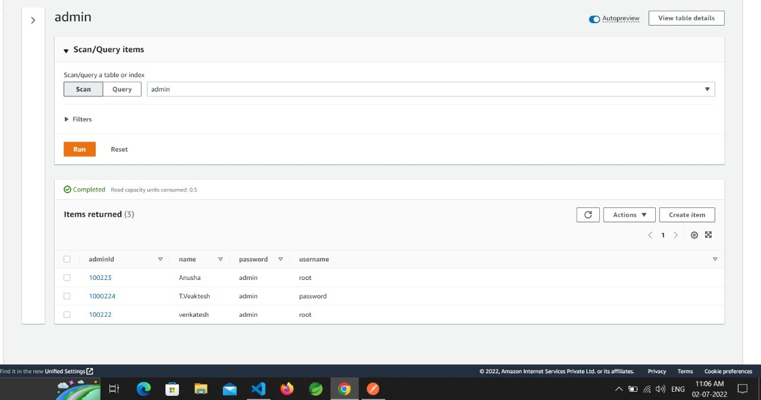
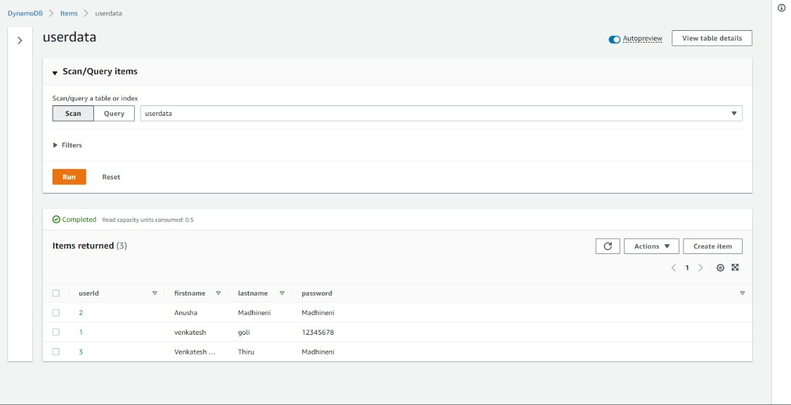
Admin table
user table

Slide 17
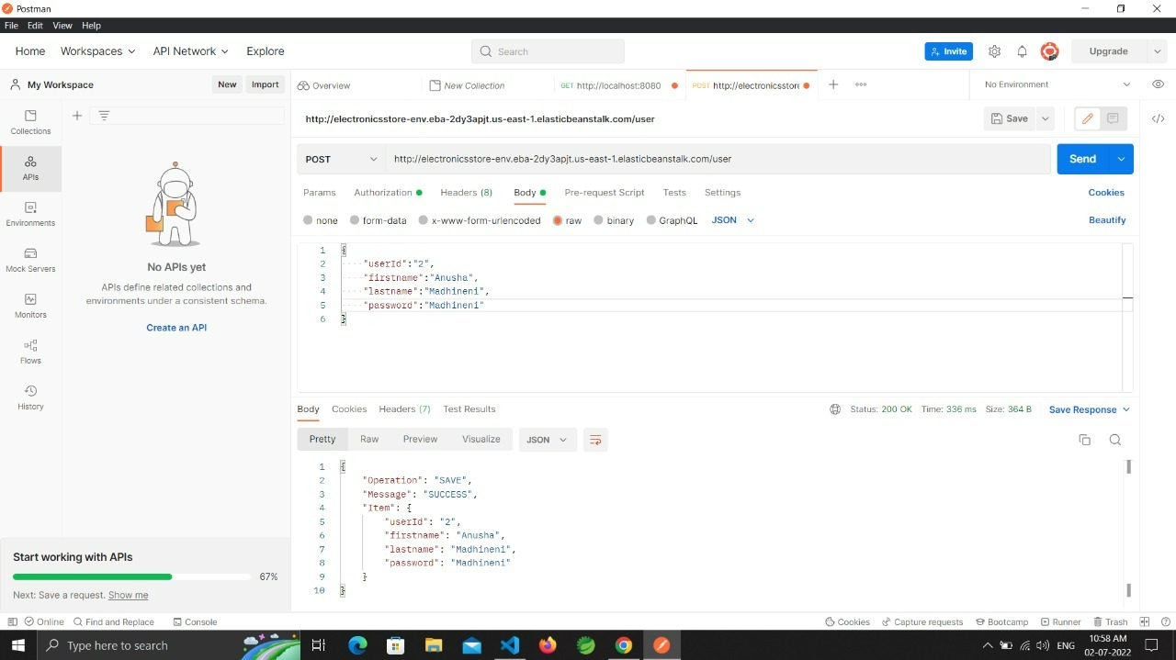
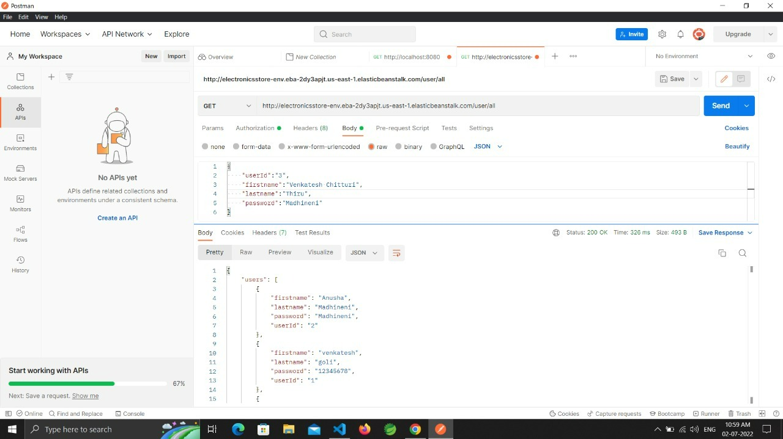
user registration
user data

Slide 18
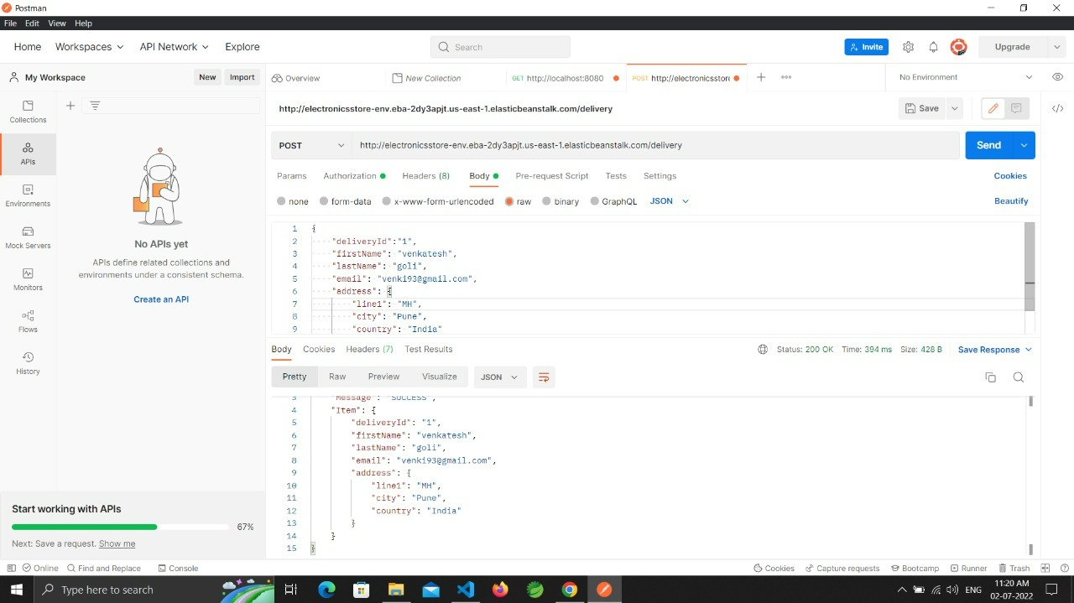

Slide 19
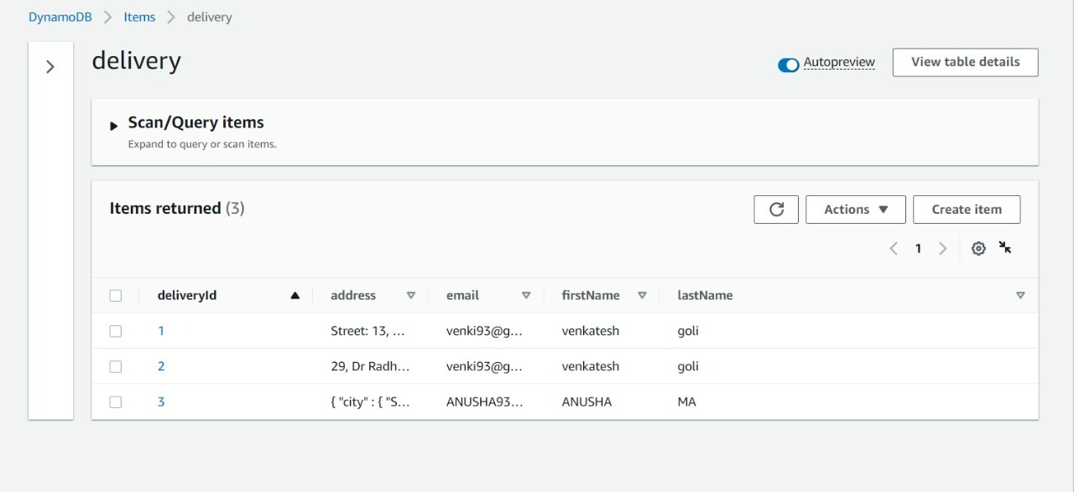

Slide 20
Conclusion
The Electronic store website app helps the user to buy electronic goods online .

Slide 21
Thankyou

