Slide 1
Healthcare Patient Analytics Pipeline
TEAM MEMBERS
Manan Batra
Tadem Madhuri
Kavya Kothapalli
Srinu Pentakota

Slide 2
Table of context
Project Overview and Objective
Technical Specifications
Design solutions with HLD and LLD
Development of Lakehouse in Databricks
Testing the ELT pipelines in AWS AND Data Bricks
Business outcomes

Slide 3
Project Overview & Objectives
Built end-to-end healthcare ETL pipeline on Databricks using Medallion Architecture (Bronze → Silver → Gold)
Ingested, cleaned, standardized, and deduplicated data using DLT with quality checks
Designed Gold layer with star schema and computed patient risk scores + analytics tables
Automated pipeline with Airflow & Databricks Workflows, enabling reliable, analytics-ready data

Slide 4
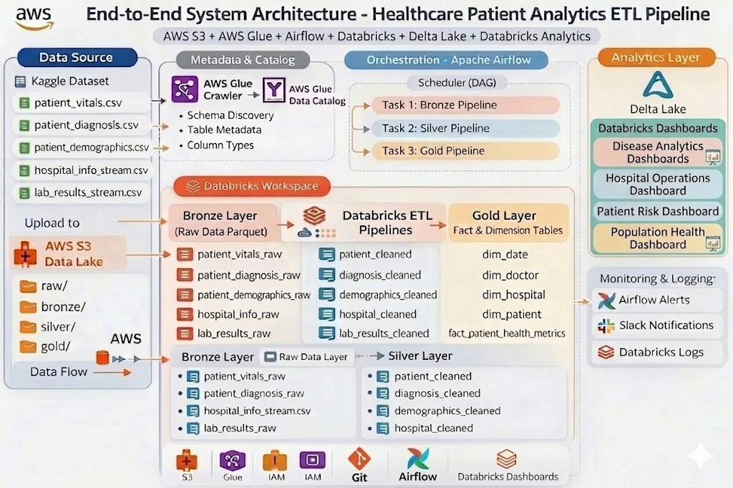
HIGH LEVEL DESIGN

Slide 5
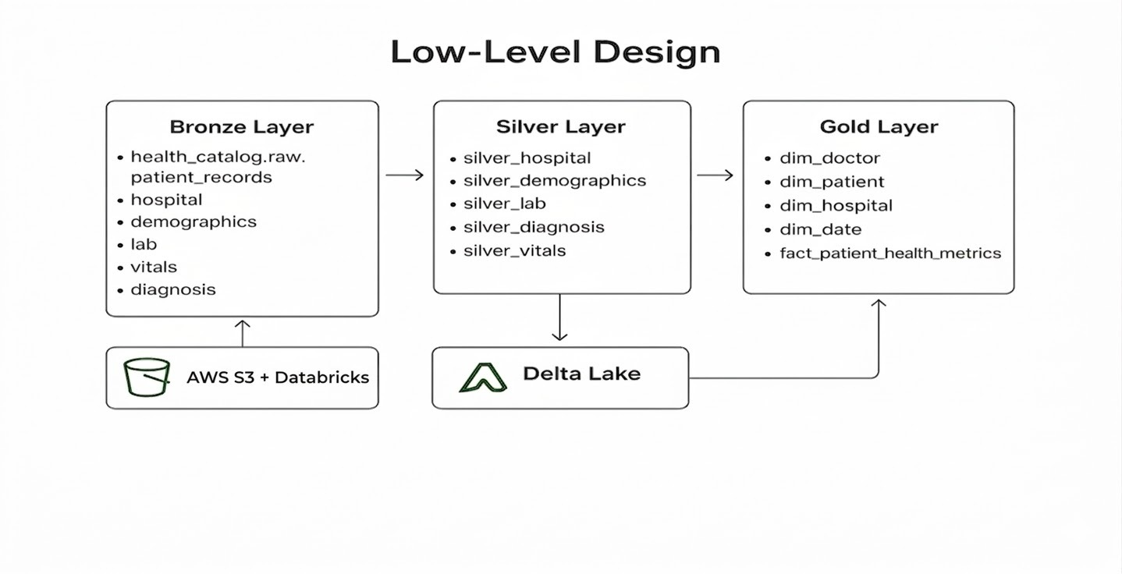

Slide 6
error handling & TESTING
Implemented try-catch with fallback schemas to ensure pipeline stability and avoid failures.
Enabled monitoring & alerting for job failures and data quality issues.
Built automated testing using PyTest + PySpark with isolated schemas in Unity Catalog.
Performed end-to-end validation across Bronze, Silver, and Gold layers ensuring data integrity, deduplication, and reliable outputs.

Slide 7
AIRFLOW orchestration
Designed and scheduled end-to-end data pipelines using Airflow DAGs for batch processing.
Orchestrated Bronze, Silver, and Gold layer workflows with proper task dependencies.
Implemented retry mechanisms and failure handling to ensure reliable pipeline execution.
Integrated Airflow with Databricks to trigger and manage data processing jobs.

Slide 8
Alerts & MonitorinG
Monitored pipeline execution using Airflow UI and Databricks job tracking.
Configured real-time alerts via Slack for job failures and pipeline issues.
Implemented data quality checks using DLT expectations to identify invalid or missing data.
Tracked pipeline performance and ensured timely issue detection and resolution.

Slide 9
Development of lakehouse
Designed scalable ETL pipelines on AWS and Databricks using Delta Live Tables with S3 as the central data lake.
Built a structured data flow from raw ingestion to refined datasets, ensuring clean, consistent, and analytics-ready data.
Established strong data governance with Unity Catalog and developed business-ready tables with key metrics like risk scores.

Slide 10
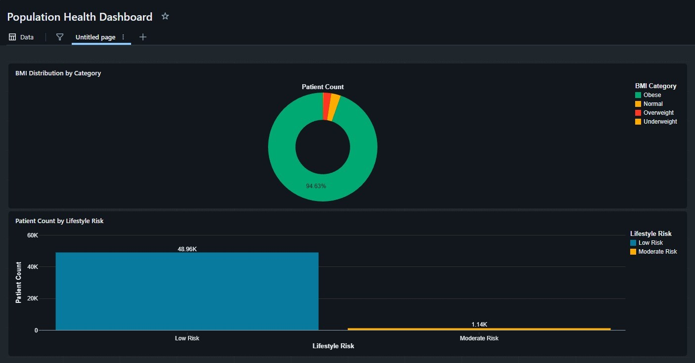
visualization

Slide 11
Population Health Dashboard – Key Insights
BMI Distribution
Majority of patients fall into one dominant BMI category (~94%).
Very small percentage in other BMI categories.
Lifestyle Risk Analysis
Low-risk patients dominate overall count.
Moderate-risk segment is significantly smaller.
Business Impact
Focus on moderate-risk patients to avoid escalation.
Supports data-driven public health planning.

Slide 12
Business Impact & Outcomes
Patient Risk – Most patients are low risk, even if there are high risk patients the number has not varied that drastically.
Disease Analytics – Recovery time is stable, and majority of patients are low risk
Hospital Operations – Patient load and bed usage are evenly spread across hospitals
Population Health – Most patients have high BMI and low lifestyle risk

Slide 13
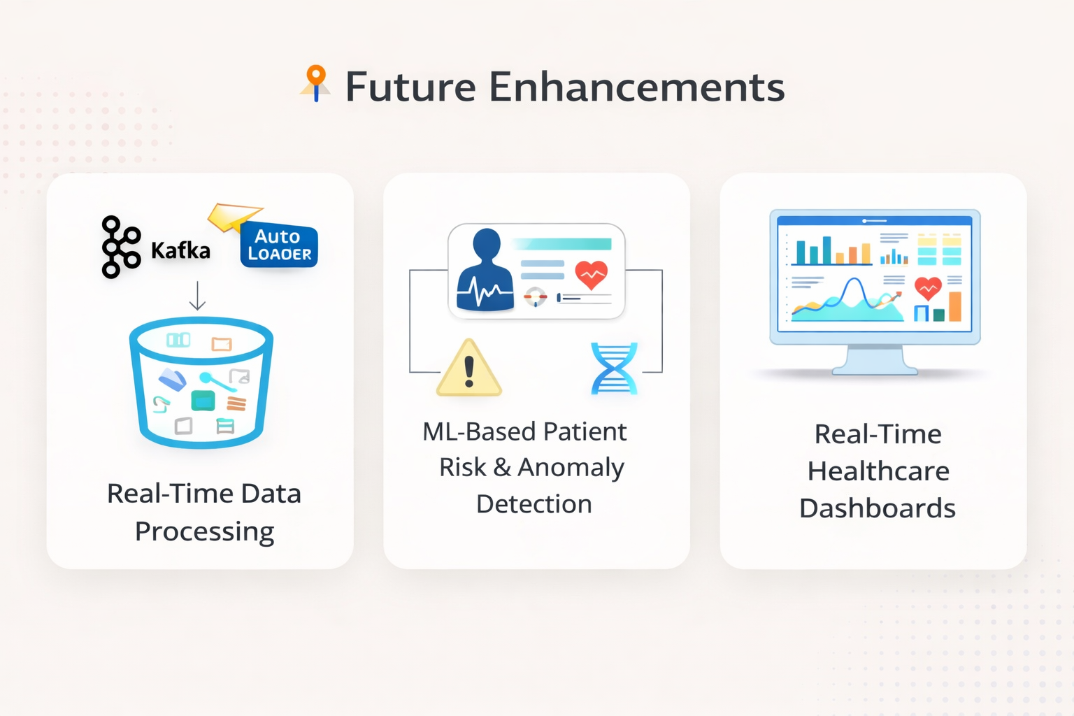
FUTURE ENHANCEMENTS
Enable real-time data processing using streaming (Kafka / Auto Loader)
Implement ML-based patient risk prediction & anomaly detection
Build real-time dashboards for live healthcare monitoring

Slide 14
Thank you

