Slide 1


INANIHUB
P E T H A N I M A D H U RI T H U M M A R K O M A L
[ 2 1 5 4 9 0 6 9 4 0 1 0 ]
[ 2 1 5 4 9 0 6 9 4 0 0 7 ]
Guide By : Pooja Bhaduriya

Slide 2
OUTLINE
INTRODUCTION
PROBLEM
DEFINITION SYSTEM
DESIGN
CORE COMPONENT
USER ACTIVITY

Slide 3

INTRODUCTION
Our project basically created for manage sell and purchase the products at on the one platform.
We provide the facility for sell and purchase at one platform.
Consistency reliability and most importantly correctness of information in to the database.
We are provided REACT.JS as front end and NODE.JS as back The project processed through a sequence of well designed forms provided with validation to ensure.

Slide 4
PROBLEM DEFINATION
E-commerce poses several challenges, including security risks, the need to establish trust and credibility, ensuring a seamless user experience, managing logistics and fulfillment, handling payment processing, scaling operations, complying with legal regulations, facing fierce competition, tackling international trade complexities, and providing exceptional customer service. Addressing these issues is crucial for businesses to thrive and succeed in the ever-evolving e-commerce industry. .

Slide 5

TECHNOLOGY USED
: InaniHub build on Visual Studion
VS CODE
MONGODB :
we need to use Mongodb for save user data , notification system and get crash report

Slide 6

Core Component
Responsive Design
Web Speed Optimization
User-friendly Navigation
Customer Supports
Ecommerce website security and Privacy
Product with Description
Checkout Option

Slide 7
PROPOSED SYSTEM
In this system, Customer can Search or View products based on product name,brand name, Customer can buy product easily by just adding cart or instant buy product.
In this system, notified to customers based on wishlist
Customer can easily give review of product.
Visitors also search product according to product name or Brand name or product Category.
Product shows based on product categpry,product name and brand of product.
Customer and visitors also use feature of muti-language interface to interact with site
.
Customer can show of own orders in order history.

Slide 8
USER ACTIVITY
Customer can Create an Account.
Customer can give review.
Customer can ask for any information regarding to his farming.
Customer can view weather information.
Customer/users can interact with other customers/users through social
media features.
Customers/users can get new notifications.
Customer/users can see the any type of crop information.
Customer/users can interact easy way through multi-language interface.
Customer/users can payment in different

Slide 9

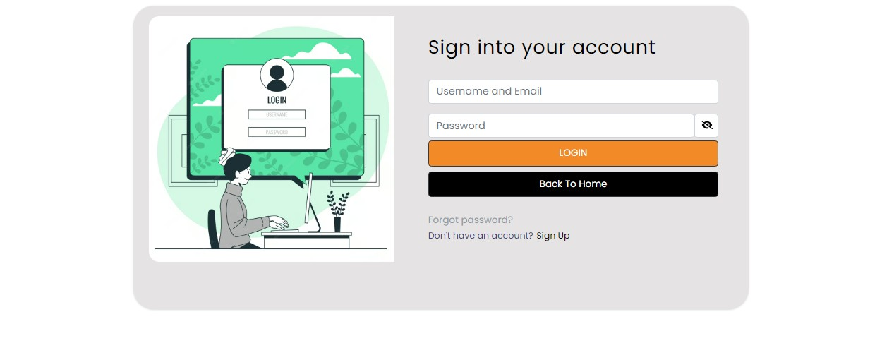
SCREENSHOT

Slide 10
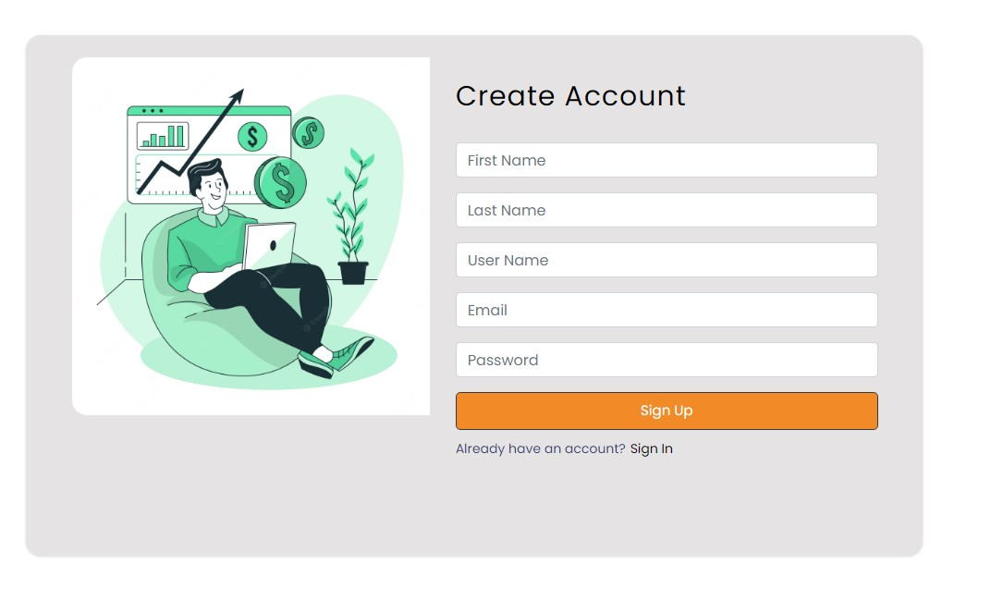
SIGN UP

Slide 11
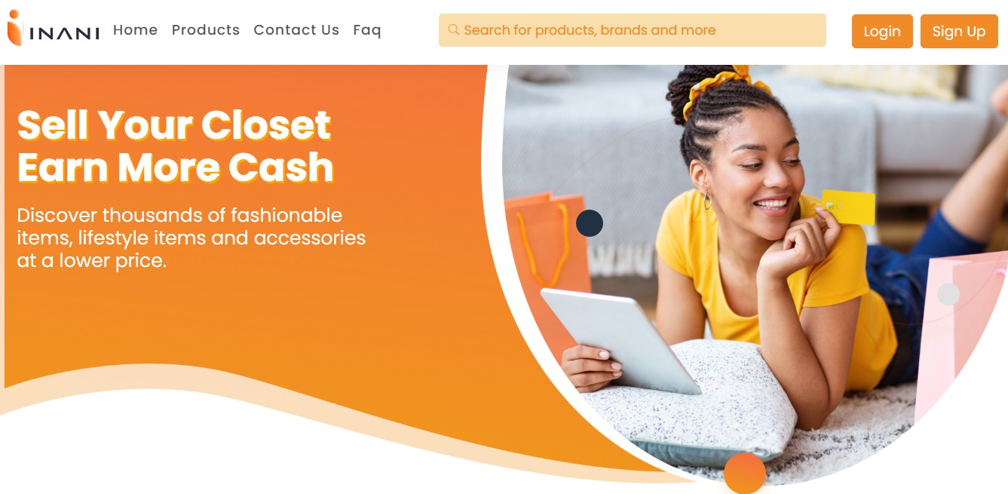
HOME PAGE

Slide 12
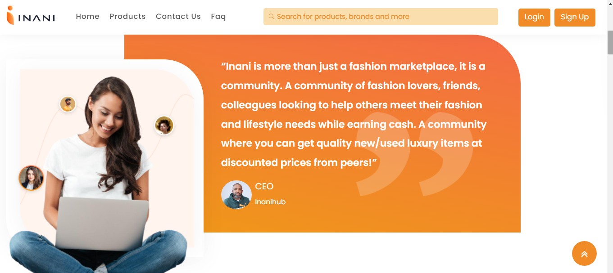
ABOUT US

Slide 13
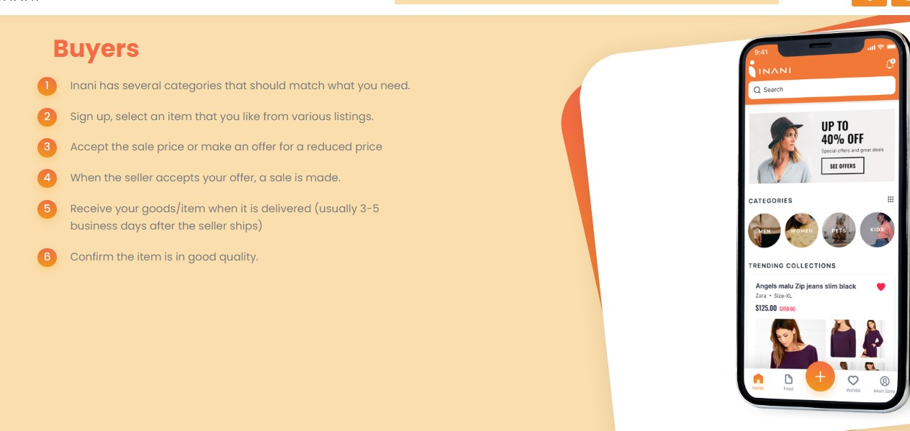

Slide 14
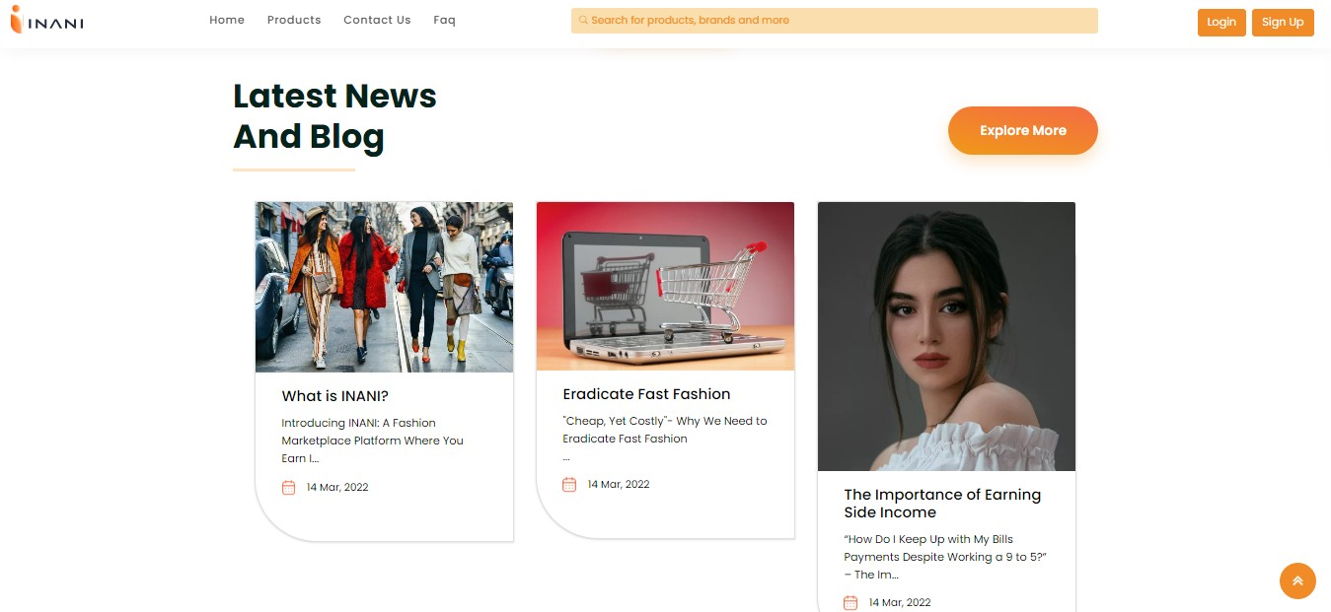

BLOG PAGE

Slide 15
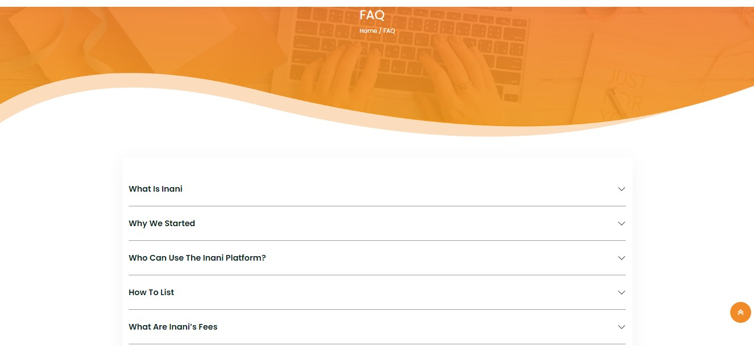
FAQ

Slide 16


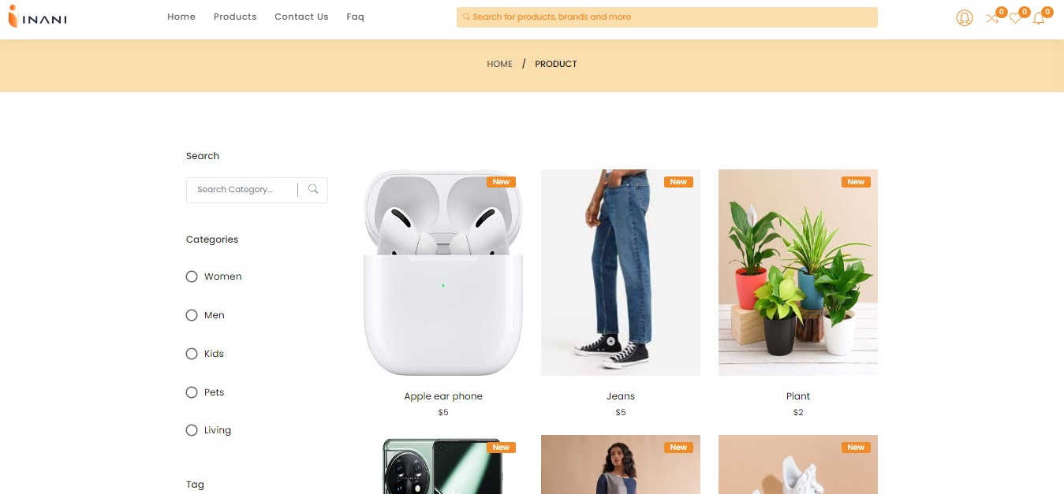
PRODUCT

Slide 17

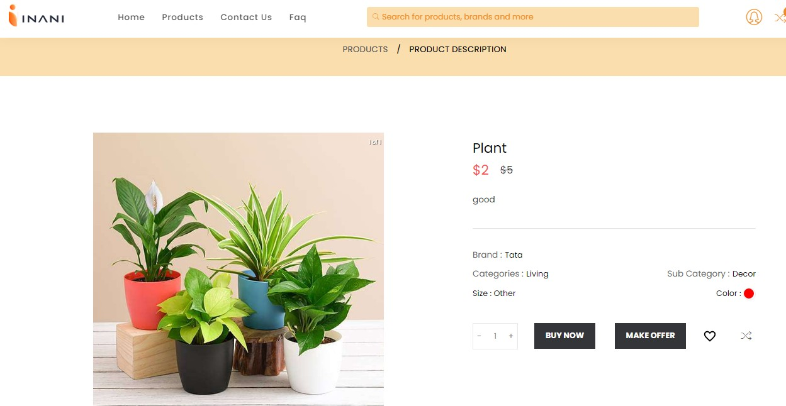
PRODUCT DESCRIPTION

Slide 18

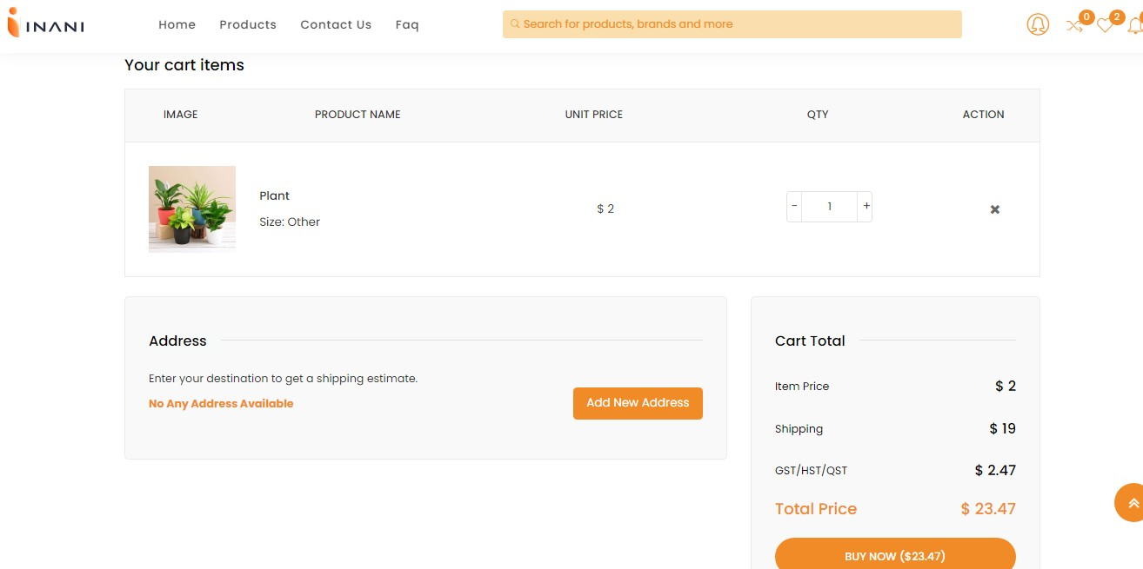
SELECTED ITEM

Slide 19
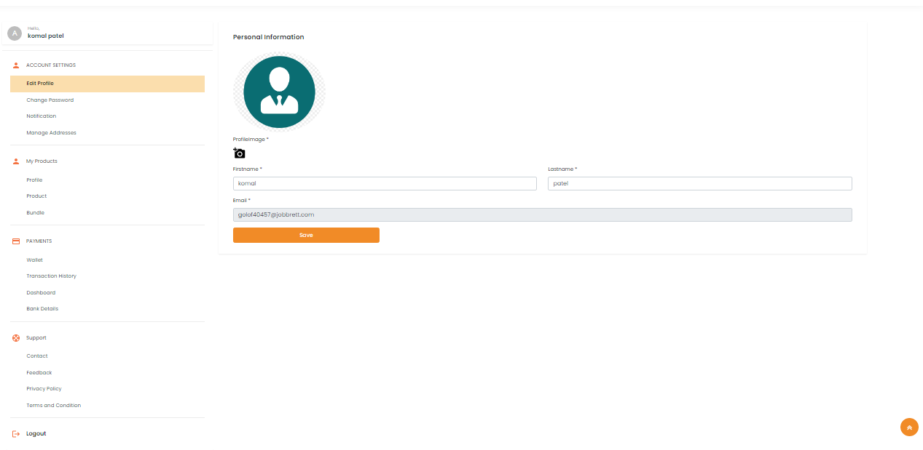
PROFILE

Slide 20
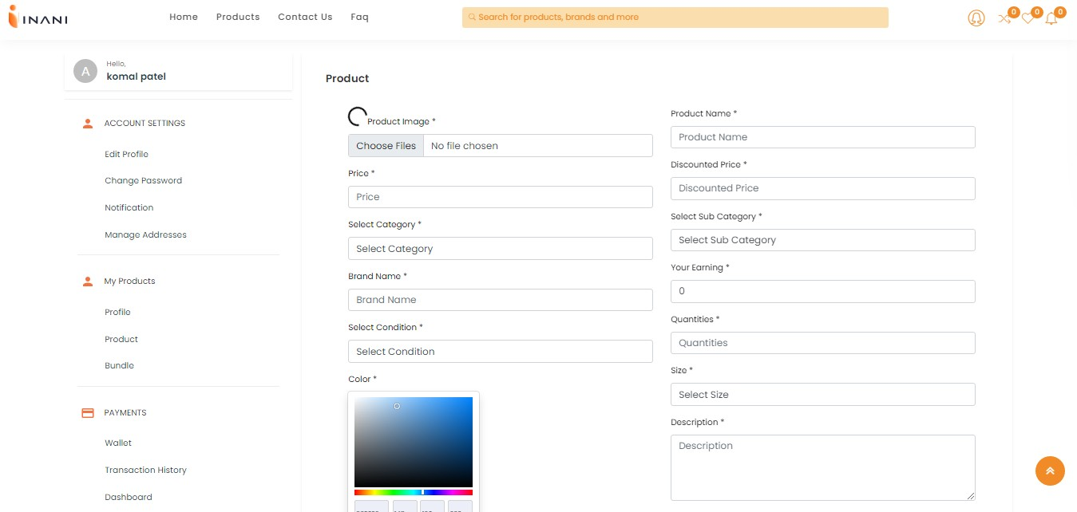
UPLOAD PRODUCT

Slide 21
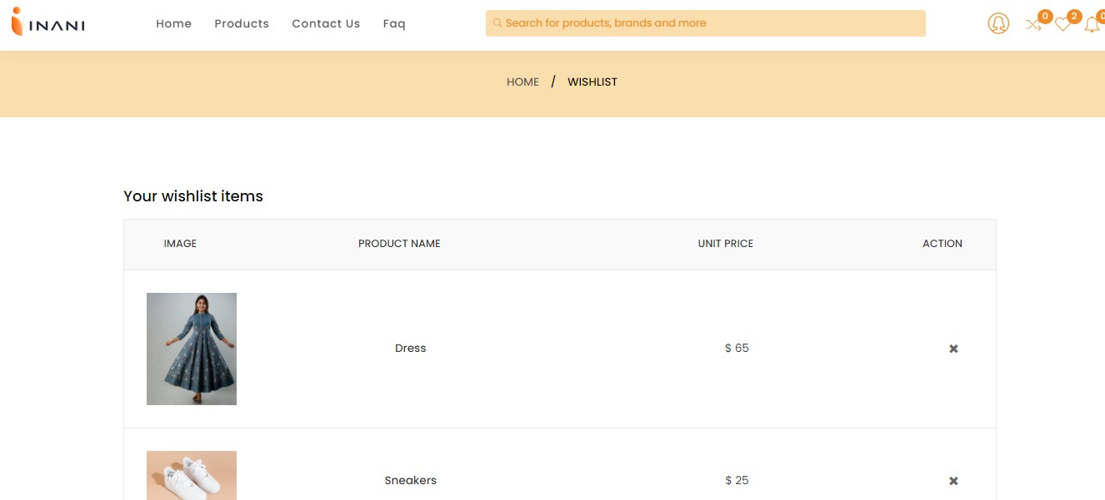
WHISHLIST

Slide 22
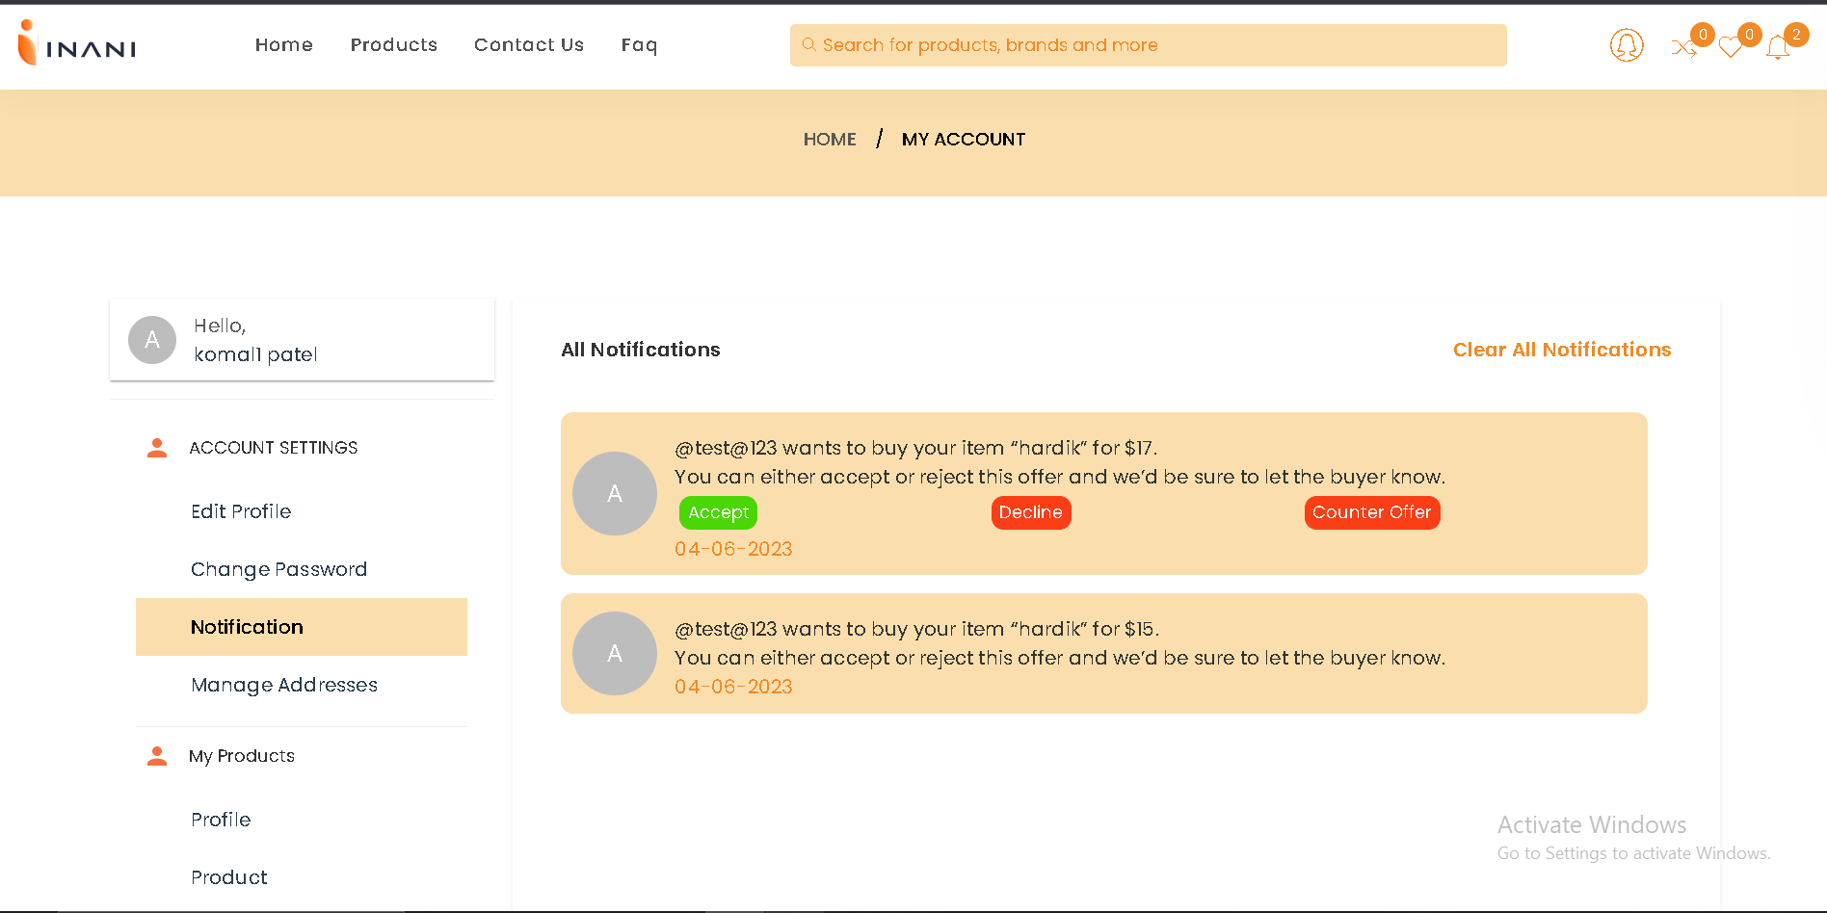
NOTIFICATION

Slide 23
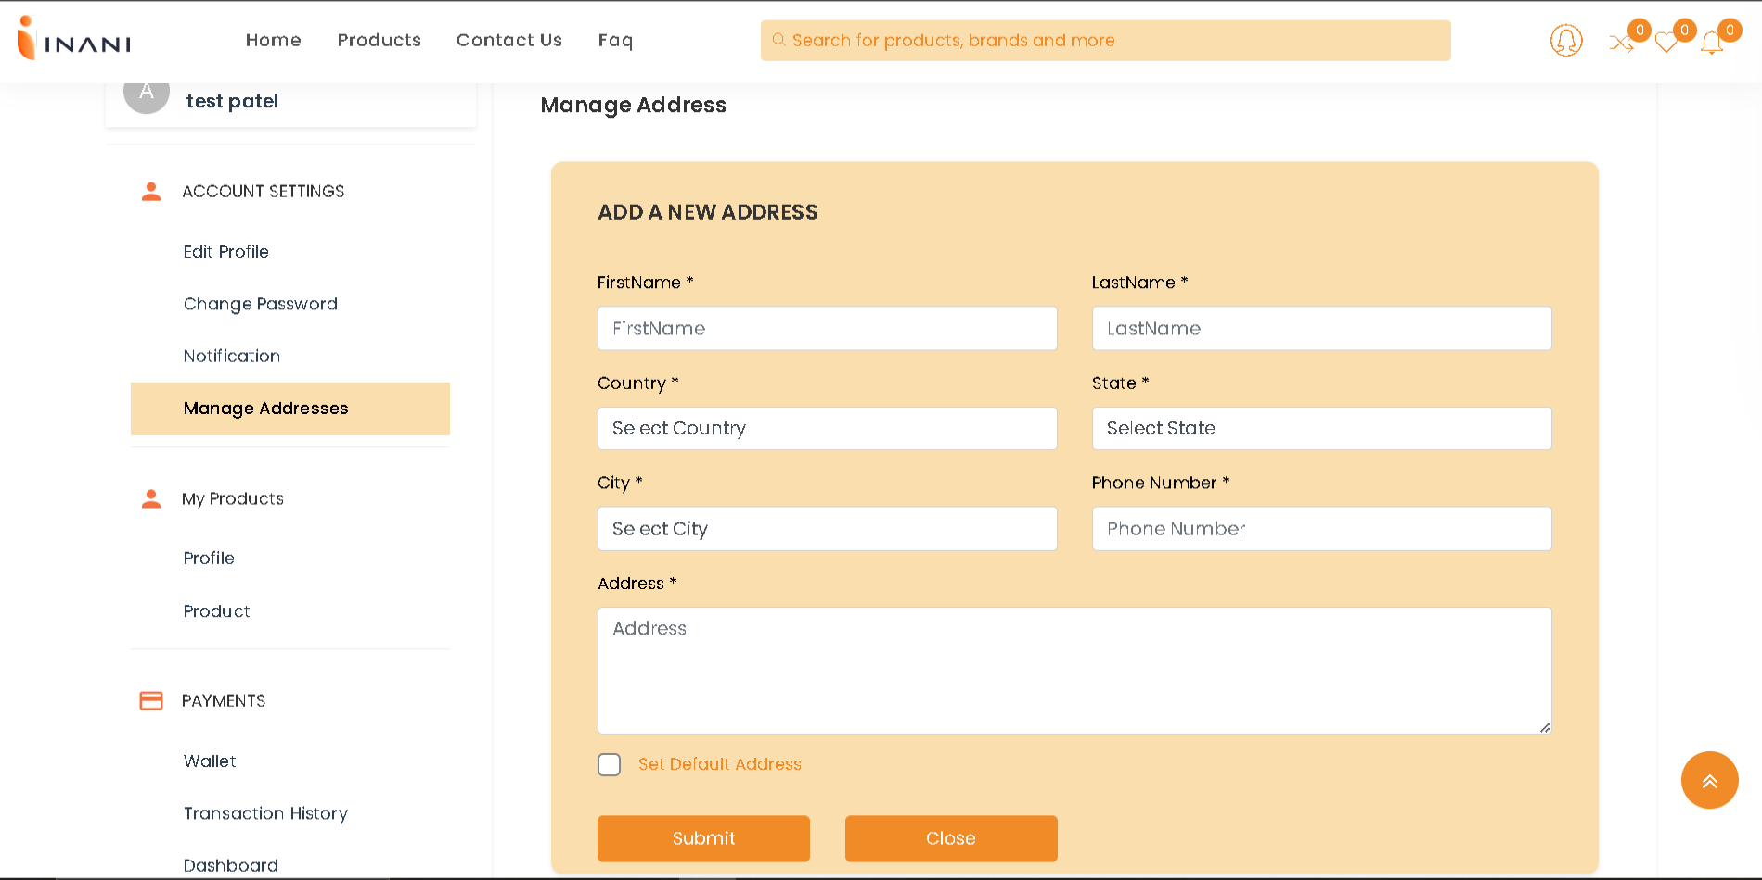
MANAGE ADDRESS

Slide 24

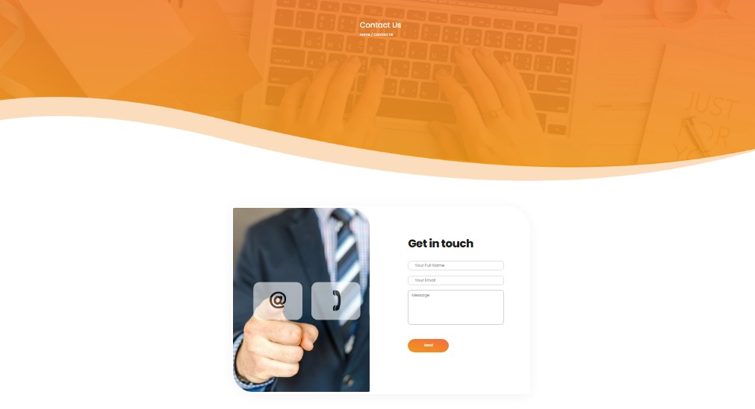
CONTACT US

Slide 25

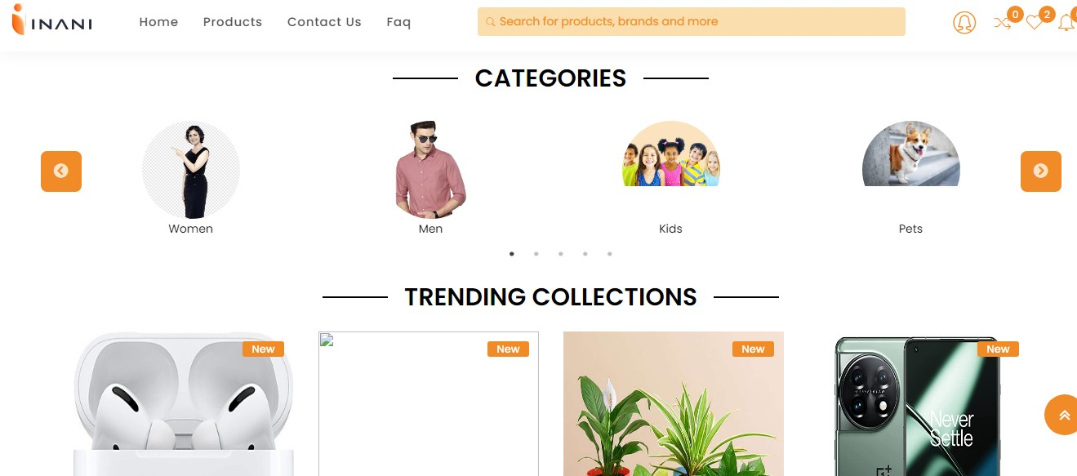
CATEGORIES

Slide 26

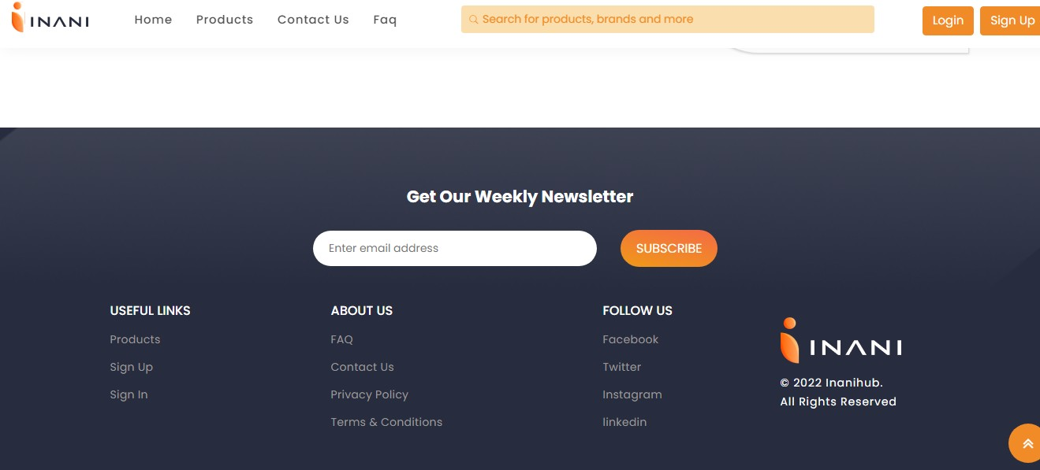
FOOTER

Slide 27

THANK YOU !

