Slide 1
Weather App Project BY-MADHURI SHARMA
Built with Vite, HTML, CSS, and JavaScript using OpenWeatherMap API

Slide 2
Project Overview
This Weather App allows users to:
- View current weather by entering a city
- Check temperature, humidity, and wind
- See a 5-day weather forecast
- Use their current location for quick weather info

Slide 3
Features Implemented
- Real-time weather updates
- Responsive and clean UI
- Error handling for wrong city input
- Uses OpenWeatherMap API
- Displays weather condition, temperature, humidity, wind speed

Slide 4
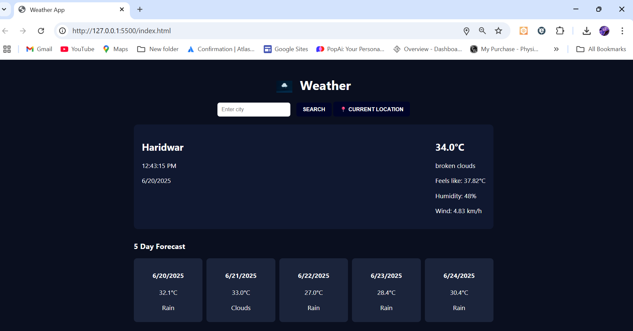
OUTCOMES

Slide 5
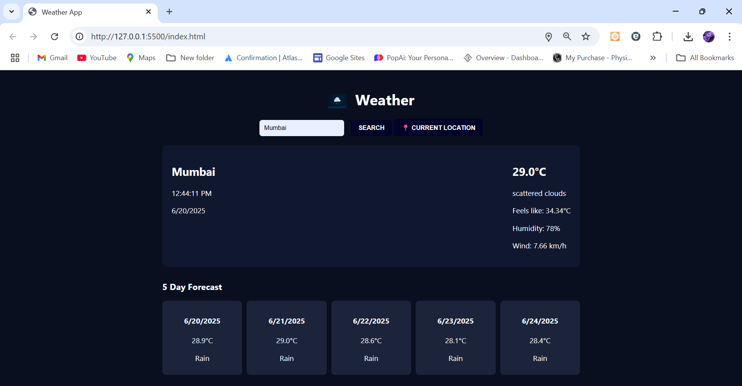
OUTCOMES

Slide 6
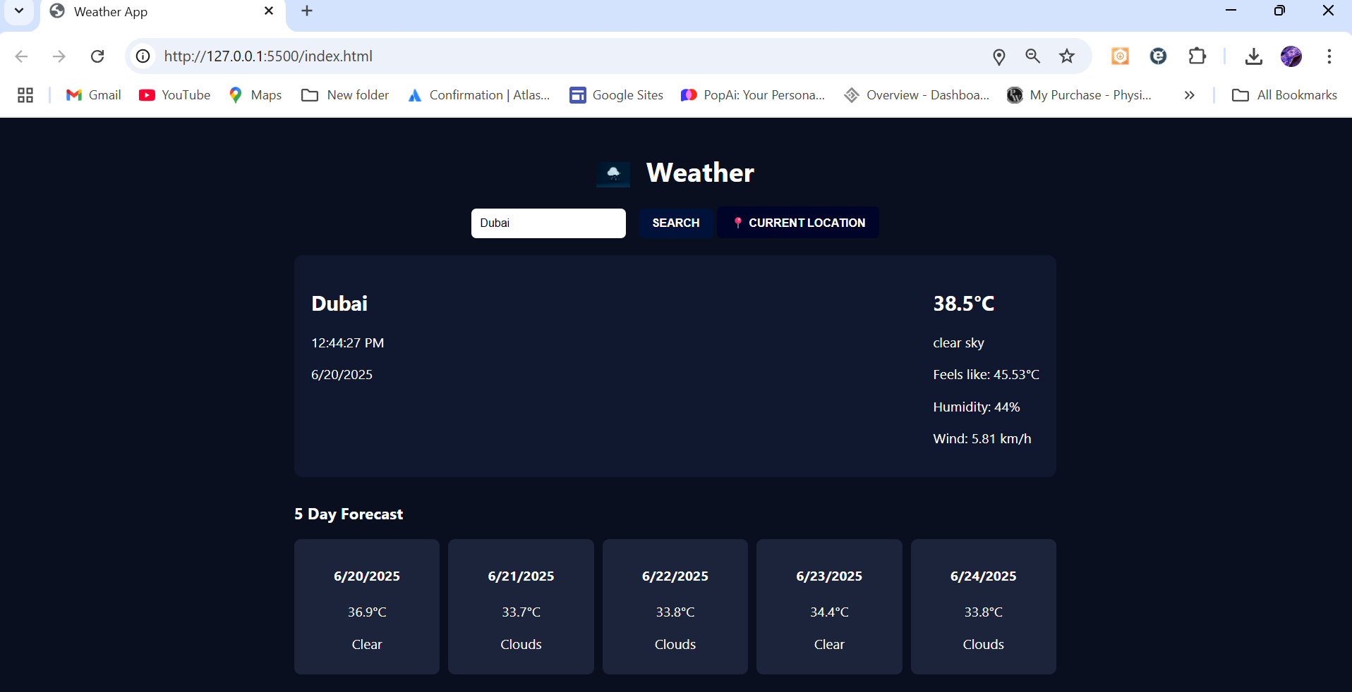
OUTCOMES

Slide 7
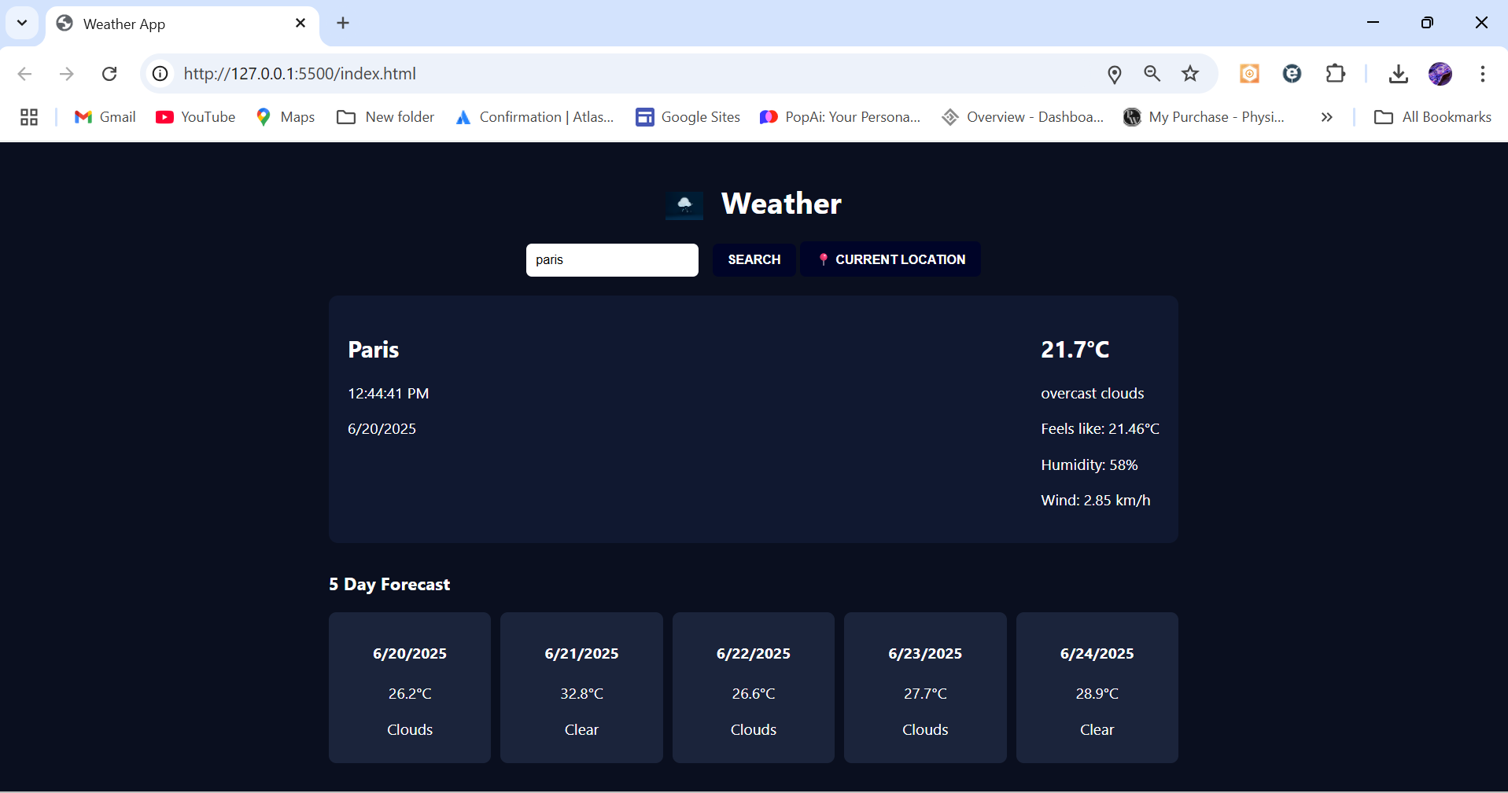
OUTCOMES

Slide 8
Conclusion
The Weather App successfully demonstrates how to build a real-time web application using JavaScript.
It uses clean code, API integration, and dynamic UI updates.

Slide 9
THANK YOU!

