Slide 1
Chatty - Social Media App BY-MADHURI SHARMA
A full-stack web project for user login, signup, post upload and gallery view

Slide 2
Introduction
Chatty is a simple full-stack social media web app where users can:
- Sign up or log in
- Upload image posts
- View uploaded posts in a gallery

Slide 3
Tech Stack
- Frontend: React + Tailwind CSS
- Backend: Node.js + Express
- Database: MongoDB Atlas
- Tools: Vite, React Router, Multer

Slide 4
Features Implemented
- User Signup and Login
- Dashboard with image post upload
- Real-time image gallery display
- Stylish and responsive UI

Slide 5
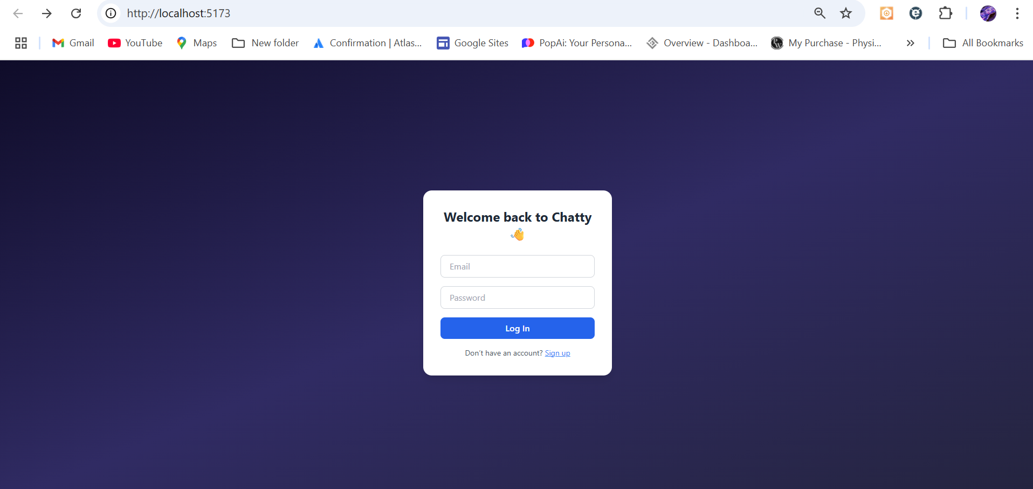
SCREENSHOTS OF WHAT IT LOOKS LIKE

Slide 6
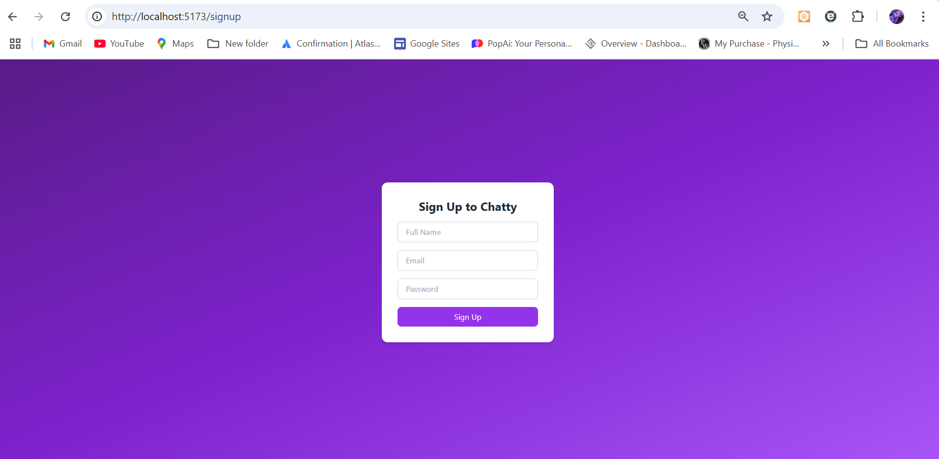

Slide 7

INCASE OF INVALID ID OR PASSWORD

Slide 8
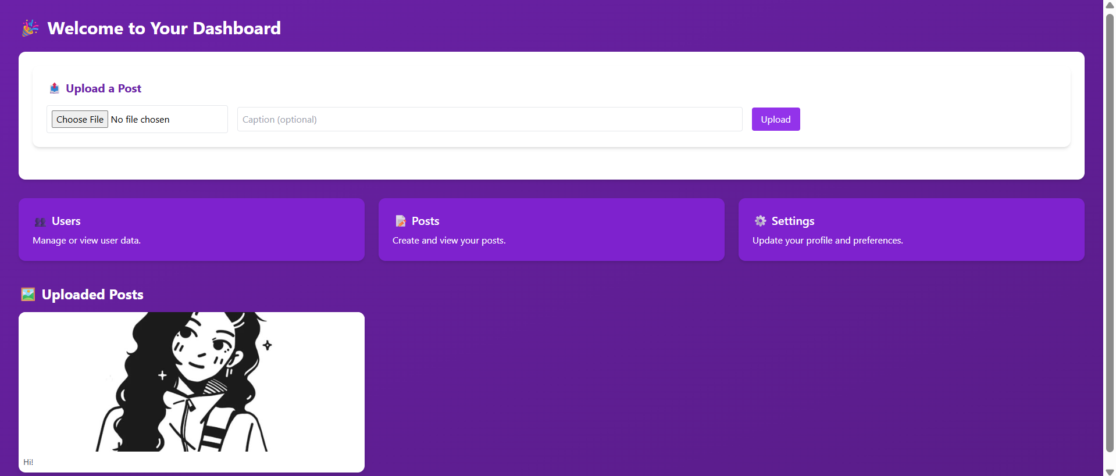
THE DASHBOARD AFTER LOGGING IN

Slide 9
Conclusion
Chatty demonstrates core full-stack development skills:
- Authentication
- REST API Integration
- File uploads
- Responsive design

Slide 10
THANK YOU!

