Slide 1
Madhuri Sawant

Slide 2
Pandas
Pandas is an open-source Python package that is most widely used for data science/data analysis and machine learning tasks.
It is built on top of another package named NumPy.
Pandas - the best data analysis and manipulation tool available.

Slide 3
What can be Done with Data Frames using Pandas?
Data cleansing
Data fill
Data normalization
Merges and joins
Data visualization
Statistical analysis
Data inspection
Loading and saving data
And much more

Slide 4


Slide 5


Slide 6
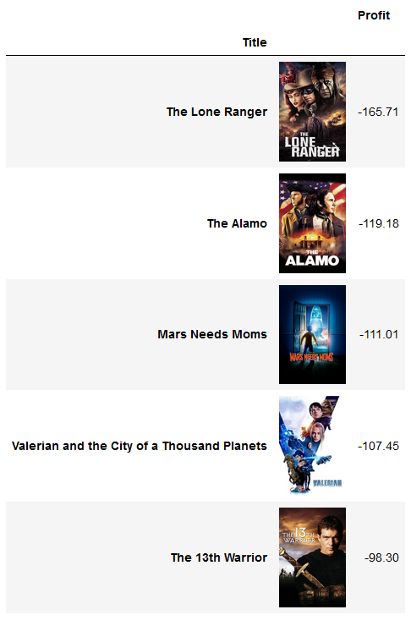

Slide 7
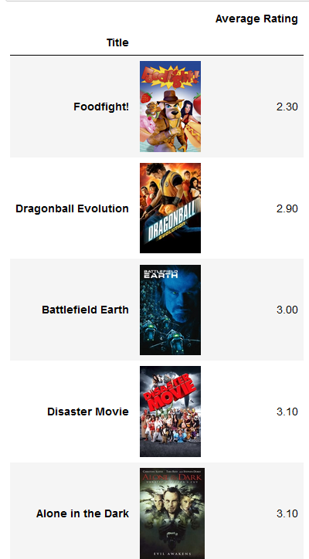

Slide 8


