Slide 1
A DEEP DIVE INTO GEORGIA’S RECIDIVISM
Abhishek Anumalla
Freny Patel
Lakshman Kushal Bogi
Madhuri Muppa
Nivedita J
AIT614 Big Data Essentials
Dr. Liao George Mason University

Slide 2
Introduction
What is Recidivism?
Recidivism is the likelihood of an individual committing new crimes after serving a sentence, measured by post-release arrests or convictions.
Importance of Recidivism:
Studying recidivism is crucial for understanding factors influencing post-criminal justice crime likelihood. This enhances public safety and supports rehabilitation for societal reintegration.
Objective:
To investigate the multifaceted factors and underlying causes contributing to high rates of recidivism among individuals involved in the Georgia State criminal justice system during the years 2013-2015.

Slide 3
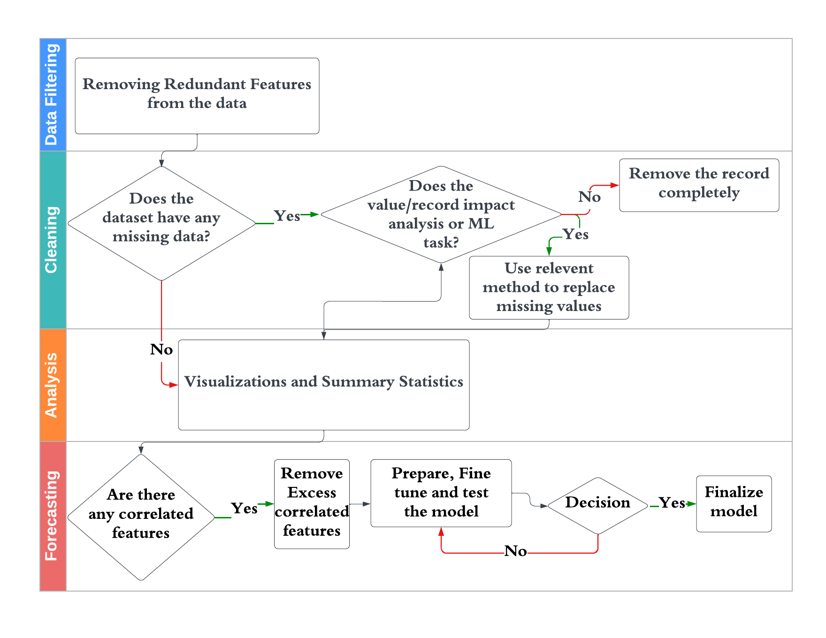
System Architecture

Slide 4
Objective
The primary objective of this research is to investigate the multifaceted factors and underlying causes contributing to high rates of recidivism among individuals involved in the Georgia State criminal justice system during the years 2013-2015. To achieve this overarching goal, the study is guided by the following specific sub-questions:
Examine the influence of demographic factors, including gender, race, and age at release, on recidivism rates, with the aim of understanding any disparities in the likelihood of reoffending.
Investigate the correlation between prior criminal history, such as the number of prior arrests, convictions, and types of offenses, and recidivism, in order to assess the impact of an individual's criminal past.
Analyze the role of behavioral factors, including substance abuse, mental health conditions, education level, employment history, and social support networks, in predicting recidivism, aiming to unveil the behavioral contributors to reoffending.
Assess the effectiveness of supervision levels and risk scores in predicting recidivism and explore whether specific supervision strategies impact the likelihood of reoffending.
Explore the impact of violations, program attendance, residence changes, and employment status on recidivism rates, to understand the effects of compliance and participation in rehabilitation and support programs.
Investigate the patterns and trends in recidivism over specified time frames (1 year, 2 years, and 3 years), aiming to identify critical periods in which interventions may be most effective.

Slide 5
Data Cleaning
Checking for Null Values: We identified missing data to understand gaps in the information.
Handling Missing Values: We used interpolation method to fill in missing values, ensuring accuracy in columns like 'Supervision_Risk_Score_First' and drug test data.
Filling Averages: For columns such as 'Avg_Days_per_DrugTest', 'Percent_Days_Employed', and 'Jobs_Per_Year', we applied the average value to fill in the missing data points.
Dropping Columns: Columns with a high volume of missing values were dropped to maintain data integrity and quality in our analysis.

Slide 6
Exploratory Data Analysis

Slide 7
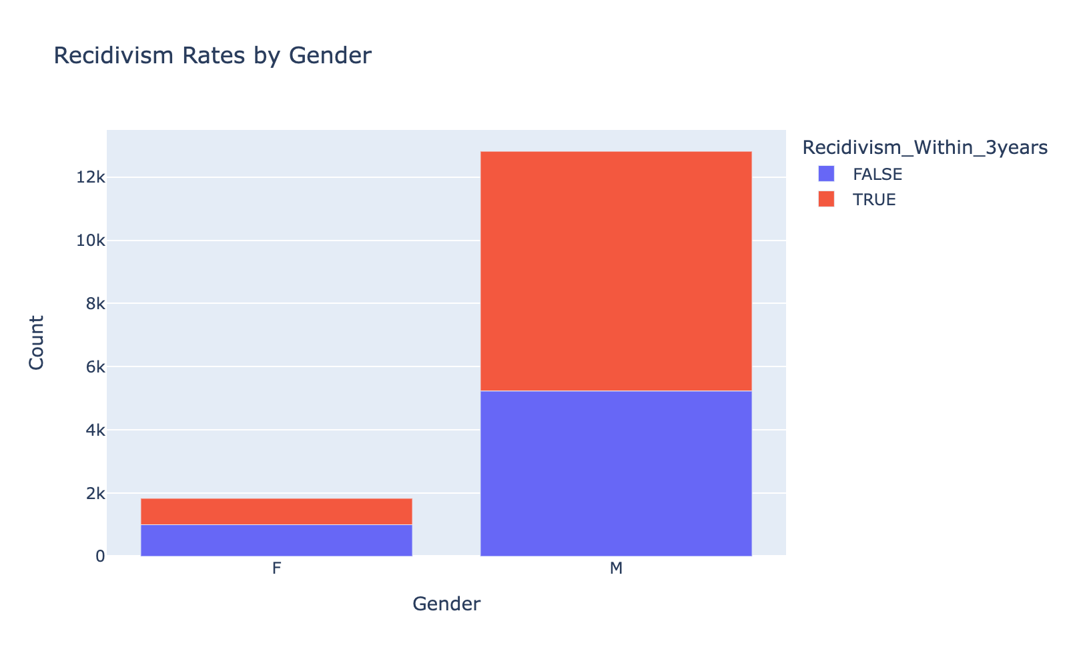
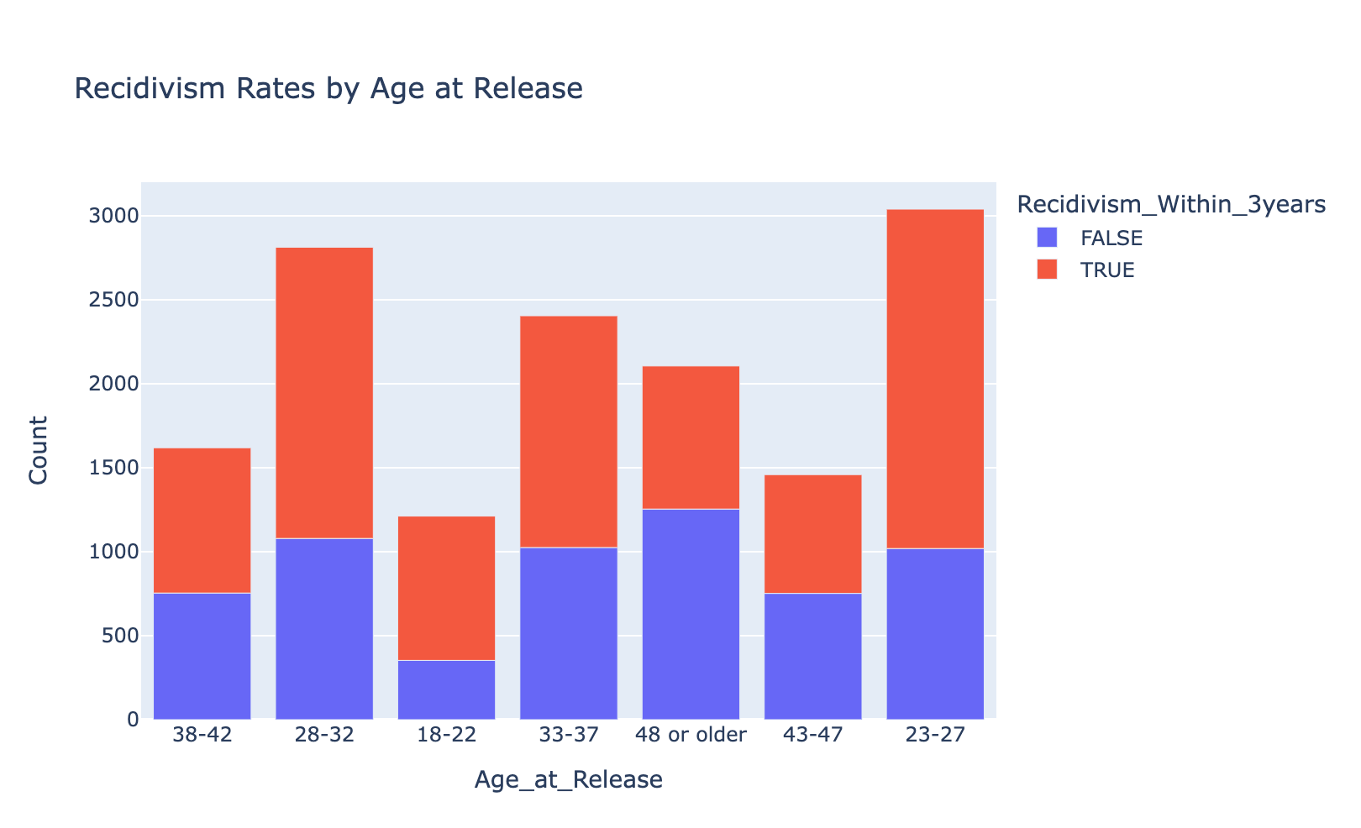
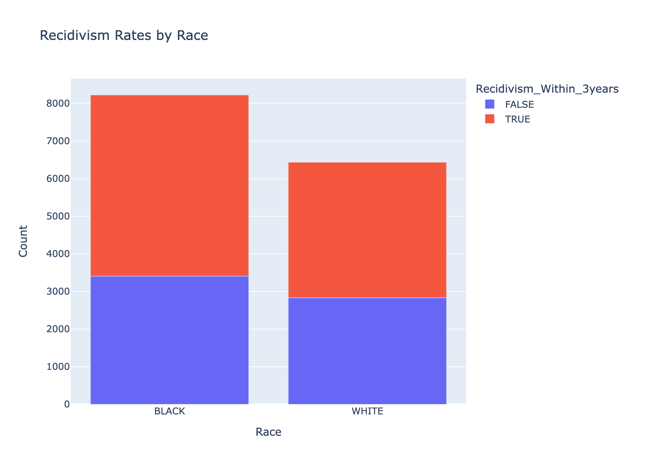
Recidivism rates by Gender, Race and Age at Release

Slide 8
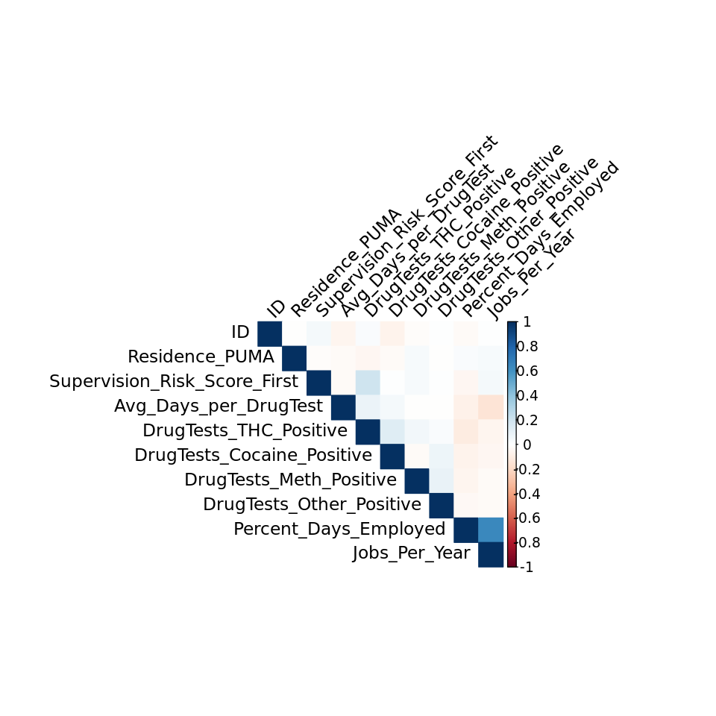
Correlation Matrix

Slide 9
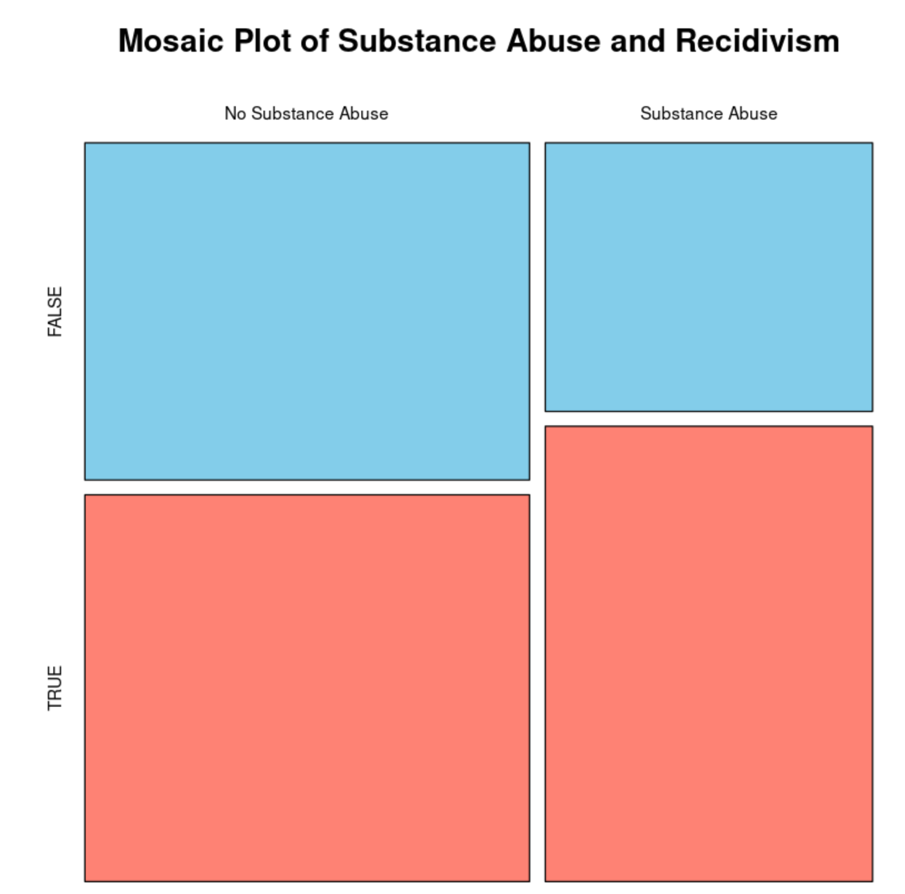
Impact of Substance Abuse on Recidivism
(Within 3 years)

Slide 10
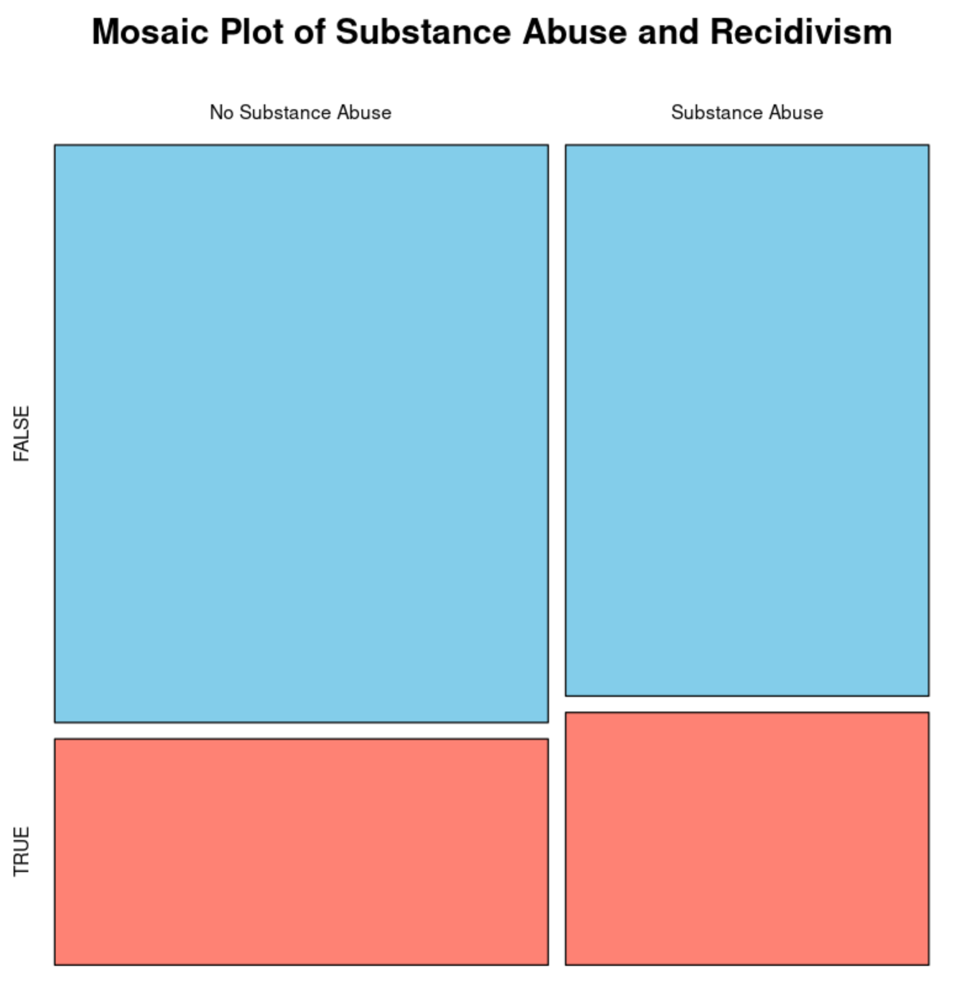
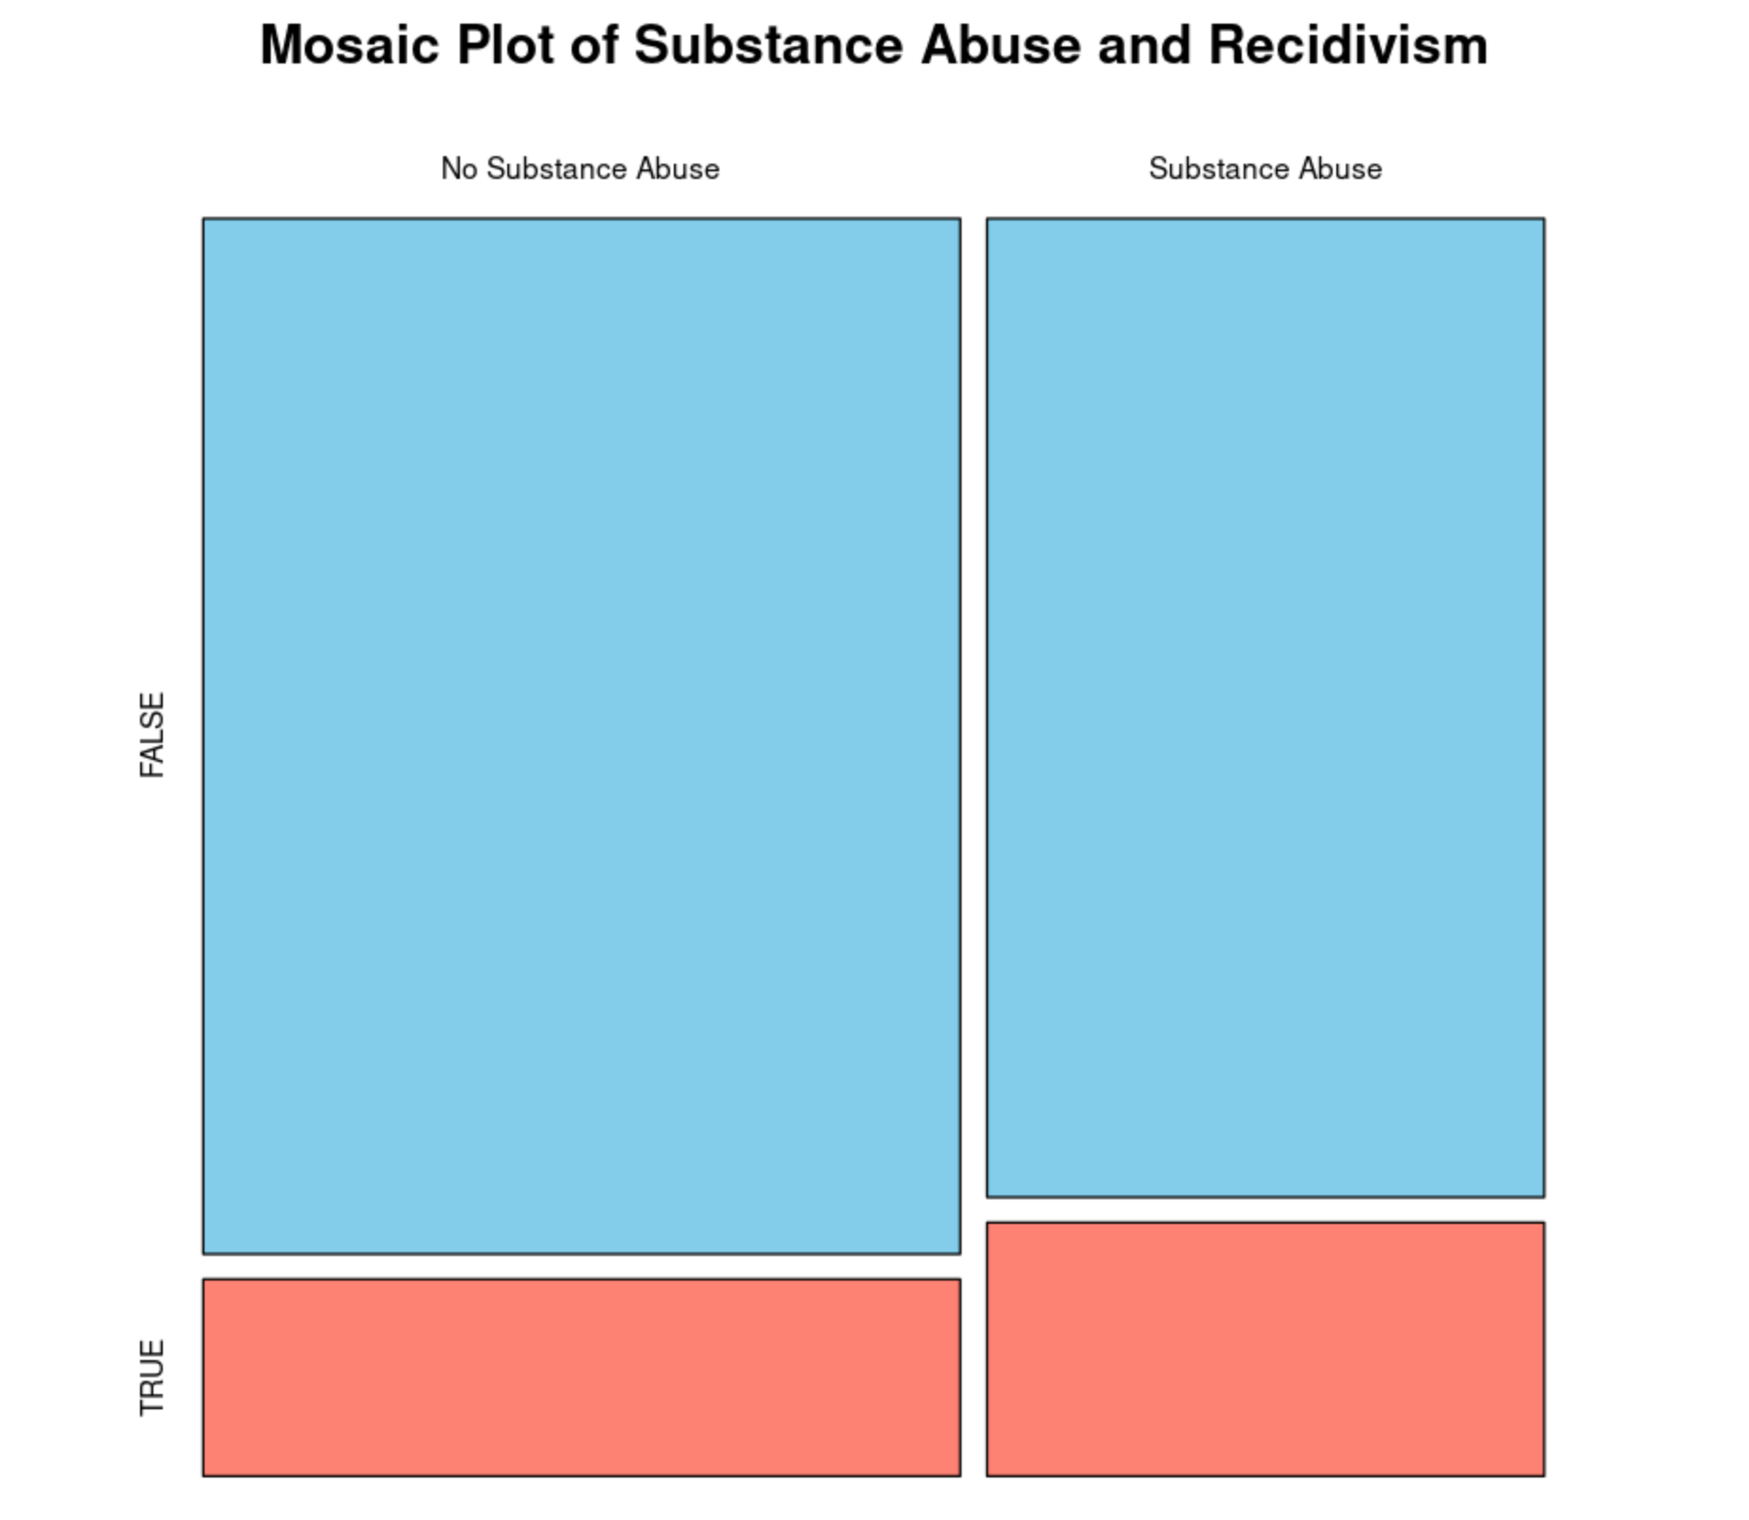
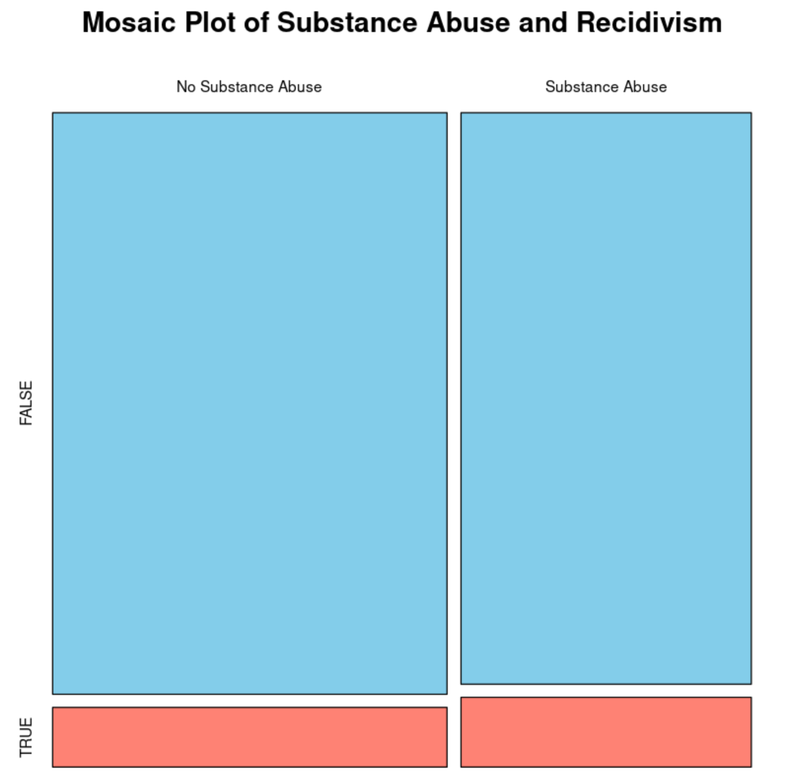
Impact of Substance Abuse on Recidivism
(Over 3 years – trend)
Year 1
Year 2
Year 3

Slide 11
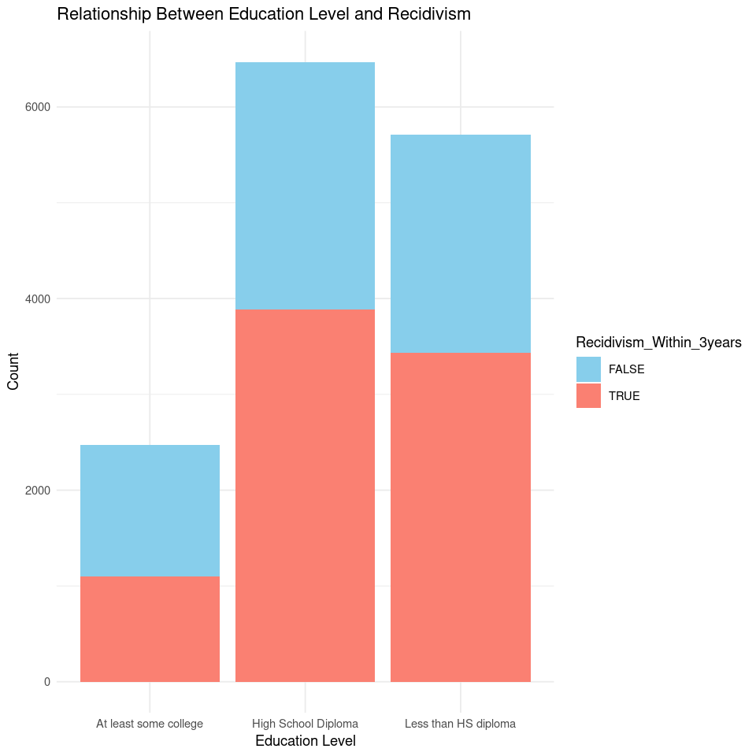
Relationship b/w Education Level and Recidivism
(Within 3 years)

Slide 12
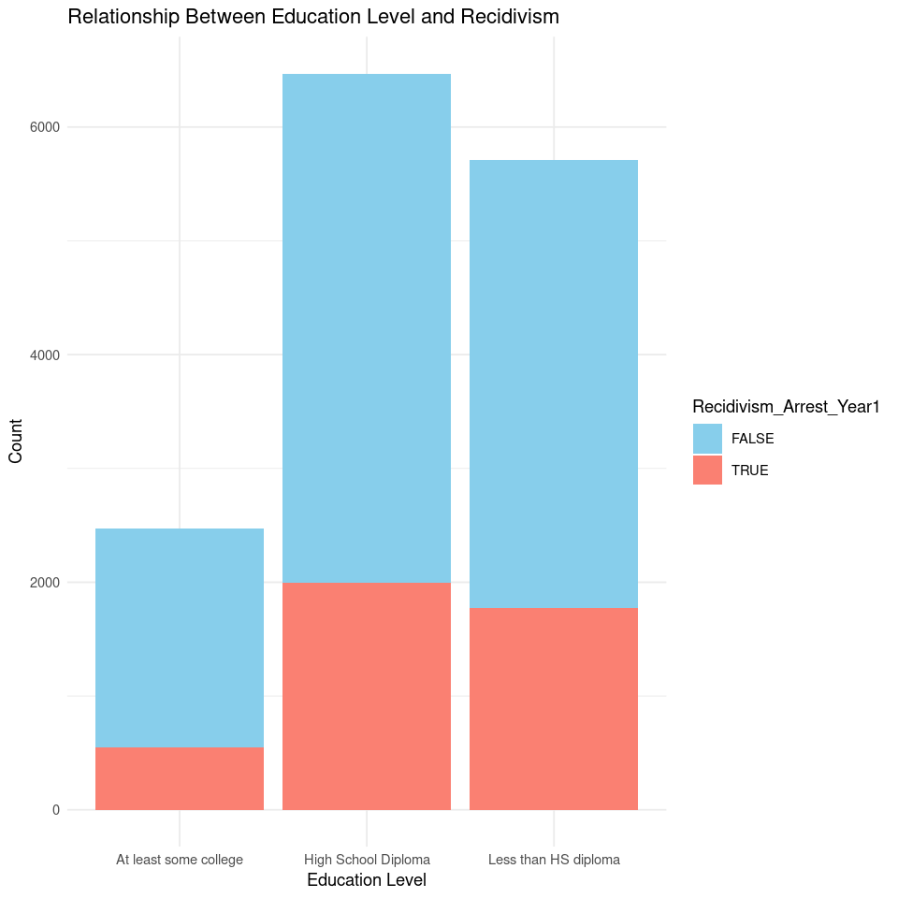
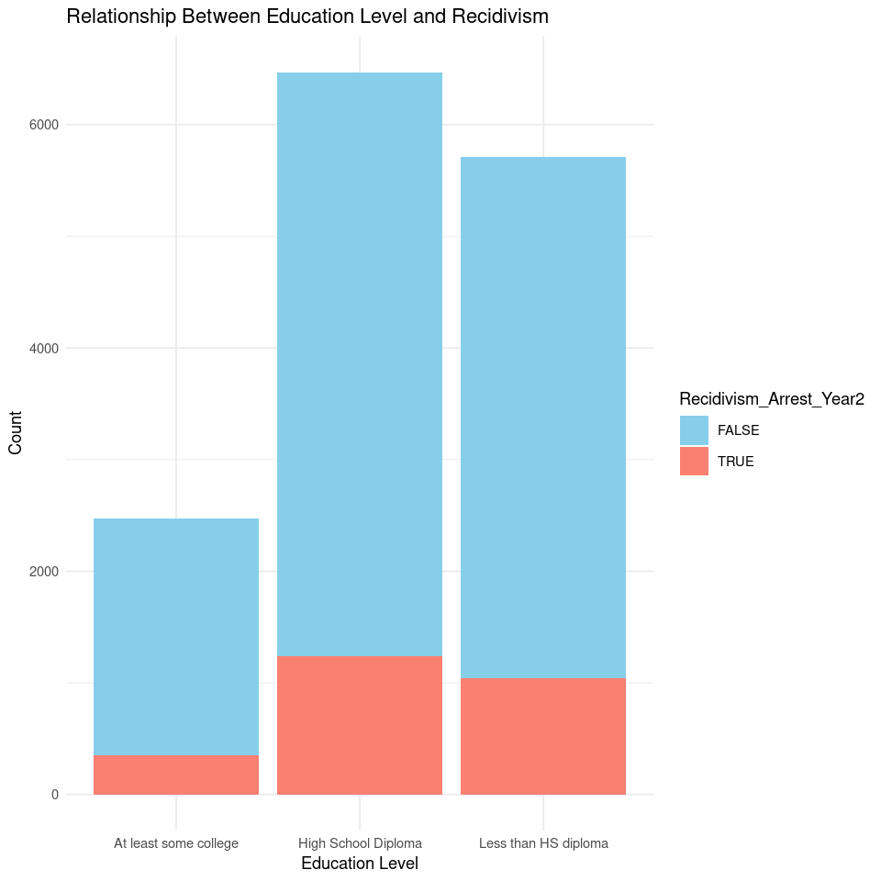
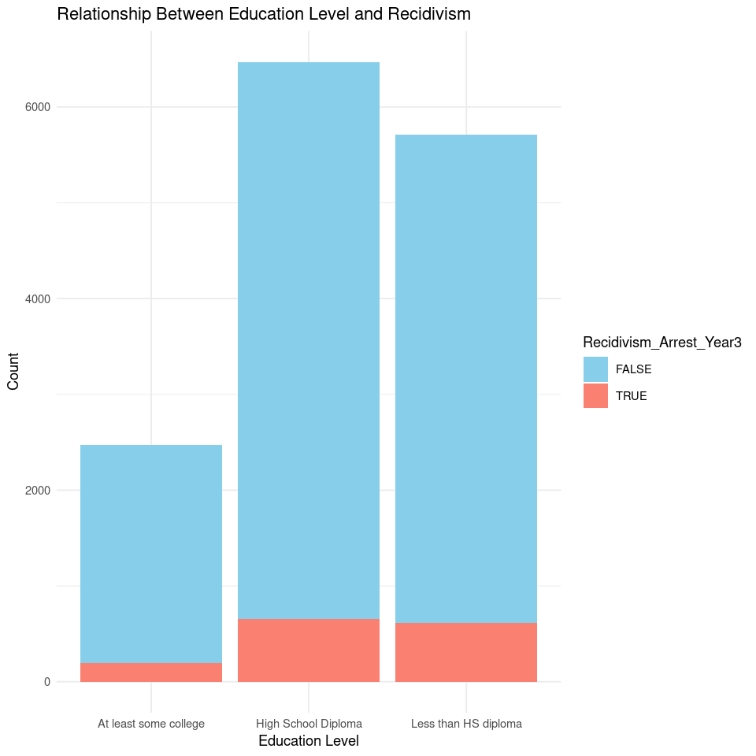
Relationship b/w Education Level and Recidivism
(Over 3 year – trend)
Year 1
Year 2
Year 3

Slide 13
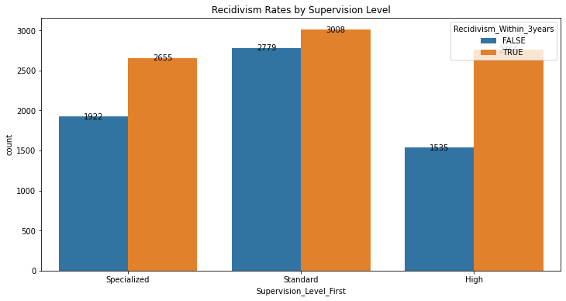
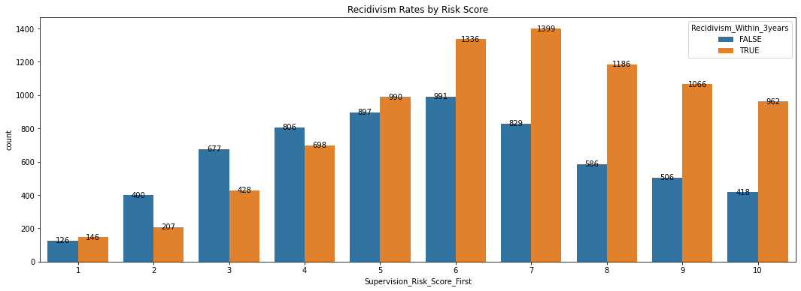
Recidivism Rate vs Supervision Level, Risk Score

Slide 14
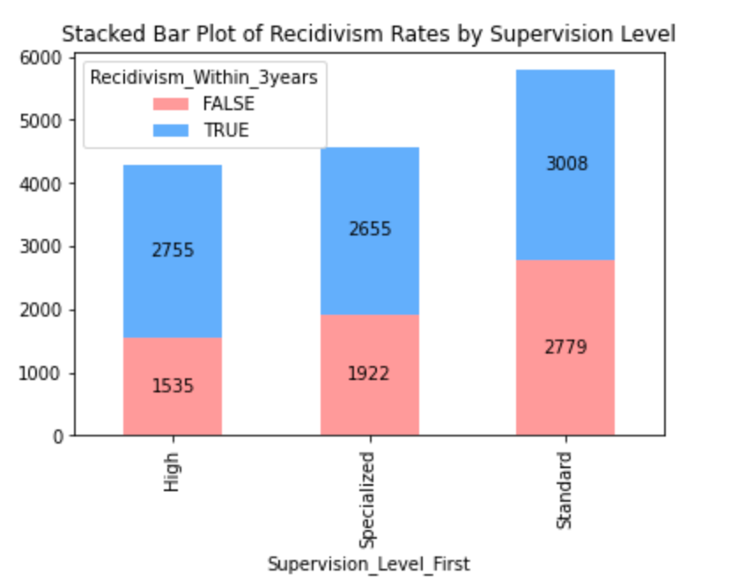
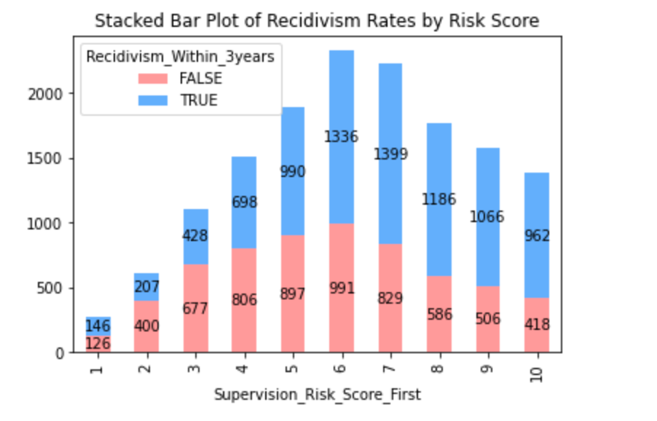
Recidivism Rate vs Supervision Level, Risk Score

Slide 15
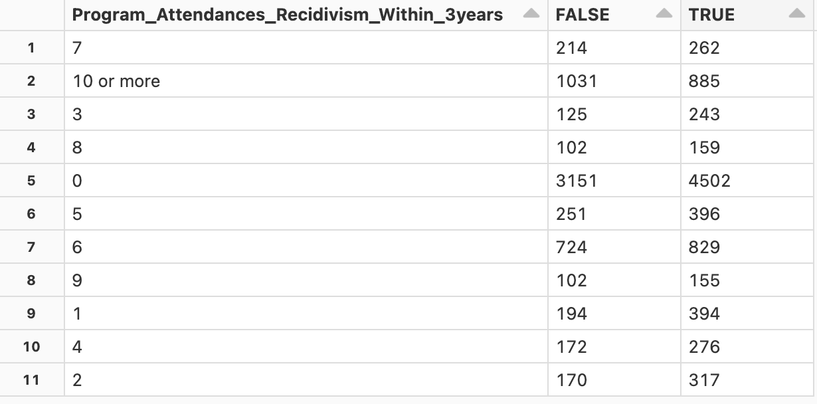
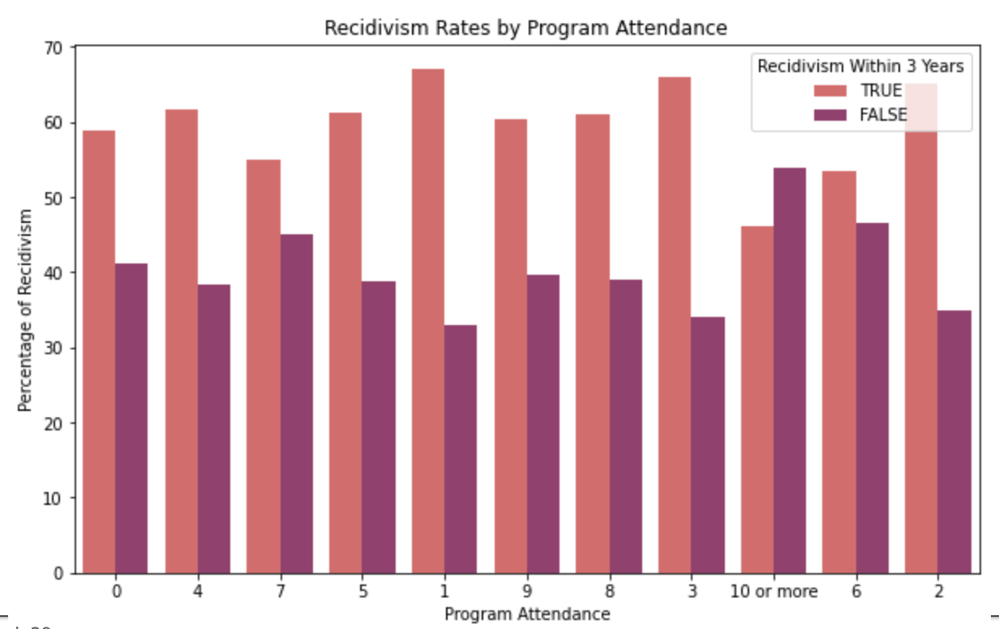
Contingency Table for Program Attendance

Slide 16
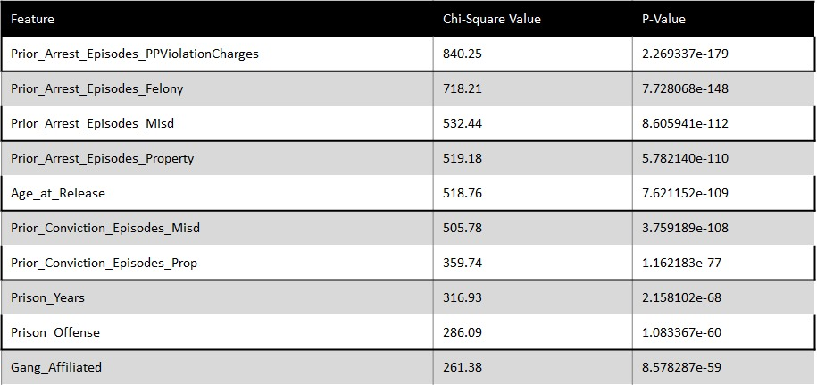
Chi Squared Test correlation b/w Prior Criminal History and Recidivism

Slide 17
Machine Learning Models
LOGISTIC REGRESSION without hyperparameter tuning and cross validation | Area under ROC curve: 0.7484329712396544 Accuracy: 0.6860830136030694
RANDOM FOREST without hyperparameter and cross validation | Area under ROC curve: 0.7588282085063021 Accuracy: 0.6927101499825602
RANDOM FOREST with hyperparameter and cross validation | Area under ROC curve: 0.7786800566755349 Accuracy: 0.7084059993024067
GRADIENT BOOSTING without hyperparameter and cross validation | Area under ROC curve: 0.7727870441721143 Accuracy: 0.7160795256365539
SUPPORT VECTOR MACHINE with hyperparameter tuning and cross validation | Tuned model - Area under ROC curve: 0.7839506326282045 Tuned model - Accuracy: 0.7185211021974189
SUPPORT VECTOR MACHINE without hyperparameter tuning and cross validation | Area under ROC curve: 0.7847301697780221 Accuracy: 0.7185211021974189
LOGISTIC REGRESSION with hyperparameter tuning and cross validation | Area under ROC curve: 0.7832108677819503 Accuracy: 0.7220090687129403

Slide 18
Conclusion
In our comprehensive evaluation of diverse machine learning models for recidivism prediction, we emphasize the significance of refining models through hyperparameter tuning and cross-validation. Notably, Logistic Regression, subjected to these optimization techniques, emerges as the optimal choice, exhibiting robust performance with the highest Area under the ROC curve (0.7832) and accuracy (0.7220). While Support Vector Machine competes effectively, our generic conclusion underscores the universal importance of fine-tuning model parameters for enhanced predictive accuracy, offering insights applicable beyond recidivism prediction.
Beyond its promising predictive prowess, the optimized Logistic Regression model, resulting from hyperparameter tuning and cross-validation, holds paramount implications for recidivism control. The heightened accuracy and precision empower criminal justice professionals to discern individuals with a higher likelihood of reoffending more accurately. This targeted identification facilitates the implementation of personalized intervention and rehabilitation strategies, optimizing resource allocation. By leveraging advanced machine learning techniques, our model contributes to a data-driven and proactive approach in the criminal justice system, paving the way for more effective programs and policies to curb recidivism rates.

Slide 19
References:
“NIJ’s Recidivism Challenge Full Dataset | Office of Justice Programs,” data.ojp.usdoj.gov.
https://data.ojp.usdoj.gov/Courts/NIJ-s-Recidivism-Challenge-Full-Dataset/ynf5-u8nk (accessed Oct. 24, 2023).
Cannonier, C., Galloway Burke, M., & Mitchell, E. (2020). The Impact of a Reentry and Aftercare Program on Recidivism. The Review of Black Political Economy, 48(1), 003464462097393.
https://doi.org/10.1177/0034644620973931. (accessed Oct. 24, 2023)
‌Khan, Shahid & Lucas, Mia. (2023). The effectiveness of restorative justice programs in reducing/recidivism. https://www.researchgate.net/publication/372750946_The_effectiveness_of_restorative_justice_programs_in_reducing_recidivism. (accessed Oct. 24, 2023)
Yukhnenko D, Blackwood N, Fazel S. Risk factors for recidivism in individuals receiving community sentences: a systematic review and meta-analysis. CNS Spectr. 2020 Apr;25(2):252-263.
https://doi.org/10.1017/S1092852919001056. Epub 2019 Jun 20. PMID: 31218975; PMCID: PMC7183820. (accessed Oct. 24, 2023)
Z. Zhang, Z. Huang, Z. Wan and L. Meng, "Comparative Analysis of Machine Learning Models for Recidivism Prediction Based on Chi-square Test," 2021 International Conference on Intelligent Computing, Automation and Applications (ICAA), Nanjing, China, 2021, pp. 21-26, https://doi.org/10.1109/ICAA53760.2021.00012. (accessed Oct. 24, 2023)
“Recidivism Forecasting Challenge.” National Institute of Justice,
nij.ojp.gov/funding/recidivism-forecasting-challenge Accessed 24 Oct. 2023.

Slide 20
Thank You

