Slide 1
Urban Pulse – Smart City Mobility Intelligence Platform Infosys Springboard Internship
RITU SUNAGAR
r. Jaswanth kumar
unatti
MADHURI

Slide 2
Objective
What is Urban Pulse?
Urban Pulse is a Power BI-based mobility intelligence platform that analyzes transportation and ride-hailing data to understand:
Travel and booking patterns
Revenue and trip performance
Waiting time and customer experience
Mobility accessibility across locations
Demand patterns
Future demand and unusual/anomalous activity
Main Aim
To convert raw mobility data into meaningful insights that can support better transportation planning, accessibility and operational decisions.
Key Questions
When and where is demand high?
How efficiently are trips being completed?
Which locations have better mobility access?
What affects customer waiting time?
What demand patterns can help in future planning?

Slide 3
Data Collection & Dataset
Dataset Used
The project uses structured mobility/ride-hailing data containing information such as:
Booking ID
Date & Time
Booking Status
Vehicle Type
Pickup Location
Ride Revenue / Booking Value
Waiting Time
Trip Distance
Customer information
Cancellation reasons
Events
Weather-related information where available
Data Flow
Raw Dataset → Power BI → Transformation → Data Model → Measures → Visualizations → Insights

Slide 4
ETL & Data Preprocessing
3. Load
The cleaned data was loaded into Power BI for:
Data modeling → DAX calculations → Visualization
Derived columns created
Examples:
Month
Month Name
Quarter
Year
Week Number
Weekday
Time Slot
Day Type — Weekday/Weekend
Peak Hour
Access Category
ETL & Data Preprocessing
1. Extract
We imported the raw dataset from Excel into Power BI.
2. Transform
Using Power Query, we:
Removed unnecessary columns
Removed/handled duplicate records
Checked missing values
Corrected data types
Standardized date and time fields
Cleaned categorical values
Created useful derived columns

Slide 5
Data Modeling & Star Schema
Why Star Schema?
Instead of keeping everything in one large table, the data can be organized into:
Fact Table
Contains measurable transaction information:
Booking ID
Revenue
Waiting Time
Trip Distance
Booking Status
Date Key
Location Key
Vehicle Key
Customer Key
Event Key
Dimension Tables
DimDate
Date
Month
Quarter
Year
Weekday
Week Number
DimVehicle
Vehicle Type
DimLocation
Pickup Location
DimCustomer
Customer ID
Rating
Gender
DimEvent
Event
Event Type
DimBookingStatus
Booking Status
Simple explanation
The fact table stores the actual trip transactions, while dimension tables provide descriptive information used to analyze those transactions.

Slide 6
RIDE HAILING
1: Ride-Hailing Analysis
Total trips
Total revenue
Average fare
Trip distance
Trip duration
Vehicle type
Pickup locations
Time slots
Events
Booking status
Important charts & questions
Trips by Day
How does booking demand change over time?
Revenue by Month
Which months generate higher revenue?
Revenue by Vehicle Type
Which vehicle types contribute more to revenue?
Bookings by Time Slot & Status
When are bookings and cancellations concentrated?
Bookings by Event & Vehicle Type
Do events influence transportation demand?
Real-life use
Helps ride-hailing operators understand demand, revenue and vehicle utilization.

Slide 7
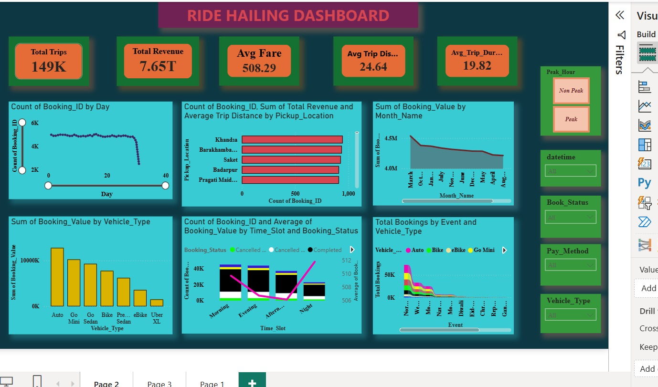

Slide 8
Mobility Dashboard Analysis
Main focus:
Understanding public transportation usage across routes, vehicles, locations and environmental conditions.
Charts answer questions such as:
Passengers by Vehicle Type
Which transportation mode carries more passengers?
Trips by Route
Which routes have higher usage?
Passengers by Date
How does transportation usage change over time?
Distance & Fare by Route
Which routes involve greater distance and fare?
Temperature / Wind Speed vs Trips
Is there any observable relationship between environmental conditions and mobility usage?
Real-life insight
This can help transportation planners understand route utilization and resource requirements.

Slide 9
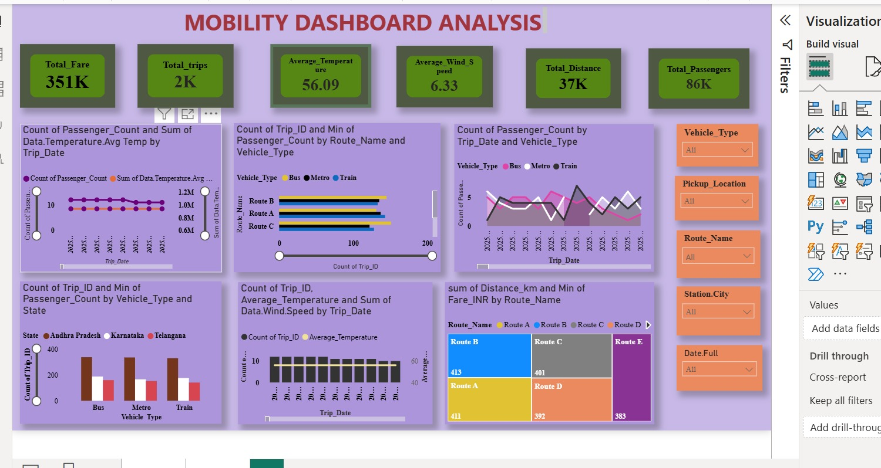

Slide 10
Geographic Mobility Analysis
Objective: Analyze how ride demand is distributed across different pickup locations and how vehicle usage varies by location.
Visuals & Purpose
Total Trips by Pickup Location — Map Shows the geographic distribution of trips across Delhi/NCR and identifies areas with higher activity.
Total Trips by Pickup Location — Bar Chart Compares the most active pickup locations based on total trips.
Vehicle Type & Pickup Location Shows how different vehicle types contribute to trips across pickup locations.
Pickup Location Table Provides detailed location-level booking information, including booking status.
Location Hierarchy / Drill-down Allows individual pickup locations to be explored in greater detail.
Key Insight
Ride demand is concentrated in specific Delhi/NCR pickup areas, while the preferred vehicle type varies across locations.

Slide 11
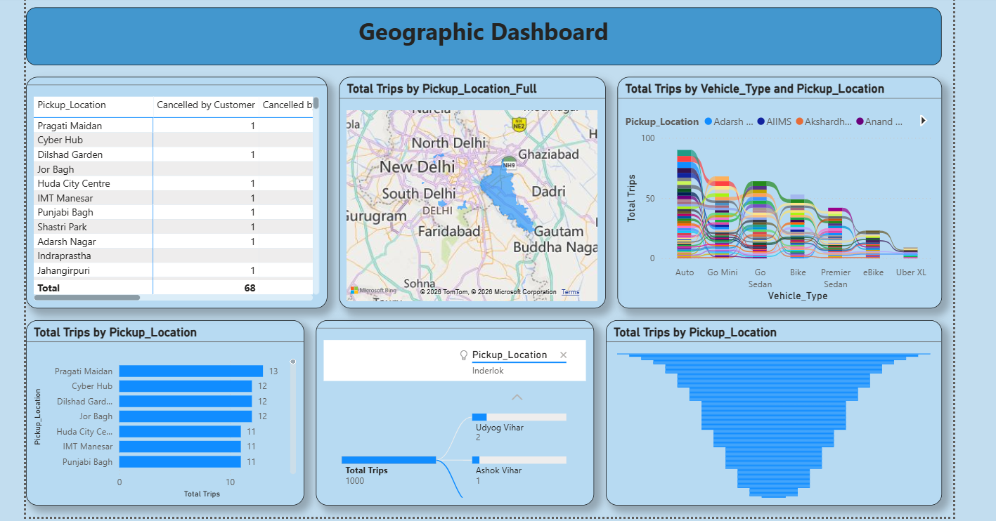

Slide 12
Mobility-Equity Dashboard
Main focus:
Accessibility + operational performance + customer experience
KPI Cards
Total Trips
Completed Trips
Average Waiting Time
Total Ride Revenue
Mobility Access Index
Charts
Revenue by Month
How does revenue change over time?
Trips by Booking Status
How many trips are completed, cancelled or incomplete?
Revenue by Event
Which events are associated with changes in revenue?
Mobility Access Index by Location
Which locations have relatively better or lower mobility access?
Waiting Time by Time Slot
During which periods do customers wait longer?
Waiting Time by Vehicle Type
Which vehicle types have higher/lower waiting times?
Cancellation Reasons
Why are customers cancelling rides?
Real-life importance
These insights help identify areas where transportation service quality and accessibility may need improvement.

Slide 13
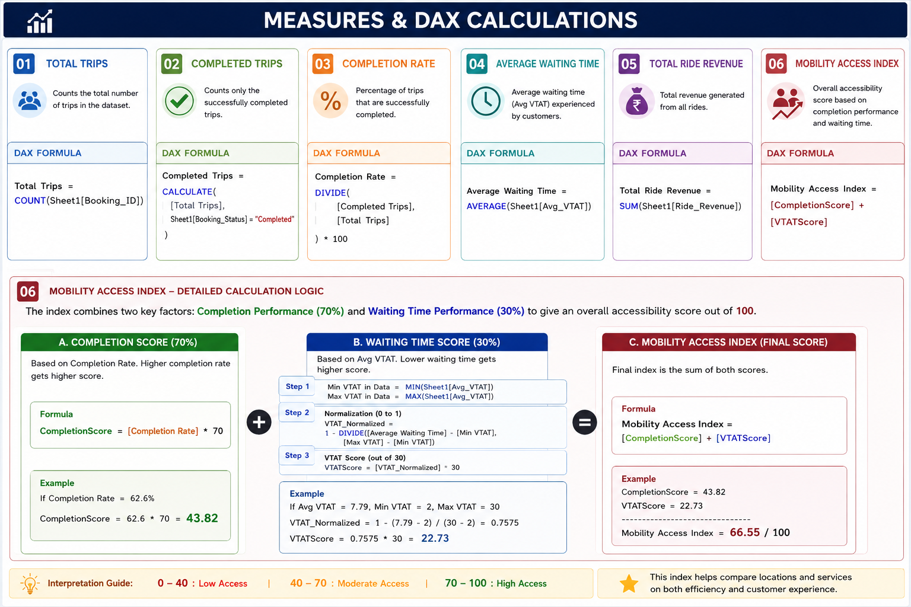

Slide 14
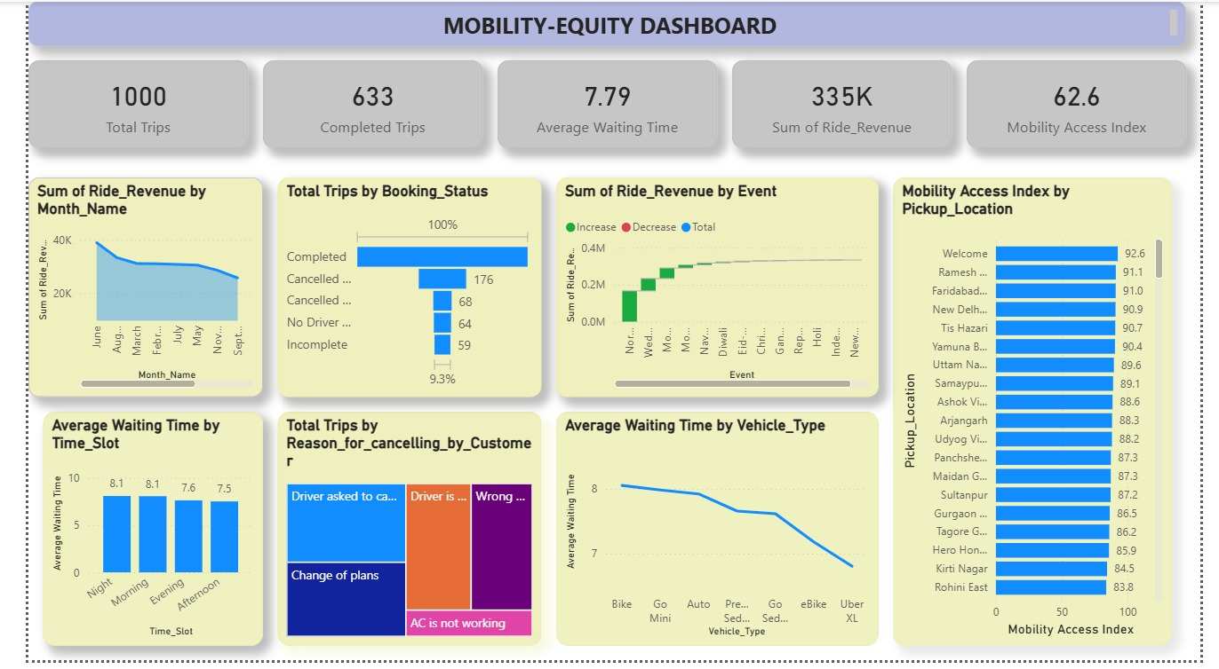

Slide 15
Seasonal Demand Dashboard
Objective
Analyse how events, seasons, vehicle types and time affect mobility demand, revenue and cancellations.
Key Insights
Revenue by Event: Normal days contribute major revenue; Auto and Go Mini are strong contributors.
Booking Value vs Distance: Longer rides generally generate higher booking values.
Vehicle Usage: Vehicle preference changes across different events.
Daily Revenue: Revenue fluctuates, with certain event days showing peaks.
Cancellation Rate: Diwali has the highest cancellation rate.
Time Slots: Demand varies by time, helping identify periods needing more vehicles.
Conclusion
Seasonal and event patterns help in fleet planning, driver allocation and managing peak demand.

Slide 16
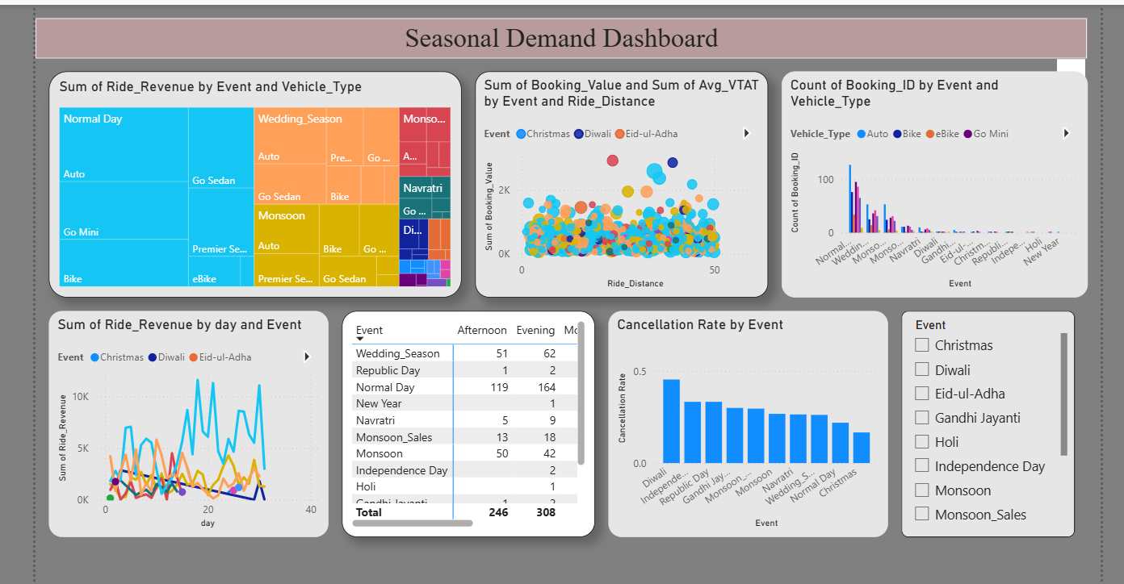

Slide 17
FORECAST AND ANAOMALY DETECTION
The dashboard compares:
Historical/Actual Demand vs Forecast Demand
This helps answer:
"What level of demand can we expect in the future?"
Anomaly Detection
The dashboard identifies unusual demand patterns that differ significantly from the normal pattern.
It helps answer:
"Where are demand patterns behaving unusually?"
Other useful analysis
Demand by Hour
Identifies high-demand hours.
Demand by Time Slot & Booking Status
Shows when demand and booking outcomes are concentrated.
Average Demand by Day
Helps compare demand across weekdays and weekends.

Slide 18
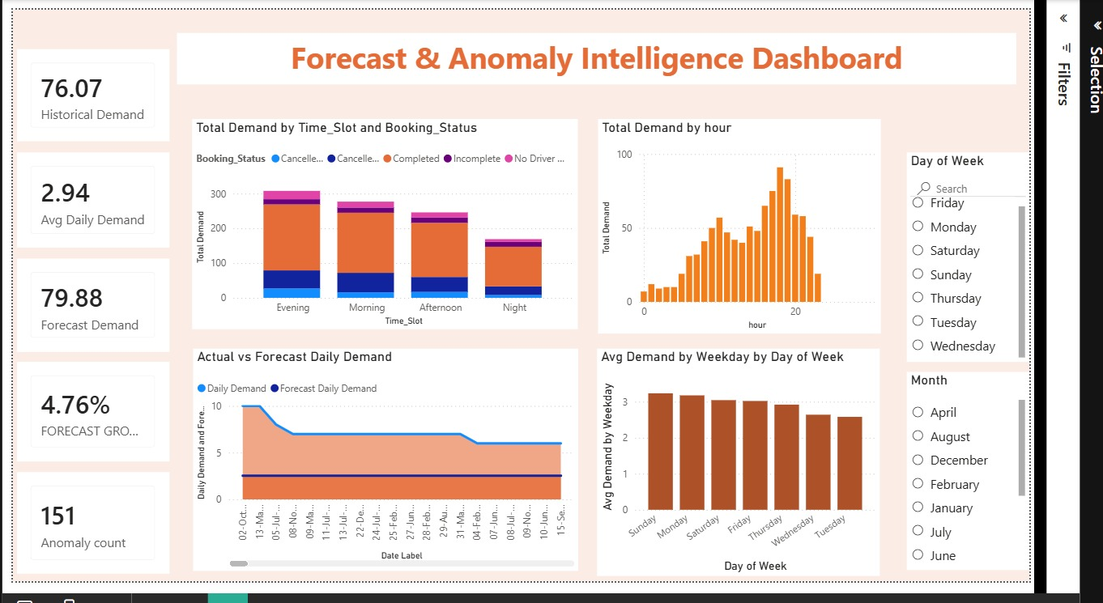

Slide 19
Key Insights
Key Insights
1. Demand varies by time
Different time slots and hours show different levels of transportation demand.
2. Operational performance varies
Completion rates and waiting times help identify differences in service performance.
3. Accessibility differs by location
The Mobility Access Index allows locations to be compared using both completion and waiting-time performance.
4. Vehicle and route patterns matter
Different vehicle types and routes contribute differently to trips, passengers and revenue.
5. Weekday vs Weekend behavior differs
The analysis shows that travel demand is not distributed equally across day types, helping planners understand different usage patterns.
6. Forecasting supports future planning
Historical demand patterns can be used to estimate future transportation requirements.
7. Anomalies highlight unusual behavior
Unusual demand patterns can be investigated instead of relying only on overall averages.

Slide 20
conclusion
Final Conclusion
Urban Pulse transforms raw mobility data into an interactive decision-support platform.
By combining data preprocessing, star-schema modeling, DAX measures, dashboards, accessibility analysis, forecasting and anomaly detection, the project provides a broader understanding of:
Demand → Operations → Revenue → Accessibility → Customer Experience → Future Planning
Final line for presentation:
"Our project moves from simply understanding what happened in mobility data to understanding why it happened and how the information can support better future transportation planning."

Slide 21

Thank you

