Slide 1
House Prices: Advanced Regression Techniques
Madhuri Konnur
AI Technology and Systems

Slide 2
Table of Contents
Problem Description
Proposed Solution
Dataset Used
Benefits and Impact
Solution Discussion
Challenges
Results
Future Work
Summary

Slide 3
Problem Description
The goal of “House Prices” project was to predict or estimate the sale price of residential home in Ames, lowa by using regression techniques. Where as almost 79 variables were helping to describe almost every aspects of house, along with the pricing for 1460 sold houses.

Slide 4
Proposed Solution
Based on multivariate regression techniques, I came up with two sets of data and applied on Linear Regression, Random Forest and GBR (Gradient Boosting Regression) models. Based on RMSE and other factors selected model for test house sales price prediction.
Used several features as based on many correlative factors.
F(x) = w0 + w11*X1 + w2*X2 + ... + wp*Xp
(Where: X1,X2,…= features, F(x) =price w0=intercept term, w1,w2=coefficients of respective features)

Slide 5
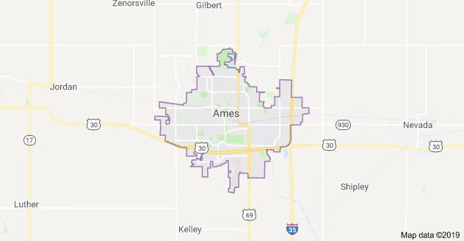
Dataset used
Dataset used from Kaggle Competition
Dataset contains house sales price and its other features for houses sold in Ames
House price dataset consists of around 3000 records with 80 feature variables
Feature variables consists of both Numerical and Categorical data
Used two sets of feature variables to predict housing price, by using multivariate techniques on regression models

Slide 6
Benefits and Impact
Multiple sets of feature variables help to find relationships between several variables simultaneously.
From this analysis can use most influencing feature variable sets to get effective prediction.
This gives multivariate analysis a decisive advantage over other forms of analysis

Slide 7
Solution Discussion
This is an open source Kaggle regression project. This project can be implemented in many ways. But here I followed advanced regression techniques like random forest and gradient boosting.
Analysis of data is done on Multivariate regression on two sets of features.
SET 1 feature - ['OverallQual', 'GrLivArea', 'GarageCars', 'GarageArea', 'TotalBsmtSF', '1stFlrSF', 'FullBath', 'YearBuilt','YearRemodAdd', 'GarageYrBlt', 'TotRmsAbvGrd']
SET 2 feature - ['OverallQual', 'OverallCond', 'YearBuilt', 'CentralAir', '1stFlrSF', '2ndFlrSF', 'BedroomAbvGr' ,'YrSold' ]
Age = YearBuilt - YrSold

Slide 8
Solution Discussion.. (contd.)
Train Data
P. Train Data
Raw Data
Pre-Processing
Test Data
P. Test Data
Preprocessing- Converting raw data into understandable form to ease the analysis further. Finding redundant and missing values (House price dataset scope of missing value is high rather than redundant data)In this dataset NaN values were present in numerical as well categorical columns and filling NaN values with sensible values.
Using LabelEncoder of scikit-learn package converted categorical data into numeric data for easy analysis. OneHotEncoding was done on the processed training and testing datasets.

Slide 9
Solution Discussion.. (contd.)
Data Analysis - Before applying any model, analyze our dataset (P.Train Data) and study the different parameters and relationship between these parameters.
Take a look at the response variable “Sale Price”. It’s positively skewed; most houses sold for between $100,000 and $250,000, but some sold for substantially more.
To maximize the performance of our model, we want to normalize our features and response variable. By applying a log transformation, Sale Price now resembles a normal distribution

Slide 10
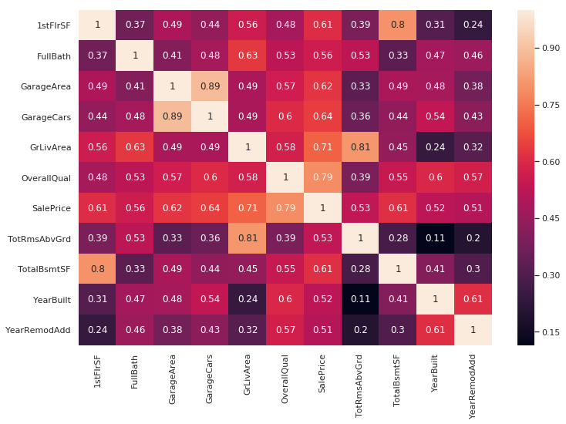
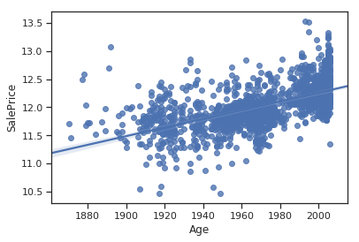
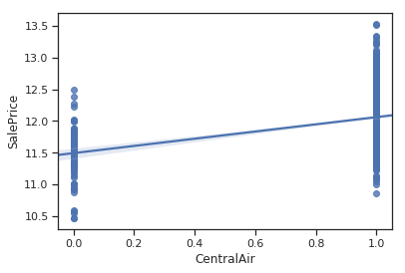
Solution Discussion.. (contd.)
Heatmap for maximum correlating parameters with respect to ‘SalePrice’
Apart from correlation map, pair plot visualization, further verify sales price with few other features on basic domain idea
Age increases,
sales price decreases
Presence of CentralAir increases SalesPrice
Training- Once we gained the insight of our dataset, we are ready to build our model. Since our label data is continuous in nature need to fit regression model

Slide 11
Challenges
Domain knowledge – By referring to similar domain specific research papers
Feature selection – Using different levels of co-relations
Regression model selection and tuning – By continuous practice

Slide 12
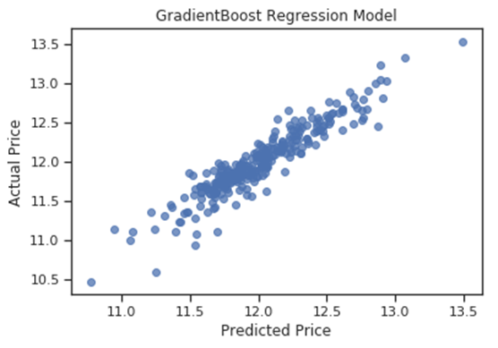
Results
Performed predicting House Sale price on 2 sets of feature variables. Using Linear Regression (LR), Random Forest (RF) and Gradient Boost (GBR).
Gradient Boosting Regressors are trees that function on boosting. Boosting is a mechanism in which samples which were not fit well in a tree are given higher probability to be utilized in the next tree. In this way, the algorithm focuses on increasing accuracy of prediction on all samples sequentially. Boosting takes advantage of weak learners and perfects them one by one. Using Gradient Boosting Regressors, the cross-validation accuracy jumped up to 87.50% and the RMSE was down to 0.02.
GBR predictions and actual prices are comparatively closer

Slide 13
Future work
House sales price prediction can be done in many different ways such as using Neural Networks, SVM etc. And even anyone can try with different sets of feature combinations. Feature may include Neighborhood, Class, CentralAir etc.

Slide 14
Summary
I have built a model using 3 regression methods on 2 sets of features to predict the house prices. Provided step by step analysis on dataset. Key steps include assigning appropriate values for NAs, normalizing variables, optimizing hyperparameters for candidate models and choosing the best model
Gradient Boosting Regression method gave 87.5% accuracy and low RMSE 0.02

Slide 15


