Slide 1


AGE GROUP ESTIMATION AND GENDER RECOGNITION USING FACIAL FEATURES
RNS INSTITUTE OF TECHNOLOGY
BENGALURU - 98
DEPARTMENT OF INFORMATION SCIENCE & ENGINEERING
VIII Semester
Presentation on
MADHURI M G USN:1RN16IS047
MAYANK KHERIA USN:1RN16IS051
MADHURA J USN:1RN16IS046
PAREESHMA P K USN:1RN16IS062
Under the guidance of:
Mr .T S Bhagavath Singh
Associate Professor
Dept of ISE, RNSIT

Slide 2
AGENDA
Abstract
Introduction
Literature Review
Objectives
System Requirements
System Design
Implementation
Results
Applications
Conclusion
Future Enhancement
References

Slide 3
ABSTRACT
The face recognition is one of the biometric methods to identify individuals by features of the face. A complete face recognition includes two patterns of face detection and face recognition. And these can be achieved using machine learning techniques.
A problem of personal verification and identification is an actively growing area of research and security areas.
Image processing is a method to perform some operations on an image, in order to get an enhanced image or to extract some useful information from it.

Slide 4
It is a type of signal processing in which input is an image and output may be image or characteristics/features associated with that image.
Nowadays, image processing is among rapidly growing technologies. It forms core research area within engineering and computer science disciplines too.
Facial features are considered as high level personal trait in the field of security, law enforcement application and attendance system. Certain applications uses facial features to unlock and to detect the right person identification. Irrespective of age and position of an individual the gender of an individual has to be detected.

Slide 5
INTRODUCTION
The face is one of the most common biometric characteristics used by humans to make a personal recognition.
People have a considerable ability to identify, extract and interpret information related to human face. Due to the nearly exponential growth of the rate of face images uploaded to the internet over the last decade.
Age and gender are two demographic attributes that influence the morphology and appearance of a face. Facial age estimation refers to the automatic labeling of age groups or the specific ages of individuals based on features extracted from the face.

Slide 6
With the progress of age, the appearance of human faces exhibits remarkable changes related to its contour, the shape of facial features (eyes, nose, mouth, etc.) and its distribution, the skin pigmentation and the emergence of wrinkles, among others.
Gender classification, on the other hand, is the process of automatically assigning one of the two sex labels (male/female) to a facial image. Studies have shown that human observers can easily differentiate between a male and female, achieving an accuracy above 95% based on looking at the face. However, the accuracy rate reduces to just above chance when considering child faces once again, what represents a challenge to some extent for humans, becomes a much greater challenge for computer vision systems.

Slide 7
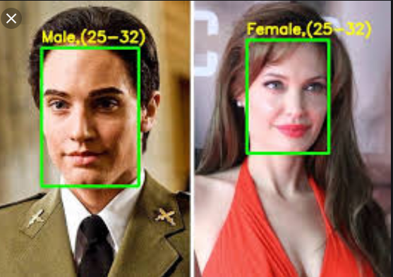

Slide 8
LITERATURE REVIEW
An extensive review of the research undertaken in the domain related to face recognition along with the gender classification and facial age estimation from the face image.
Every technical and IEEE papers have their own features which elaborate about particular technique with certain methodology. It contains both advantages and drawbacks.
IEEE papers :

Slide 9
Sl no | Title of paper | Author | Publication | Techniques used
01 | Gender Identification Using Frontal Facial Images | Amit Jain, Jeffrey Huang and Shiaofen Fang | IEEE 2005 | Cosine classifier, (LDA)Linear Discriminant classifier, Support Vector Machine-SVM
Advantages:
It uses ICA(Independent Component Analysis) which reduces the dimensions of the data.
This paper deals with use of 2D-facial images for gender classification .
Disadvantages:
Not applicable for 3D-facial images.
Computational cost is high for 3D configuration.

Slide 10
Sl no | Title of paper | Author | Publication | Techniques used
02 | Robust Face Recognition via Sparse Representation | John Wright , Allen Y. Yang, Arvind Ganesh | IEEE 2009 | Sparse feature selection method
Advantages:
Provides framework for two crucial issues: feature extraction and robustness.
Applicable for high-classification of high-dimensional data as well as for corrupted images.
Disadvantages:
Not applicable for object detection.

Slide 11
Sl no | Title of paper | Author | Publication | Techniques used
03 | Age Synthesis and Estimation via Faces: A Survey | Yun Fu , Guodong Guo, Thomas S.Huang | IEEE 2010 | Support Vector Machine(SVM), Support Vector Regression (SVR)
Advantages:
Individual’s face is considered who’s image of different ages are estimated by age synthesis and age estimation.
The image is identified irrespective of face expressions.
Disadvantages:
General model implementation is difficult.
3D and non-frontal faces cannot be used for estimation.

Slide 12
Sl no | Title of paper | Author | Publication | Techniques used
04 | Facial Image Classification Based on Age and Gender | Thakshila R.Kalansuriya, Anuja T. Dharmaratne | IEEE 2013 | Artificial Neural Network(ANN) classifier for age, LBP for gender classification
Advantages:
Face detection in videos are implemented giving less accuracy comparitively which is an advanced implementation.
Disadvantages:
Cannot detect age of babies and children under 8 years old and elders above 64 years.

Slide 13
Sl no | Title of paper | Author | Publication | Techniques used
05 | Age Estimation and Gender Classification of facial images based on local directional pattern | Min Hu, Yoana Zheng, Fuji Ren, He Jiang | IEEE 2014 | Support Vector Machine(SVM) classifier, Local Directional Pattern(LDP)
Advantages:
LDP is an extraction algorithm which improves age and gender recognition rate effectively with robustness for noise is better.
Ear and hair is also considered as a part of face recognition.
Used in paper advertisements.
Disadvantages:
Complexity is high.

Slide 14
Sl no | Title of paper | Author | Publication | Techniques used
06 | Age Group Classification and Gender Detection Based on Forced Expiratory Spirometry | Sema Cosgun, I. Yucel Ozbek | IEEE 2015 | Guassian Mixture model classifier (GMM) , Support Vector Machine(SVM) classifier
Advantages:
Can be used for large databases.
FES gives high accuracy comparitively for classification.
Disadvantages:
Age classification is priortized than gender recognition.
Less compatibility in new images detections.

Slide 15
Sl no | Title of paper | Author | Publication | Technique used
07 | Facial expression recognition: A survey | Jyoti Kumari , R.Rajesh, K.M Pooja | ELSEVIER 2015 | Local binary pattern, Local gradient code, Local directional pattern(feature extraction method)
Advantages:
Quick survey of facial expressions.
Less noise in the time of processing compared to many techniques.
Disadvantages:
Provides less accuracy for dynamic images and sequence of images(videos).

Slide 16
Sl no | Title of paper | Author | Publication | Techniques used
08 | Texture-based estimation of age and gender from wild conditions | Aswathy Unnikrishnan, Ajesh F, Dr. Jubilant J Kizhaketotam | ELSEVIER 2015 | Support Vector Machine (SVM), KNN
Advantages:
Video-based, sketch-based, near-infrared face recognition is detected and estimated.
Disadvantages:
Multi-hidden layer is not learned by model.

Slide 17
Sl no | Title of paper | Author | Publication | Techniques used
09 | Face Recognition System Using Genetic Algorithm | Prathibha Sukhija, Sunny Behal, Pritpal Singh | ELSEVIER 2016 | Principle Component Analysis(PCA), Linear Discriminate Analysis(LDA)
Advantages:
The proposed method is the challenging aspect in the field of image analysis and computer vision.
It detects the unknown images and classifies with the database images.
Disadvantages:
PCA and LDA methods gives less accuracy comparitively than many other methods.

Slide 18
Sl no | Title of paper | Author | Publication | Technique used
10 | Age Group and Gender Estimation in the Wild With Deep RoR Architecture | Ke Zhang | IEEE 2017, Special section based on recent advantages of computer vision based on Chinese conference on computer vision 2017 | RoR(residual networks of residual networks) architecture , IMDB-WIKI-101
Advantages:
RoR can be used for high resolution images.
Better performance by fine tuning of dataset.
Reduced overfitting problem.
Disadvantages:
Noisy images tuning is difficult if there are large datasets.

Slide 19
Sl no | Title of paper | Author | Publication | Technique used
11 | Research on Face Recognition Based on Deep Learning | Xia Han , Qingdong Du | IEEE 2018 | CNN, Linear encoder
Advantages:
Linear encoding is uses pooling concept which enables large computation, good robustness and reduced complexity of network computing.
Disadvantages:
Network performance is low.
Hard to evaluate and judge the input characteristics.
Not applicable for 3D models.

Slide 20
Sl no | Title of paper | Author | Publication | Technique used
12 | Face Recognition and Age Estimation Implications of Changes in Facial Features: A Critical Review Study | Rasha Atallah, Amirrudin Kasim, Maizatul Akmar Ismail, Sherin Abdelrahman, Saber Zerdoumi | IEEE 2018 | Support Vector Machine(SVM), Deep Convolutional Neural Network(CNN) model, (SVR)Support Vector Regression
Advantages:
New born baby face detection.
Simple technique with large database.
Useful to find child face features.
Disadvantages:
In the presence of facial hair, sunglasses etc it is difficult to classify.
No graphical user interface recognition of face.

Slide 21
Sl no | Title of paper | Author | Publication | Technique used
13 | Wide Residual Networks | Sergey Zagoruyko, Nikos Komodakis | IEEE 2017 | Wide resnet technique
Advantages:
Simple technique with large database.
The architecture is used which decrease depth and increase width of residual networks.
Wide residual networks are several times faster to train.
Disadvantages:
Cannot compute in extreme deep.

Slide 22
SYSTEM REQUIREMENTS
HARDWARE
RAM 2GB or higher
I3/i5 processor
SOFTWARE
Programming language: Python 3.5
OS 64 bit :Windows 10
Back end : TensorFlow 1.4.0, Keras 2.0.8,cv2
Front end: Xml
IDE : Jupyter notebook

Slide 23
OBJECTIVES
The main objective of this project is:
To learn face features and recognise the gender and estimate the age with the additional GUI property.
To concentrate on overcoming certain drawbacks like noise, improper distance between face parts and low resolution images.
To provide accurate estimation of age.
To recognise face and determine gender irrespective of face position and distance(certain level).

Slide 24
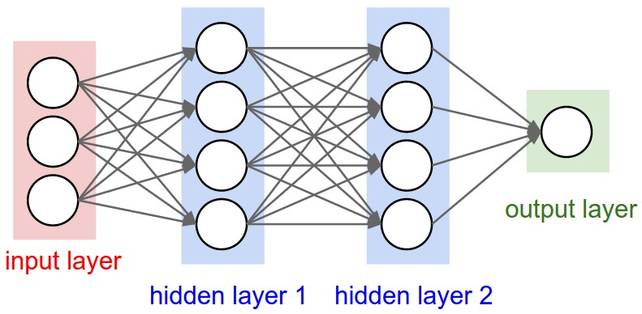
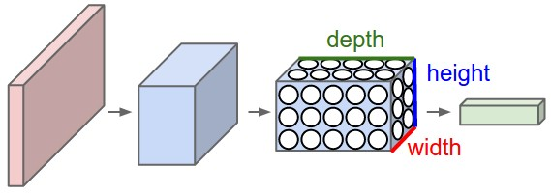
CNN(Convolutional Neural Network)
ConvNet architectures make the explicit assumption that the inputs are images.
The last fully-connected layer is called the “output layer” and in classification settings it represents the class scores.

Slide 25
INPUT [32x32x3] will hold the raw pixel values of the image.
CONV layer will compute the output of neurons that are connected to local regions in the input
This may result in volume such as [32x32x12] if we decided to use 12 filters.
RELU layer will apply an elementwise activation function, such as the max(0,x) thresholding at zero.
POOL layer will perform a downsampling [16x16x12].
FC (i.e. fully-connected) layer will compute the class scores, resulting in volume of size [1x1x10].
The parameters in the CONV/FC layers will be trained with gradient descent so that the class scores that the ConvNet computes are consistent with the labels in the training set for each image

Slide 26
ReLU (Rectified Linear Unit)
In a neural network, the activation function is responsible for transforming the summed weighted input from the node into the activation of the node or output for that input.
Instead of sigmoids, most recent deep learning networks use rectified linear units (ReLUs) for the hidden layers. A rectified linear unit has output 0 if the input is less than 0, and raw output otherwise. That is, if the input is greater than 0, the output is equal to the input. ReLUs' machinery is more like a real neuron in our body.
The rectified linear activation function is a simple calculation that returns the value provided as input directly, or the value 0.0 if the input is 0.0 or less.
F(x)=max(x,0)

Slide 27
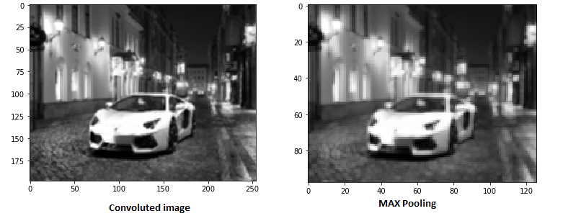
Max pooling
Sometimes when the images are too large, we would need to reduce the number of trainable parameters. It is then desired to periodically introduce pooling layers between subsequent convolution layers.

Slide 28
SOFTMAX FUNCTION
The softmax function squashes the outputs of each unit to be between 0 and 1, just like a sigmoid function. But it also divides each output such that the total sum of the outputs is equal to 1.
The output of the softmax function is equivalent to a categorical probability distribution, it tells you the probability that any of the classes are true.
Softmax function outputs a vector that represents the probability distributions of a list of potential outcomes.

Slide 29
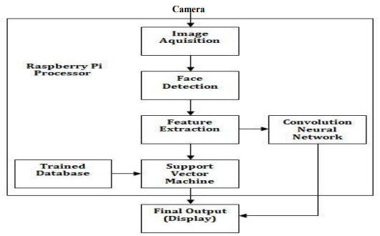
SYSTEM DESIGN
Binary Classification
Wide Resnet technique
Binary Classification
Age
Gender
Flowchart of overall system design

Slide 30
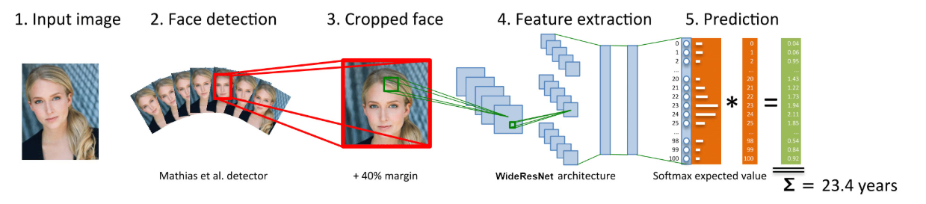
An overview of how it works
Steps:
Input image
Face Detection
Cropped Face
Feature Extraction
Prediction

Slide 31
IMPLEMENTATION
Implementation of this model is shown in the below steps using the following techniques.
Input image:
First, the photo is taken from the webcam stream live by the cv2 module. To capture live stream with camera, OpenCV is used which provides a very simple interface to this. To capture a video, a VideoCapture object is created. Its argument can be either the device index or the name of a video file. Device index is just the number to specify which camera. Normally one camera will be connected. So it is simply passed with 0 (or -1). After that, we can capture frame-by-frame.

Slide 32
# 0 means the default video capture device in OS video_capture = cv2.VideoCapture(0)
# infinite loop, break by key ESC
while True:
if not video_capture.isOpened():
sleep(5)
# Capture frame-by-frame
ret, frame = video_capture.read()

Slide 33
Face Detection:
Second, we turn the image to grayscale and use the cv2 module's CascadeClassifier class to detect faces in the image.
The variable faces return by the detectMultiScale method is a list of detected face coordinates [x, y, w, h].
cvtColor() method is used to convert an image from one color space to another. There are more than 150 color-space conversion methods available in OpenCV.
The above method is passed with 2 arguments where one is frame(input image) and another is type of conversion.

Slide 34
gray = cv2.cvtColor(frame, cv2.COLOR_BGR2GRAY)
faces = face_cascade.detectMultiScale(
gray,
scaleFactor=1.2,
minNeighbors=10,
minSize=(self.face_size, self.face_size) )
Since we are converting image to grayscale (or gray level) image is simply one in which the only colors are shades of gray.
The reason for differentiating such images from any other sort of color image is that less information needs to be provided for each pixel.

Slide 35
Cropped face:
After known the faces' coordinates, we need to crop those faces before feeding to the neural network model.
We add the 40% margin to the face area so that the full head is included.
Face is cropped using crop_face method giving frame as the input.
cv2. rectangle() method is used to draw a rectangle on any image color: It is the color of border line of rectangle to be drawn. For BGR, we pass a tuple.
Eg: (255, 0, 0) for blue color.

Slide 36
# placeholder for cropped faces
face_imgs = np.empty((
len(faces),
self.face_size,
self.face_size, 3))
for i, face in enumerate(faces):
face_img, cropped = self.crop_face(frame,
Face,
margin=40,
size=self.face_size)
(x, y, w, h) = cropped cv2.rectangle(frame,
(x, y),
(x + w, y + h),
(255, 200, 0), 2)
face_imgs[i,:,:,:] = face_img

Slide 37
Feature Extraction:
Then we are ready to feed those cropped faces to the model, it's as simple as calling the predict method.
Here we are using Wide Resnet architecture to predict age.
For the age prediction, the output of the model is a list of 101 values associated with age probabilities ranging from 0~100, and all the 101 values add up to 1 (or what we call softmax).The image is processed using wide resnet technique.
So we multiply each value with its associated age and sum them up resulting final predicted age.
In hidden layer ReLU is used as activation function and in output layer softmax function as activation function.

Slide 38
if len(face_imgs) > 0:
# predict ages and genders of the detected faces
results = self.model.predict(face_imgs)
predicted_genders = results[0]
ages = np.arange(0, 101).reshape(101, 1)
predicted_ages = results[1].dot(ages).flatten()
The feature extraction part of the neural network uses the WideResNet architecture, short for Wide Residual Networks. It leverages the power of Convolutional Neural Networks to learn the features of the face. From less abstract features like edges and corners to more abstract features like eyes and mouth.

Slide 39
WIDE RESNET NETWORK
What is WRNs(Wide Resnet)?
The “depth” of a neural network is the number of layers, but “width” usually refers to the number of neurons per layer, or for convolutional layers, the number of feature maps per layer.
Residual block with identity mapping can be represented by the following formula:
xl+1 =xl +F(xl,Wl) where
xl+1 and xl are input and output of the l-th unit in the network,
F is a residual function and
Wl are parameters of the block.

Slide 40
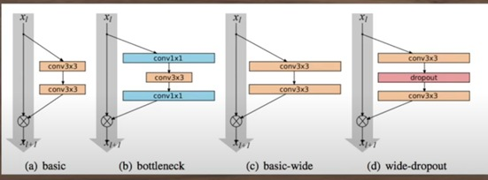
Working Architecture of WRN

Slide 41
In residual networks consisted of two type of blocks:
basic - with two consecutive 3×3 convolutions with batch normalization and ReLU preceding convolution: conv3×3-conv3×3
bottleneck - with one 3×3 convolution surrounded by dimensionality reducing and expanding 1×1 convolution layers: conv1×1-conv3×3-conv1×1.
Original architecture is equivalent to k=1. Groups of convolutions are shown in brackets where N is a number of blocks in group, down sampling performed by the ﬁrst layers in groups conv3 and conv4. Final classiﬁcation layer is omitted for clearance. In the particular example shown, the network uses a ResNet block of type B(3,3).

Slide 42
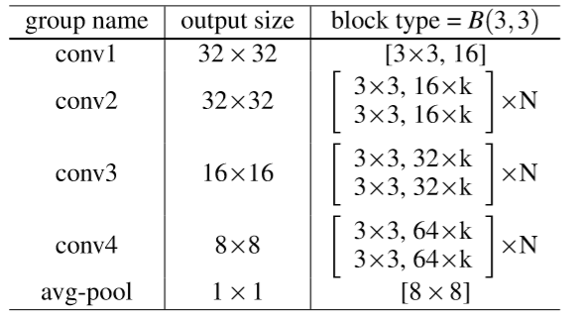
Structure of wide residual networks

Slide 43
Why WRNs?
Deep residual networks were shown to be able to scale up to thousands of layers and still have improving performance. However, each fraction of a percent of improved accuracy costs nearly doubling the number of layers, and so training very deep residual networks has a problem of diminishing feature reuse, which makes these networks very slow to train.
To tackle these problems, the architecture is used which decrease depth and increase width of residual networks. The resulting network structure is wide residual networks (WRNs)

Slide 44
Prediction
Last but not least we draw the result and render the image. The output of wide resnet technique outputs the value of age ranges and on applying binary classification on it the gender is recognized.
for i, face in enumerate(faces):
label = "{}, {}".format(int(predicted_ages[i]),
"F" if predicted_genders[i][0] > 0.5 else "M") self.draw_label(frame, (face[0], face[1]), label) cv2.imshow('Keras Faces', frame) if cv2.waitKey(5) == 27:
# ESC key press break

Slide 45
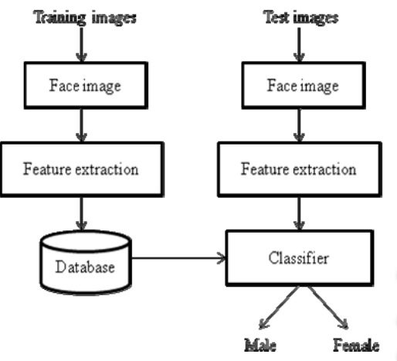
BINARY CLASSIFICATION
The goal of a binary classification problem is to make a prediction that can be one of just two possible values.The gender prediction is a binary classification task. The model outputs value between 0~1, where the higher the value, the more confidence the model think the face is a male.The output of wide resnet is used and using binary qualification gender is recognized from the image captured.

Slide 46
RESULTS
Output: Age- Output age group ranges between 0-100
Ranges are :
0-18
19-35
36-55
56-75
76-100
Gender- M for Male
F for Female

Slide 47
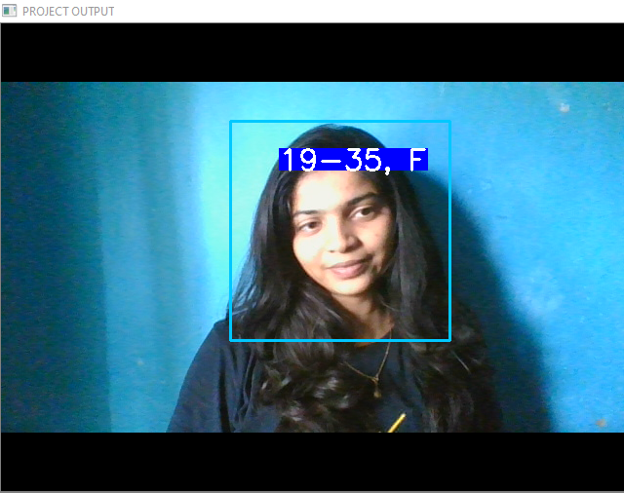
O1: One face detection Gender->F(female) Age->19-35

Slide 48
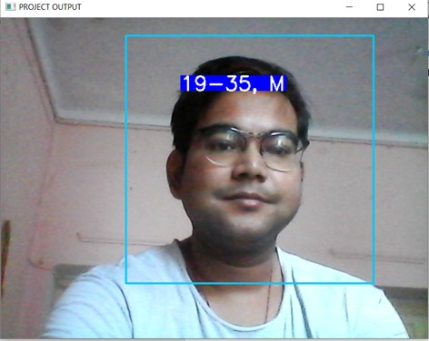
O2: One face detection Gender->M(Male) Age->19-35

Slide 49
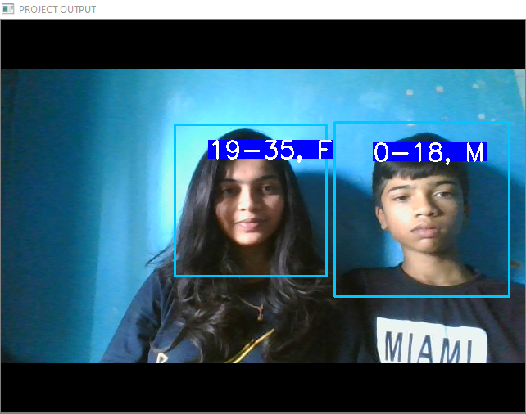
O3: Two face detection
Face1: Gender->F Age->19-35
Face2: Gender->M Age->0-18

Slide 50
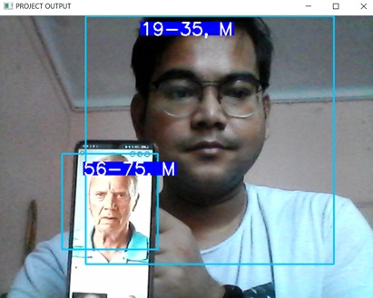
O4: Two face detection
Face1: Gender->M Age->19-35
Face2: Gender->M Age->56-75

Slide 51
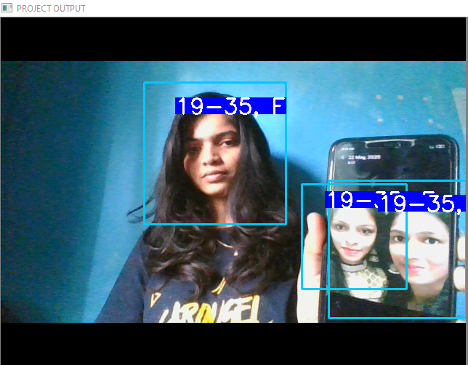
O4: Three face detection(with 2 faces in photo)
Face1: Gender->F Age->19-35
Photo Face2: Gender->F Age->19-35
Photo Face3: Gender->F Age->19-35

Slide 52
APPLICATIONS
Access Control
Mobile Applications
Video Surveillance
Government related applications
Identity Cards
Forensic applications
Biometrics
Intelligent marketing
Attendance system and many more

Slide 53
CONCLUSION
Gender recognition and age estimation plays a prominent role in many applications.
The techniques which will be used gives good accuracy removing noise in images.
Simple technique and user friendly and can easily be implemented in simple systems.
Reduces the complexity of face detection is many fields.
Easily accessible.

Slide 54
FUTURE ENHANCEMENT
Our model can be modified to display information of previously read or stored face data of a person as like used in google photos.
Classifying the images of every individual to separate dataset and storing at one particular set for easy access of individual person’s images.
More accuracy and less fluctuation with the better training dataset to get good performance rate to model.

Slide 55
REFERENCES
Technical paper on analysis on gender classificationand age estimation approaches by Kanwal Deep Kaur.
Gender classification techniques-From machine learning to deep learning by Ranjeet Singh and Mohit Kumar.
Age and gender recognition in the wild with deep attention by Pau Rodriguez.
Age group estimation and gender recognition using face features by Prajakta A. Melange.
IEEE “Gender Identification Using Frontal Facial Images ” by Amit Jain, Jeffrey Huang and Shiaofen Fang, 2005.
IEEE “Robust Face Recognition via Sparse Representation” by John Wright,Allen Y. Yang, Arvind Ganesh, 2009.

Slide 56
IEEE “Facial Image Classification Based on Age and Gender ” by Thakshila R.Kalansuriya, Anuja T. Dharmaratne,2013.
IEEE “Age Estimation and Gender Classification of facial images based on the local directional pattern” by Min Hu,Yoana Zheng,Fuji Ren,He Jiang, 2014.
IEEE “Age Group Classification and Gender Detection Based on Forced Expiratory Spirometry” by Sema Cosgun, I. Yucel Ozbek, 2015.
ELSEVIER “Facial expression recognition: A survey” by Jyoti Kumari, R.Rajesh, K.M Pooja, 2015.
ELSEVIER “Texture-based estimation of age and gender from wild conditions”, by Aswathy Unnikrishnan, Ajesh F,Dr. Jubilant J Kizhaketotam, 2015.
ELSEVIER “Face Recognition System Using Genetic Algorithm” by Prathibha Sukhija, Sunny Behal,Pritpal Singh, 2016.

Slide 57
THANK YOU

