Slide 1

Continuous Integration &
Continuous Deployment

Slide 2
CICD & its Implementation
I
Need for DevOps & Its Evolution
II
Continuous Integration & its benefits
III
Continuous Deployment & its benefits

Slide 3
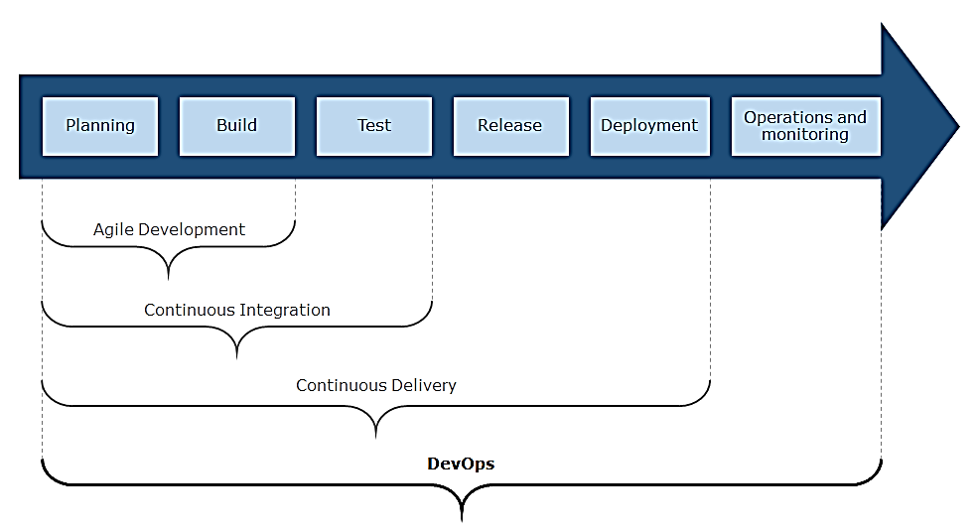
Transition from Agile to DevOps… To be able to deliver features faster and thereby accelerate time to market, while ensuring higher quality and cost efficiency

Slide 4
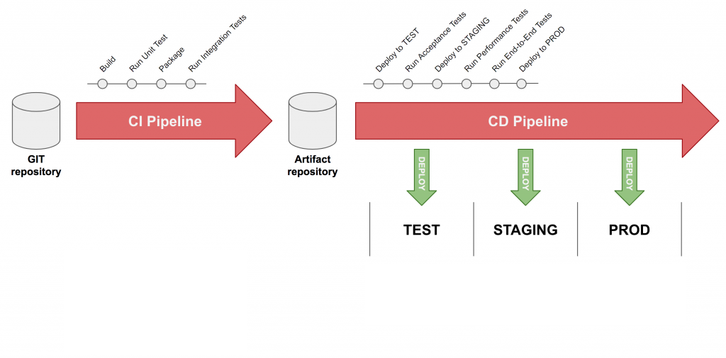
Continuous Integration and Continuous Deployment

Slide 5
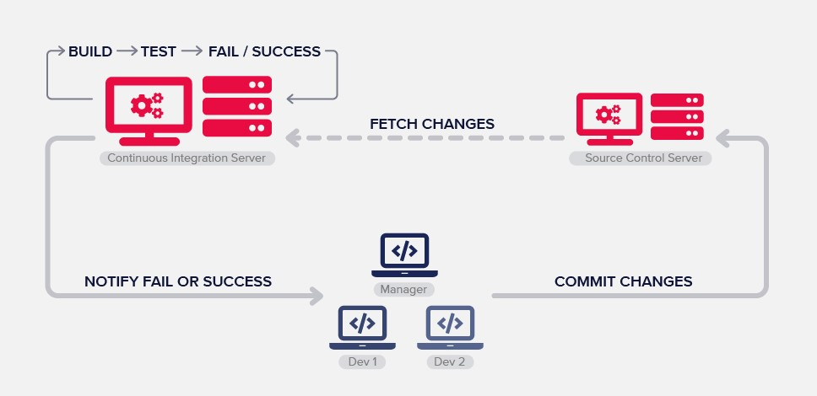
Continuous Integration
Continuous Integration (CI) is a development practice where developers integrate code into a shared repository frequently, preferably several times a day

Slide 6
Benefits of Continuous Integration
Say
Say goodbye to long and tense integrations
Increase
Increase visibility enabling greater communication
Catch
Catch issues early and nip them in the bud
Spend
Spend less time debugging and more time adding features
Build
Build a solid foundation
Stop
Stop waiting to find out if your code’s going to work
Reduce
Reduce integration problems allowing you to deliver software more rapidly

Slide 7
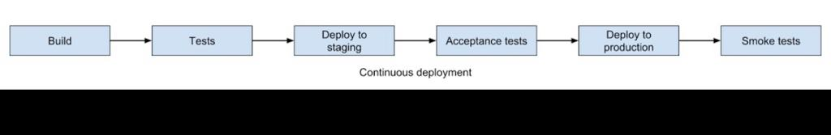
Continuous Deployment
Continuous Deployment (CD) is a software release process that uses automated testing to validate if changes to a codebase are correct and stable for immediate autonomous deployment to a production environment.

Slide 8
Benefits of Using Continuous Deployment
Eliminate DIY for Continuous Delivery and increase the focus on the product.
Automate the repetitive tasks and focus on actual testing.
Connect your existing tools and technologies (such as CI providers, DevOps tools, or scripts) into a harmonious workflow.
Integrate teams and processes with a unified pipeline.
Create workflows across the development, testing, and production environments
Provide a single view across all applications and environments.
Improve overall productivity.

Slide 9
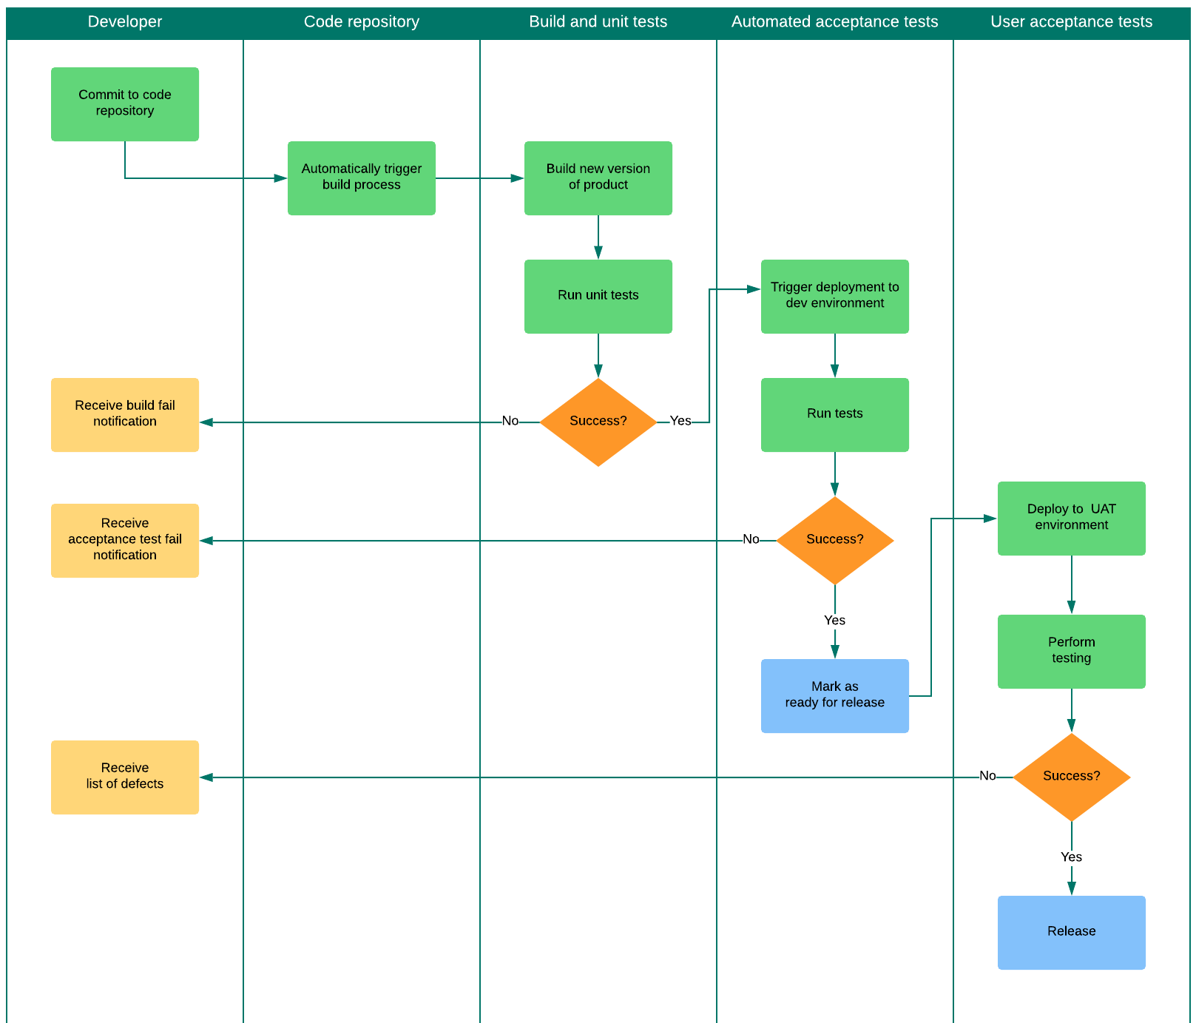
Continuous Deployment Process Flow

Slide 10
Thank You

