Slide 1

MEMRACE: Smart Learning Platform
by
S. MADHURI
Roll No. 224G1A0543
K. VISHNU SAI
Roll No. 224G1A05C4
I. VENKATA CHANDRA SEKHAR REDDY
Roll No. 224G1A05C1
Under the guidance of
Dr. P. Veera Prakash, M.Tech., Ph.D
Assistant Professor
Department of Computer Science and Engineering
Srinivasa Ramanujan Institute of Technology
Autonomous
Rotarypuram Village, B K Samudram Mandal, Ananthapuramu – 515701.
2025-2026
A - 01
Department of Computer Science and Engineering
Srinivasa Ramanujan Institute of Technology
01

Slide 2
Contents
MEMRACE: Smart learning Platform
Title Justification
Abstract
Problem statement
Objectives of Project
Literature survey for objectives
Proposed Work -(Methods to be followed for proposed system)
References
GitHub Link
Queries
Srinivasa Ramanujan Institute of Technology

Slide 3
Title Justification
MEMRACE: Smart learning Platform
The title “MEMRACE – Smart Learning Platform” is suitable because the project focuses on improving memory and learning speed through intelligent revision techniques. The word MEM represents memory and RACE represents the competition to improve performance. Since the platform provides adaptive quizzes, spaced repetition, and gamification to help students strengthen learning efficiency, the title clearly reflects the purpose and core functionality of the project.
Srinivasa Ramanujan Institute of Technology

Slide 4
Abstract
MEMRACE: Smart learning Platform
Students struggle with long-term retention and consistent revision, while teachers face difficulty creating engaging assessments quickly.
Tools like AnkiDroid (spaced repetition) and Kahoot (interactive quizzes) exist but work in isolation and lack AI-driven personalization.
MemRace provides a unified platform with AI-generated flashcards, adaptive revision, gamified quizzes, and real-time analytics to support both learners and educators.
It uses machine learning, adaptive spaced-repetition algorithms, scalable database architecture, and a modern 21st.dev UI for smart, efficient learning, memorization techniques.
Achieves faster content creation for teachers, improved memory retention for students, and higher engagement through personalized insights and gamified learning.
Srinivasa Ramanujan Institute of Technology

Slide 5
Problem Statement
MEMRACE: Smart learning Platform
Traditional learning practices do not adapt to student performance and do not provide revision reminders, which causes forgetting of studied concepts.
Students find it difficult to track weak topics, manage regular practice, and maintain motivation. Manual revision planning becomes time-consuming and ineffective.
Therefore, a smart learning system is required that personalizes learning behaviour, automates revision scheduling, and tracks performance efficiently to enhance long-term memory retention.
Srinivasa Ramanujan Institute of Technology

Slide 6
Objectives of Project
MEMRACE: Smart learning Platform
Research Objective 1:
To develop a smart and adaptive learning platform that provides personalized quizzes, timely revision using spaced-repetition, and quick concept recall through flashcards, so that students can improve long-term memory retention efficiently.
Research Objective 2:
To enhance student engagement and performance transparency by offering gamification features such as badges, points, and leaderboards, along with analytics on accuracy, weak topics, and learning progress for continuous improvement.
Srinivasa Ramanujan Institute of Technology

Slide 7
MEMRACE: Smart learning Platform
Literature survey for objectives
No | Title | Author | Journal Name & Year | Methodology / Approach Used | Key Findings | Gaps Identified
1 | Adaptive E-Learning System for Personalized Education | Kumar & Rao | Int. Journal of Smart Education, 2020 | Performance-based adaptive learning | Improved user engagement through personalized content | Limited revision support; no memory retention methods
2 | Spaced-Repetition Model for Long-Term Memory | Ashley et al. | IEEE Learning Technologies, 2021 | Spaced repetition scheduling | Significant improvement in long-term retention | No analytics or progress tracking for learning
3 | Gamification in Online Learning Platforms | Sharma & Devi | Springer Education Research Journal, 2022 | Points, badges, leaderboard gamification | Increased learner motivation & participation | Motivation decreases without personalized guidance
4 | Digital Quiz-Based Learning Portal | Prakash & Singh | Journal of Web-Learning Systems, 2023 | Topic-wise quiz system | Easy access to practise questions | No adaptive difficulty; lacks weak topic identification
Srinivasa Ramanujan Institute of Technology

Slide 8
Proposed System
MEMRACE: Smart learning Platform
Our project provides a smart learning platform where only registered users can access courses and assessments.
Teachers upload or AI instantly provides topics and questions, while students learn through adaptive quizzes that adjust difficulty based on their performance.
A spaced-repetition system reminds students to revise at the right time, and flashcards help with quick concept recall.
The platform tracks accuracy, weak topics and progress using analytics, while gamification features like badges, points and leaderboard keep students motivated throughout their learning journey.
Srinivasa Ramanujan Institute of Technology

Slide 9
References
MEMRACE: Smart learning Platform
[1] Kumar, A., & Reddy, S. (2023). Adaptive Learning Models for Smart Education. International Journal of Computer Science (IJCS), 11(3), 55–62.
[2] Ashley, D., & Brown, L. (2022). Memory Retention using Spaced Repetition Techniques. IEEE Conference on Learning Technologies, pp. 1–6.
[3] Sharma, P., & Devi, R. (2021). Gamification Techniques for Motivation in Learning Systems. Springer Journal of Educational Research, 9(2), 88–95.
Srinivasa Ramanujan Institute of Technology

Slide 10
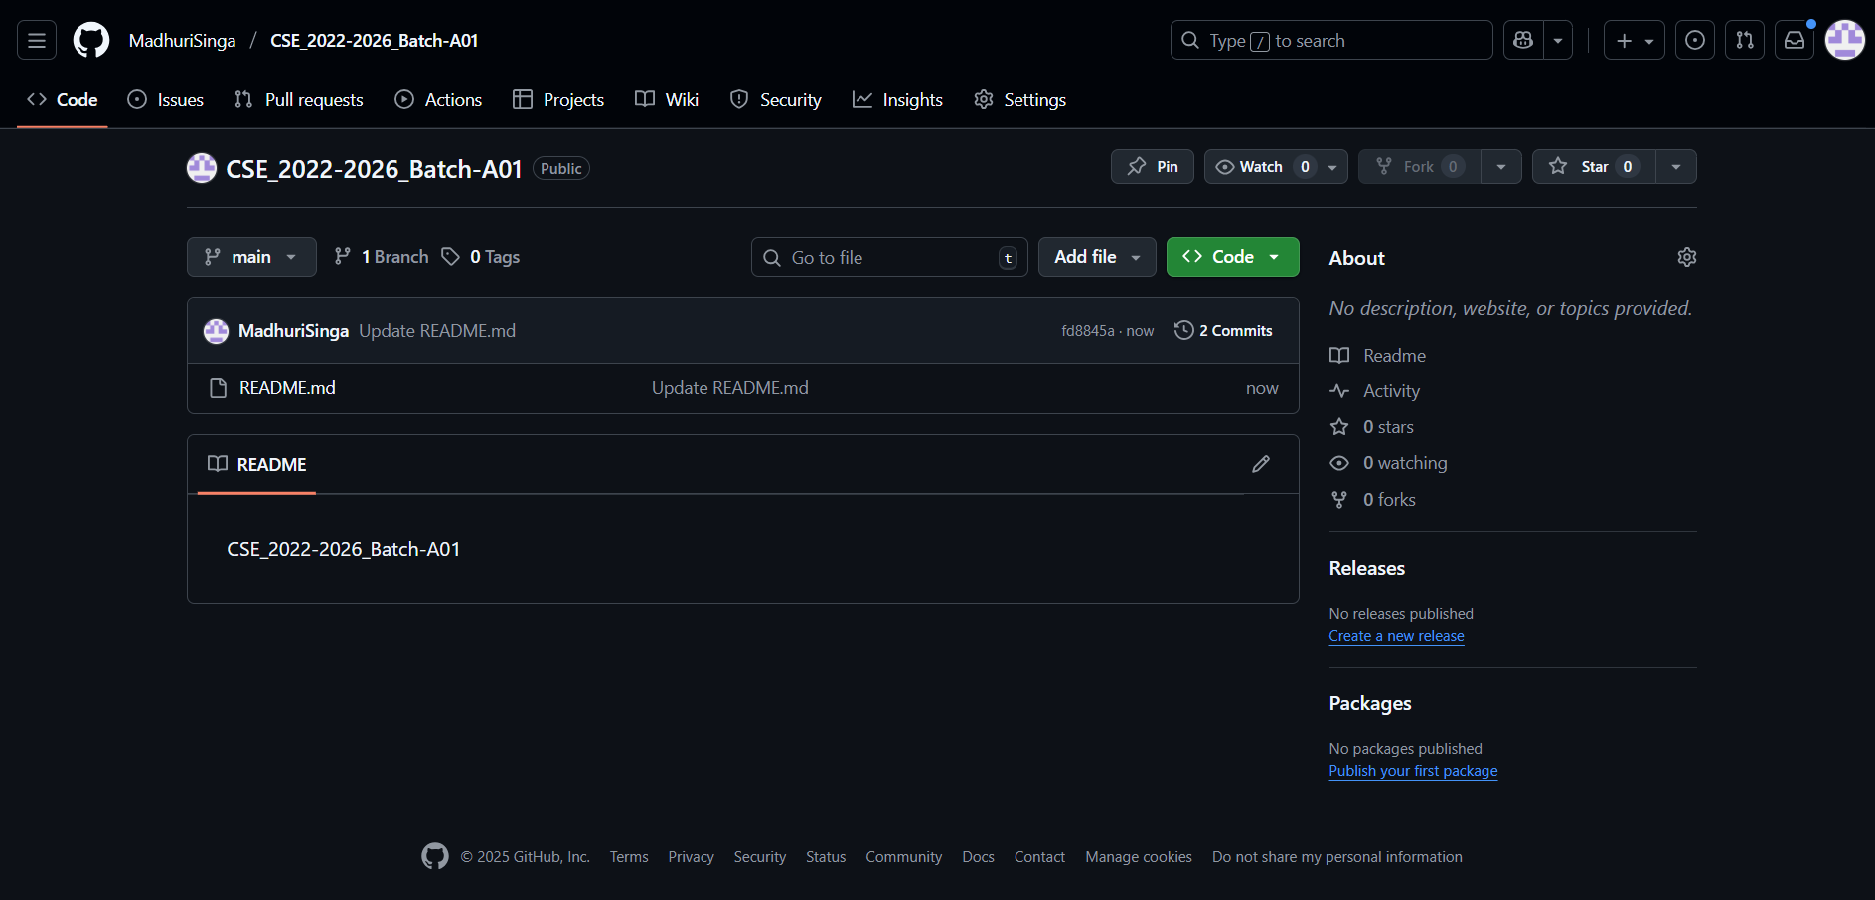
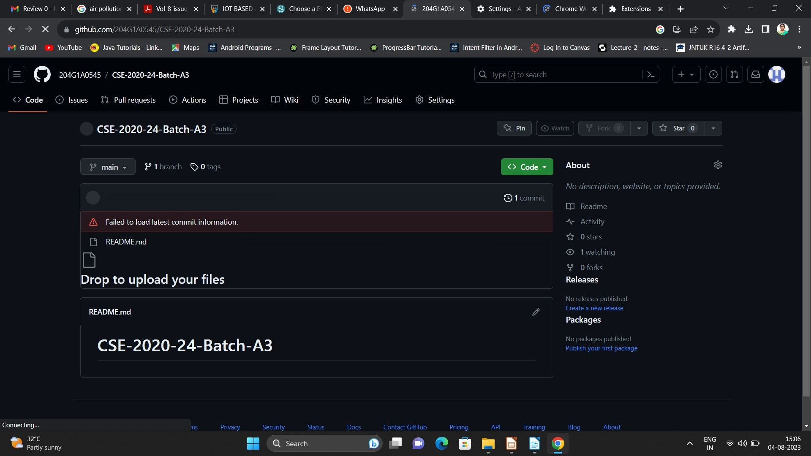
Git Hub Dashboards of each student
MEMRACE: Smart learning Platform
Github Link: https://github.com/MadhuriSinga/CSE_2022-2026_Batch-A01
Srinivasa Ramanujan Institute of Technology

Slide 11
Any Queries?
MEMRACE: Smart learning Platform
Srinivasa Ramanujan Institute of Technology

