Slide 1

STOXIE
‘An app to track and review stock market data’
Sontineni Bhavya Sri Sai | 002893685 Madhuri Tumula | 002892521

Slide 2
INTRODUCTION
Stoxie is a mobile application designed to help users efficiently organize, monitor, and keep track of their favorite stocks.
It features a user-friendly interface, real-time market updates, and a personalized “My Stocks” list.
Stoxie simplifies the stock tracking experience for everyone.

Slide 3

TARGET AUDIENCE
Retail Investors: Beginners and self-managing investors looking for easy-to-use tools, educational resources, and portfolio management features.
Traders and Financial Professionals: Experienced traders, analysts, and advisors seeking advanced analytics, real-time data, and trading solutions.
Young investors: interested in user-friendly platforms, ESG investments, and modern trends like cryptocurrency.
Students and Educators in Finance: Aspiring professionals and institutions requiring simulators, courses, or hands-on stock market learning tools.
Global Investors: International users accessing diverse markets.

Slide 4

PROBLEM STATEMENT
Managing and tracking personal stock investments can be complex for users who lack access to intuitive tools.
Managing multiple stock investments can be overwhelming without an easy-to-use platform.
Need for a platform where users can curate, analyze, and view stock trends seamlessly.

Slide 5




TECHNICAL STACK
Frontend: Flutter (Dart)
UI design and navigation.
Provider for state management.
Backend: Firebase Firestore
Real-time database for user data and stock management.
APIs: Stock Market API (finnhub.io).
Fetch real-time stock prices and details.
Tools & Platforms:
Android Studio/Xcode for app testing.
GitHub for version control.
Firebase Authentication for user login.

Slide 6
APP OVERVIEW
1. Login Screen → My Stocks Screen.
2. My Stocks Screen →
Choose Stocks Screen (Add button).
Stock Price Screen (Select stock).
Settings Screen (Settings icon).
3. Choose Stocks Screen → My Stocks Screen (After adding stocks).
4. Stock Price Screen → My Stocks Screen (Back button)
5. Top Stocks Screen → Stock Price Screen (Select stock)
6. Newsfeed Screen → My Stocks Screen (Back button)
7. Settings Screen → My Stocks Screen (Back button)

Slide 7

TESTING
Unit Testing:
Verifying core functionalities like: • Search • Stock addition • Fetching data
Integration Testing:
UI components integrated with Firebase functionality
Manual Testing:
Real-world tests performed on: • Android devices • iOS devices

Slide 8
DETAILED EXPLANATION

Slide 9
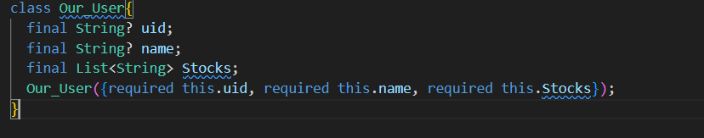
USER_MODEL.DART
Purpose: Defines the structure of a user within the application.
Attributes:
Constructor: The Our User constructor ensures all required fields are initialized.
Key Design Features:
The Our User class enables structured data handling for user authentication and preferences.
The Stocks attribute is critical for managing user-selected stocks.
uid: Unique identifier for each user (nullable).
name: Name of the user (nullable).
stocks: A list of stock symbols selected by the user.

Slide 10
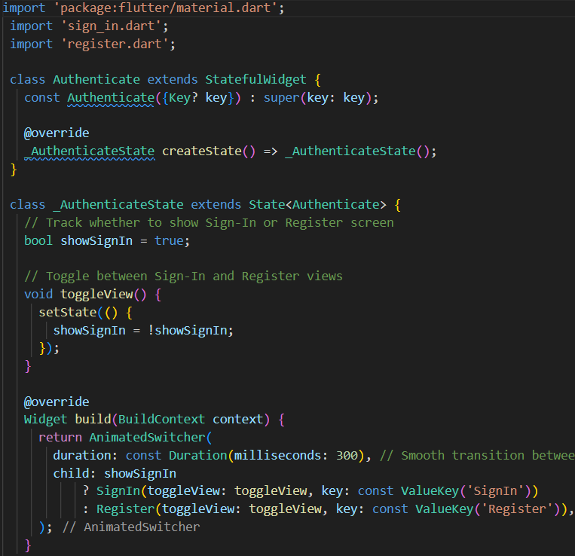
AUTHENTICATION
Purpose: The Authenticate widget is responsible for toggling between the Sign-In and Register screens.
Key Features:
Stateful Widget: Tracks whether to show Sign-In or Register view using the show SignIn boolean.
Functionality:
toggleView(): Toggles between Sign-In and Register views.
build(): Displays the appropriate screen based on the value of showSignIn.
Key Design Highlights:
Modularity: SignIn and Register screens are encapsulated in separate widgets for clean code structure.

Slide 11
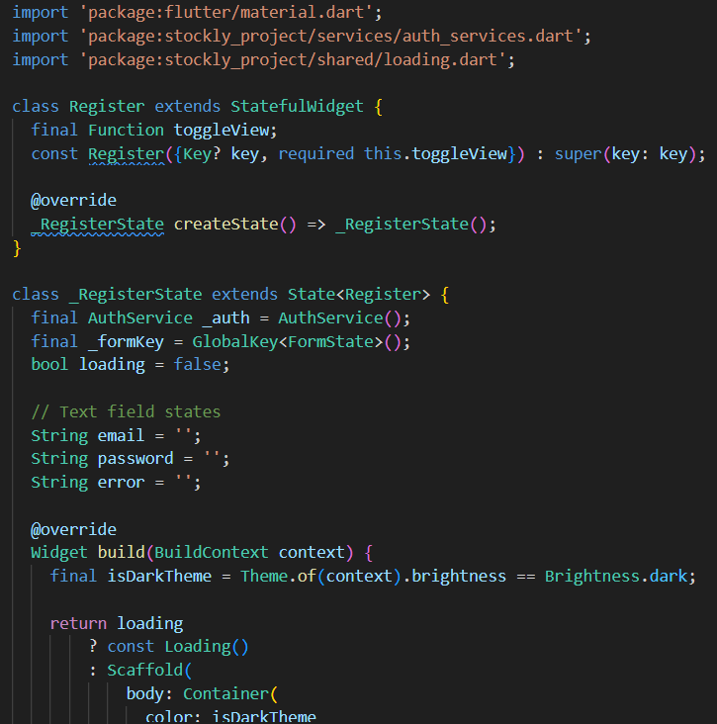
REGISTER
Implements the user registration screen with email/password authentication.
Key Components:
Loading Indicator: Displays a loading animation when a registration attempt is in progress.
Email Field: Validates email input.
Password Field: Ensures the password has a minimum length of 6 characters.
Error Handling: Displays error messages on failed registration attempts.
Sign-In Redirect: A button to navigate to the Sign-In screen.
Key Features:
Validation: Utilizes form validation for robust user input handling.
Firebase Authentication: Integrates with the AuthService for backend authentication.
UI Components:
A clean form layout for email and password inputs.
Button for submitting the registration form.
Link for users to toggle to the Sign-In screen.
User Feedback:
Clear and concise error messages.
Smooth transitions using setState() for reactivity.

Slide 12
SIGN IN
The Signin widget is a stateful widget (StatefulWidget) that manages user interactions and UI updates during the sign-in process.
bool loading=false;
A loading state is used to display a loading spinner when the sign-in process is in progress.
If loading is true, a Loading widget is shown (shared/loading.dart).
final AuthService auth=AuthService();This connects to the custom AuthService class (presumably handling Firebase or backend authentication).
The SignInWithEmailAndPassword method is used to sign in the user using the entered email and password.
validator: (val) => val!.isEmpty ? 'Please enter your email': null,
Email and password fields use form validators
These checks ensure basic input validity before submission.
Form Layout
A Form widget with a GlobalKey (formKey) is used to manage validation and submission.
Error Handling
Displays an error message if error is not empty,
Registration Redirect:
Redirects the user to the registration screen by calling toggleView(), a callback function passed to the Signin widget.

Slide 13
MAIN.DART
Firebase Initialization:
•Firebase.initializeApp() initializes Firebase with the platform-specific configuration from firebase options.dart.
•Ensures Firebase services (authentication, database) are ready to use.
Widgets Binding:
WidgetsFlutterBinding.ensureInitialized() ensures Flutter engine services are initialized before Firebase setup.
Main Application Widget (MyApp):
•Extends StatelessWidget, serving as the root of the app.
•Provides:StreamProvider<Our User?>: Listens to authentication state changes through AuthService().user and passes user data to child widgets.
• Defines a route /newsfeed, mapped to the NewsFeedScreen widget.
• Passes an empty stock symbols list (myStockSymbols: []) for initialization.
Key Features Enabled by This Code:
•Firebase-powered user authentication and database handling.
• Stream-based architecture ensures dynamic updates to the app based on user
state.
• Well-structured navigation using Wrapper and predefined routes.
• Future-proof and scalable foundation for adding new screens and features.

Slide 14
HOME SCREEN
User Personalization: Displays a personalized welcome message using the user's stored name from the database (Firebase Firestore).
Interactive Navigation:
Top Stocks: Navigate to explore the top-performing stocks.
My Stocks: View and manage personal stock investments.
Settings: Update user preferences using a modal bottom sheet.

Slide 15
SETTINGS FORM
Dependencies:
cloud_firestore: Used for accessing Firestore database.
provider: To manage the user’s authentication context. models/usermodel.dart and services/database.dart: Custom imports for user data and database services.
State Management:
The SettingsForm widget uses StreamBuilder to listen for changes in the Firestore document containing user details.
The StreamBuilder retrieves the current username (NAME) from Firestore and displays it in a form.
Form Functionality:
The form uses a TextFormField with initial value set to the current username fetched from Firestore.
The user can update their name and submit it using the "Update" button.
Firestore Interaction:
Upon submission, the updated name is written back to Firestore.

Slide 16
CHOOSE STOCKS SCREEN
The ChooseStocksPage is a Flutter app screen designed to allow users to search for, select, and save stocks of interest.
Key Features:
Stock Search: Users can search for stocks by company name or symbol through a search bar.
Dynamic Stock List: A list of all stocks is filtered in real-time based on the search query.
Selection: Users can tap on a stock to select or deselect it.1719
Save Selection: Selected stocks are saved to Firestore under the current user's document (MY STOCKS field).

Slide 17
MY STOCKS SCREEN
Search Functionality:
A search bar allows users to filter the displayed stocks based on the symbol or company name.
Interactive List of Stocks:
Stocks are displayed as a list, and tapping a stock navigates to a detailed screen (StockPrice) for further exploration.
Floating Action Buttons:
Two floating buttons enable users to:
Add new stocks to their portfolio.
View the latest news related to their chosen stocks.
Code Design
Provider Integration:
The app uses the Provider package to access user details such as uid for database operations.
Separation of Concerns:
Database queries are handled by a Database Service class, ensuring clean and maintainable code.
Reusable UI Components:
The buildStockTile method encapsulates the logic for creating a consistent card design for each stock.

Slide 18
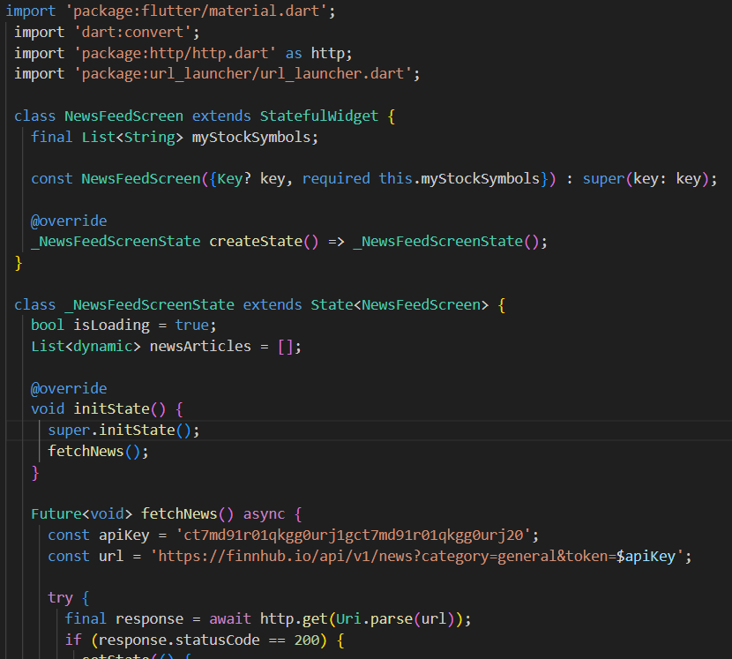
NEWSFEED SCREEN
Fetching News:
The app uses http to fetch the latest news articles related to finance. The API key used is ct7md91r01qkgg0urj1gct7md91r01qkggOurj20, and it fetches general news articles from Finnhub API.
State Management:
The app has a loading state (isLoading) that is initially set to true. When news articles are fetched, this state changes, and the UI is updated.
Refresh Functionality:
The news feed can be refreshed by pulling down to reload the content using RefreshIndicator.
Error Handling:
The app shows an error message if the news fails to load or if there are no available news articles.
Opening News Links:
If the user taps on the news article, it will launch the URL using launchUrl from the url_launcher package.

Slide 19
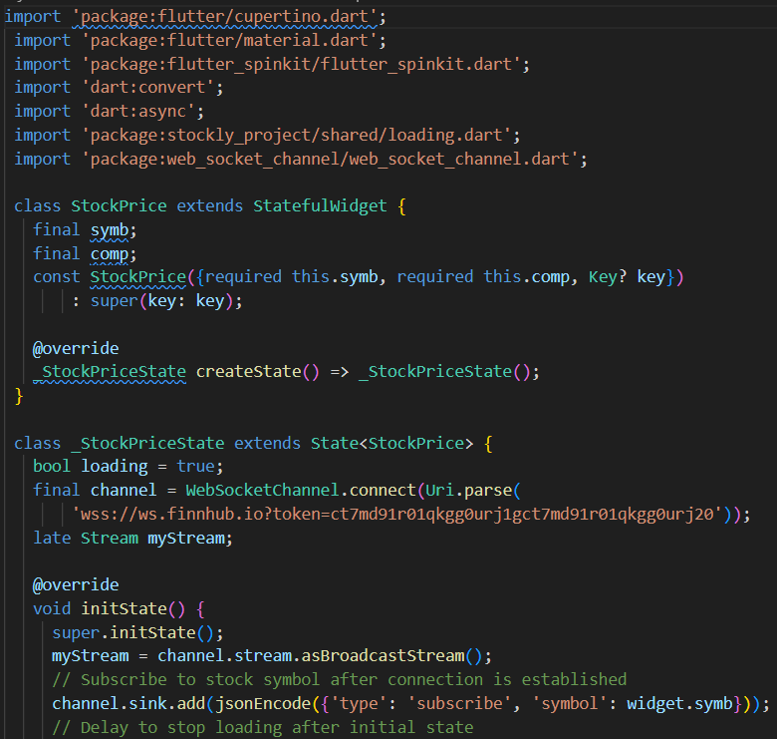
STOCK PRICE SCREEN
Code Walkthrough:
1.initState():
Initializes the WebSocket connection and subscribes to the stock symbol (widget.symb).
Sets a delayed function to stop showing the loading spinner after 1 second.
2.StreamBuilder:
Listens to the WebSocket stream (myStream), and depending on the data received:
If ping is received, it shows the loading spinner.
If stock data is received, it displays the stock price.
3.Widgets:
_buildLoadingState(): Displays loading UI with a spinner and shows the stock symbol and company name.
buildStockDataDisplay(): Displays the stock symbol, company name, and current stock price once the data is available.
4.dispose():
Ensures the WebSocket connection is closed when the widget is disposed to prevent memory leaks.

Slide 20
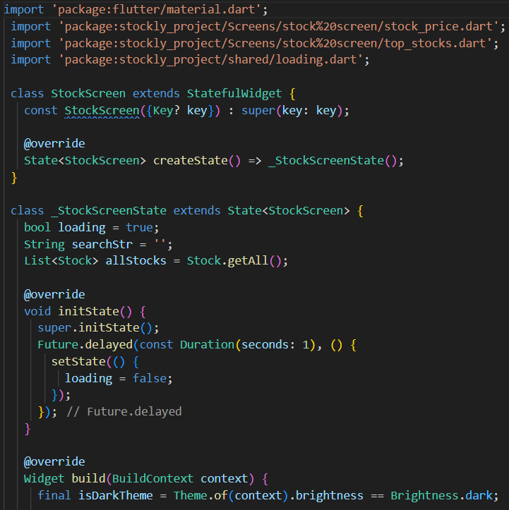
TOP STOCKS PAGE
Search Bar:
A TextField is used for searching stocks.
As the user types in the search field, the displayed stock list updates to show only the stocks.
Stock List:
A list of stocks (allStocks) is generated by calling Stock.getAll(). The list is dynamically filtered based on the searchStr, which is updated whenever the user types in the search field.
Each stock is displayed as a List Tile inside a Card. The tile displays the stock symbol and company name.
Navigation:
When a stock tile is tapped, it navigates to a new screen, StockPrice to that screen. This allows the user to view detailed information about the selected stock

Slide 21
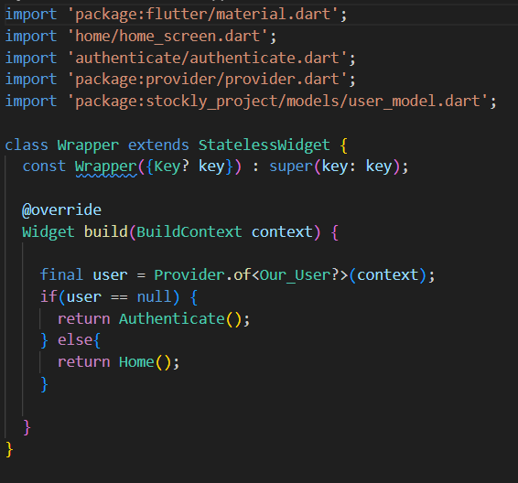
WRAPPER
Overview of Wrapper Widget
The Wrapper widget serves as the entry point for deciding between different screens based on the authentication status of the user.
It checks if a user is logged in and navigates them to the appropriate screen.
Key Components
Provider: Used for managing the state of the user.
Our User?: A model that holds user authentication data, possibly representing the current user or null if the user is not authenticated.
Screens:
Authenticate: A screen displayed when the user is not logged in.
Home: A screen displayed when the user is logged in.
Logic Flow
If the user is not logged in:
The Authenticate screen is displayed to allow the user to sign in or register.
If the user is logged in:
The Home screen is displayed, providing access to the main features of the app.

Slide 22
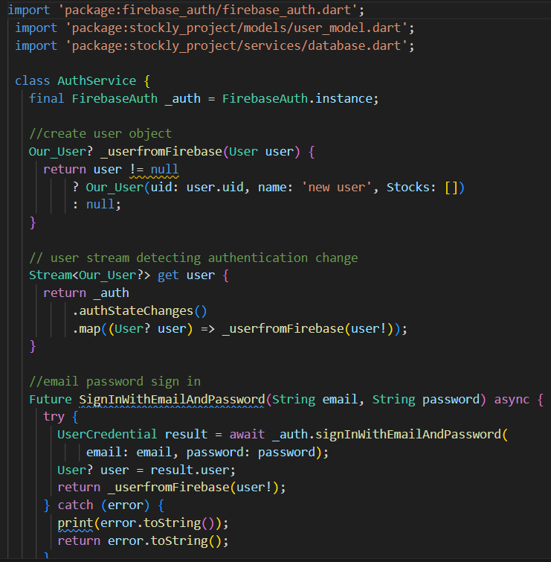
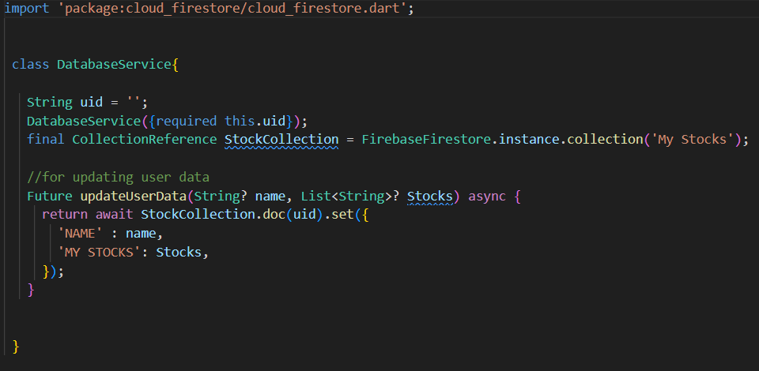
SERVICES-AUTH&DATABASE
Authentication
Code Breakdown
User Object Mapping: Converts Firebase user data into the custom Our_User model.
AuthStateChanges: Listens for authentication changes (sign-in, sign-out).
Error Handling: Catches and prints errors during sign-in, registration, or sign- out operations.
DatabaseService
Interacts with Firebase Firestore to manage user data.
Specifically used for updating and storing user-specific stock data in the Firestore database.
Associates each user with a unique uid for personalized storage.
Code Breakdown
updateUserData:
Sets or updates the user's data in Firestore using the set method.
If the document already exists, it will overwrite it with the new data.

Slide 23
FUTURE WORKS
Advanced Features: Al-driven stock recommendations and predictive analytics.
Real-time notifications for stock updates and market events.
Enhanced Security: Multi-factor authentication and biometric login options.
Localization: Multi-language support and regional stock exchange integration.
Monetization: Premium subscriptions and ad-based revenue.
Machine Learning: Sentiment analysis and stock trend predictions.
Offline Mode: Access to cached data and portfolio offline.
These upgrades will enhance usability, security, and market competitiveness

Slide 24
CONCLUSION
Stoxie provides a personalized, user-friendly platform for managing stocks.
Emphasizes simplicity and real-time updates.
Future enhancements aim to create a more engaging experience for users.
The app bridges the gap between casual investors and market insights

