Slide 1
Predicting Movie Revenue based on IMDb Data

Slide 2
introduction

Slide 3
Problem statement
Predict the movie box office gross level in U.S. For movie investors before filming. They can use this system to adjust budget, cast and movie genre to optimize the movie box office gross.
Data Collection
IMDB Movie Dataset from 2000 - 2012.
Data Features:
Categorical : Movie Title, Director Name, Actor1Name, Actor2Name, Actor3Name, Plot Keywords, Language, Country, Movie Imdb Link
Numeric : Duration, Director Facebook Likes, Actor 1 Facebook Likes, Actor 2 Facebook Likes, Actor 3 Facebook Likes, Num User For Reviews, Num Critic For Reviews, Num Voted Users, Cast Total Facebook Likes, Movie Facebook Likes, Face Number In Poster, Title Year, Content Rating, Aspect Ratio, Gross, Budget, Imdb Score

Slide 4
LINEAR REGRESSION

Slide 5
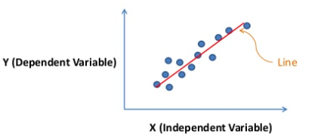
Linear Regression is a linear approach for modelling the relationship between dependent variable and independent variable Used to predict correlation between one or more independent variables and a dependent variable eg: speeding is correlated with traffic death when data is plotted on graph there appears, to be straight line relationship

Slide 6
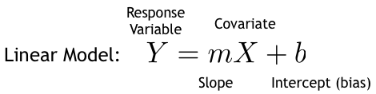
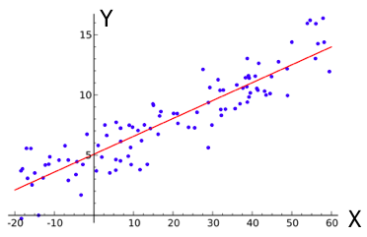
Simple Linear Regression
Used to predict correlation between one or more independent variables and a dependent variable
Find a linear approximate (line) relationship independent variable and dependent variable
In machine learning X is referred as feature and y is referred as label

Slide 7
In our ﬁrst model, we use standard least-squares linear regression. To do this, we intend to use stochastic gradient descent. Once we have trained a set of feature weights, we could then generate gross revenue predictions as follows:
Gross = θ0+θ1* F1+θ2* F2+ ... + θn* Fn
where θi are the weights,
Fi are the features, and
n is the number of features.

Slide 8
Logistic Regression

Slide 9
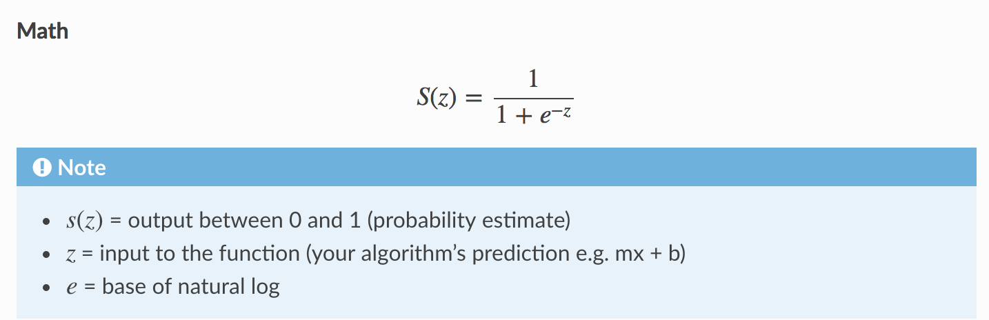
Involves a more probabilistic view of classification.
Logistic Regression fits a curve to data in which the dependent variable is binary.
It assigns observation to discrete set of classes.
In order to map predicted values to probabilities, we use the sigmoid function. The function maps any real value into another value between 0 and 1. In machine learning, we use sigmoid to map predictions to probabilities.

Slide 10
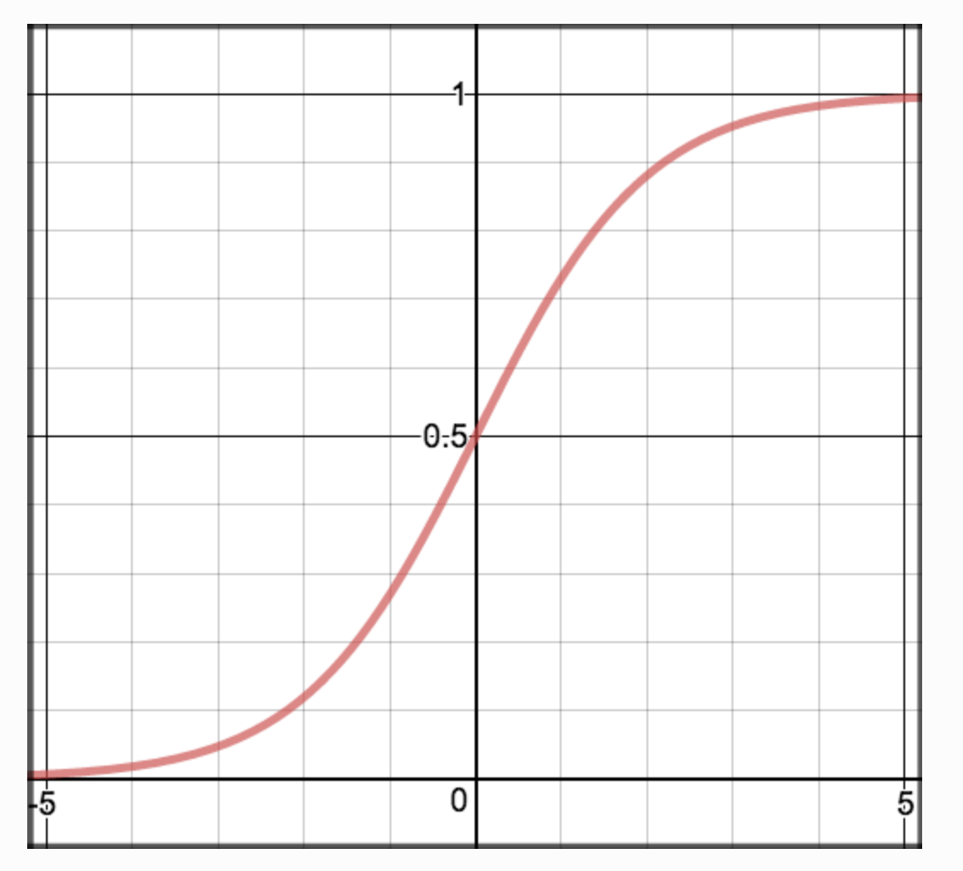

Slide 11
Advantages
Makes no assumptions about distributions of classes in feature space.
Easily extended to multiple classes (multinomial regression).
Natural probabilistic view of class predictions
Quick to train.
Very fast at classifying unknown records.
Good accuracy for many simple data sets.
Resistant to overfitting.
Can interpret model coefficients as indicators of feature importance.

Slide 12
Support Vector Machine

Slide 13
SVM
Support vector machine constructs a hyper-plane or set of hyper-planes in a high dimensional space, which can be used for classification, regression or outliers detection.
Tries to find best split
SVM regression tries to find a function F(X), that has atmost deviation from the actually obtained target 'Y' for the training data.

Slide 14
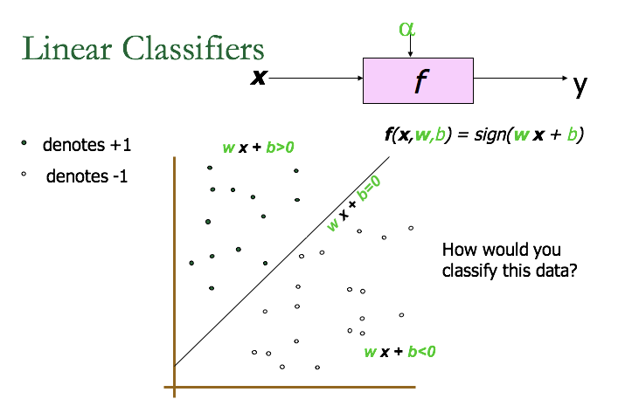

Slide 15
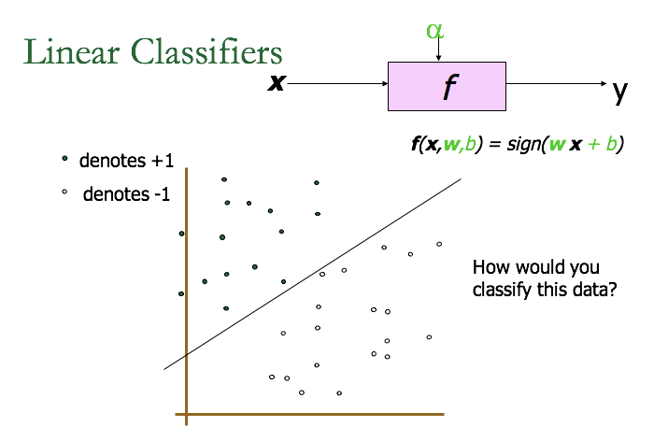

Slide 16


Slide 17


Slide 18
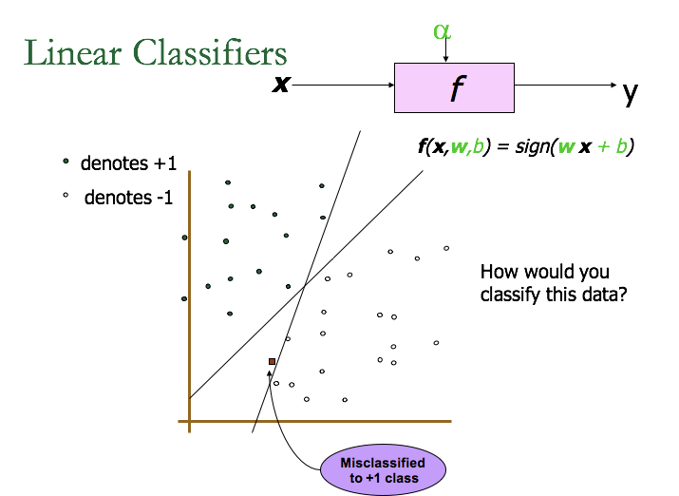

Slide 19
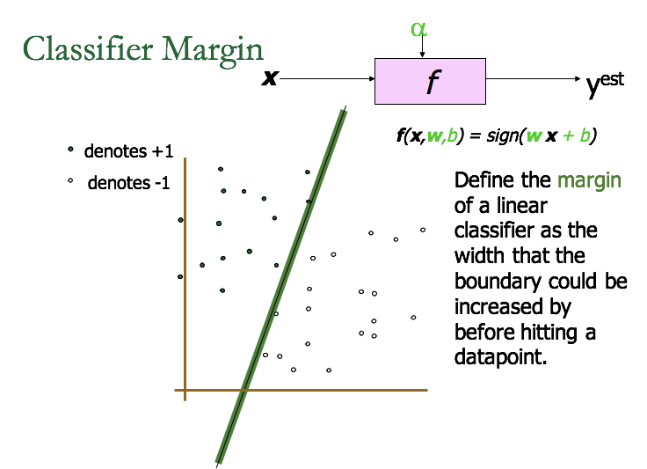

Slide 20
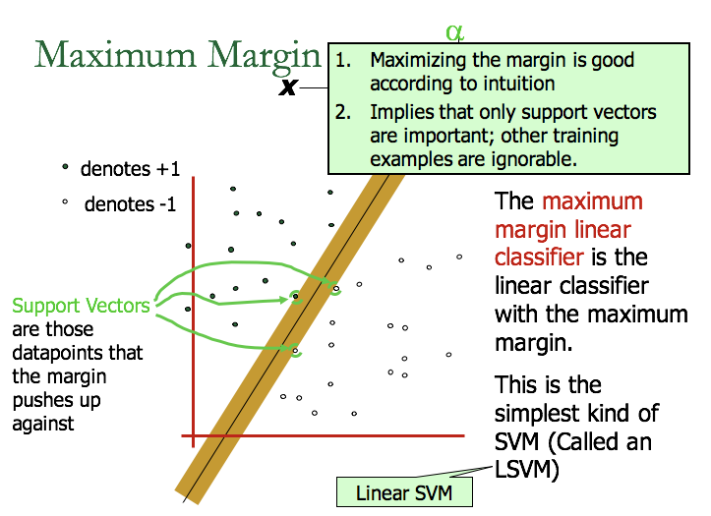

Slide 21
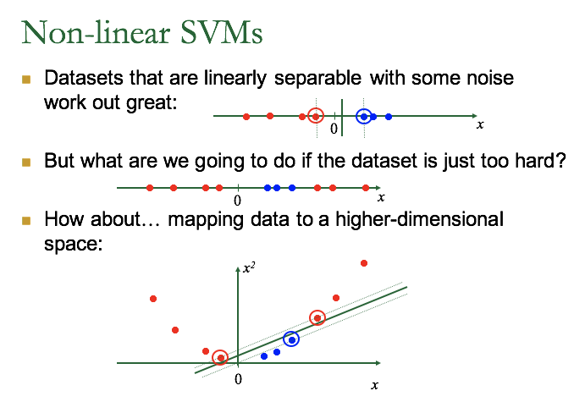

Slide 22
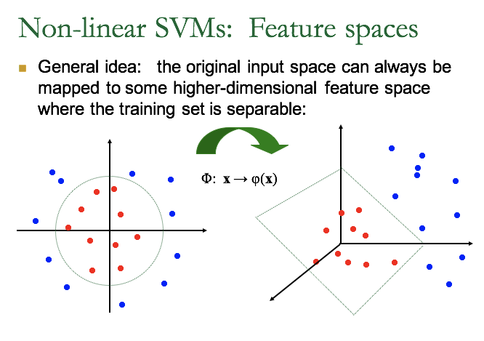

Slide 23

The “Kernel Trick”
If every data point is mapped into high-dimensional space via some transformation Φ: x → φ(x), the dot product becomes:
K(x_{i},x_{j})= φ(x_{i}) ^{T}φ(x_{j})
The kernel function plays the role of the dot product in the feature space.
Examples of Kernel Functions
Linear: K(x_{i},x_{j})= x_{i} ^{T}x_{j}
Polynomial of power p: K(xi,xj)= (1+ xi Txj)p
Gaussian (radial-basis function network):

