Slide 1

WiT HACKATHON
TEAM POWERPUFF

Slide 2
PROBLEM STATEMENT
During the Covid-19 pandemic situation the most vulnerable ones are those without the means to meet the basic necessities and are struggling every day of their lives. The daily wage workers, migrant workers without the means to work and senior citizens, single women with no help are majorly affected. By means of this platform, we envision to reach out to these populations to provide support and create a work environment in order to resume their normal lives.

Slide 3
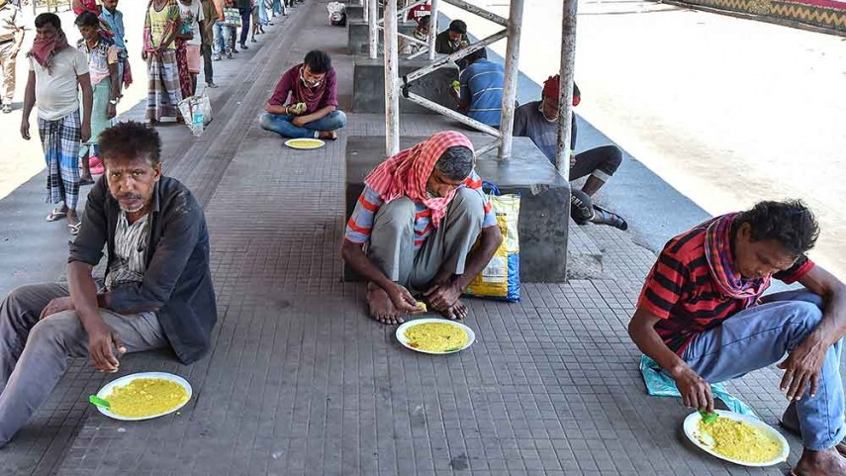
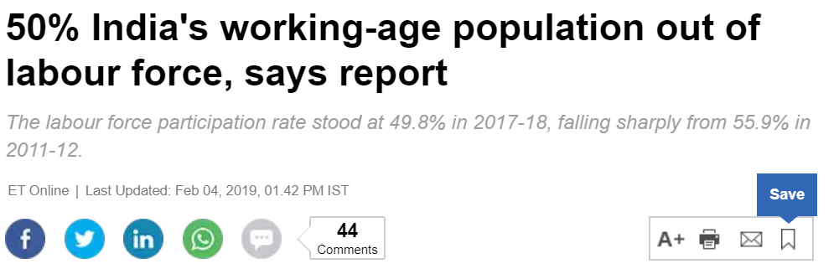

Slide 4

IDEA
Our idea is to create a KIOSK, incorporated with an interactive app - SAHAYAK which can be operated by hand gesture/foot for navigations to avoid Corona impacts, installed at public places/essential shops to empower needy people (Requestors) by connecting them with Donors who are geographically closer

Slide 5
Modes of connect
KIOSK
APP – SAHAYAK installed in smart phones

Slide 6
KIOSK
The migrant workers, the under privileged, other Requestors (who do not know about the app – SAHAYAK) can use the Kiosk to provide their details – name, picture, area of stay and the kind of help they require either with the help of person designated at the Kiosk / the shop keeper at essential shop / voice to text (WATSON assistant).
The details are collected and stored in cloud.

Slide 7
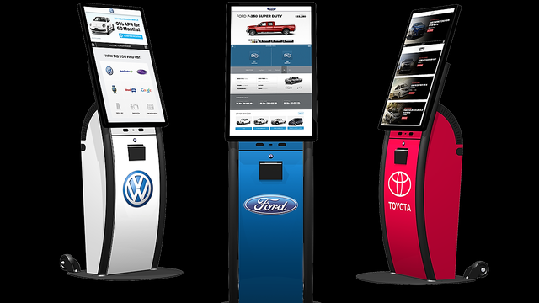
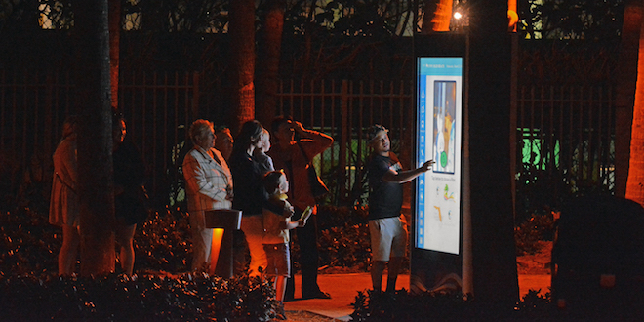
Kiosk With volunteer helping people use kiosk
Place hoardings at public places to get people know about KIOSK and SAHAYAK app
Use social media – Twitter, WhatsApp, Facebook, etc. to spread awareness of SAHAYAK app

Slide 8
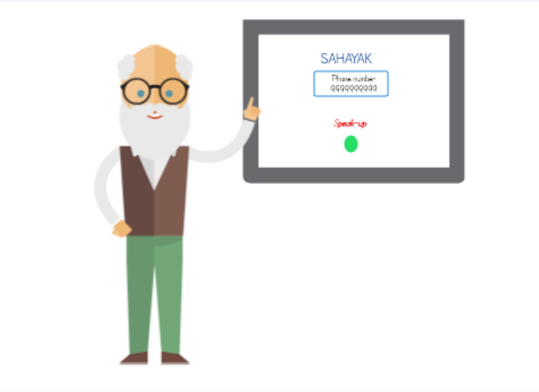
KIOSK using voice to text FEAture

Slide 9
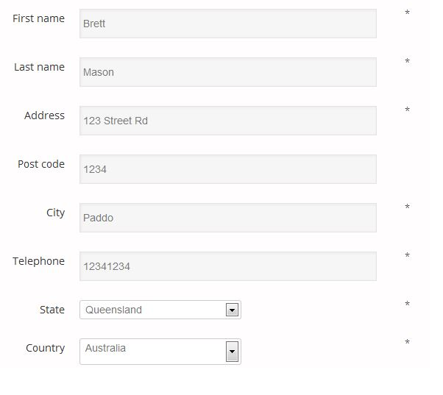
SAHAYAK installed in smart phones
In the app the requestors/donors provide the information which is immediately stored in cloud.

Slide 10
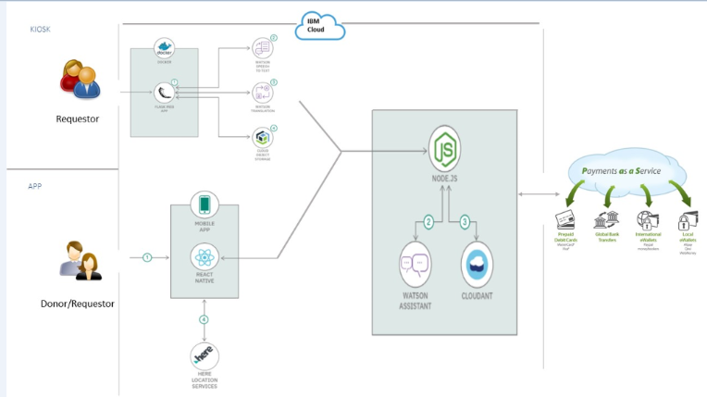
Architecture

Slide 11
HOW DOES THIS WORK ?
The Here location service identifies all the relevant Donors (who has already himself/herself on the app) and gets an alert geographically close to that Requestor and sends an alert to them to help the Requestor.
For example the requestor who is a migrant asks for essentials. This information is sent as an alert to the nearby donors who can help the requestor
In a similar manner help can also be provided to people who are seeking for employment.

Slide 12
The service required for the requests can be either free of cost or paid service.
Also, there will be an interface in SAHAYAK to conduct sessions online by Donors, such as, Music classes, Art and Craft classes, Instrument classes, Online tutors, etc. which can be paid service that in turn helps skilled people to earn some livelihood.

Slide 13
INSTANCE 1
An under privileged man (Requestor) raises the request in KIOSK for food using WATSON assistant. HERE location service sends alert to all the geographically closest Donors registered in SAHAYAK. The interested Donor, say Donor1 - who is a woman staying alone with infants - can choose that request but is unable to travel to complete the request, can raise a request for Rider. HERE location service sends alert to all the geographically closest Riders registered in SAHAYAK. The interested Rider (Donor) can choose that request and complete the request and get paid by the Donor1.

Slide 14
INSTANCE 2
A senior citizen (Requestor) raises a request in SAHAYAK for electronic appliance repair. HERE location service sends alert to all the geographically closest electricians registered in SAHAYAK. The interested electrician (Donor) can choose that request and complete the request and get paid by the Requestor.

Slide 15
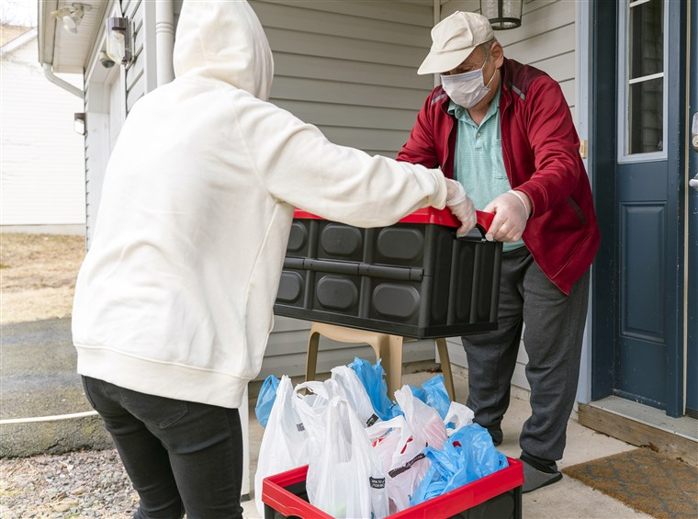
A Requestor helping a elder citizen

Slide 16
How to Sustain the New Normal Conclusion
Technology when blended with the right idea can work wonders and make the new normal a smooth ride for everyone living in the society. This is exactly what our idea offers.

Slide 17


