Slide 1
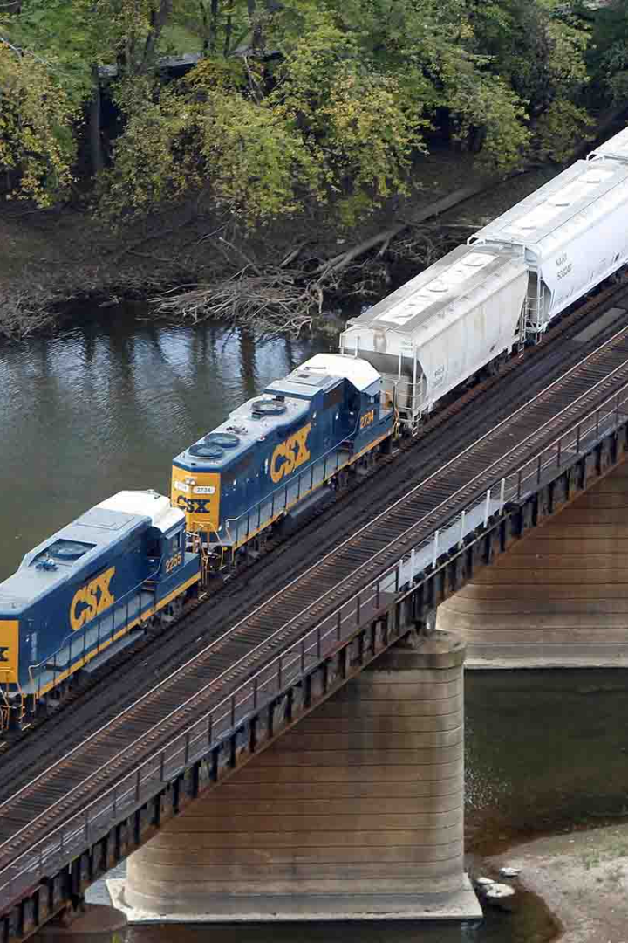

AWS Project: Transportation Management
This project is designed to revolutionize transportation logistics with the help of AWS. With the use of cutting-edge technology, we aim to solve some of the key challenges in the industry.

Slide 2

The Challenge of Transportation Management
1
Complexity 🤯
2
Visibility 🔎
Transportation management is complex with multiple players and thousands of transactions.
Lack of visibility hinders proactive management, leading to high costs and delays.
3
Automation 🔧
4
Customer Experience 🤝
Limited automation leads to inefficiencies, manual errors, and increased operational costs.
In today's fast-paced world, customers demand real-time visibility and status updates of their shipments.

Slide 3
Key Challenges Addressed by the Project
Route Optimization 🗺️
Real-time Visibility 🔍
Provide dynamic and optimized route planning coupled with real-time tracking of vehicle movements to help reduce operational costs and gain efficiencies.
Provide end-to-end visibility of the goods in transit with real-time ETA updates, location tracking, and alerts on potential delays.
Automation 🤖
Customer Satisfaction 😎
Implement automation to eliminate manual errors and reduce the time required for processing, invoicing, and payment processes.
Provide customers with self-service portals to help them track shipments, manage orders, and submit support requests.

Slide 4
Benefits of Using AWS for Transportation Management
Cost-effective
Flexible
Secure 🔒
AWS provides cost-effective solutions, allowing businesses to pay only for the resources they use and avoid any upfront investment.
AWS provides flexibility to scale up or down as per business needs and requirements, helping to save time and money.
AWS provides a secure infrastructure with multiple levels of protection, including data encryption, network security, and identity and access management.

Slide 5
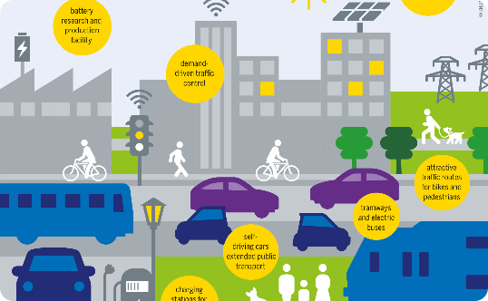
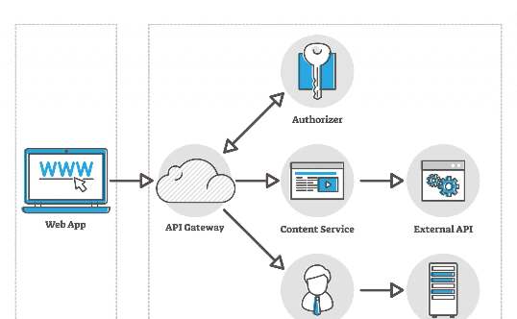
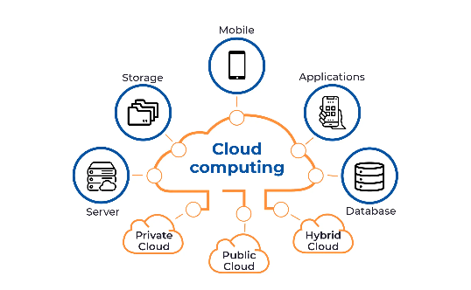
Architecture of the Solution
Internet of Things (IoT)
Serverless Architecture
Cloud Computing
From tracking devices to RFID sensors, AWS IoT provides the ability to collect data from various endpoints for real-time monitoring.
With AWS Lambda, businesses can run code without the need for servers, resulting in cost savings and increased scalability.
AWS provides on-demand cloud computing resources to help businesses scale up or down quickly as per demand.

Slide 6
Implementation Details
Design and Develop
Create a detailed solution architecture, implement key components, and test the solution before deployment.
1
2
3
Discovery and Analysis
Deploy and Monitor
Understand business requirements, identify pain points, and create a roadmap for the project.
Deploy the solution, conduct user testing, and continuously monitor for improvement opportunities

Slide 7
Results and Future Enhancements
Improved Efficiency 🚚
Cost Savings 💰
Continuous Improvement 📈
The solution offered significant improvements in efficiency by providing an optimized route planning algorithm and real-time visibility of shipments.
The implementation of automation and AWS serverless architecture resulted in cost savings for our clients.
We aim to add additional features like real-time analytics, machine learning, and predictive maintenance, enabling our clients to be even more proactive and competitive in the market.

