Slide 1

Predictive Analysis on Road Accident Risks Based on Heterogeneous Sparse Data
Predictive Analysis on Road Accident Based on Heterogeneous Sparse Data
Debayan Das(19MCA0070)
Madhurima Chakraborty(19MCA0087)
Pragya Yadav(19MCA0125)
Master of Computer Application
Vellore Institute of Technology, Vellore

Slide 2
Predictive Analysis on Road Accident Based on Heterogeneous Sparse Data
Dataset:
This is a countrywide traffic accident dataset, which covers 49 states of the United States. The data is collected from February 2016 to December 2019, using several data providers, including two APIs which provide streaming traffic event data. These APIs broadcast traffic events captured by a variety of entities, such as the US and state departments of transportation, law enforcement agencies, traffic cameras, and traffic sensors within the road-networks. Currently, there are about 3.0 million accident records in this dataset.
This dataset is obtained from Kaggle open public datasets:
https://www.kaggle.com/sobhanmoosavi/us-accidents

Slide 3
Predictive Analysis on Road Accident Based on Heterogeneous Sparse Data
In total the dataset Contains 49 Attributes named:
'ID', 'Source', 'TMC', 'Severity', 'Start_Time', 'End_Time', 'Start_Lat', 'Start_Lng', 'End_Lat', 'End_Lng', 'Distance(mi)', 'Description', 'Number', 'Street', 'Side', 'City', 'County', 'State', 'Zipcode', 'Country', 'Timezone', 'Airport_Code', 'Weather_Timestamp', 'Temperature(F)', 'Wind_Chill(F)', 'Humidity(%)', 'Pressure(in)’, 'Visibility(mi)', 'Wind_Direction', 'Wind_Speed(mph)', 'Precipitation(in)’, 'Weather_Condition', 'Amenity', 'Bump', 'Crossing', 'Give_Way', 'Junction', 'No_Exit', 'Railway', 'Roundabout', 'Station', 'Stop', 'Traffic_Calming', 'Traffic_Signal', 'Turning_Loop', 'Sunrise_Sunset', 'Civil_Twilight', 'Nautical_Twilight', 'Astronomical_Twilight’.

Slide 4
Predictive Analysis on Road Accident Based on Heterogeneous Sparse Data
The attributes contains descriptions about the following topics:
Location of the accident: The location of the accident i.e. the street, city, state, country moreover the geographical location(latitude & longitude) of the accident.
Weather Conditions: The various weather conditions at the time of the accident.
Time of the Occurrence of the accident: The time of the accident.
Location Description: The description of the location i.e. the nearby points of the accident location.
Severity: The severity of the accident i.e. how much sever the accident was.

Slide 5
Predictive Analysis on Road Accident Based on Heterogeneous Sparse Data
Data Pre Processing:
Filling Missing Data:
Filling with the data mean data using binning if the range of the data is less else fill with the regression method, else drop the record.
Convert to Number:
Converting the categorical data into numerical data using label encoding or dummy coding.
Date Time Conversion:
Creating new columns day, month, year, hour, minute, second from the existing datetime data.
Data Cleaning;
Removal of the unwanted data i.e. the attribute values not necessary for our study.

Slide 6
Predictive Analysis on Road Accident Based on Heterogeneous Sparse Data
Methodologies Used:
Finding Accident Hotspots: Finding the most accident prone areas i.e. identifying the areas with most severe accident records. That is clustering of the accident locations into two classes more accident prone and less accident prone using clustering algorithms.

Slide 7
Predictive Analysis on Road Accident Based on Heterogeneous Sparse Data
Finding rush hours: By seeing all the accident timings identifying the hours that are more prone to accident. Grouping the total hours of a day into 6 hour groups and then classify the hour groups into two classes accident prone and less accident prone using clustering algorithms.
Classify the accident conditions: Depending upon the weather conditions and geographical location(latitude and longitude) classify the severity of the accident into 4 classes using supervised learning models.

Slide 8
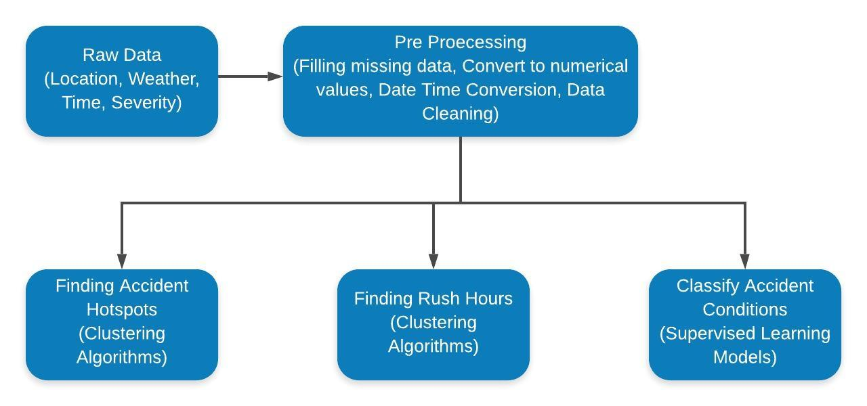
Predictive Analysis on Road Accident Based on Heterogeneous Sparse Data
Proposed Framework

Slide 9
Predictive Analysis on Road Accident Based on Heterogeneous Sparse Data
THANK YOU

