Slide 1
mTutor Website
Other team members:
1. Madhurima Handa
2. Mallika Kaur
3. Anurag Gupta
Efforts By:
Shivam Aggarwal
Bca Sem 5 D
01217702014

Slide 2
STUDENT MODULE
Features Provided
Functions
Academic Performance
A quick look of the Student Website Module

Slide 3
Features provided
A student
Connects with the tutors
Finds best skilled tutors
Gets proper mentorship
Resolves problems
Gets appropriate study material
Interact with the faculty
Review feedbacks
Posts views

Slide 4
FUNCTIONS
Register as a Student
Set and Update Profile
View Dashboard
See Notifications
Reply tutors with Messages
Perform tests and short quizzes
Rate tutors
Logout

Slide 5
Increase in Academic performance
By enrolling into mTutor, a student avails best guide for himself/herself.
With a wide and suitable options of tutors, a student can choose the right choice for himself/herself.
Learning platform established.
Fast Delivery Of Enquired Messages Provided.
Short Quizzes and Quick Revisions provided for free.
Tutors available for doubt sessions and for extra competitive preparations.

Slide 6
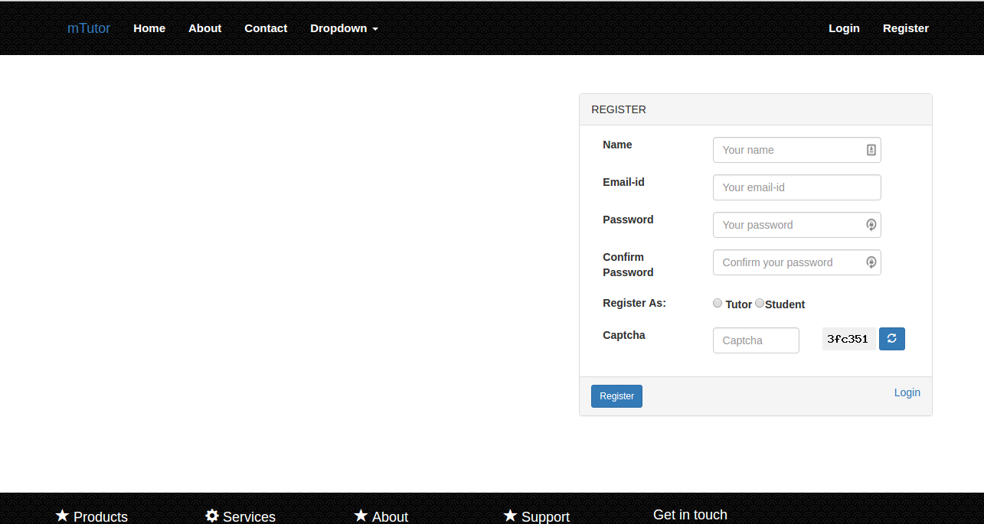
REGISTER AS A STUDENT

Slide 7
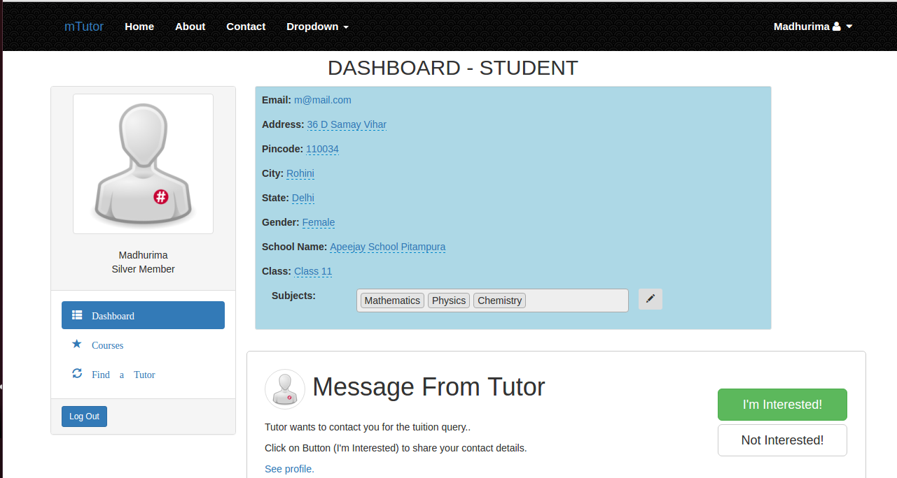
STUDENT’S DASHBOARD

Slide 8
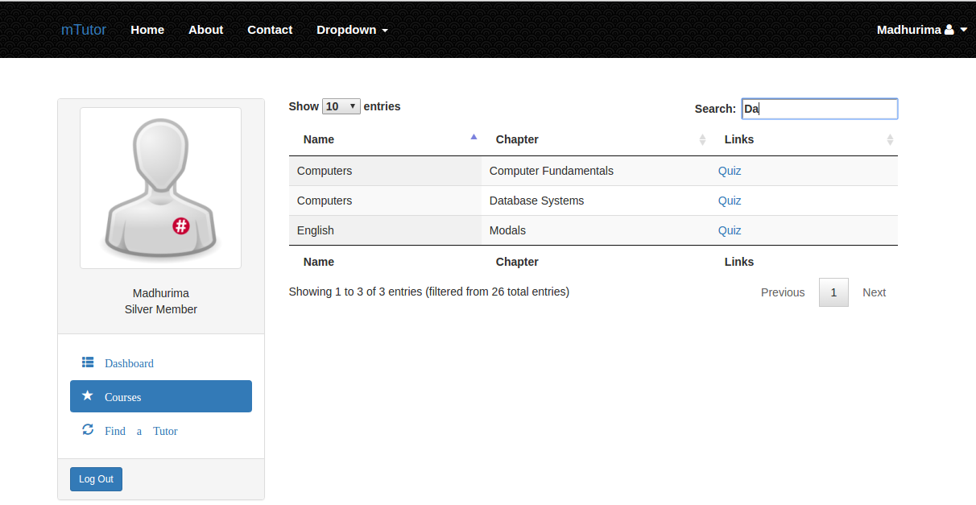
SEARCH The course

Slide 9
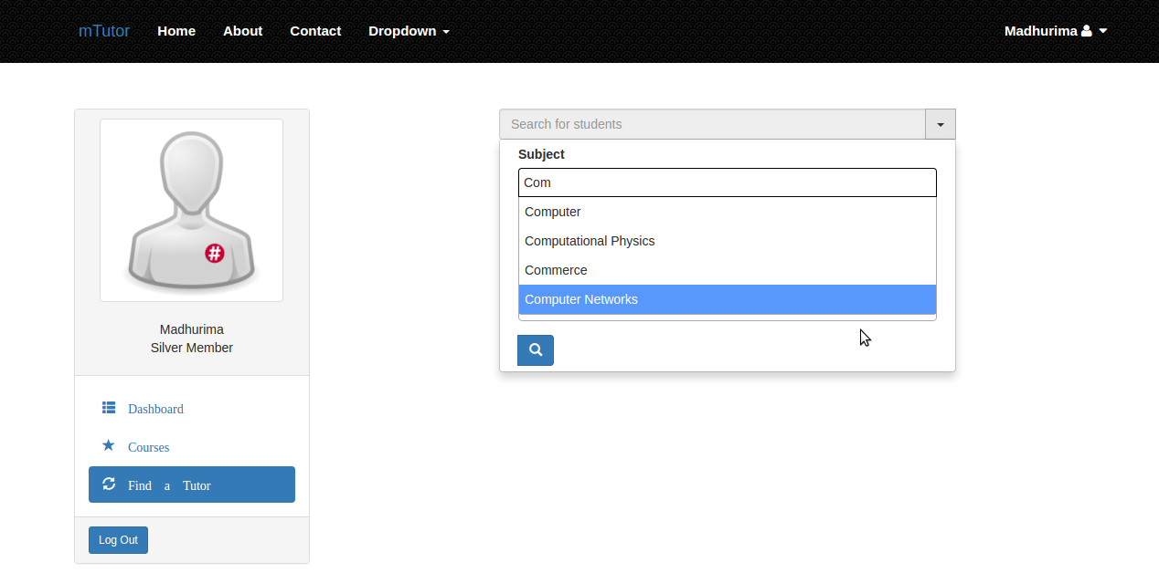
Finding A TUTOR

Slide 10


