Slide 1
Mtutor
Website
Efforts by :
Anurag Gupta
BCA
05017702014

Slide 2
A website doesn’t only need to be tested once it is fully made but needs constant testing during the whole course of its creation.
Testing is done basically to find errors. Exhaustive and dynamic testing is impossible to perform manually.
There are several techniques to locate errors. The one used in Mtutor is a type of automation testing.

Slide 3
Automation Testing
Automation Testing tools are capable of executing tests, reporting outcomes and comparing results with earlier test runs tests carried out with these tools can be repeatedly done several times.
Goal of automation testing is to reduce the no. of test cases to be run manually and not eliminate manual testing altogether.

Slide 4
What is Selenium?
Selenium is a free (open source) automated testing suite for web applications across different browsers and platforms.
It is quite similar to HP Quick Test Pro (QTP) only that Selenium focuses on automating web-based applications.
Selenium is not just a single tool but a suite of software's, each catering to different testing needs of an organization.
It has four components.
Selenium Integrated Development Environment (IDE)
Selenium Remote Control (RC)
WebDriver
Selenium Grid

Slide 5
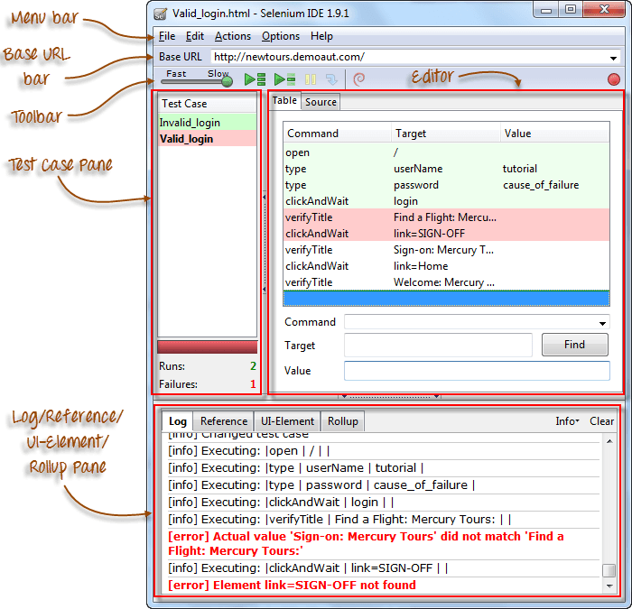
Features of Selenium

Slide 6
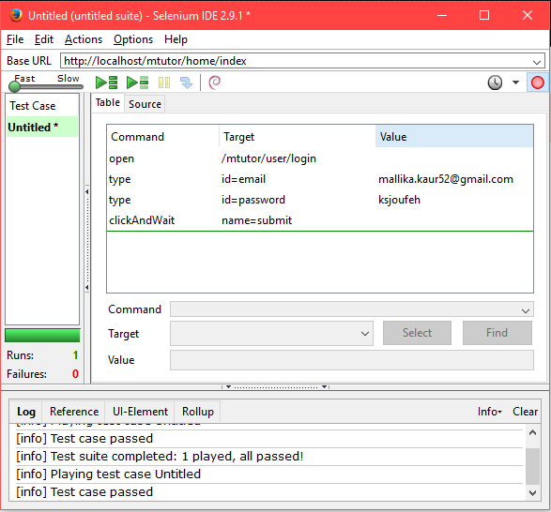
Screenshot
For Mtutor login

Slide 7
Test scripts can be created either by recording or typing the commands and parameters manually.
When creating scripts manually, Firebug is used to get the locator.
The Find button is used to check that the command is able to access the correct element.
Table View displays a test script in tabular form while Source View displays it in HTML format.
Changing the Source View to a non-HTML format is still experimental.
Do not use the Source View in creating tests in other formats. Use the Export features instead.
Parameters are not required all the time. It depends upon the command.

Slide 8
There are three types of commands:
Actions - directly interacts with page elements
Accessors - "reads" an element property and stores it in a variable
Assertions - compares an actual value with an expected one
The most common commands are:
open
click/clickAndWait
type/typeKeys
verifyElementPresent
verifyTable
waitForPageToLoad
waitForElementPresent

Slide 9
THANK YOU

