Slide 1
mTutor Website
Other team members:
1. Shivam Aggarwal
2. Mallika Kaur
3. Anurag Gupta
Efforts By:
Madhurima Handa
Bca Sem 5 D
00517702014

Slide 2
TUTOR MODULE
Role
Functions
Assessments
Skill Development

Slide 3
ROLE
A tutor
Connects with the students
Guides the students
Provide mentorship
Establish a bond between a student and the tutor itself
Compete with other tutors
Have an income

Slide 4
FUNCTIONS
Register as a tutor
Set and Update Profile
View Dashboard
See Notifications
Reply Students with Messages
Perform tests and short quizzes
Improves rank
Logout

Slide 5
ASSESSMENTS
Tutor is assessed on some specific topics.
Aptitude Tests
Short quizzes
Analysis made

Slide 6
SKILL DEVELOPMENT
To be engrossed in the mTutor website and its services, the tutor needs to be in a continuous evaluation.
To improve his/her ranking, he/she must give tests and develop the skills.
Improvements can be acquired by regular assessments performed and reward points given.
Learning platform established

Slide 7
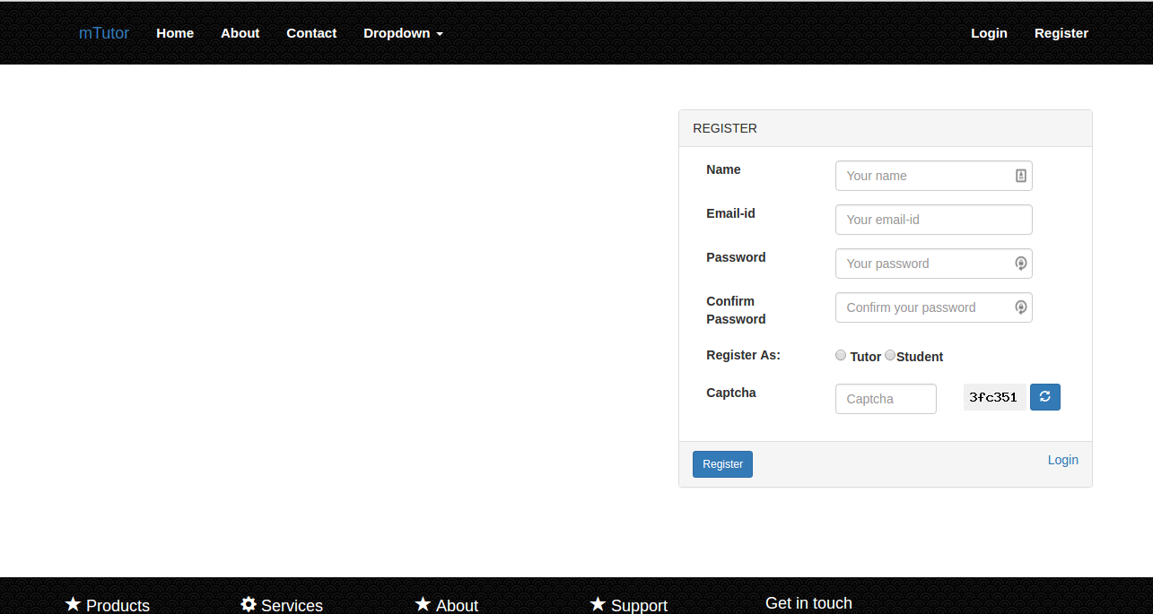
REGISTER AS A TUTOR

Slide 8
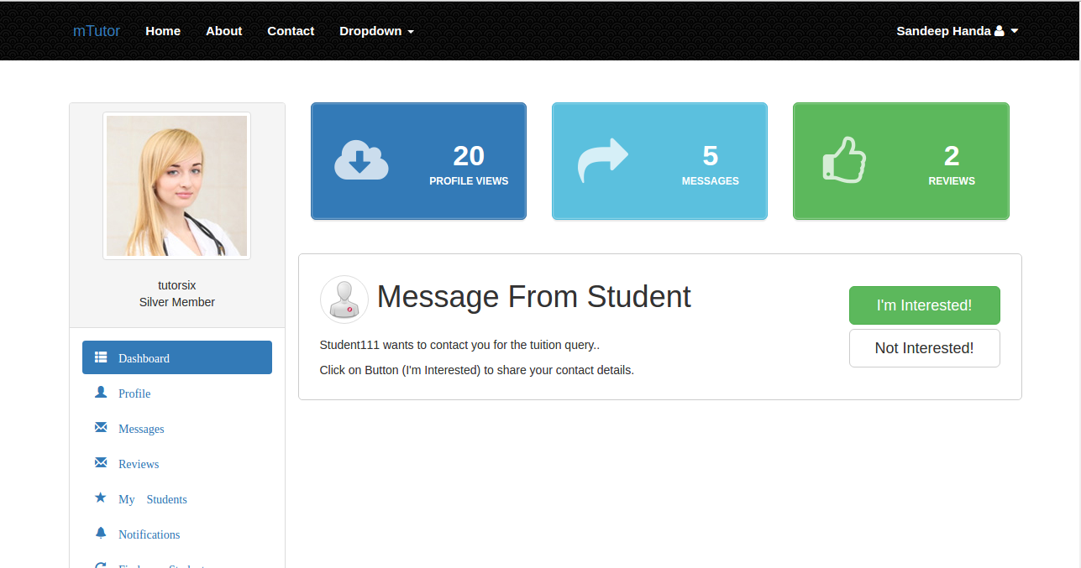
TUTOR’S DASHBOARD

Slide 9
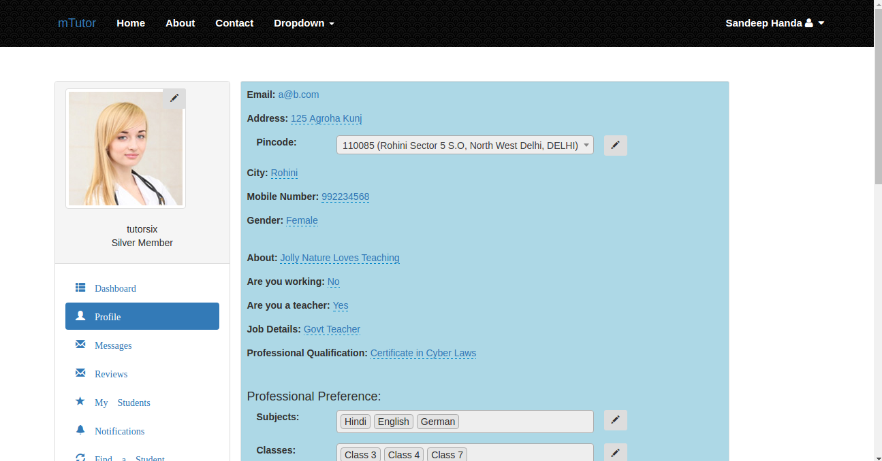
TUTOR’S PROFILE

Slide 10
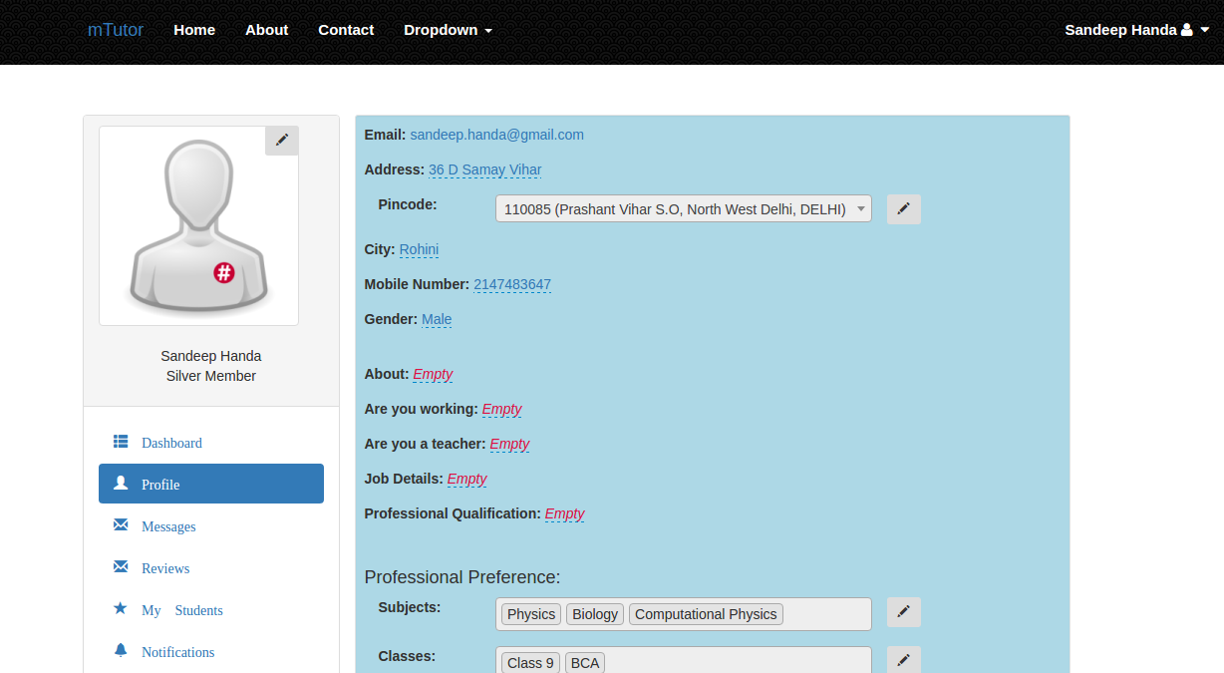
TUTOR’S PROFILE

Slide 11
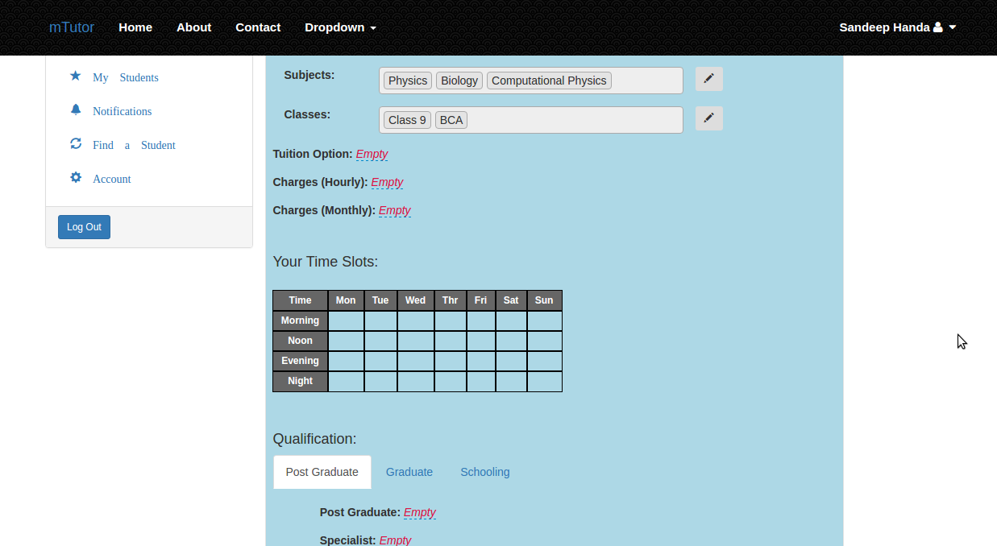
TUTOR’S PROFILE (CONT.)

Slide 12

UPDATING PROFILE

Slide 13
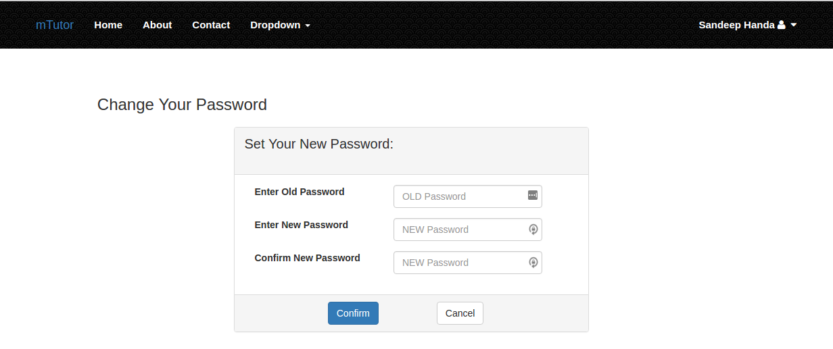
CHANGE PASSWORD

Slide 14
MODERATOR MODULE
Roles Of A Moderator
Functions Of A Moderator

Slide 15
ROLES OF A MODERATOR
Checks Messages
Moderates Accounts
Verifies Profiles
Notifies in case of any abuse reported
Emergency calls acknowledged
Feedback taken
Evaluate tutor performance
Regular Updates
Set Limits

Slide 16
FUNCTIONS OF A MODERATOR
Login
Maintain a database
Moderates and verifies tasks
Manage the proper functionality of Website
Accounts Registrations
Messages Checkups
Resolve Queries
Provide Acknowledgement and Updates
Logout

Slide 17
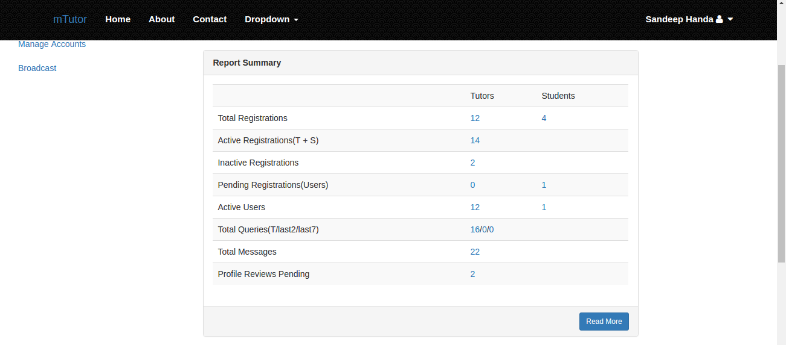
MODERATOR DASHBOARD

Slide 18


