Slide 1
EXPENSE EASE
Internal Guide:
Mrs. G. Deepthi Batch number:14
21N31A66D4: P.S.V.S.S.Madhurima
21N31A66F1: P. Nithin
22N35A6616: Romala Abilash

Slide 2
ABSTRACT
Expense Ease is a powerful financial management solution that enables users to categorize and track expenses with ease, manage unplanned accidental expenses, and personalize profiles through image uploads. With comprehensive CRUD operations, users can log and filter transactions by custom categories like groceries or entertainment, gaining clear insights into spending patterns and budgeting. The platform includes a dedicated accidental expenses feature, allowing users to set aside an accidental budget for emergencies, log unexpected costs, and view visual comparisons of budgeted versus actual spending, with remaining balance indicators for easy monitoring. Additionally, profile image uploads add a personalized touch and multi-tenancy ensures that users only access their own data while administrators can oversee all activities, providing a well-rounded, user-friendly financial tracking experience.

Slide 3
INTRODUCTION
Expense Ease is a comprehensive financial management system designed to simplify personal expense tracking and budgeting. Built using HTML and CSS for the frontend, PHP for backend functionality, and MySQL for database management, this platform empowers users to take control of their finances through intuitive features. It offers a robust user authentication system, ensuring financial data remains protected. The platform enables comprehensive tracking of income and expenses, with detailed categorization such as food, transport and health, providing valuable insights into spending habits. Users can log both planned and accidental expenses, ensuring unforeseen costs are accounted for without disrupting regular budgets. With profile management features, including personalized profile pictures, the platform delivers a highly engaging user experience. Additionally, it empowers users to generate detailed, customizable reports for analyzing spending trends and income sources, offering flexibility in date-wise, monthly, and yearly reporting.

Slide 4
EXISTING SYSTEM
User Management: Enables multi-tenancy with individual user access to their own data while allowing administrators to oversee and manage all users' information.
Income Tracking: Users can log their sources of income to keep track of their earnings alongside their expenses.
Simple Dashboards: Overview dashboards that provide a snapshot of financial health, showing key metrics like total income, total expenses, and remaining budget.

Slide 5
PROPOSED SYSTEM
User Authentication: Secure registration and login system for users, ensuring that financial data is protected.
Financial Tracking: Comprehensive tracking of income and expenses with detailed categorization (e.g., food, transport, salary) to provide insights into spending habits.
Categorization: Users can categorize expenses and income, enabling a clearer understanding of their financial activities and helping identify areas for savings.
Profile Management: Users can upload profile pictures, enhancing personalization and allowing for easy identification within the application.
Accidental Expenses Logging: A dedicated feature for logging unplanned or unforeseen costs separately from the regular budget, helping users maintain better control over unexpected expenses.
Detailed Reporting: Generation of customizable reports that offer insights into spending trends, income sources, and budget performance, with options for date-wise, monthly-wise, and yearly-wise analysis.

Slide 6
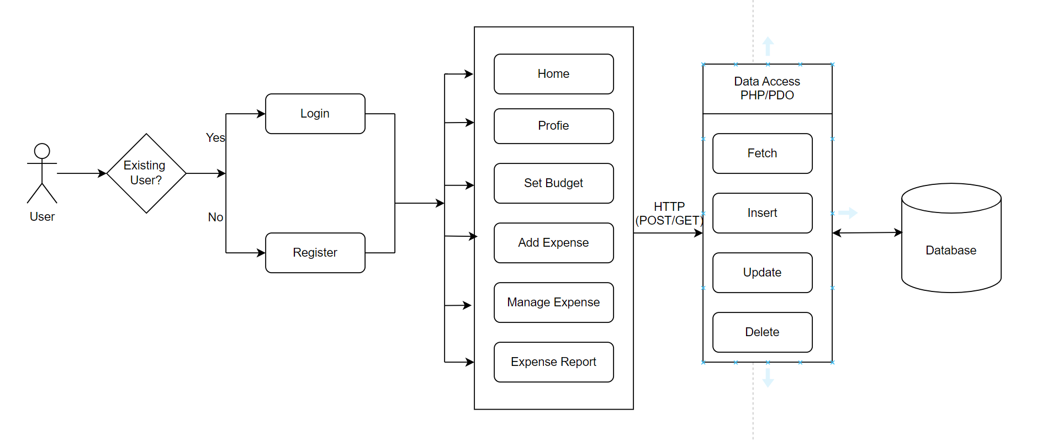
SYSTEM ARCHITECTURE

Slide 7
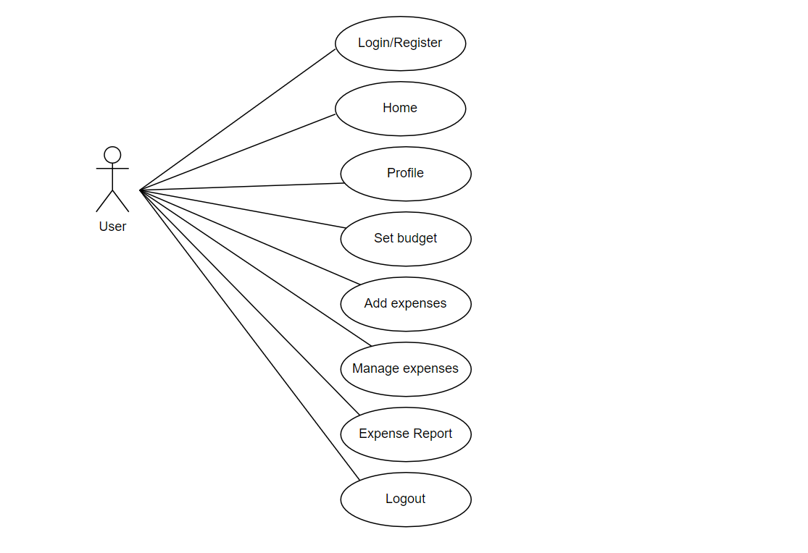
USE CASE DIAGRAM

Slide 8
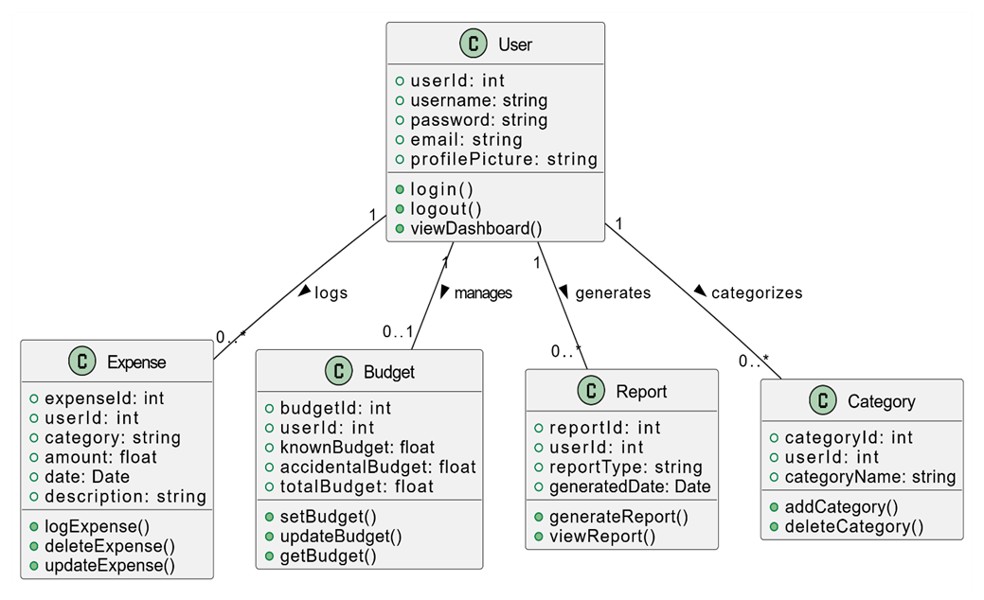
CLASS DIAGRAM

Slide 9
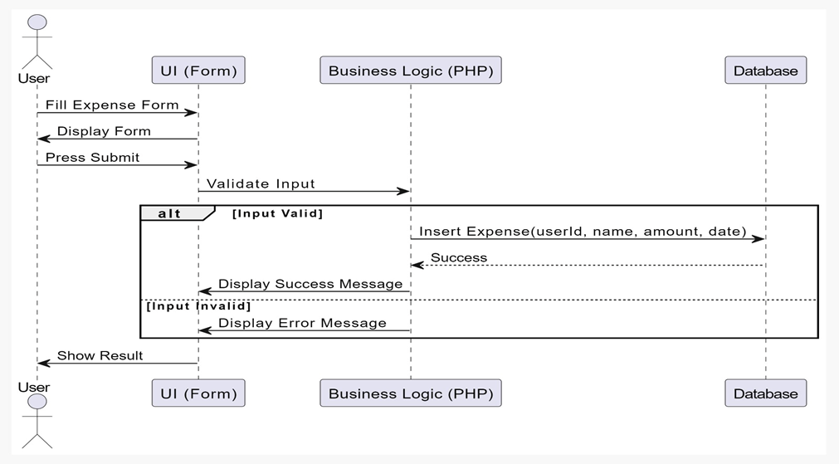
SEQUENCE DIAGRAM

Slide 10
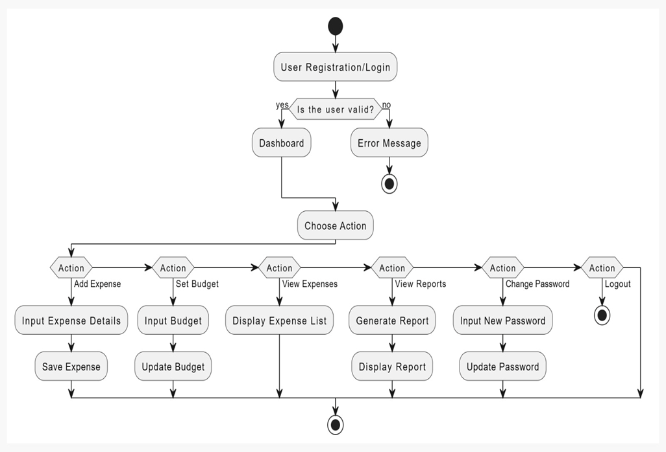
ACTIVITY DIAGRAM

Slide 11
SOFTWARE & HARDWARE REQUIREMENTS
Software:
Coding language: PHP
XAMPP Server
MySQL
OS: Windows 8/8.1/10/11 (64-bit)
Visual Studio Code
PhpMyAdmin
Hardware:
Processor: Intel Core i5-8400 3.0 GHz or better
RAM: 8 GB
Hard Disk: 30 GB

Slide 12
CONCLUSION
The Expense Ease project provides a robust, user-friendly platform for efficient financial management and tracking. With its comprehensive features for managing income, expenses, budgeting, and generating detailed reports, it enables users to gain valuable insights into their financial habits and make informed decisions. Categorization options, multi-tenancy support, and the inclusion of features like profile image upload and accidental expense logging enhance the overall usability and personalization of the application. By simplifying financial tracking and reporting, it serves as an essential tool for individuals seeking to improve their financial awareness and accountability, ultimately fostering better budgeting and financial planning practices.

Slide 13
REFERENCES
References are from research gateway, YouTube and google.
1. Dr . C K Gomathy, Article: A Study on the recent Advancements in Online Surveying, International Journal of Emerging technologies and Innovative Research (JETIR) Volume 5 | Issue 11 | ISSN :2349-5162, P. No:327-331, Nov-2018
2. “Why We Need to Start Budget Tracking Now” by David Ning.
3. https://www.w3schools.com
4. https://youtu.be/r0lDDeVkaks?si=T-A8vQ51SD0ijSfK
5. https://youtu.be/N676lCQq4n8?si=AygcszsveLOzpfmK

Slide 14
THANK YOU

