Slide 1
Object Tracking using Python and OpenCV
COMP-7901-011 Independent study of Data Science
Venkata Karampudi

Slide 2
Project Goal and Scope
Goal: Create object tracking in computer vision using Python and OpenCV to solve business problems.
Applications:
Surveillance: Increase efficiency of surveillance systems.
Augmented Reality: Merge digital objects into the real environment.
Robotics: Assist robots in following and interacting with specific objects.
Warehouse Automation: Automate the flow of items, eliminating manual labor and enhancing accuracy.

Slide 3
Data Source and Data set
Webcam: Use built-in or external webcam.
Video file: Use pre-recorded video file.
Live stream: Use live stream.
Image sequences: Use series of images.
Method: Use cv2.VideoCapture() to capture frames from the data source and apply object tracking techniques to track objects in the frames.
Real world event videos and images will be used to train and develop the object tracking program. Image Net – 1.2 million images, annotated in 20,000 categories.

Slide 4

Data Exploration
Video Data Loading: Analyze each frame in a video using Video Capture() class.
Video Data Visualization: Visualize content and quality by plotting pixel value distribution across frames.
Region Identification: Select region where object is present using manual selection or object detection and segmentation algorithms.
Motion Patterns: Analyze motion patterns of objects within region by calculating velocity, acceleration, and trajectory over time.
Motion Model: Predict approximate object location using location and speed in previous frames.
Appearance Model: Predict object location using appearance (shape) and searching nearby positions.

Slide 5
Pre-existing Model Research:
“Visual tracking with online adaptive appearance models” by Ross et al. introduced online adaptive appearance models for object tracking.
“Learning to track at 100 FPS with deep regression networks” by Bertinetto et al. proposed a deep learning-based method for real-time object tracking using a Siamese network.
Case Study: Object Tracking with Deep Regression Networks
Background: Object tracking is an important task in computer vision.
Methodology: A Siamese network is used to learn a similarity metric between object templates and image patches.
Result: The method outperforms several other deep learning-based trackers and traditional methods and shows robustness to occlusions, scale changes, and motion blur.
Application: The approach has various applications in surveillance, object tracking for autonomous vehicles, and human-robot interaction.
Conclusion: “Learning to track at 100 FPS using deep regression networks” is a successful real-time object tracking approach that employs deep learning and has numerous applications in computer vision and robotics.

Slide 6
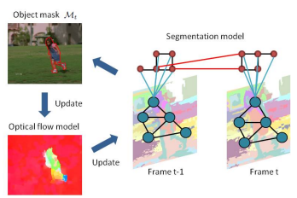
Video Object Segmentation
A multi-level spatial-temporal model for segmentation.
The red circles stand for pixels that are part of the super pixel denoted by the turquoise circles.
The geographical and temporal links are shown by the black and red lines, respectively.
The turquoise lines indicate the connections between the pixels and the super pixel. After obtaining the object mask, Mt, we utilise it to re-estimate the optical flow and repeatedly update both models.

Slide 7
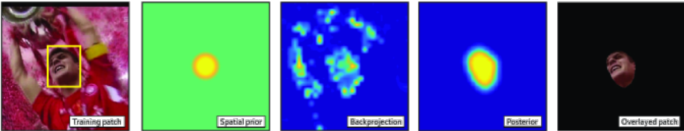
CSRT Tracker
The Discriminative Correlation Filter with Channel and Spatial Reliability (DCF-CSR), also known as CSRT, uses a spatial reliability map to tailor the filter to the region of the selected frame for tracking. This helps in the identification of the object of interest. It also provides good precision at a reduced frame rate (25 fps).
From left to right: Training patch with the bounding box of the object.
HOG to extract useful information of the image.
Application of random Markov Test to generate probabilities.
Training patch masked using the confidence map.

Slide 8
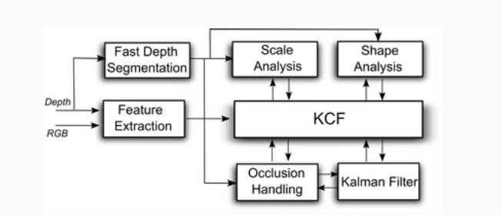
KCF Tracker
KCF Tracker: It is Kernelized Correlation Filters. KCF is based on the idea that several good instances in a single bag of MIL Tracker have a lot of overlap. Because of the overlap, various obvious mathematical algorithms for the KCF tracker have emerged.
Pros: It has higher accuracy and speed than MIL, and it reports tracking failure better than BOOSTING and MIL
Cons: Does not recover from complete blockage.

Slide 9
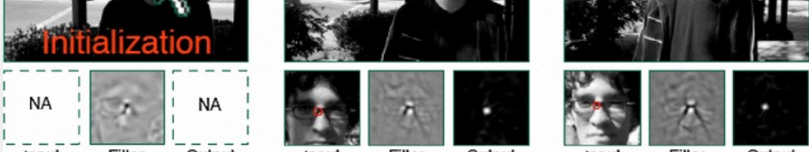
MOSSE Tracker
It is Minimum Output Sum of Squared Error. For tracking, it employed adaptive correlation, which produces reliable correlation filters. It is resistant to changes in scale, position, non-rigid deformations, and illumination. It can also manage occlusion and restart tracking as soon as the item reappears. Nonetheless, on a performance scale, it trails deep earnings based GOTURN.
Robust to light variations, scale and pose
Correlation filters

Slide 10
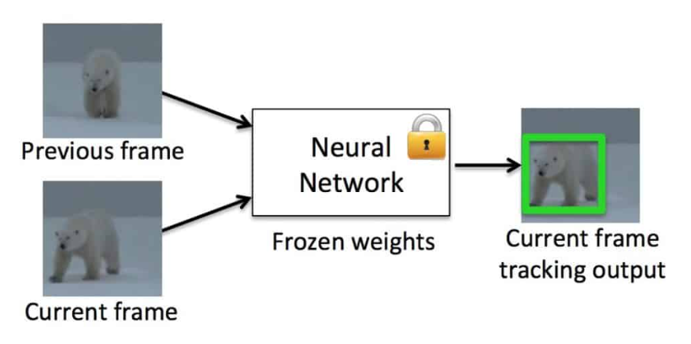
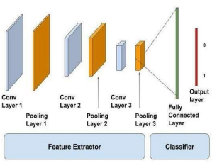
GOTURN Tracker
This is the only tracker that uses deep learning. Convolutional neural networks are used to create it. It is accurate in that it is resistant to deformations, illumination changes, and perspective shifts, but it cannot handle occlusion adequately.
GOTURN is a fast and generic tracker, but it may struggle in certain situations. It may have problems tracking things or sections of objects that are not in the training set.
Because of the composition of the training set, GOTURN's performance may be biased towards certain objects.
When objects are partially obscured by other comparable objects, the two-frame model lacks motion information, which can lead to erroneous tracking.

Slide 11
Table
GOTURN Variant | Overall, Errors | Accuracy errors | Robustness errors
L2 loss | 0.43 | 0.69 | 0.17
No motion smoothness | 0.30 | 0.48 | 0.13
Image training only | 0.35 | 0.54 | 0.16
Video training only | 0.29 | 0.44 | 0.13
Full Method (Ours) | 0.24 | 0.39 | 0.10

Slide 12
Conclusion
CSRT: Good accuracy, but it is slower than others.
KCF: not so good accuracy, but it is fast.
MOSSE: it is the fastest.
GOTURN: This is the only tracking algorithm in the tracker class that is based on a Convolutional Neural Network (CNN). we know it is “robust to viewpoint changes, lighting changes, and deformations”. But it does not handle occlusion very well.

Slide 13
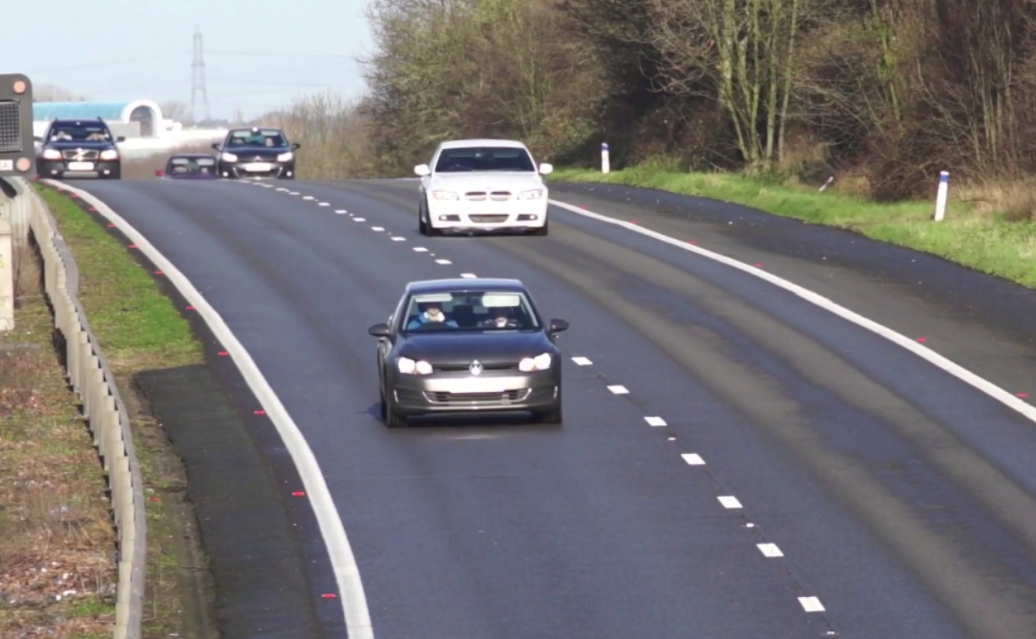
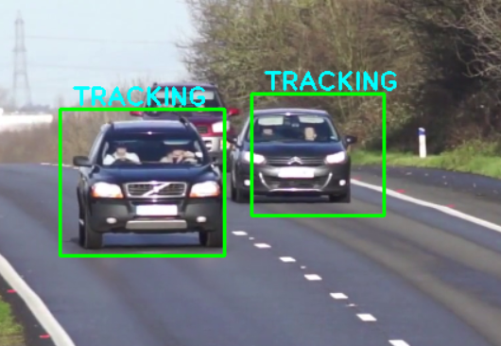
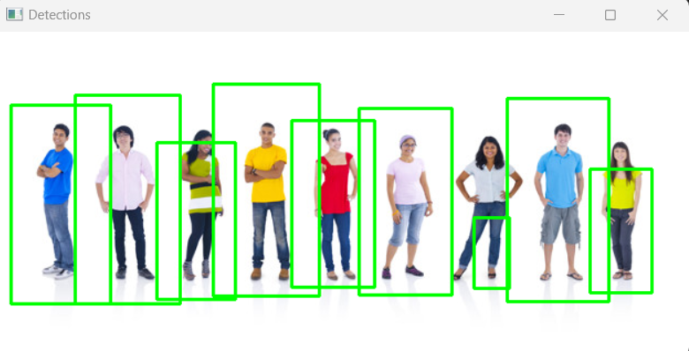
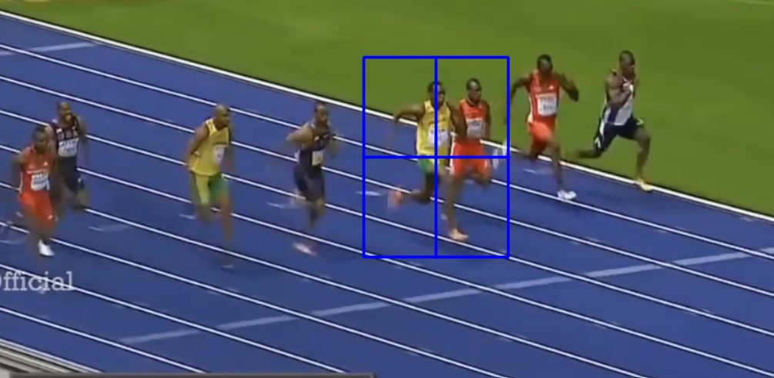
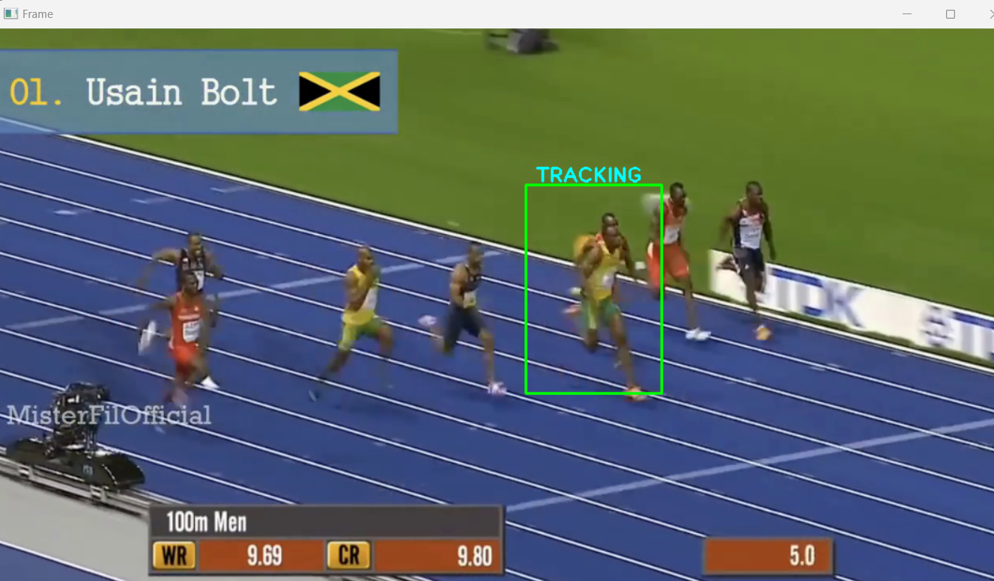
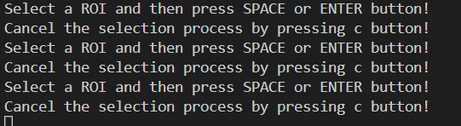
Results

Slide 14
References
FairMOT: On the Fairness of Detection and Re-Identification in Multiple Object Tracking, 4 Apr 2020· Yifu Zhang, Chunyu Wang, Xinggang Wang, Wen-Jun Zeng, Wenyu Liu.
N. Raghava, K. Gupta, I. Kedia and A. Goyal, "An Experimental Comparison of Different Object Tracking Algorithms," 2020 International Conference on Communication and Signal Processing (ICCSP), Chennai, India, 2020, pp. 0726-0730, Doi: 10.1109/ICCSP48568.2020.9182101.
N. Jain, S. Yerragolla, T. Guha and Mohana, "Performance Analysis of Object Detection and Tracking Algorithms for Traffic Surveillance Applications using Neural Networks," 2019 Third International conference on I-SMAC (IoT in Social, Mobile, Analytics and Cloud) (I-SMAC), Palladam, India, 2019, pp. 690-696, Doi: 10.1109/I-SMAC47947.2019.9032502.
Bertinetto, L., Valmadre, J., Henriques, J. F., Tao, R., & Vedaldi, A. (2016). Learning to track at 100 FPS with deep regression networks. In Proceedings of the European Conference on Computer Vision (ECCV) (pp. 125-141).
Ross, D. A., Bagnell, J. A., & Hebert, M. (2008). Visual tracking with online adaptive appearance models. In 2008 IEEE Computer Society Conference on Computer Vision and Pattern Recognition Workshops (pp. 1-8). IEEE.

Slide 15
Everything should be made as simple as possible, but not simpler." - Albert Einstein (quite possibly!)

Slide 16
Thank You

