Slide 1

Innovation partner H2S Media partner YOURSTORY
AI for Bharat Hackathon
AI for Bharat Hackathon
Powered by aws
TEAM NAME
PROBLEM STATEMENT
TEAM LEADER NAME
SupaDev
Tool Fragmentation & Accessibility in Bharat
MADHUR JAIN

Slide 2

Powered by
aws
Innovation partner H2S
Media partner YOURSTORY
AI for Bharat Hackathon
Brief about the Idea
The Core Concept
Solving the Problem
SupaDev is an AI-powered Agentic IDE designed specifically for Bharat's developers. It operates offline-first, ensuring privacy and accessibility even with poor internet connectivity in Tier 2/3 cities.
•
Eliminates Fragmentation: Reduces context switching between 5-8 tools, saving ~40% productivity.
•
Bridge the Gap: Provides mentorship to junior devs via AI agents.
How is it different?
•
Offline Capability: Runs locally to bypass connectivity issues.
Unlike standard autocomplete tools (e.g., Copilot), SupaDev features autonomous agents that Research, Architect, Code, and QA. It is a full IDE replacement, not just a plugin.

Slide 3

Powered by
aws
Innovation partner H2S
Media partner YOURSTORY
AI for Bharat Hackathon
List of features offered by the solution
AI-Native Core
Agentic Pipelines
Features Ghost completions, Smart Documentation (Option+Click), and a Natural Language Command Bar that converts "Make this blue" into CSS code instantly.
A 6-stage autonomous workflow where agents handle Research, Architecture, Coding, Verification, and QA before Human approval.
Full IDE Replacement
Privacy-First
Not a plugin. A complete environment with built-in Terminal, Git integration, Debugger (LLDB), and support for 35+ languages via Tree-sitter.
Code stays local. Intelligent router sends only necessary prompts to AWS Bedrock, ensuring IP protection and no telemetry.

Slide 4
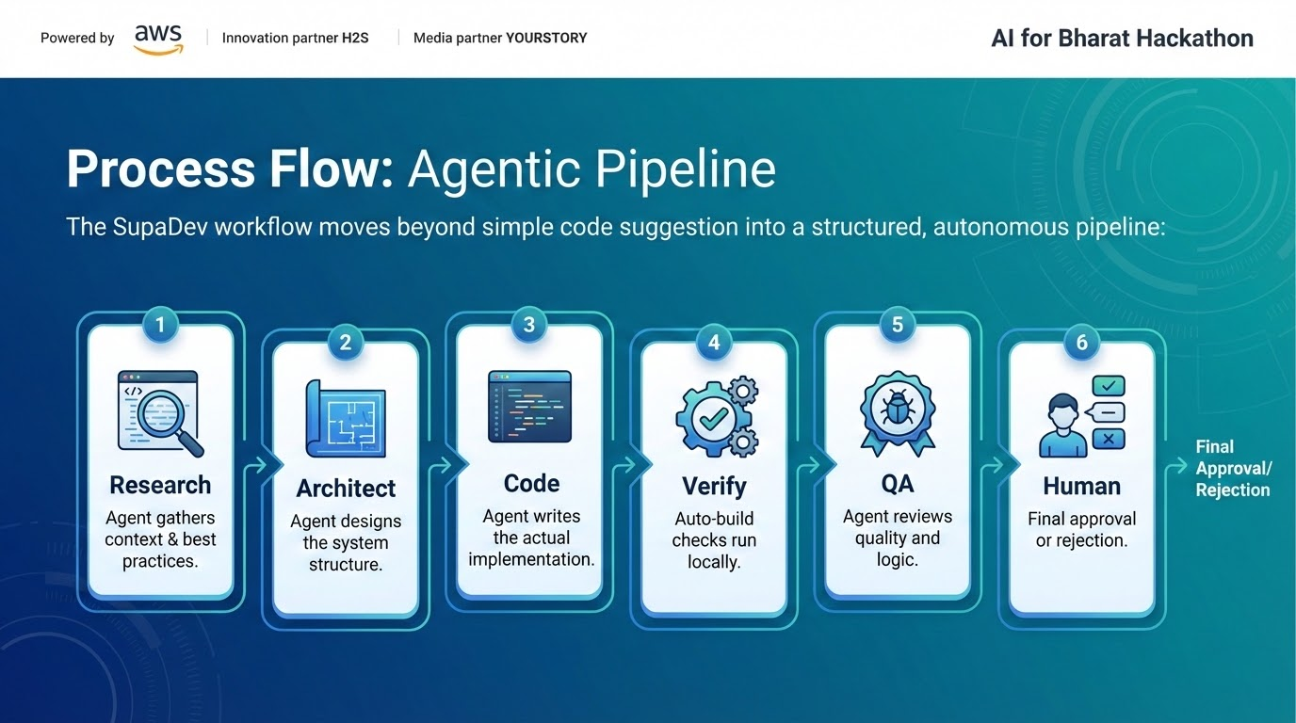

Slide 5

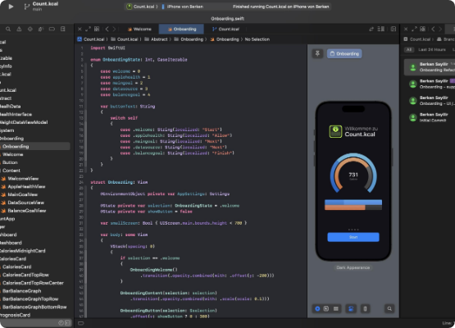

Powered by
aws
Innovation partner H2S
Media partner YOURSTORY
AI for Bharat Hackathon
Wireframes of the proposed solution
SupaDev Editor Interface
Integrated Terminal
Built-in terminal with AI command injection.
Git Graph
Visual commit history and hunk-level staging managed by agents.
Intelligent Debugger
One-click "Fix It" button that analyzes stack traces and applies patches.
The interface is designed to be familiar to VS Code users but streamlined for agentic interactions. The "Ghost Text" (purple overlay) shows agent suggestions in real-time.

Slide 6
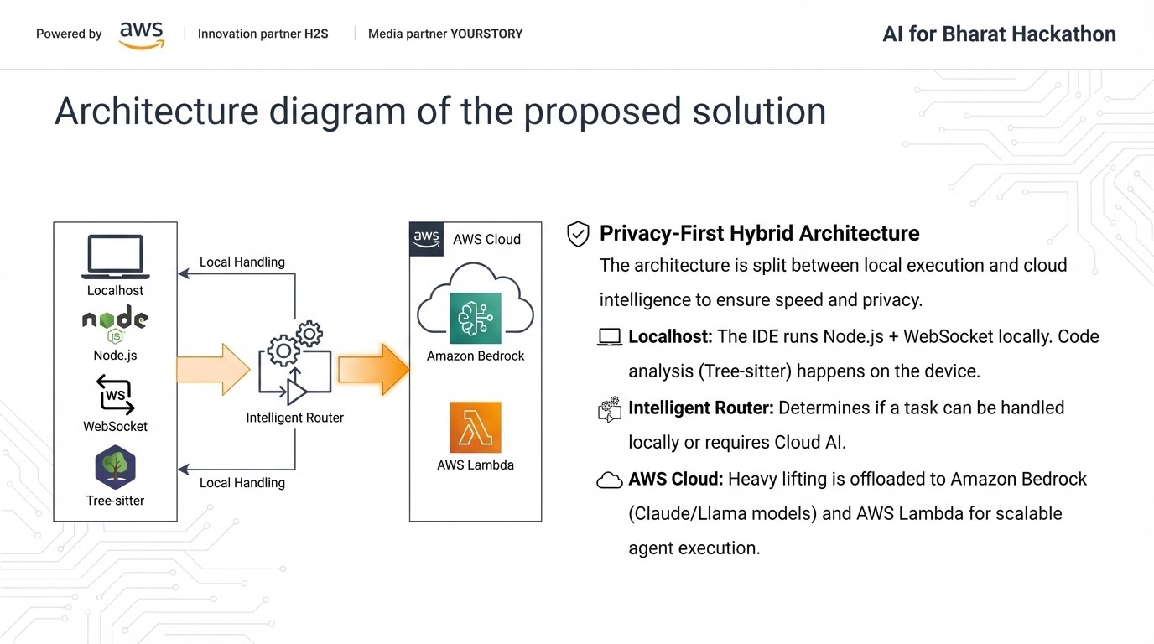

Slide 7






Powered by
aws
Innovation partner H2S
Media partner YOURSTORY
AI for Bharat Hackathon
Technologies to be used in the solution
Core Frameworks
AWS Cloud Stack
•
Swift (AppKit/SwiftUI): For native macOS performance.
•
Tree-sitter: For high-performance syntax highlighting and code parsing.
Amazon Bedrock
AWS Lambda
Amazon S3
•
LLDB: Integrated debugging infrastructure.
•
Node.js: Local backend and extension host.
AWS CodePipeline

Slide 8
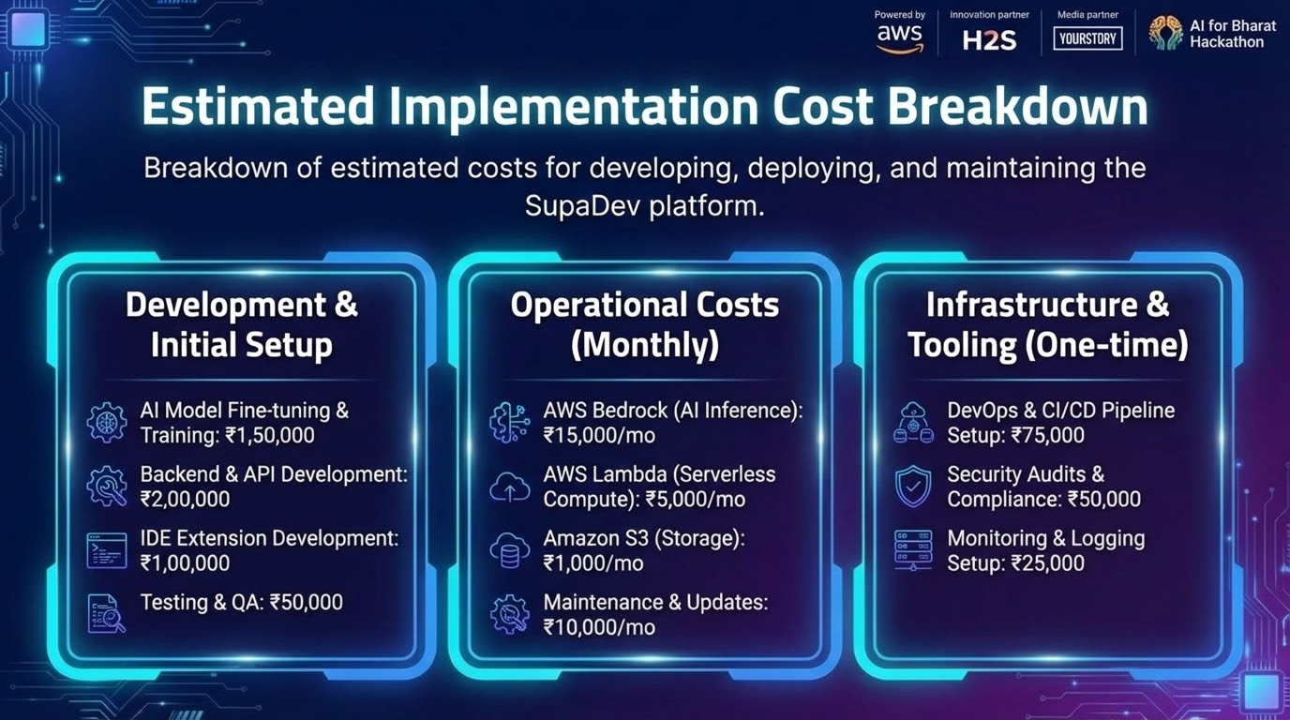

Slide 9


Innovation partner H2S Media partner YOURSTORY
AI for Bharat Hackathon
AI for Bharat Hackathon
Powered by aws
Thank You

