Slide 1

VISVESVARAYA TECHNOLOGICAL UNIVERSITY
“JNANA SANGAMA”, BELAGAVI - 590018
K.R PET KRISHNA GOVERNMENT ENGINEERING COLLEGE, K.R PET -571426
Department of Computer Science & Engineering
Mini Project of 6th semester
on
“STOCK MARKET PRICE PREDICTION USING MACHINE LEARNING”
Presented by
HAMSA D M 4GK21CS016
MADHUSHREE C K 4GK21CS020
PRIYANKA B R 4GK21CS034
SHIVAYOGI A M 4GK21CS044 Under the Supervision of
Project Guide Head of the Department
Dr Hareesh k Dr Hareesh K Assistant Professor Assistant Professor and HOD
Department of CSE 2023-24

Slide 2
CONTENTS:
Abstract
Introduction
Literature survey
Existing system
Problem statement
Objectives
Advantage and Disadvantage
Conclusion
Reference

Slide 3
Abstract:
Introducing Machine Learning algorithms has shown the feasibility of stock market price forecasting.
This study employs advanced Machine Learning models that can predict stock price movements with the right level of accuracy.
In this research work, the LSTM model, which is a type of Recurrent Neural Network (RNN), time series forecasting Facebook Prophet algorithm and Random Forest.
Remarkably, the LSTM model exhibits significant accuracy, yielding the best results with evaluation metrics, including RMSE (0.35), MAPE (0.50%), and MAE (0.30).

Slide 4

Introduction:
The stock market constantly fluctuating in the fast-paced financial sector, finding it challenging to formulate reliable stock predictions.
Machine learning (ML) is becoming a strong tool for intelligent investment management that can help investors do better at buying and selling stocks.
This study distinguishes between Mean Absolute Percentage Error (MAPE), Mean Absolute Error (MAE), and Root Mean Square Error (RMSE).
The global stock market value has topped 68.654 trillion US dollars, according to a (World Bank, 2023) study.

Slide 5
Literature Survey:
Predicting stock prices, a number of deciding algorithms, such as fuzzy systems, decision trees, neural networks, and genetic algorithms, have been developed.
Stock market data prediction is based on a Neural Network Approach in research by Yoon and Swales (1991), including both quantitative and qualitative elements for decision-making.
The study uses neural networks and Support Vector Machines (SVM) in recognition of ARIMA's limits in capturing nonlinear patterns.

Slide 6
Existing system
Traditional statistical Models: Autoregressive integrated moving average(ARIMA),Generalized autoregressive conditional(GARCH)
Basic Machine Learning Models: Linear regressions, support vector machines(SVM)
Deep learning models: Long short-term memory networks(LSTM),CNN
Research publications:Numnerous Academic papers
Financial Instituitions:utilize proprietary algorithms e.g., Renaissance Technologies ext.

Slide 7
Problem statement
Predicting stock market prices using machine learning techniques involves developing models that can analyze historical data, identify patterns, and make future price forecasts. The challenge lies in handling the complexity and volatility of financial markets, where multiple factors influence stock prices. Machine learning algorithms such as regression, time series analysis, can be applied to historical stock data, incorporating features like past prices, trading volumes, and market indicators to train predictive models.

Slide 8
Objectives
Develops models that can predict future stock prices with high accuracy.
Strategies that maximize returns while minimizing risks through automated system.
Models that adapt to changing market condition and remain robust over time.
User-friendly interface.
Educational Insights and learning opportunities for investors to understand market dynamics.

Slide 9
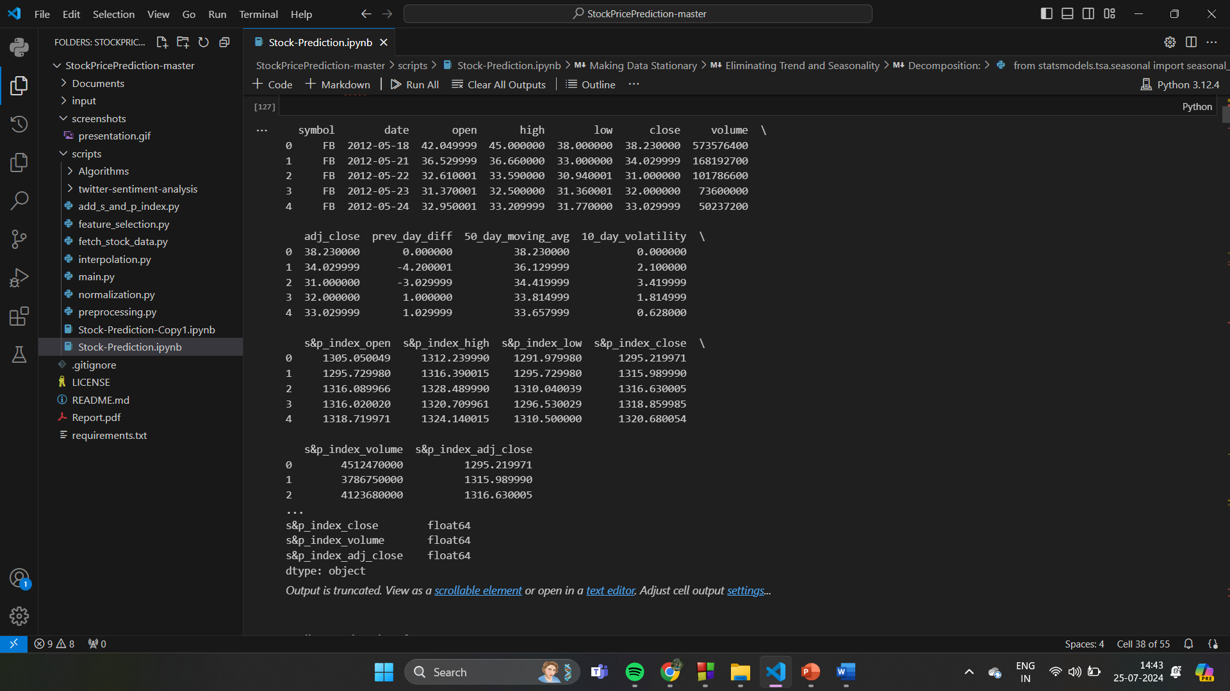
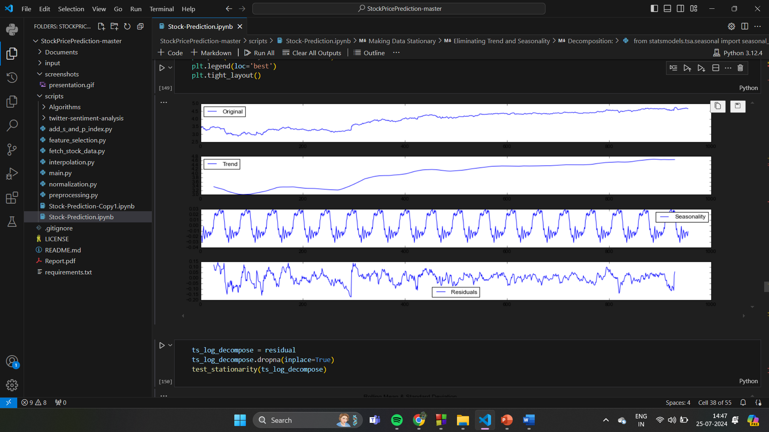
snapshots
Distribution of datasets
2D distributions

Slide 10
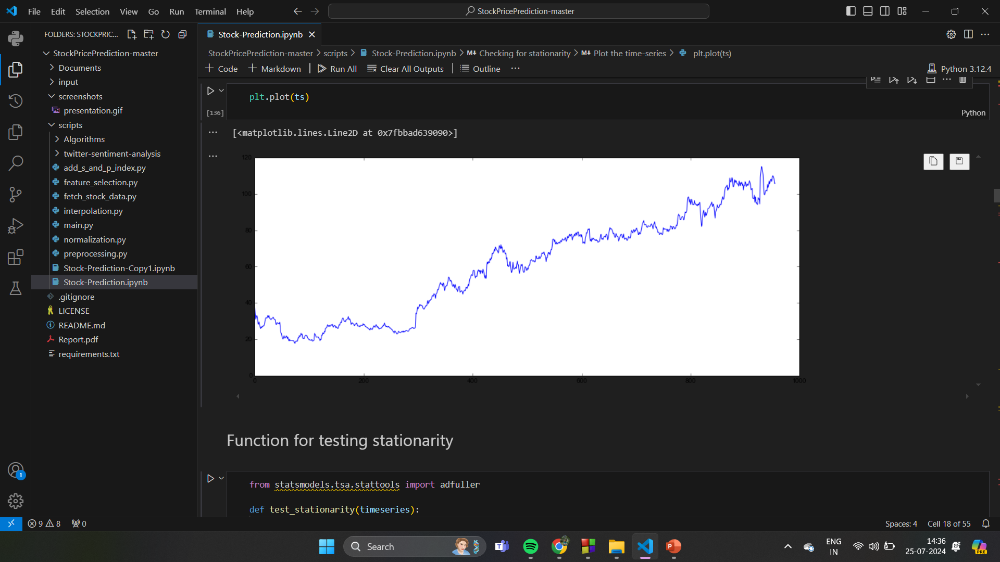
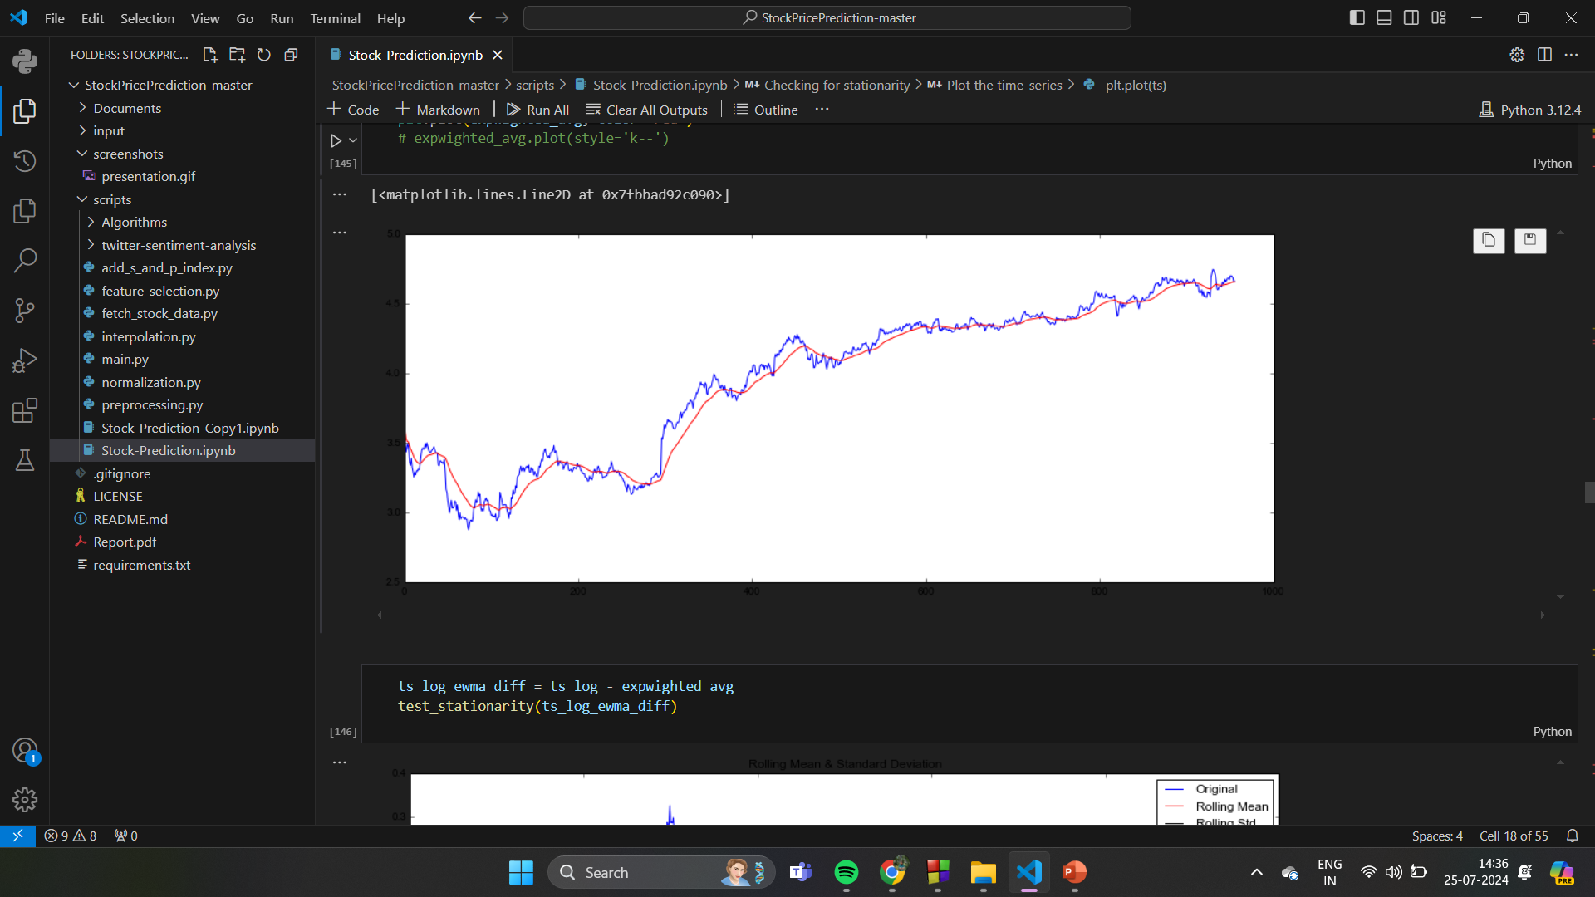
Representation of datasets

Slide 11
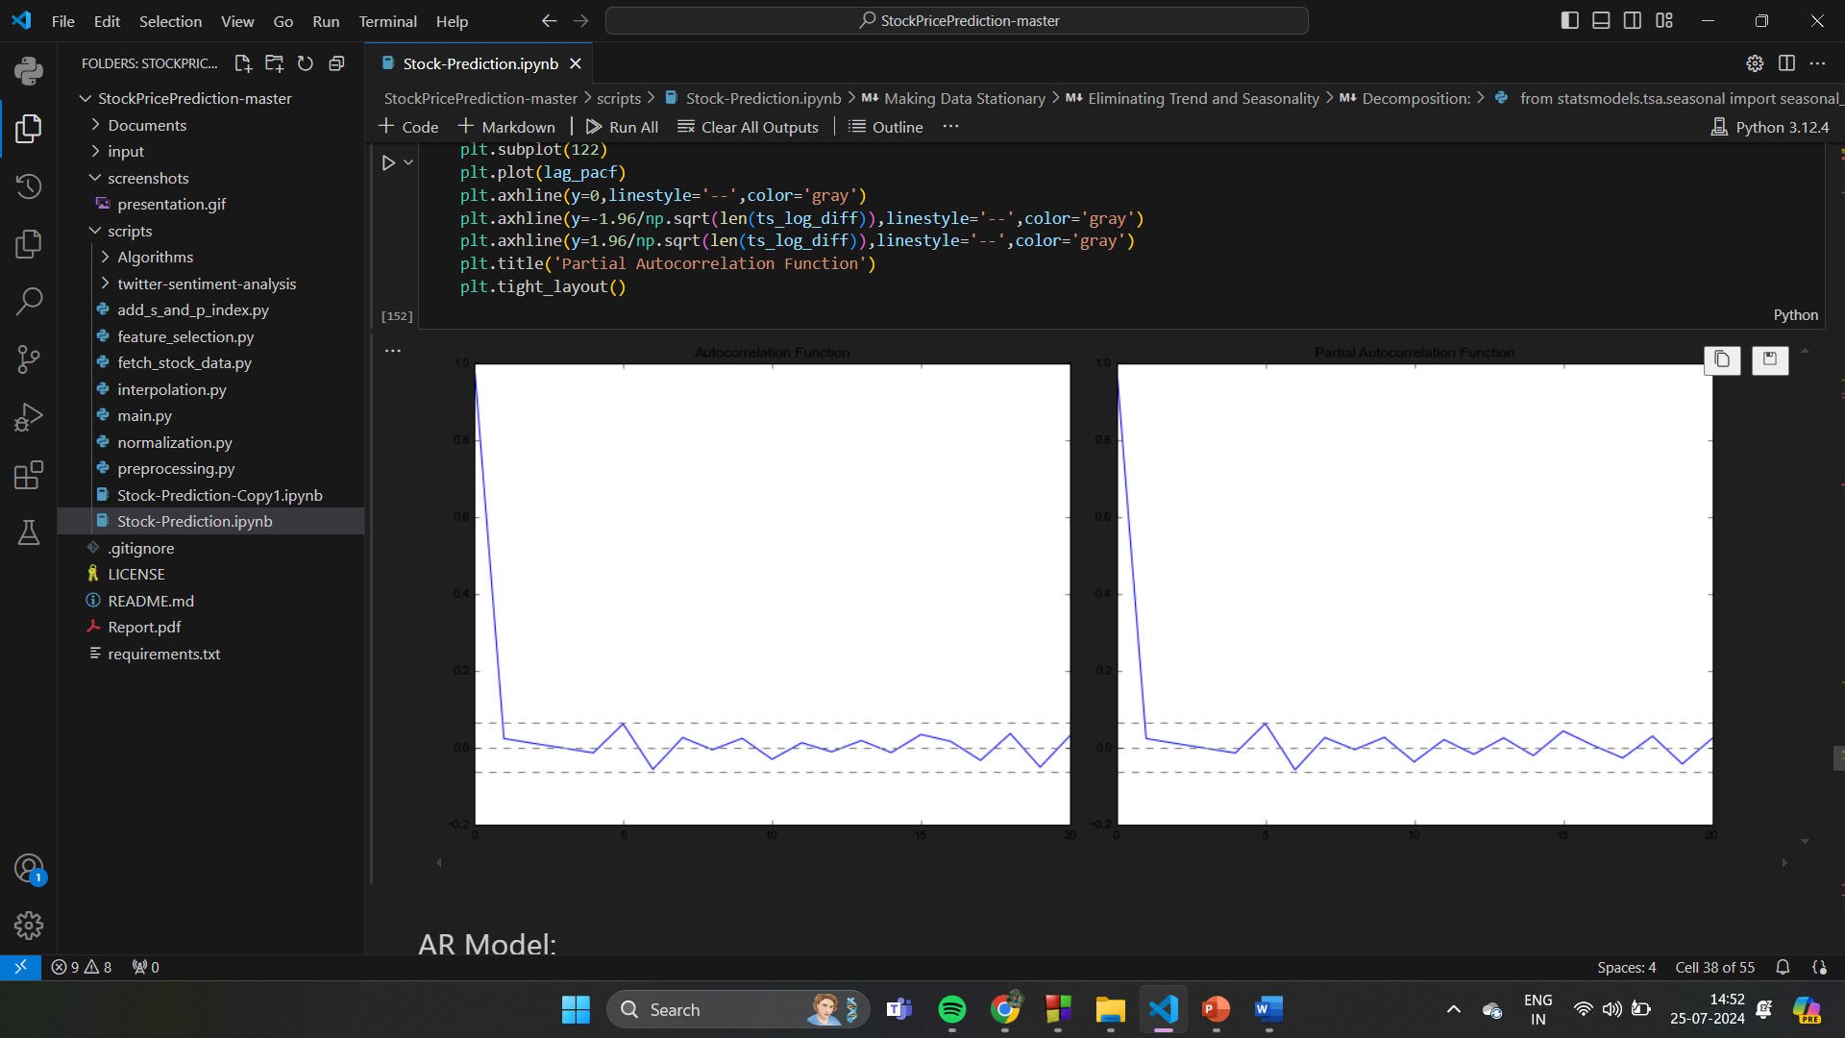
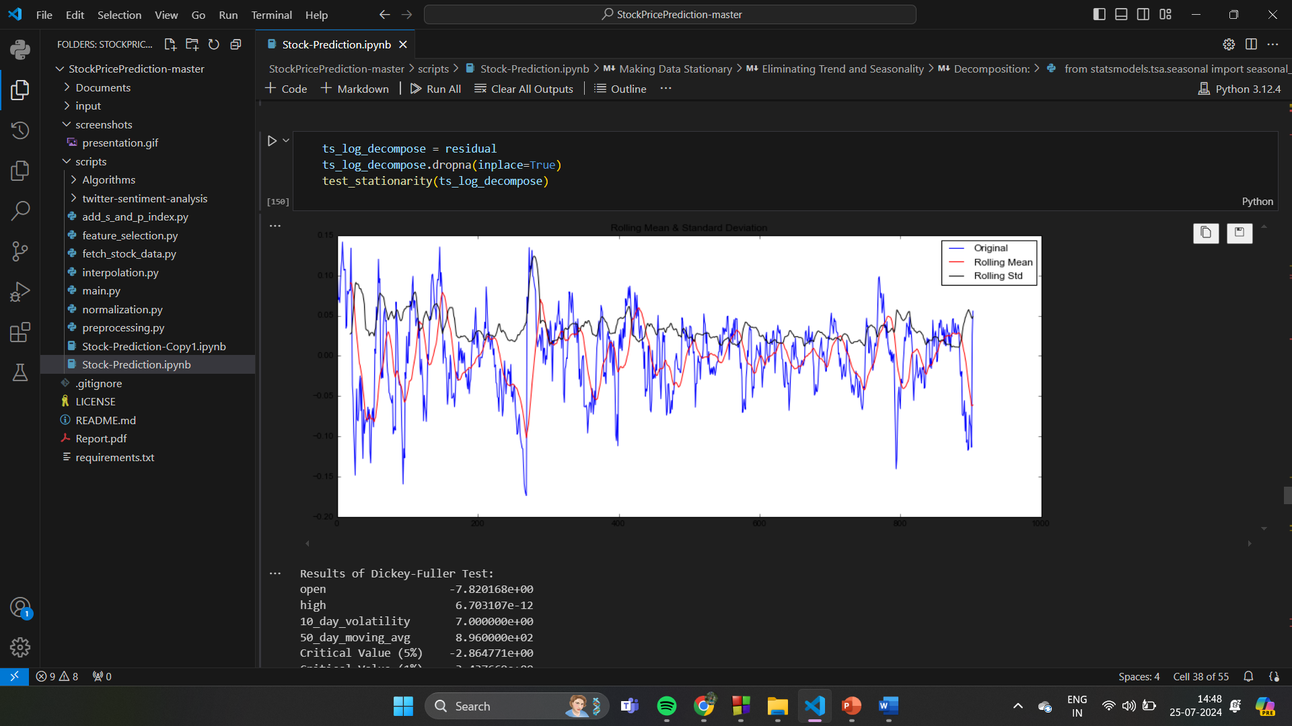
Open stock price

Slide 12
Advantages
Improved Accuracy
Automation and efficiency
Risk management
Incorporation of diverse data sources
Enhanced portfolio management
Scalability and consistency

Slide 13
Disadvantages
Inaccurate predictions: poor Quality or incomplete lead to erroneous predictions.
Model overfitting: This Leads to Noise.
Market volatility and Unpredictability: external factors ,Black swan events
High computational cost.
Dependency on historical Data: Past performance limitations.
Ethical and logical risks.

Slide 14
Conclusion
This project explores the use of machine learning models, specifically LSTM, Facebook Prophet, and Random Forest Regressor, to improve stock market sentiment forecasting. The study contributes to the evolving discourse on stock market prediction, providing and understanding of machine learning models' capabilities and limitations. Further exploration and refinement of predictive techniques are essential for staying ahead in the dynamic financial market landscape.

Slide 15
References
Article in American International Journal of Sciences and Engineering Research ·February 2024
https://www.researchgate.net/publication/378008818
Yoon, Y., & Swales, G. (1991, January). Predicting stock price performance
Dhaka Stock Market Historical Data. Retrieved from https://www.dsebd.org
https://github.com
Yu, L., Chen, H., Wang, S., & Lai, K. K. (2008). Evolving least squares support vector machines for stock market trend mining. IEEE Transactions on evolutionary computation, 13(1), 87-102
Mehta, Yash, Atharva Malhar, and Radha Shankarmani. "Stock Price Prediction using Machine Learning and Sentiment Analysis." 2021 2nd International Conference for Emerging Technology (INCET). IEEE, 2021.

