Slide 1
Employee Engagement, Satisfaction, and Burnout Diagnostic Analysis AT Palo Alto Networks
Name: Madhushree S G
Internship ID: UMID07022680379

Slide 2
PROJECT OVERVIEW
This project analyzes employee engagement and burnout risk
Uses employee satisfaction and workload data
Calculates Engagement Index
Identifies burnout risk employees
Applies machine learning models
Provides Streamlit dashboard for HR insights

Slide 3
OBJECTIVES
Measure employee engagement level
Identify employees at risk of burnout
Analyze overtime and work-life balance
Study engagement across job roles
Provide data-driven HR insights
Improve employee productivity and retention

Slide 4
PROBLEM STATEMENT
Employees face high workload and stress
Burnout leads to disengagement
No early detection system
HR decisions are reactive
Need predictive analytics solution

Slide 5
DATASET OVERVIEW
Job Satisfaction
Environment Satisfaction
Work Life Balance
Overtime
Monthly Income
Job Role
Years at Company
Attrition

Slide 6
METHODOLOGY
Data Collection — Employee dataset gathered containing satisfaction, workload, and demographic features.
Data Preprocessing — Cleaned data, handled missing values, and encoded categorical variables.
Exploratory Data Analysis — Analyzed patterns between engagement, overtime, and work-life balance.
Engagement Index Calculation — Combined satisfaction metrics to measure overall employee engagement.
Burnout Risk Classification — Identified high-risk employees using overtime and work-life balance.
Machine Learning Model — Trained models to predict engagement and burnout risk.
Dashboard Development — Built Streamlit dashboard to visualize insights and predictions.

Slide 7
KEY FEATURES
Engagement Index
Burnout Risk Score
EDA Visualizations
Machine Learning Prediction
Interactive Dashboard

Slide 8
RESULTS
Overtime reduces engagement
Poor work-life balance increases burnout
Job satisfaction improves engagement
High burnout leads to attrition

Slide 9
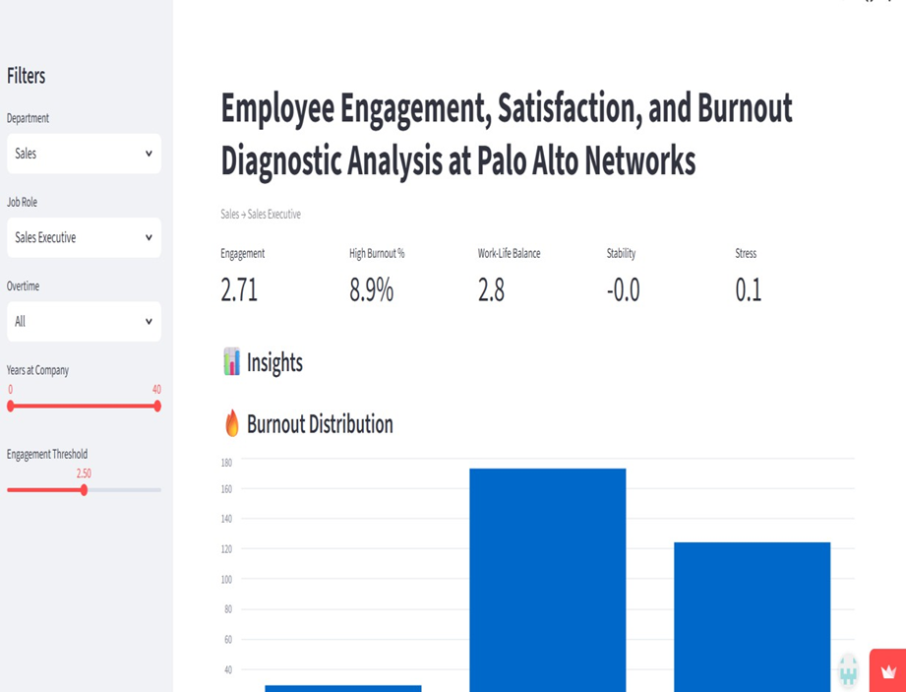

Slide 10
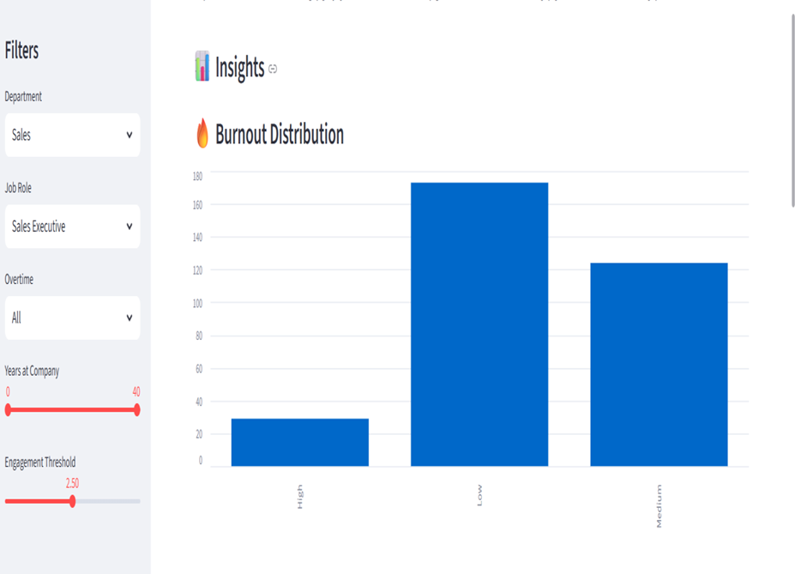

Slide 11
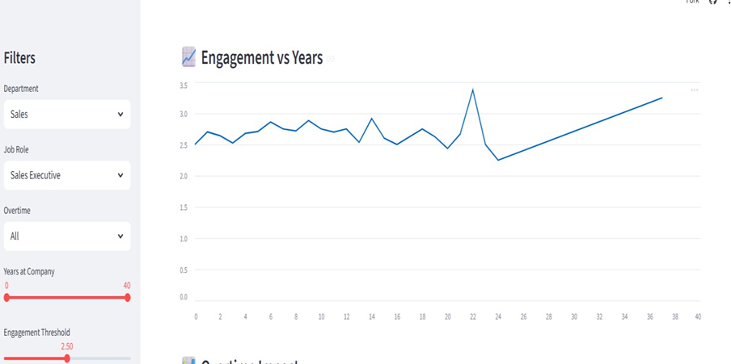

Slide 12
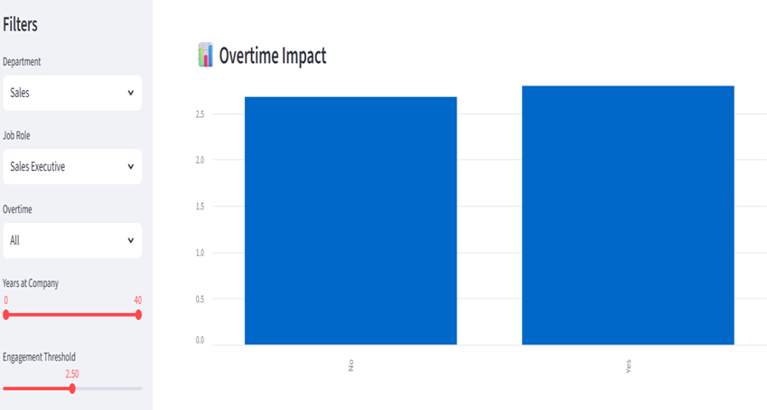
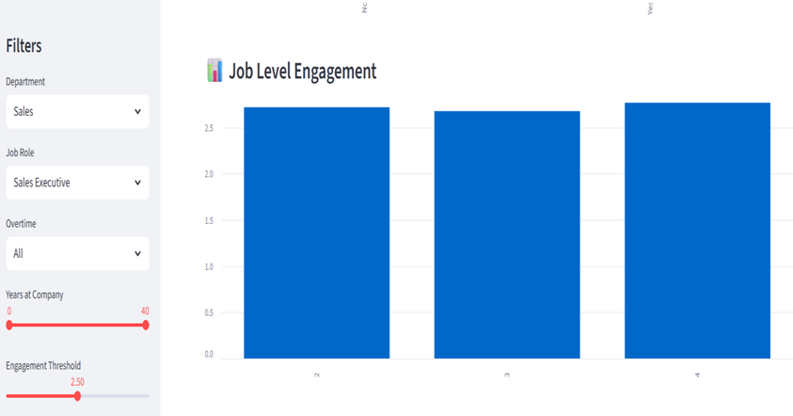

Slide 13
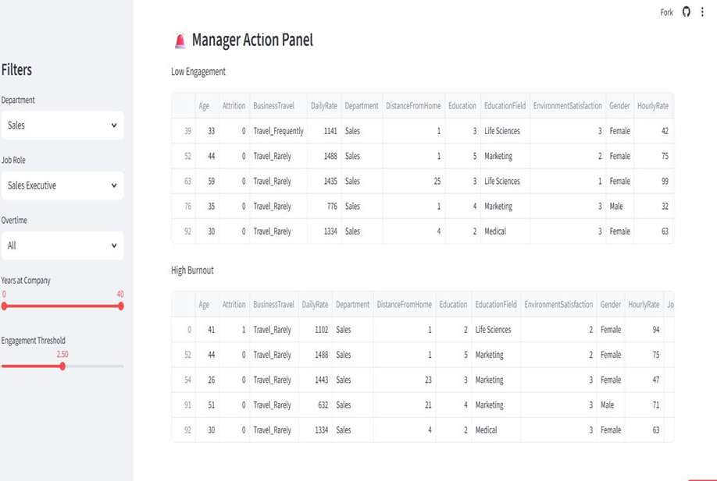

Slide 14
THANK YOU

