Slide 1
Reducing Inappropriate Hospitalizations (ACSC)
Big Data Health Science Case Competition
February 5th ,2022
B5 Team Powerpuff Analysts

Slide 2
Introduction
Ambulatory Care Sensitive Conditions (ACSC) are medical conditions for which timely and appropriate outpatient care and reduce the risk of hospitalization.
These are majorly due to onset of illness or managing a chronic illness or condition.
We identified the recovery rules that contribute to the identification of a hospitalization due to ACSC

Slide 3
Effects of Inappropriate Hospitalizations
Costly
Spread of infections
Scarce in hospital resources

Slide 4
What we did?
Elimination |  | Eliminate irrelevant predictors
Data preparation |  | Impute missing data, handled outliers
Exploratory Data Analysis |  | Visualize data and evaluate relationships between the predictors and the target FLAG variable
Modelling |  | Ran models and got insights on the most contributing variable

Slide 5
Data Overview
Datasets are from Year 2016 to 2020
Close to 10% of false hospitalizations occurred in 2020
Data Shape: approximately 2.5M rows, 212 columns per year
Predictors Eliminated: DAYS, COUNTY
Reduced columns from 212 to 11

Slide 6
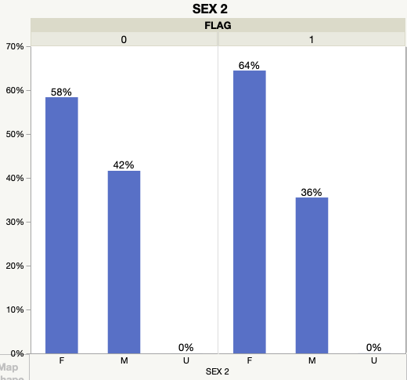
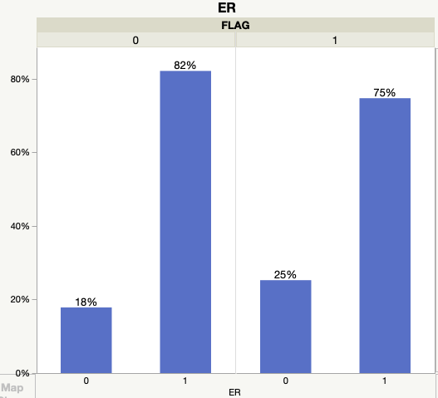
2019 Findings
Women are admitted more with
ACSC conditions.
People admitted in the ER
considered ACSCs are more than
those not admitted.

Slide 7
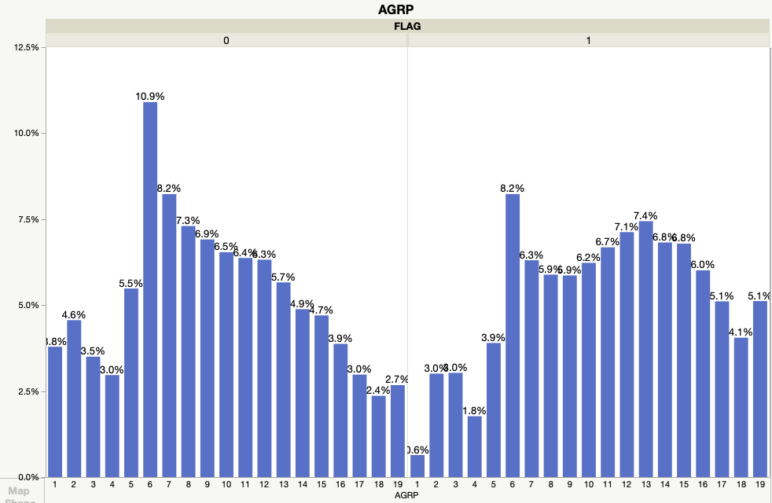
2019 Findings
Patients in age group 6 are the highest in being identified with ACSC conditions.

Slide 8
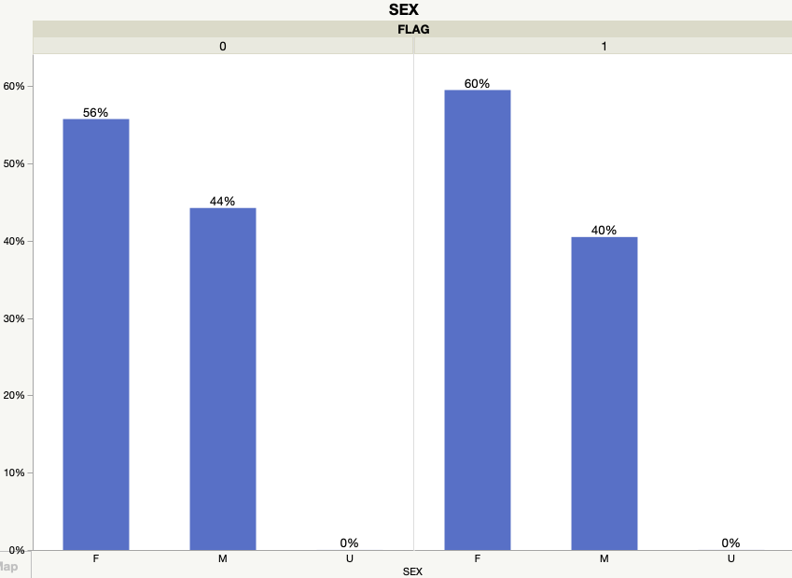
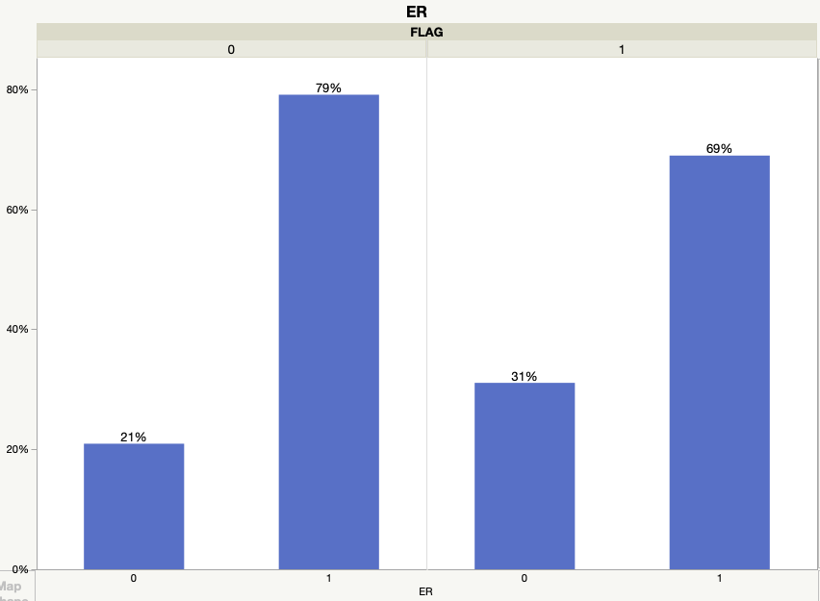
2020 Findings
Women are admitted more with
ACSC conditions.
69%of patients admitted in ER are identified with ACSC conditions.

Slide 9
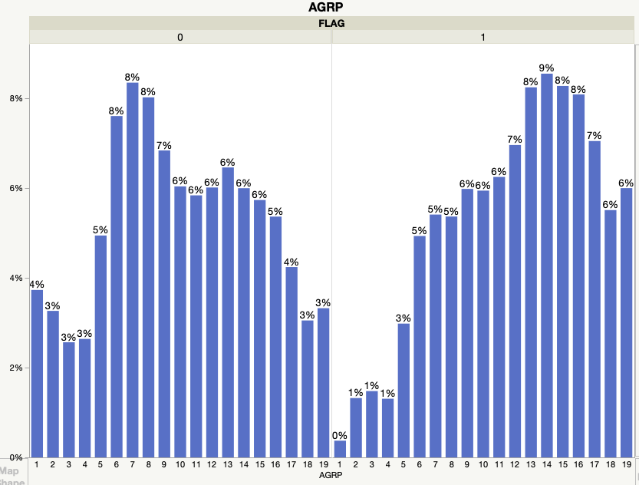
2020 Findings
Patients in age group 14 are the highest in being identified with ACSC conditions.

Slide 10
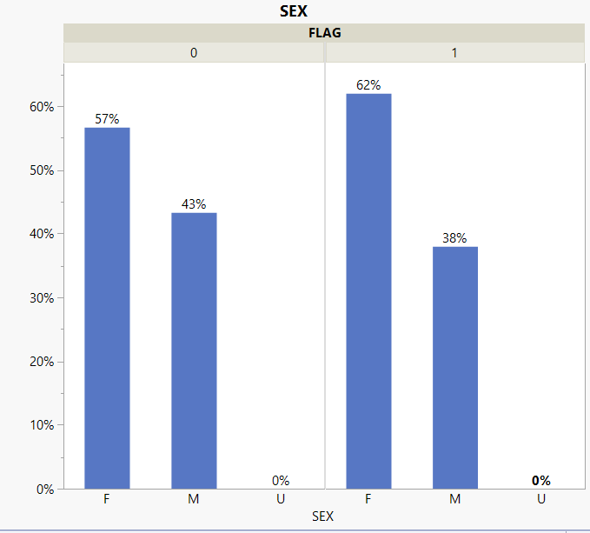
2018 Findings
Women are also admitted more with
ACSC conditions.

Slide 11
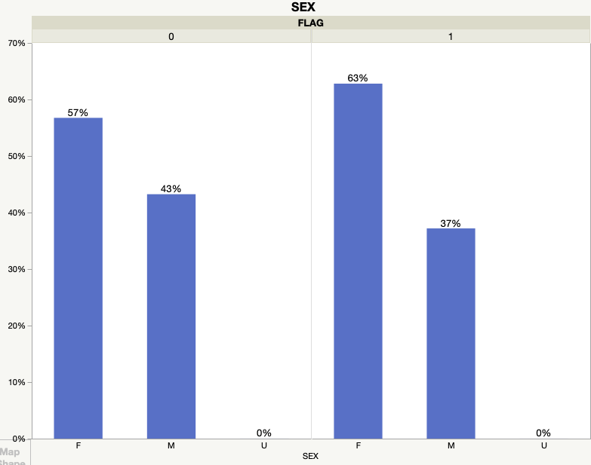
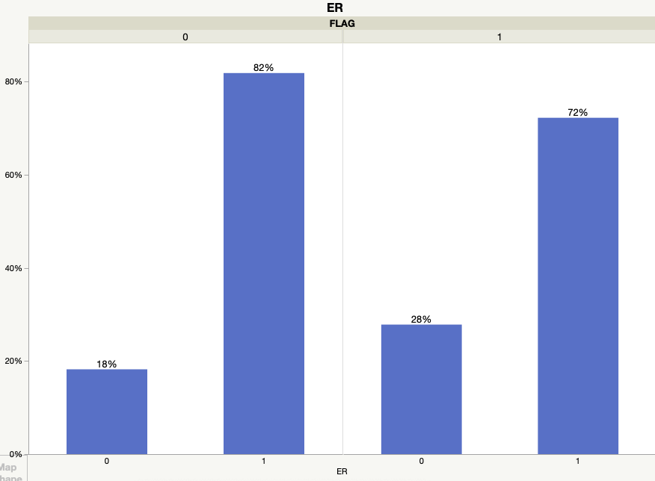
2017 Findings
Women are admitted more with ACSC conditions.
People admitted in the ER considered ACSCs are more than those not admitted.

Slide 12
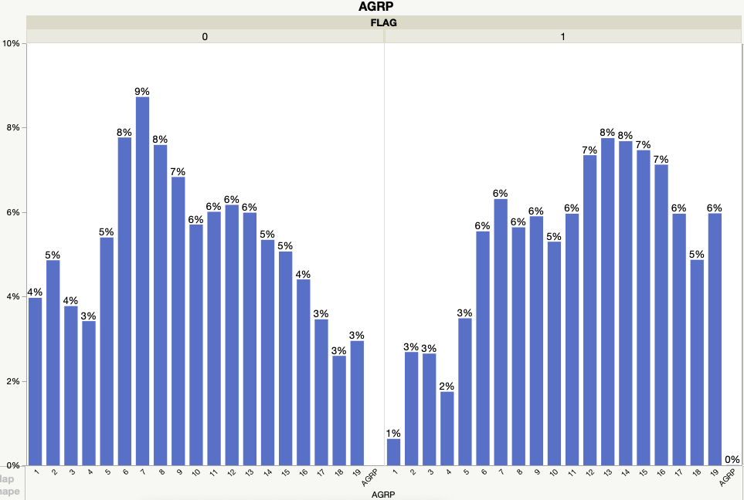
2017 Findings
Patients in age group 13
are the highest
in being identified with
ACSC conditions.

Slide 13
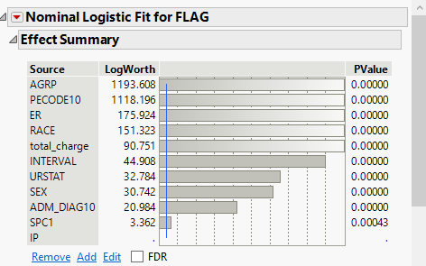
Variable Contribution
Major Contributor:
AGRP
PECODE10
ER

Slide 14
CONCLUSIONS & RECOMMENDATIONS
Avoid of hospital admissions due to ACSC conditions are likely to be more cost efficient. (Ref 1)
As women are admitted more with ACSC conditions, they should be provided with more primary care and better insurance facilities.(Ref 1)
As more patients admitted in ER are identified with ACSC condition, primary care can help in reduction of the hospital load and make space for the people who needs appropriate treatment.
As patients in age group 6 are the highest in being identified with ACSC conditions, they should be taken care. (Ref 2)
Notes:
Ref1: Patients Characteristics Associated With Hospitalizations for Ambulatory Care Sensitive Conditions In South Carolina, Shi. L, et al. ,NIH, National Library of Medicine.
Ref2: Ambulatory care sensitive condition Hospitalizations Among Rural Children, Policy Brief

Slide 15
THANKS!
Any questions?

