Slide 1
Identifying Underlying
Cause Of
False Hospitalizations
Big Data Health Science Case Competition
February 6th ,2022
Team 2 - Powerpuff Analysts

Slide 2
Problem Statement
Sometimes, patients might have been admitted into the hospital if required or not. Sometimes, even if needed, the hospitalization might not take place. This would result in many casualties.
Investigate underlying causes and the factors influencing false hospitalizations/dismissals.
Find whether the patients were hospitalized correctly or not

Slide 3


What we did?
Examined carefully each column and eliminated unnecessary predictors
Elimination
Data Sampling
Implemented a sampling strategy to get a good
representation of the data
Data Preparation
Impute missing data, handle outliers
Exploratory Data Analysis
Visualize data and evaluate relationships between predictors
Modelling
Model the data and conclude key contributors.

Slide 4
Data Overview
Datasets are from Year 2016 to 2020
Actual hospitalizations account for approximately 8% for each year
Data Shape: approximately 2.5M rows, 213 columns per year
Reduced columns from 213 to 13 predicting variables

Slide 5
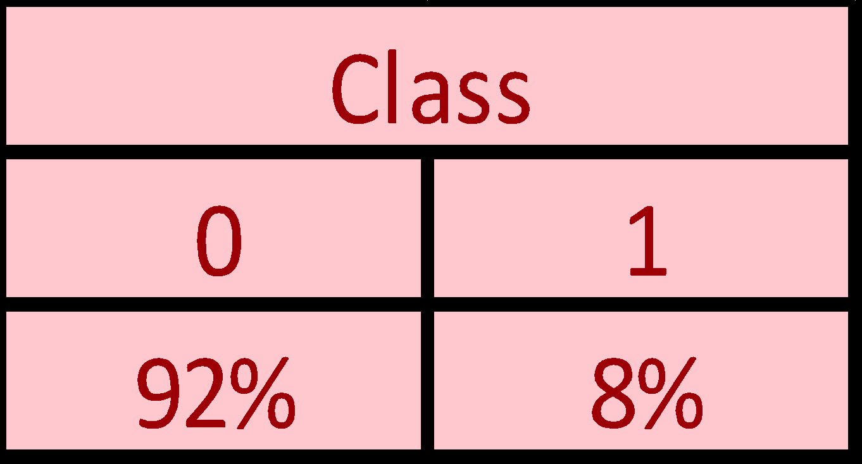
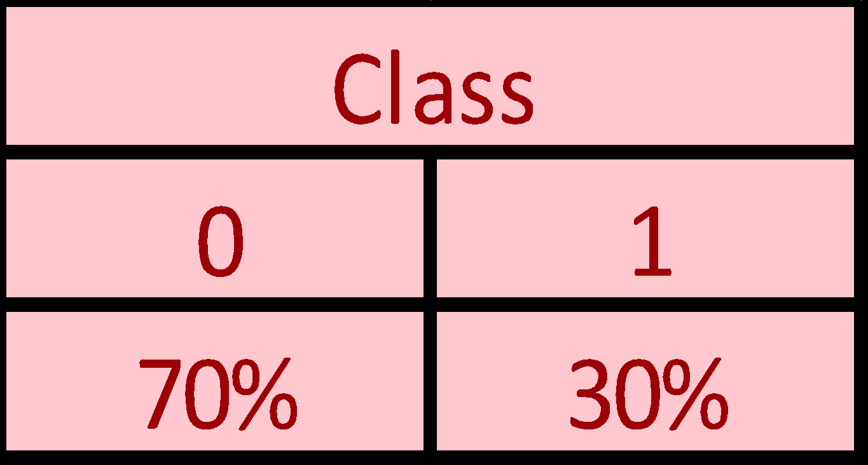
Sampling Strategy
Chosen sample size of 10,000
in each year
Oversampling done. 30% are “1”
and 70% are “0”
Final modeling was done on 50,000 samples maintaining
the “0” class 70%
and “1” class 30%
Original True Proportion for
Actually Hospitalized
Data Proportion
After Resampling

Slide 6
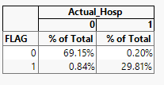
ACSC_Flag Variable VS Actual_Hosp

Slide 7
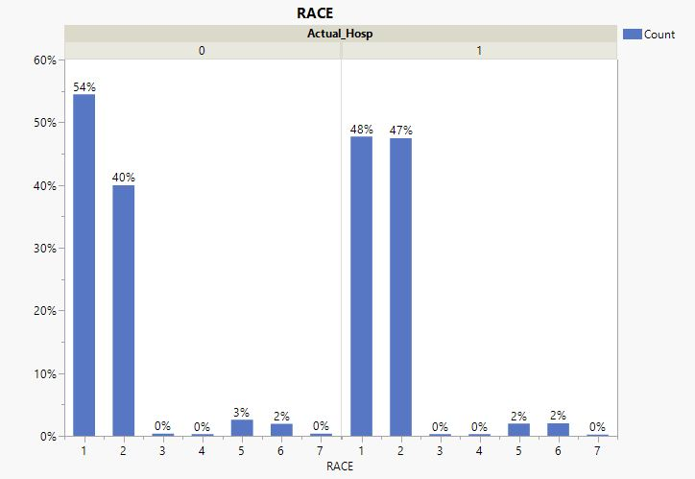
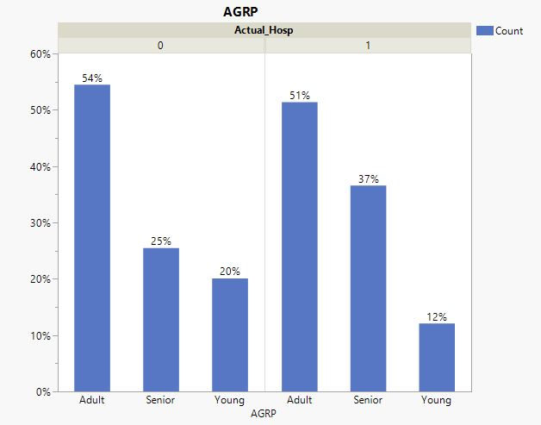

Findings
Race
Age Group
Notes:
Implicit Bias and Racial Disparities in Health Care, by Khiara M. Bridges, ABA
Ageism in the Health Care System: Providers, Patients, and Systems, Mary F. Wyman, SpringerLink

Slide 8
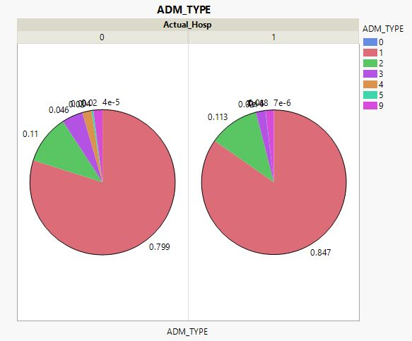
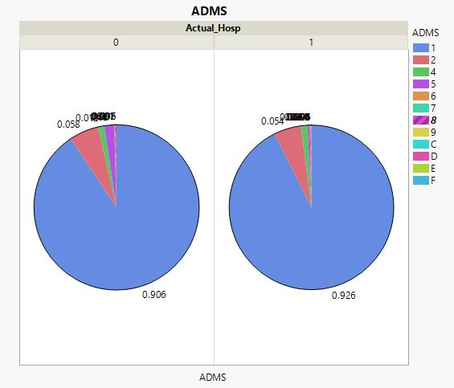
Findings
Confusion Matrix for
Actually Hospitalized
Admission Type
Point of Origin for Admission or Visit (Admission Source)

Slide 9
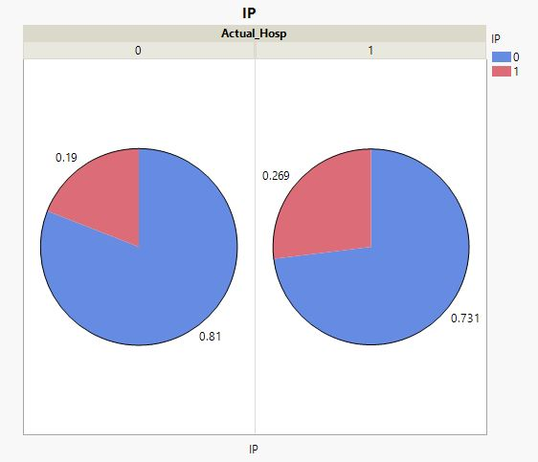
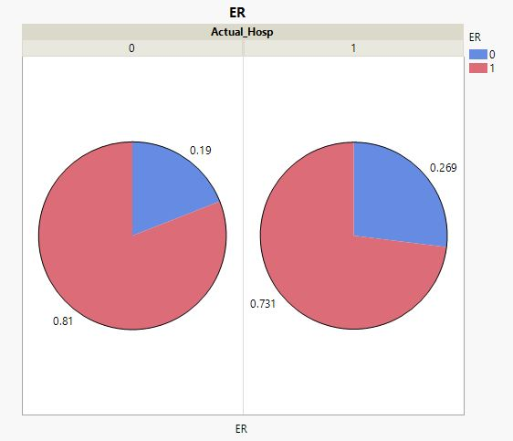
Findings
Inpatient Flag
Emergency flag

Slide 10
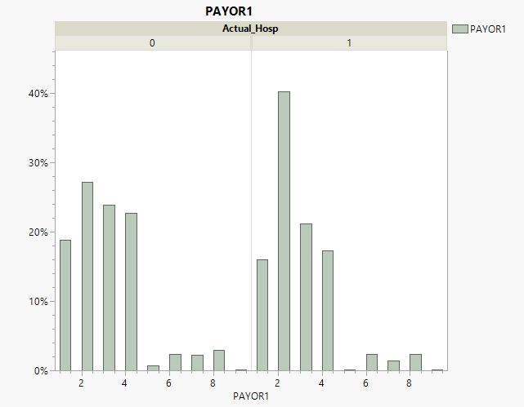
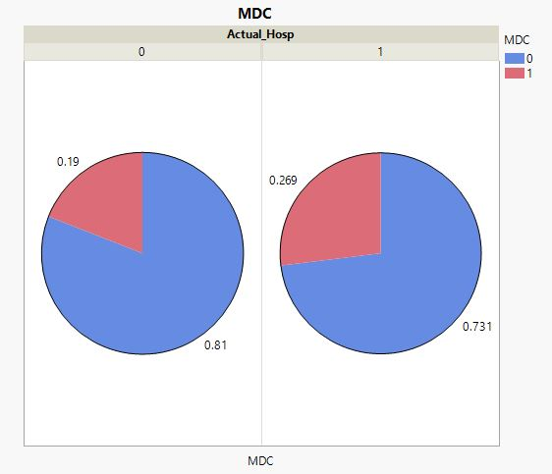
Findings
Primary Payor
Major Diagnostic Category
Notes:
Reports of Insurance-Based Discrimination in Health Care and Its Association With Access to Care, Xinxin Han et Al, NCBI

Slide 11

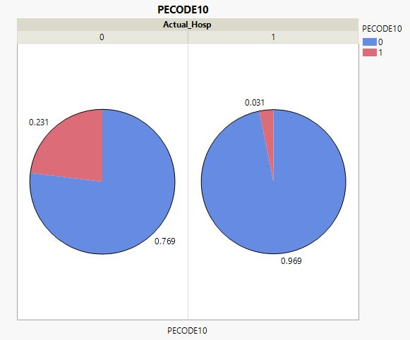
Findings
Primary Present on Admission Indicator
External Cause Of Injury Code ICD-10-CM

Slide 12
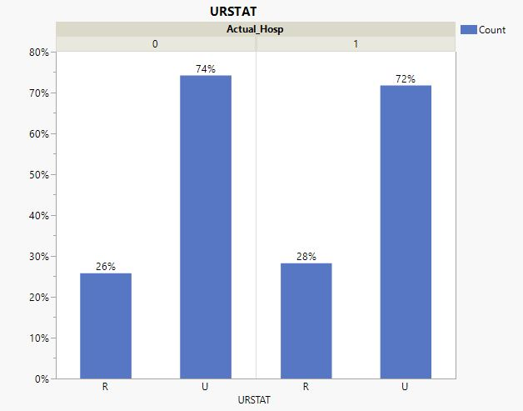
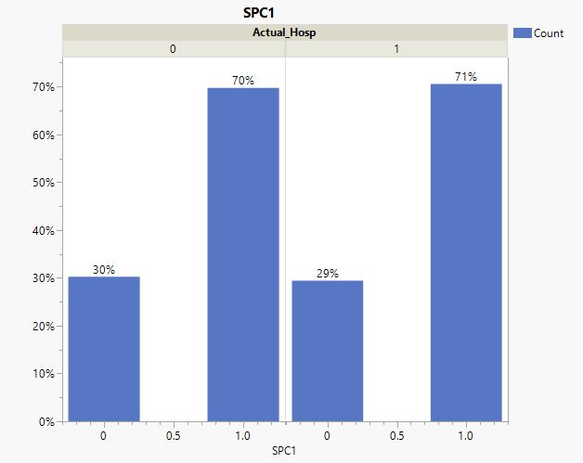
Findings
1st Physician Speciality
Urban Rural Status

Slide 13
Modeling Strategy
Data
Train Data (90%)
Test Data(10%)
Logistic Regression
Bootstrap Forest
Model Fits were validated using Test Data
Variable Selection by stepwise procedure
Final Model

Slide 14
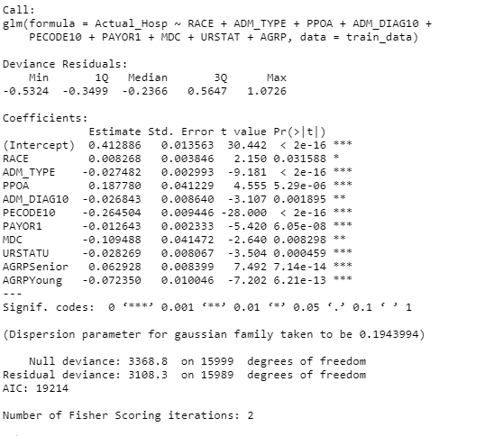
Logistic Regression Model

Slide 15
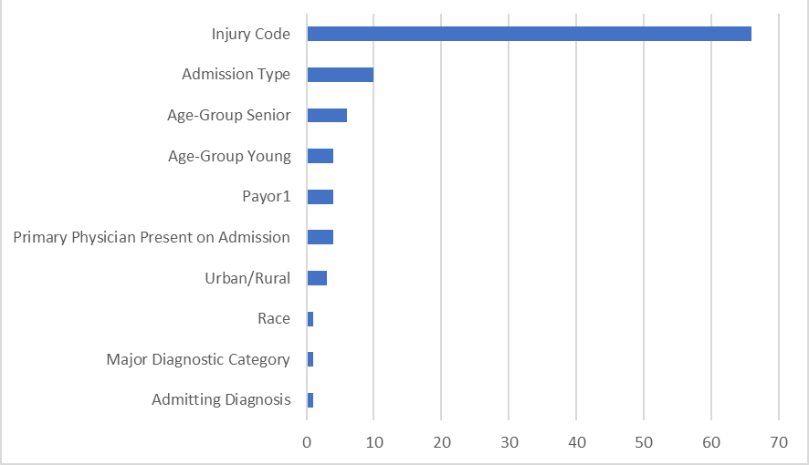
Variable Importance from Logistic Regression Model
Feature Importance using Log-worth Scores

Slide 16
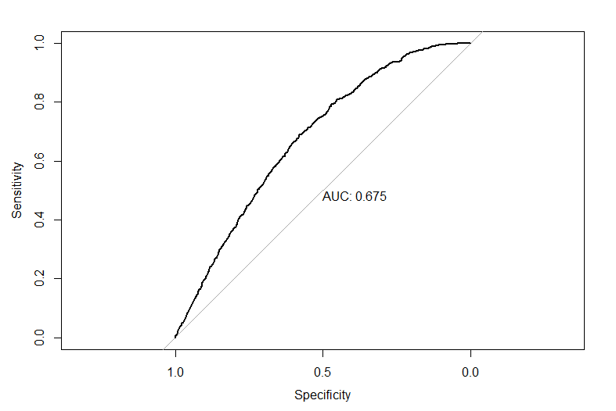
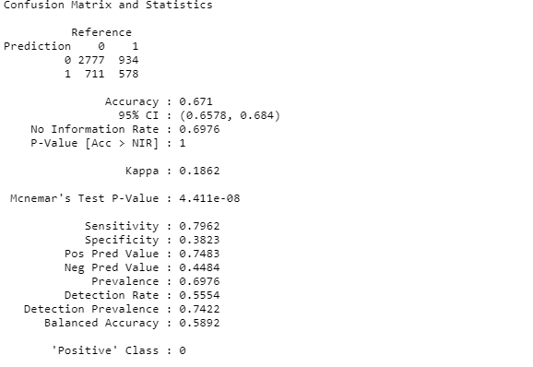
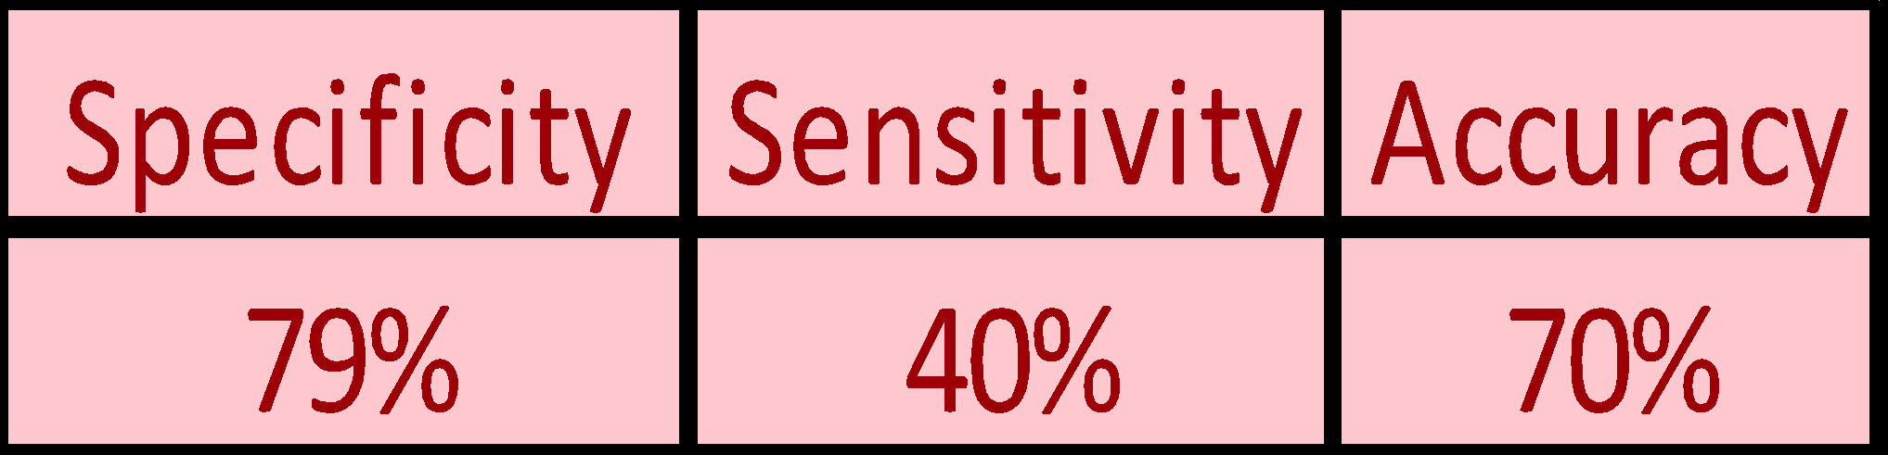
Model Validation
Confusion Matrix
ROC Curve

Slide 17
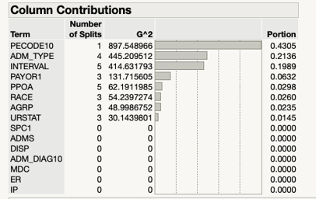
Column Contributions from Bootstrap Forest

Slide 18
CONCLUSIONS & RECOMMENDATIONS
We observed a Race bias in admissions to hospitals.¹
Urban Rural Status and having first physician speciality are not creating much difference in hospital admissions
A person hospitalized with injury is often dismissed as they are often having small injury
Age-group bias is there in hospitalizations and seniors are not dismissed.²
Admission type of a patient is a major contributor of the target variable “Actual_Hos”
Insurance is also acting as a bias in hospital admissions.³
The predictor variables we saw in Slide 15, the authority should focus on those parameters to do the hospitalizations correctly.
1.Implicit Bias and Racial Disparities in Health Care, by Khiara M. Bridges, ABA
2.Ageism in the Health Care System: Providers, Patients, and Systems, Mary F. Wyman, SpringerLink
3.Reports of Insurance-Based Discrimination in Health Care and Its Association With Access to Care, Xinxin Han et Al, NCBI

Slide 19
THANKS!
Questions?
Please, keep this slide for attribution.

