Slide 1
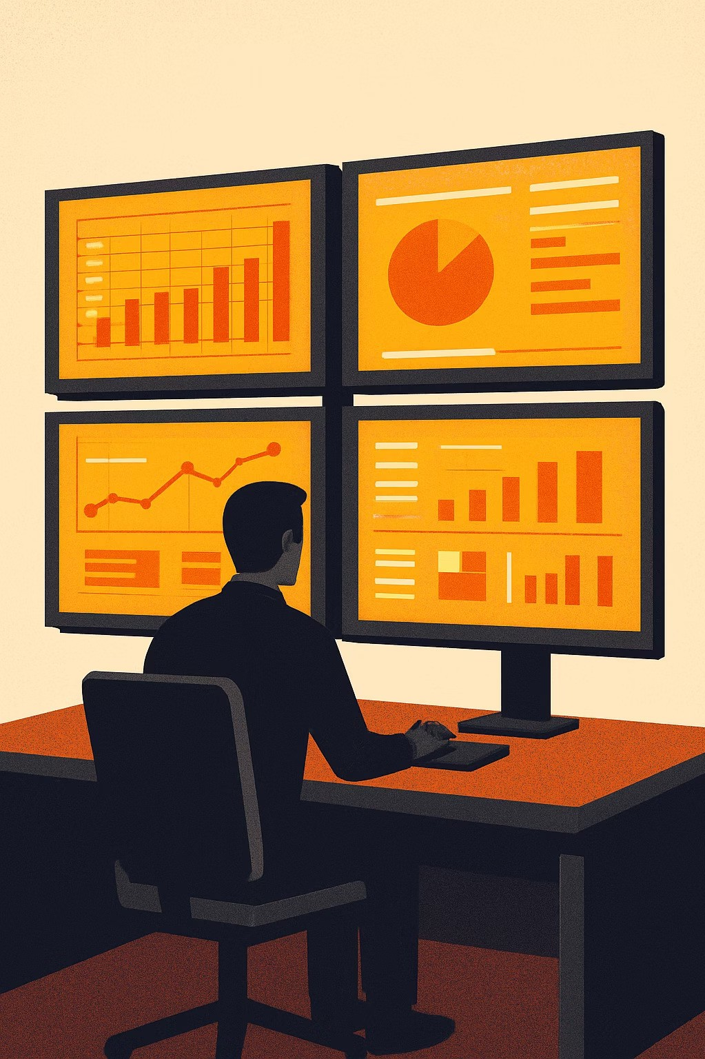
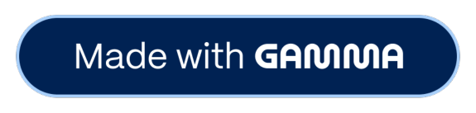
Customer Shopping Behavior Analysis
Uncovering spending patterns, customer segments, and product preferences from 3,900 transactions to guide strategic business decisions.

Slide 2
Dataset at a Glance
3,900
Purchases
18
Columns
37
Missing Ratings
Demographics
Age, Gender, Location, Subscription
Purchase Details
Item, Category, Amount, Season, Size
Behavior
Discounts, Frequency, Ratings, Shipping

Slide 3

Data Preparation in Python
01
Load & Explore
Imported with pandas; used df.info() and .describe()
02
Clean & Impute
Missing Review Ratings filled with per-category median
03
Feature Engineering
Added age_group and purchase_frequency_days columns
04
Export to PostgreSQL
Cleaned DataFrame loaded into database for SQL analysis

Slide 4
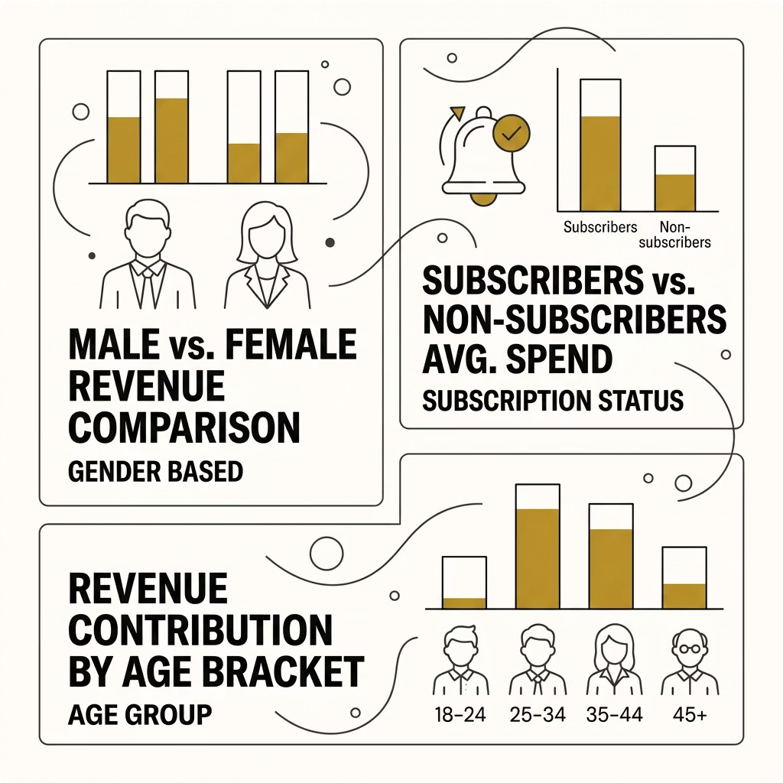
SQL Analysis: Revenue Insights
Revenue by Gender
Compared total revenue from male vs. female customers.
Subscribers vs. Non-Subscribers
Subscribers show higher average spend and total revenue contribution.
Revenue by Age Group
Identified which age segments drive the most revenue.

Slide 5
SQL Analysis: Customer Behavior
High-Spending Discount Users
Customers using discounts yet spending above average purchase amount
Discount-Dependent Products
Top 5 products with the highest % of discounted purchases identified
Repeat Buyers & Subscriptions
Customers with >5 purchases are more likely to subscribe

Slide 6

Customer Segmentation
Customers classified by purchase history into three segments:
2 New
First-time buyers
Returning
Moderate history
{ Loyal
High-frequency buyers

Slide 7

Product Performance
Top 5 by Rating
Products with the highest average review ratings surfaced via SQL
Top 3 per Category
Most purchased products ranked within each product category
Shipping Comparison
Express vs. Standard shipping 4 average purchase amounts compared

Slide 8
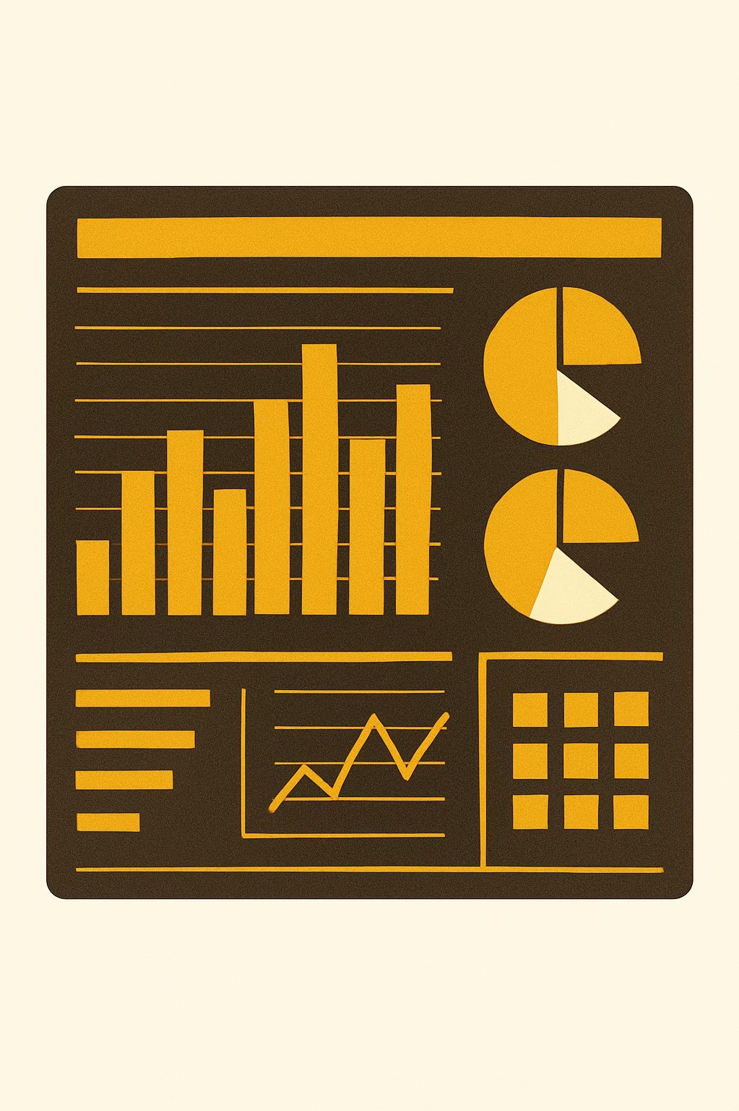
Power BI Dashboard
Interactive dashboard built to present all insights visually 4 enabling stakeholders to explore segments, revenue trends, and product performance at a glance.

Slide 9
Business Recommendations
1
2
3
Boost Subscriptions
Promote exclusive subscriber benefits
Loyalty Programs
Reward repeat buyers S move to "Loyal" segment
Review Discount Policy
Balance sales boosts with margin control
4
5
Product Positioning
Highlight top-rated & best-selling items in campaigns
Targeted Marketing
Focus on high-revenue age groups & express-shipping users

Slide 10

Key Takeaways
3,900 Transactions
Cleaned, engineered & analyzed end-to-end
Python + SQL + Power BI
Full analytics pipeline from raw data to dashboard
Actionable Insights
5 strategic recommendations ready for execution

