Slide 1

A
MAJOR PROJECT-II PRESENTATION
ON
“TECHTRENDS LEARNING”
Mahakal Institute of Technology,Ujjain
Department of Computer Science and Engineering
Presented By:
Madhusudan Narwadiya
0704CS211104
Manish Bhartiya
0704CS211108
Nikhil Patidar
0704CS211126
Piyush Saklecha
0704CS211134
  Under the guidance of:
  Prof. Mohammad Mudassar Khan
Notes:
EMC Update
October 2004

Slide 2
CONTENTS
INTRODUCTION
LITERATURE REVIEW
PROBLEM STATEMENT
ANALYSIS OVERVIEW
DESIGN OVERVIEW
LIMITATIONS & FUTURE SCOPE
SCREENSHOTS
CONCLUSION
REFERENCES

Slide 3
INTRODUCTION
TechTrends Learning is a MERN stack-based EdTech platform designed for seamless and interactive learning. It enables users to create, consume, and rate educational content, fostering an engaging learning ecosystem. With a focus on accessibility and user experience, it aims to revolutionize online education.
Key Points:
Comprehensive resources across various fields
Interactive tools to enhance learning
Progress tracking and expert guidance

Slide 4
LITERATURE REVIEW
Growth of online education globally
Benefits of personalized learning paths
Increasing demand for accessible, flexible education resources
Online education is rapidly evolving with increasing adoption of digital platforms.
Studies highlight the benefits of interactive and self-paced learning.
Issues like content quality and learner retention need to be addressed.
04/10/2024

Slide 5
PROBLEM STATEMENT
Challenges: Lack of personalized learning experiences, limited access to interactive tools, and a one-size-fits-all approach in many e-learning platforms.
Solution by TechTrends Learning: A customizable, flexible approach that adapts to learners’ needs and schedules.

Slide 6
ANALYSIS OVERVIEW
User-Friendly Design: Simplifies course creation, purchase, and access for instructors and students.
Feature-Rich: Includes course management, secure payments, and dashboards.
Scalable & Reliable: Ensures high performance and minimal downtime as usage grows.
Accessible: Compatible across devices and major browsers for inclusivity.

Slide 7
DESIGN OVERVIEW
User Interface: Intuitive, mobile-friendly design accessible on both desktop and mobile.
Technology Stack: Uses React for frontend, Node.js for backend.
Features: Progress tracking, interactive dashboards, and AI-driven content recommendations.

Slide 8
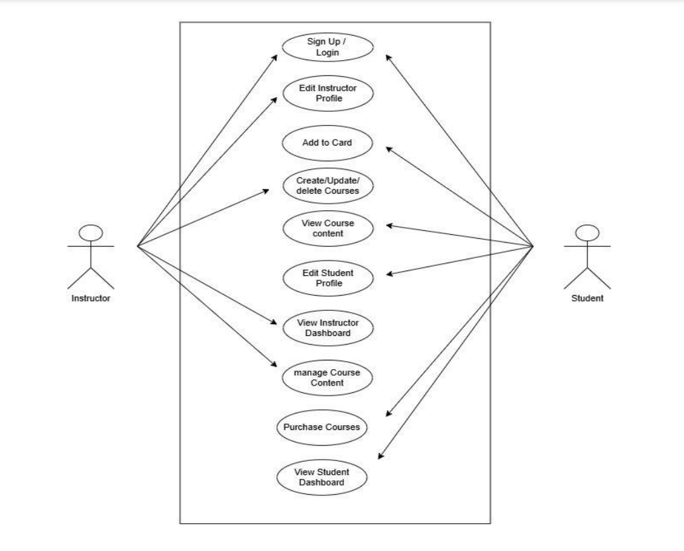
Use Case Diagram

Slide 9
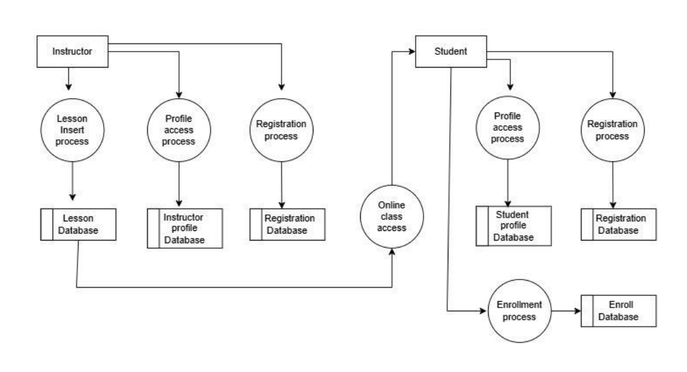
System Flow Diagram

Slide 10
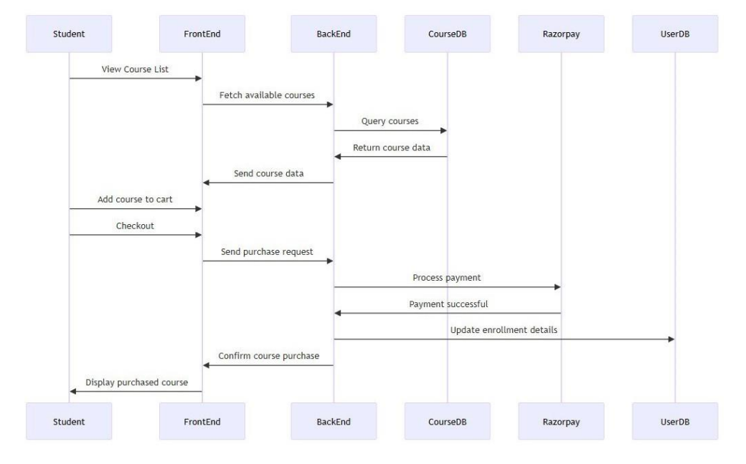
Sequence Diagram

Slide 11
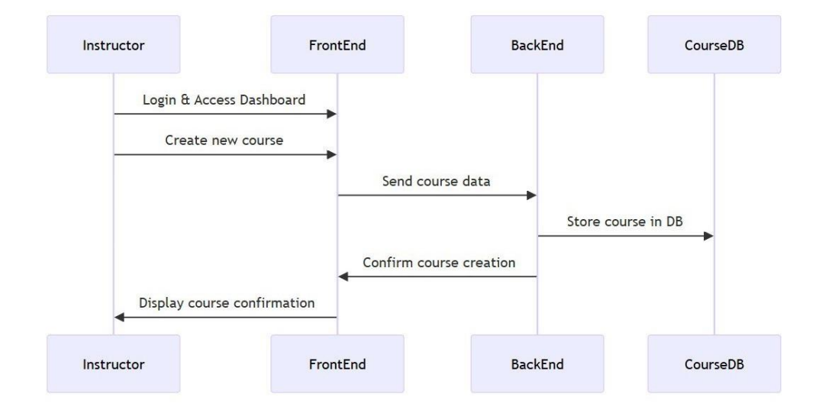

Slide 12
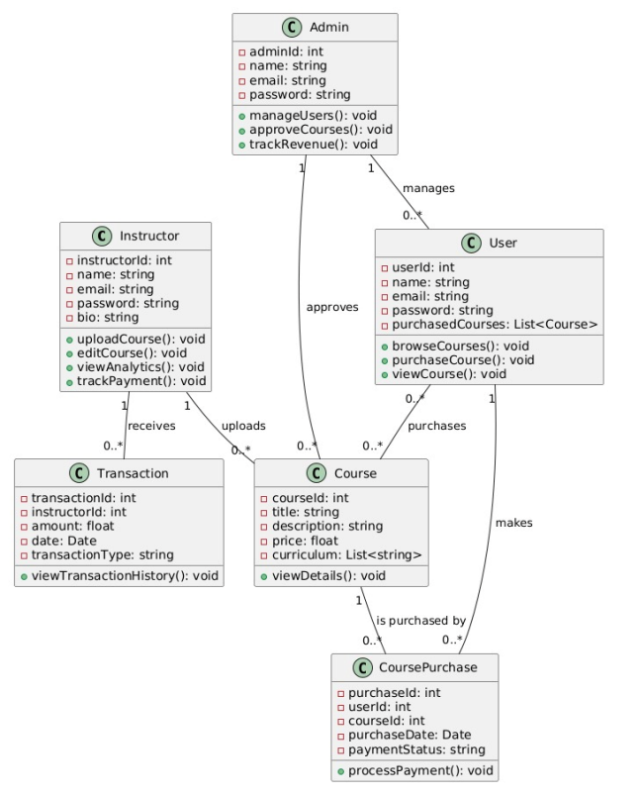
Class Diagram

Slide 13
LIMITATIONS & FUTURE SCOPE
Current Limitations: Limited to users with stable internet access, some courses require more interactive elements.
Future Enhancements: Expanding courses in high-demand areas like AI, Data Science.
Integrating more immersive tech (VR/AR) for subjects like science and engineering.
Advanced AI for deeper personalization.

Slide 14
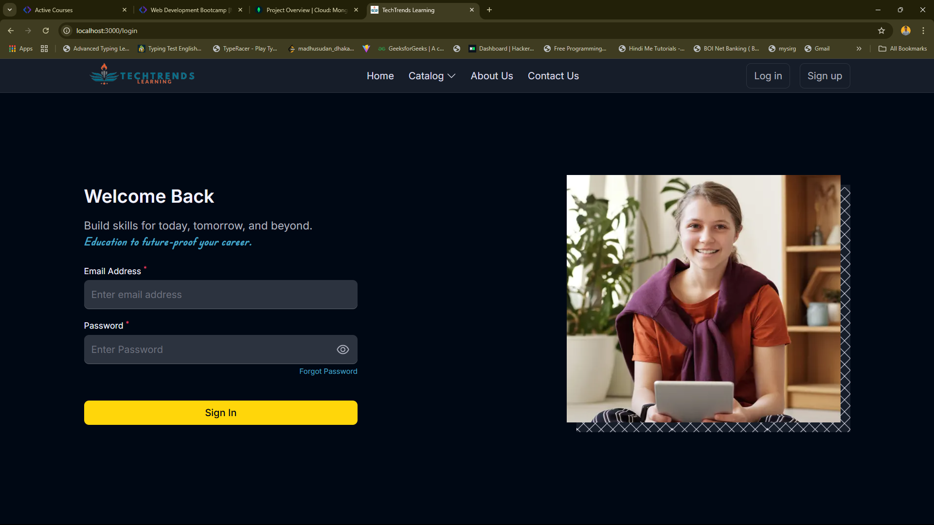
Screenshots
04/10/2024

Slide 15
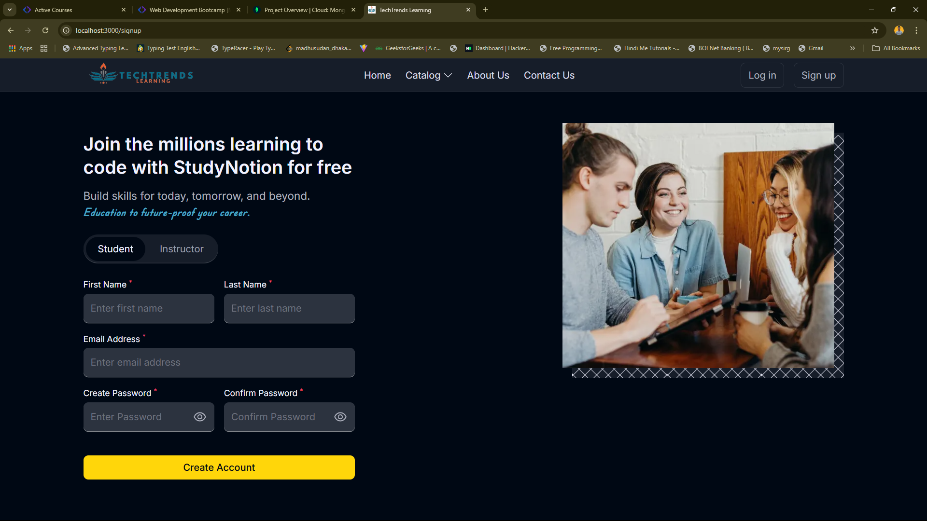
04/10/2024

Slide 16
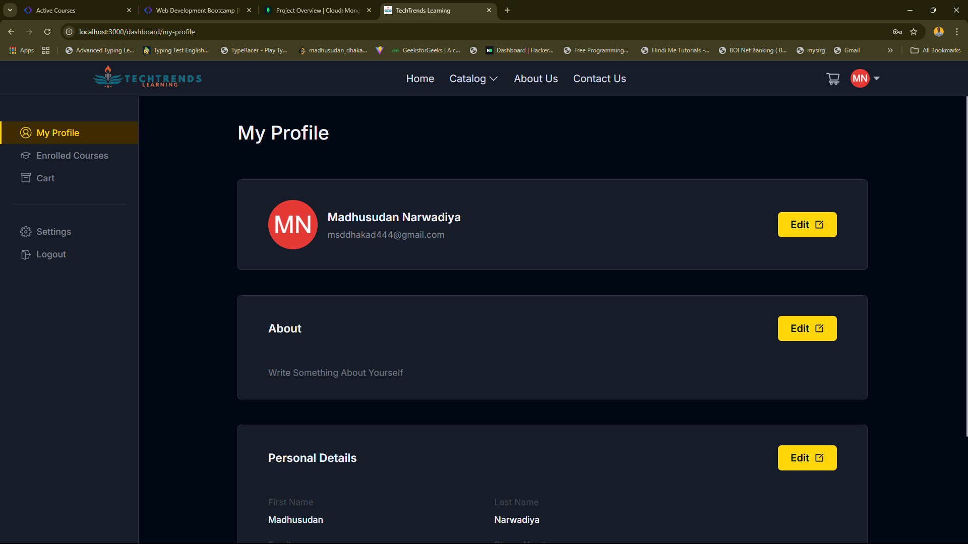
04/10/2024

Slide 17
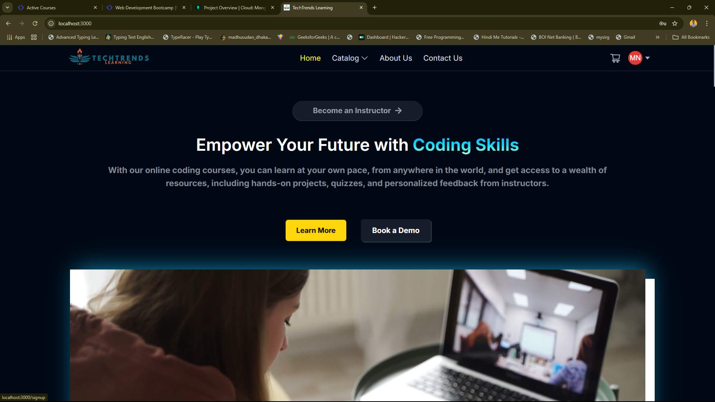
04/10/2024

Slide 18
CONCLUSION
Aim: Make quality education accessible, personalized, and engaging.
Encourages lifelong learning and upskilling.
Positioned to be a leading platform with unique, user-focused features.

Slide 19
References
NodeJs Official Documentation.
MongoDB Official Documentation.
React Official Documentation.
Tailwind Official Documentation.
Chatgpt.

Slide 20
Thank You

