Slide 1

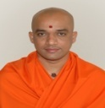

|| Jai Sri Gurudev ||
S J C Institute of Technology
Affiliated to VTU Belagavi Recognized, by AICTE, New Delhi, Accredited by NAAC
Chickballapur-562101,Karnataka
Department Of Information Science And Engineering
Artificial intelligence and Machine learning
Assignment Seminar
On
“Artificial Neural Network by implementing the Back propagation algorithm”
Presented by :
MEDHINI.T.R (1SJ20IS057)
MADHUSUDHAN.B (1SJ20IS051)
Under the guidance of
Prof. Dr Abdul khadar A
Assistant Professor,
Dept of ISE ,SJCIT

Slide 2
BACK PROPAGATION ALGORITHM
BACKPROPAGATION (training_example, ƞ, nin, nout, nhidden )
Each training example is a pair of the form (𝑥 , 𝑡 ), where (𝑥) is the vector of network input values, (𝑡) and is the vector of target network output values.
ƞ is the learning rate (e.g., .05). ni , is the number of network inputs, nhidden the number of units in the hidden layer, and nout the number of output units.
The input from unit i into unit j is denoted xji, and the weight from unit i to unit j is denoted wji
Create a feed-forward network with ni inputs, nhidden hidden units, and nout
output units.
Initialize all network weights to small random numbers
Until the termination condition is met, Do
For each ( 𝑥, 𝑡 ), in training examples
Do Propagate the input forward through the network:

Slide 3



Input the instance 𝑥 , to the network and compute the output ou of every unit u in the network. Propagate the errors backward through the network:
For each network output unit k, calculate its error term delta_{1}
3. For each hidden unit, calculate its error term delta_{h}
4.Update each network weight wij

Slide 4
PROGRAM.05
Build an Artificial Neural Network by implementing the Back propagation algorithm and test the same using appropriate data sets.

Slide 5
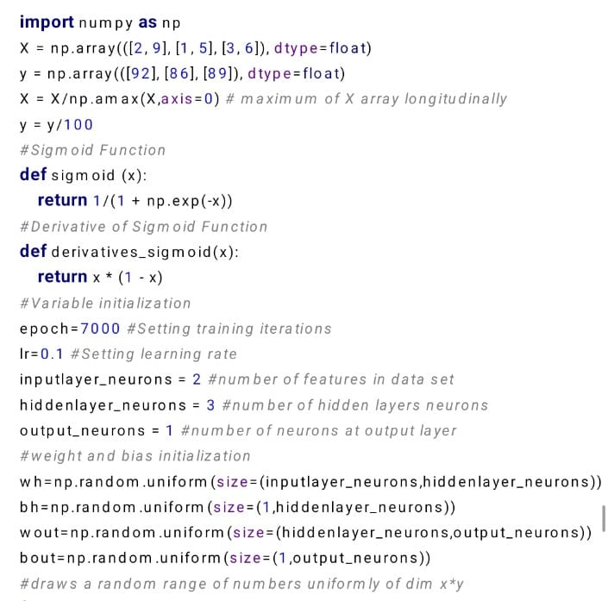

Slide 6
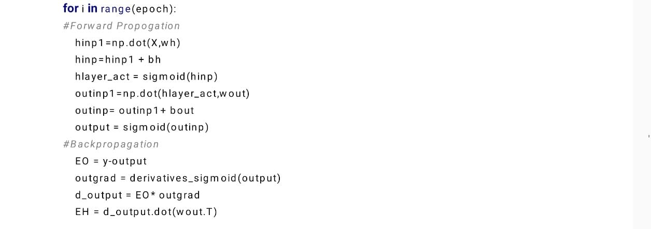
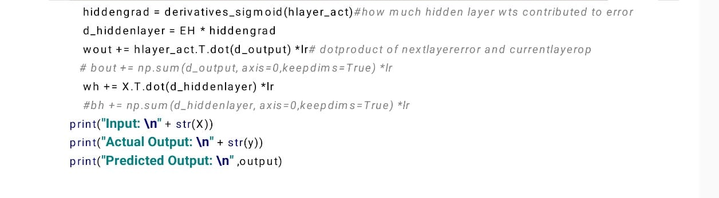

Slide 7
OUTPUT
Input: [[0.66666667 1. ] [0.33333333 0.55555556] [1. 0.66666667]] Actual Output: [[0.92] [0.86] [0.89]]
Predicted Output: [[0.89429777] [0.87537484] [0.90042802]]

