Slide 1
SOFTWARE DEVELOPMENT LIFE CYCLE (SDLC)

Slide 2
SDLC :
SDLC stands for Software development Life Cycle.
It used in the software industry to describe the process for creating a new software product.
The people how are developing software product are used this as a guide.
The main aim is to produce the product with low cost and high quality with customer satisfaction as well.
There are several phases present in SDLC they are Project Planning, Requirement Gathering, Designing, Coding, Testing, Deployment and Maintenance as well.

Slide 3
SDLC Phases:
The 7 Phases Of SDLC (Software Development Life Cycle)
Stage 1: Project Planning : This is the first phase here the discussion of project “What do we need?”
Stage 2: Gathering Requirements & Analysis : In this phase more interaction with the customer is happened for getting a clear document about the requirements which is called as SRS Document.
Stage 3: Design : In this phase, the software design is created, which includes the overall architecture of the software. In this we have two designs HIGH LEVEL AND LOW LEVEL designs

Slide 4
SDLC Phases:
Stage 4: Coding or Implementation : In this phase the actual coding is done by the developers. This phase is called as development phase as well in several times.
Stage 5: Testing : Here the testing team will check the product/project is up to the requirements of the Customer or not.
Stage 6: Deployment : After successful testing, The software is deployed to a production environment and made available to end-users.
Stage 7: Maintenance :ongoing support, bug fixes, and updates to the software.

Slide 5
TESTING :
Testing is done in two ways :
Manual Testing : Manual testing is a testing process carried out by human testers where software applications are tested manually without the use of automated testing tools. We don’t need coding knowledge as well in manual testing since we don’t need to access automation tools.
Automation Testing : Automation testing is the process of using automated tools and scripts to perform software testing tasks, instead of manually executing test cases. Need some coding knowledge to write scripts to execute.

Slide 6
Types Of Testing :
Black Box Testing : Black box testing is a software testing technique where the internal structure, design, or implementation of the software under test is not known to the tester.
White Box Testing : It is a software testing technique where the internal structure, design, and implementation of the software are known to the tester. It is also know as clear box testing, glass box testing.
Grey Box Testing : (Black box + white box) In grey box testing, testers have partial knowledge of the internal workings of the software, typically more than black box testers but less than white box testers.

Slide 7
Levels of Testing :
There are mainly 4 Levels in testing They are
Unit Testing : At this level, individual components or units of the software are tested. It is done at development end.
Integration Testing : In integration testing, individual units or components are combined and tested together as a group.
System Testing : System testing evaluates the complete and integrated software system.
Acceptance Testing :(UAT) Acceptance testing validates whether the software meets the acceptance criteria and is ready for deployment. It is done at end user level.

Slide 8
SDLC MODELS

Slide 9
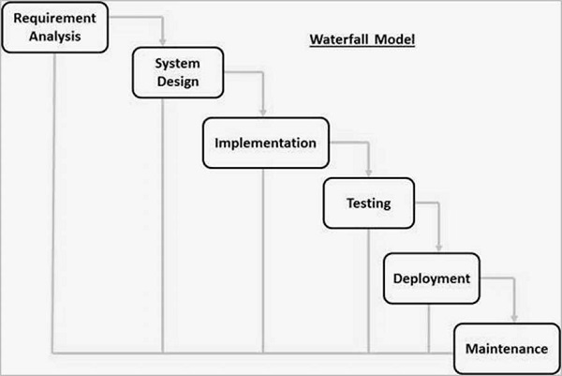
Waterfall Model :

Slide 10
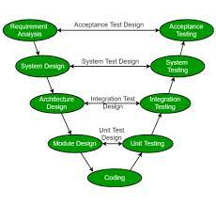
V Model :

Slide 11
V Model :
V-Model also referred to as the Verification and Validation Model.
In this, each phase of SDLC must complete before the next phase starts.
Verification: It involves a static analysis method (review) done without executing code. It is the process of evaluation of the product development process to find whether specified requirements meet.
Validation: It involves dynamic analysis method (functional, non-functional), testing is done by executing code. Validation is the process to classify the software after the completion of the development process to determine whether the software meets the customer expectations and requirements.

Slide 12
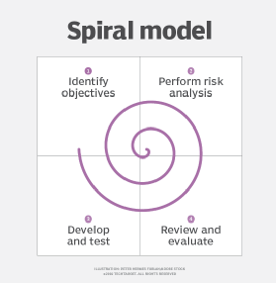
Spiral Model :

Slide 13
Spiral Model :
The Spiral Model is a Software Development Life Cycle (SDLC) model
Each loop of the spiral is called a Phase of the software development process.
Risk Handling, Good for large projects, Flexibility in Requirements etc.
Complex, Expensive, Time-Consuming, Too much dependability on Risk Analysis etc are disadvantages.

Slide 14
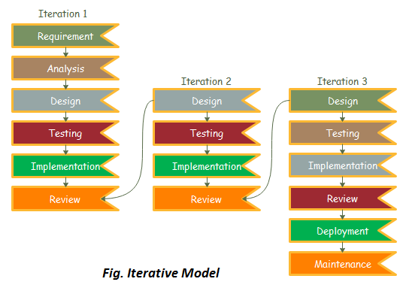
Iterative Model :

Slide 15
Iterative Model :
In this Model, you can start with some of the software specifications and develop the first version of the software.
When requirements are defined clearly and easy to understand we can use this.
When the software application is large also.
Easy to test as well.
More resources are used.

Slide 16
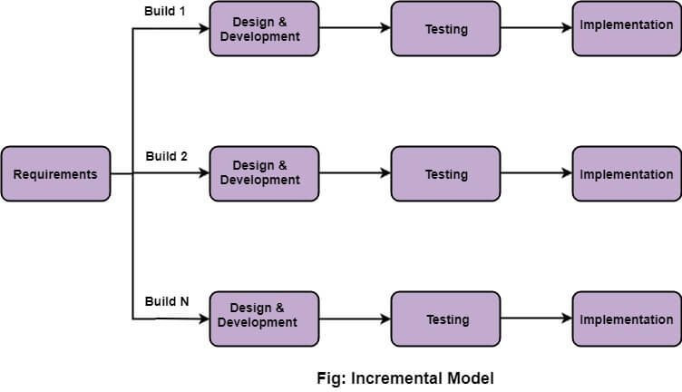
Incremental Model :

Slide 17
Incremental Model :
We have multiple versions in incremental models.
The software build will be updated at every version as well.
Based on the changes in requirments the software will be updates and releses new build as well.

Slide 18
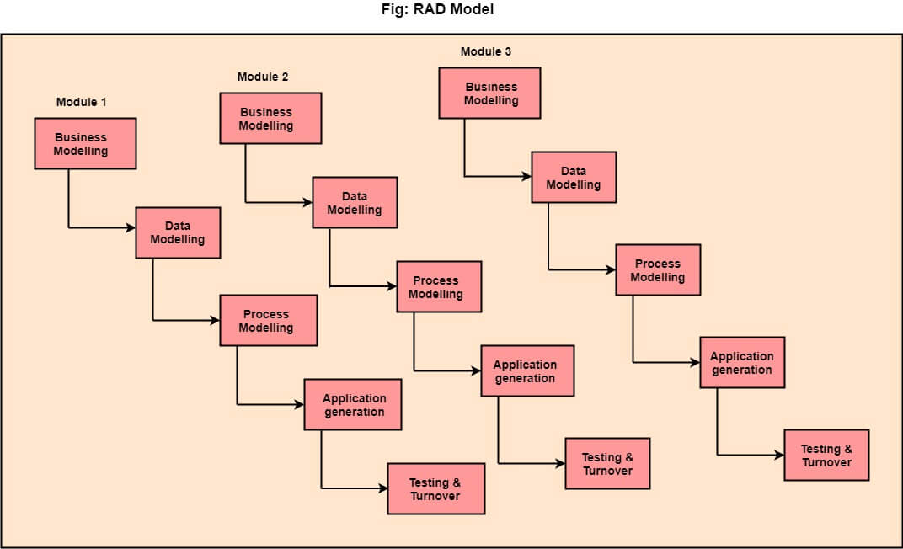
Rad Model :

Slide 19
Rad Model :
RAD stands for Rapid Application Development.
RAD is a linear sequential software development process model.
The re-use of software components.
Flexibility for changes as well.
Need high skilled persons to work.

Slide 20
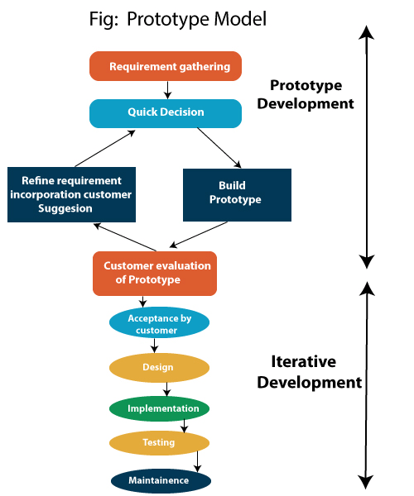
Prototype Model :

Slide 21
Prototype Model :
The prototype model requires that before carrying out the development of actual software, a working prototype of the system should be built.
In such a scenario where there is an absence of detailed information regarding the input to the system, the processing needs, and the output requirement, the prototyping model may be employed.
Advantage of Prototype Model
Reduce the risk of incorrect user requirement
Good where requirement are changing/uncommitted
Reduce Maintenance cost.
Errors can be detected much earlier

Slide 22
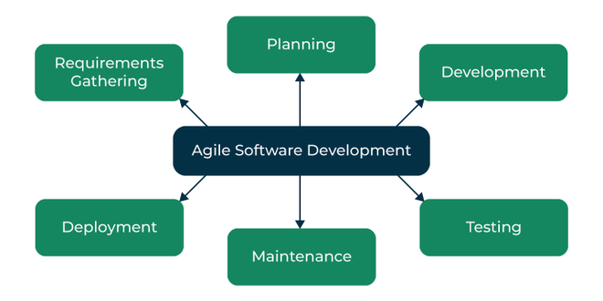
Agile Model :

Slide 23
Agile Model :
"Agile process model" refers to a software development approach based on iterative development.
Agile methods break tasks into smaller iterations, or parts do not directly involve long term planning.
Each iteration is considered as a short time "frame" in the Agile process model
Many frameworks like scrum framework etc.
Advantage of Agile Method:
1. Frequent Delivery
2. Face-to-Face Communication with clients.
3.Efficient design and fulfils the business requirement.
4.Anytime changes are acceptable.

Slide 24
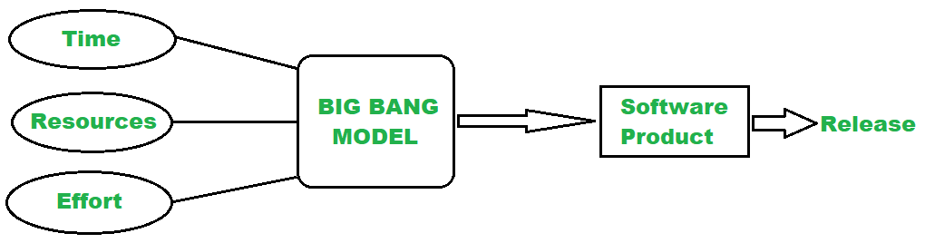
Big-Bang Model :

Slide 25
Big-Bang Model :
The Big bang model is an SDLC model that starts from nothing.
It is the simplest model in SDLC (Software Development Life Cycle) as it requires almost no planning.
However, it requires lots of funds and coding and takes more time.
Similarly, this SDLC model combines time, efforts, and resources to build a product.
Advantages of Big Bang Model :
There is no planning required for this.
Suitable for small projects
Very few resources are required.

