Slide 1


SMART SHOPPING TROLLEY WITH WEB BASED RFID BILLING SYSTEM
UNDER THE GUIDANCE:
Mrs.J.SUGANYA, M.E
AP/ECE, APEC.
SUBMITTED BY:
J. MADHUVANTHI (420419106017)

Slide 2
AGENDA
• INTRODUCTION
• OBJECTIVE
• LITERATURE SURVEY
• EXISTING SYSTEM
• PROPOSED SYSTEM
• PROPOSED SYSTEM ADVANTAGES
• SYSTEM ARCHITECTURE
• MODULES
• SYSTEM REQUIREMENTS
• RESULTS OBTAINED
• CONCLUSION
• REFERENCES

Slide 3
INTRODUCTION
A supermarket or a shop is a form where wide variety of product items is available. These product items can be food, beverages, cloths, or any other products. The main purpose of supermarkets is to provide availability of all the products and save the time of the customers, but sometimes customer gets frustrated while waiting in the queue at billing. To overcome these problems, we have designed a smart trolley using a smart phone and RFID Reader.

Slide 4
INTRODUCTION(cont..)
With this system, there is no need for the customer to wait in the queue for their turn to scan the product items for billing purpose. Supermarkets or Shops provide this facility to only those customers which having Smart Phones. When the customer connects their phone in the trolley or basket then only it will work as a smart trolley. Otherwise, it will work as a normal trolley. Supermarkets and Malls use this technique as a strategy to increase the number of customers.

Slide 5
OBJECTIVE
• To reduce the customer waiting time in billing queue.
• To use this as an strategy to increase the number of customers.
• To know the total cost of the products dynamically while purchasing.
• To reduce the cost of implementation.
• To Ease the use of Customer.

Slide 6
LITERATURE SURVEY
1. A Novel Low-Cost intelligent Shopping Cart- Dr. Suryaprasad J
Abstract:
To develop a low cost intelligent shopping aid that assists
the customer to search and select products and inform the
customer on any special deals available on the products as they
move around in the shopping complex.
Advantage:
• Customers can easily buy what they want.
Disadvantage:
• Need to search for products.
• Time was wasted by waiting on queues.

Slide 7
LITERATURE SURVEY
2. Aisle-level Scanning for Pervasive RFID-based Shopping Applications- Amine Carmouche.
Abstract:
To develop a system that is able to scan dynamic and static
products in the shopping space using RFID Reader
antennas. Instead of conducting the RFID observations at
the level of individual carts, aisle level scanning is
performed.
Advantage:
• Detects shop lifted items.
Disadvantage:
• Cost of RFID antennas are high.

Slide 8
LITERATURE SURVEY
3. Smart Shopping Cart with Automatic billing System through RFID and ZigBee.Mr. P. Chandrasekar
Abstract:
To develop a shopping cart with a Product Identification
Device (PID) which will contain a microcontroller a LCD,
RFID reader, EEPROM and ZigBee module.
Advantage:
• Easy for billing and payment.
Disadvantage:
• Cost of this module was high.

Slide 9
EXISTING SYSTEM
Traditional System:
Customers have to pick items and place it on the trolley and move to bill counter and wait there for their turn for payment.
Arduino Based System:
Customers pick products and scans them on RFID reader and put them on their trolley. RFID reader was connected with Arduino that have product details like cost etc.. An display shows the total amount at final and then they can proceed for checkout from shop.

Slide 10
PROPOSED SYSTEM
• Instead of using Arduino module we used customer smart phones as billing system. This will reduce the cost of implementation by 50% from the existing system.
• Customers visit the localhost website from their smart phones by scanning the QR Code present on the trolley. Then the browser loads the billing application from the store server.
• Now they can pick products and swipe it on the RFID Reader and place them on the trolley. The item list was showed on the phone screen and finally they can check out without wasting time on bill counter queues.

Slide 11
PROPOSED SYSTEM ADVANTAGES
• This system provides on spot scanning of the product and shows its price details on Mobile Browser. This allows customers to compare the total price with the budget in the pocket before billing.
• Customers don’t have to wait in the long queues at the billing counters.
• By this server-based billing system, product cost can be changed at any time in the database whenever the rate changes.
• Since we designed this system using Wamp Server and user Smart Mobile Phone to act as billing screen, this system requires low cost to design. This system requires less power supply and it displays the bill and total amount to the user. so this is an user-friendly system.

Slide 12
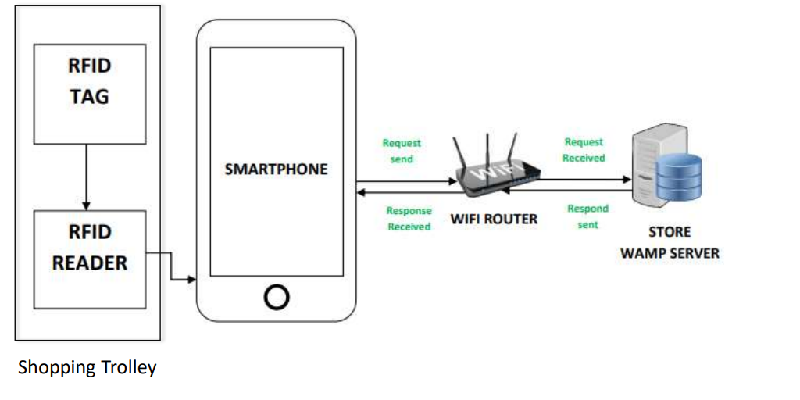
SYSTEM ARCHITECTURE

Slide 13
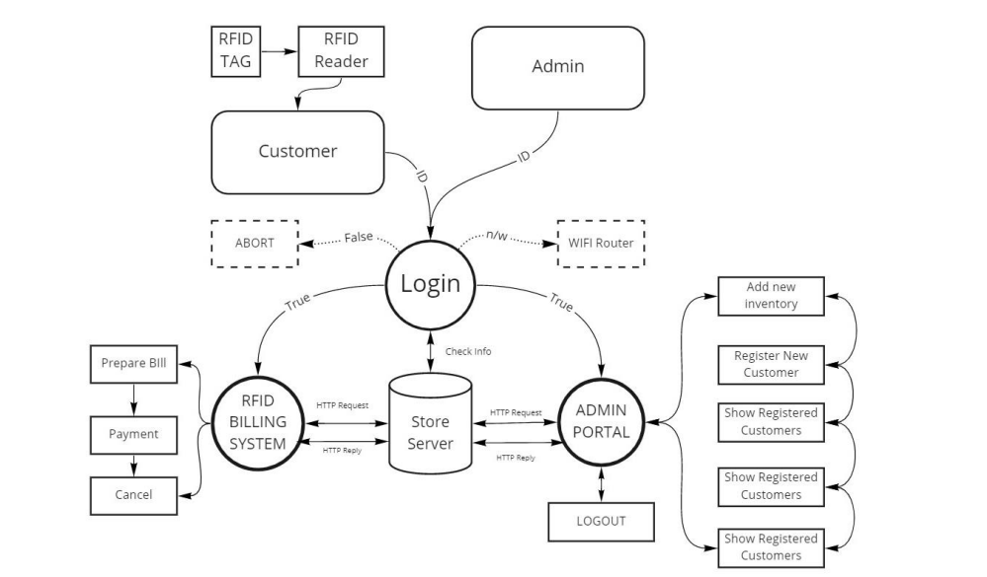
MODULES

Slide 14
SYSTEM REQUIREMENTS
HARDWARE REQUIREMENTS | SOFTWARE REQUIREMENTS
RFID Reader | Apache Tomcat
 | Eclipse JEE
RFID Tag | Wamp Server
 | Browser

Slide 15
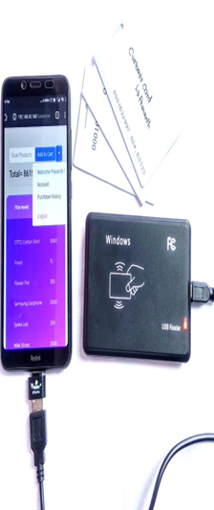
RESULTS OBTAINED

Slide 16
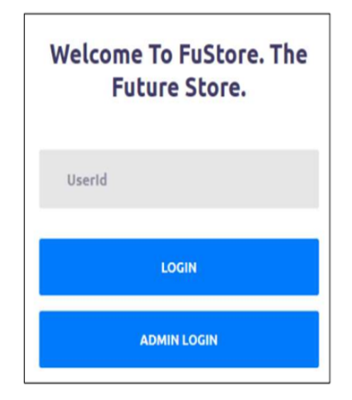
RESULTS OBTAINED

Slide 17
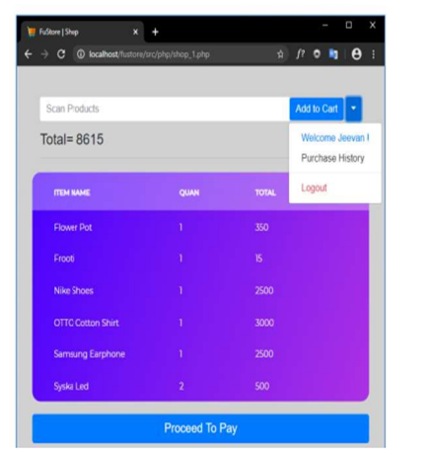
RESULTS OBTAINED

Slide 18
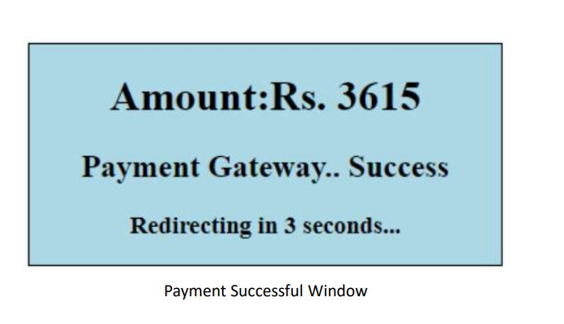
RESULTS OBTAINED

Slide 19
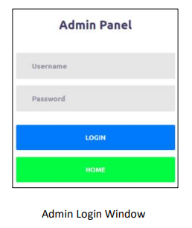
RESULTS OBTAINED

Slide 20
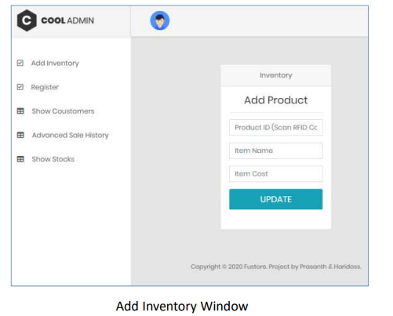
RESULTS OBTAINED

Slide 21
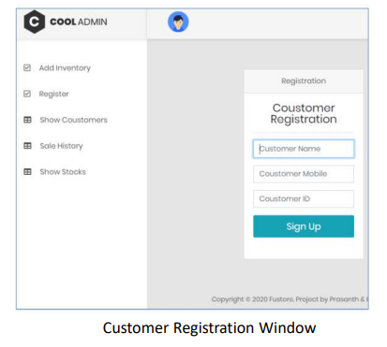
RESULTS OBTAINED

Slide 22
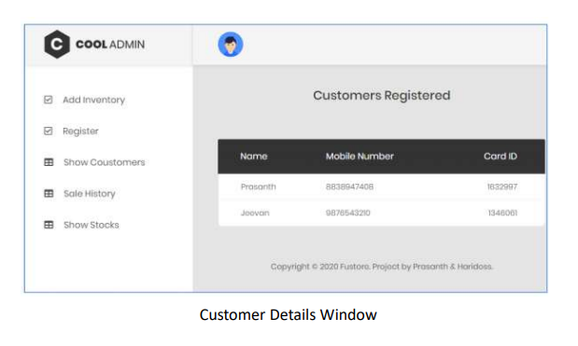
RESULTS OBTAINED

Slide 23
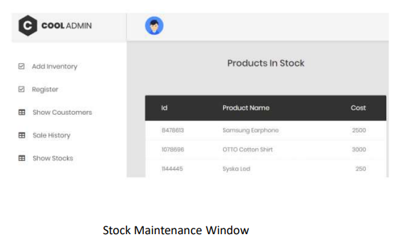
RESULTS OBTAINED

Slide 24
CONCLUSION
By Smart Trolley System, there is no need for the customers to wait in the queue for his/her turn for the scanning of the purchased items. By this they can make their own bill while shopping the products. Finally, they can walk out from the store easily after the checkout. So, supermarkets or hypermarkets use this concept as their business strategy to attract a greater number of customers. Also the Stock maintenance was made easier.

Slide 25
REFERENCES
[1] Shraddha Wakode, Pranav Arakhrao, Anuja Dive, Kishor Bandal ,” Smart Trolley with Automated Billing”, Volume: 09 Issue: 03 | Mar 2022
[2 ] BHAGYASHREE, KAVYA, VIJAYLAXMI, SUSHMA, PROF. SHRAVAN KUMAR, “Smart Shopping Trolley Based on RFID” Vol. 5, Issue JUN 2022.
[3 ] Shubham Singh, Vaibhav Dwivedi , Shweta Kumari1 , Salony Gupta1 , Navneet Kumar Pandey,“SMART SHOPPING TROLLEY”, Volume 8 Issue 6, 2021.
[4] Anitha.R1 , Dr.Subburam.S, Keerthana.G, K.H.Yoganandarajurs, “SMART TROLLEY BILLING SYSTEM” , Volume 7, Issue 11, 2020.

