Slide 1
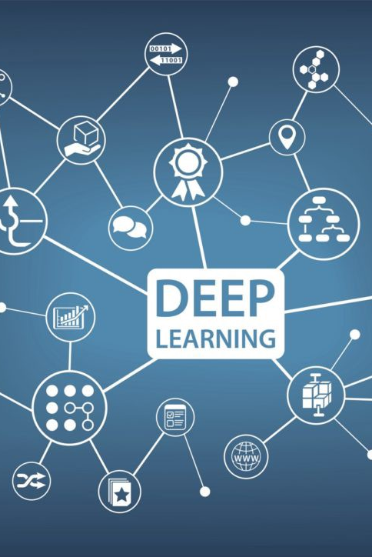
TWO WAY SIGN LANGUAGE INTERPRETER
1805065 – AAMIR FAROOQ
1805095 – LISHARA.V
1805097 – MADHUVARSHINI.R
1805100 – MUHYMIN FAROOQ

Slide 2
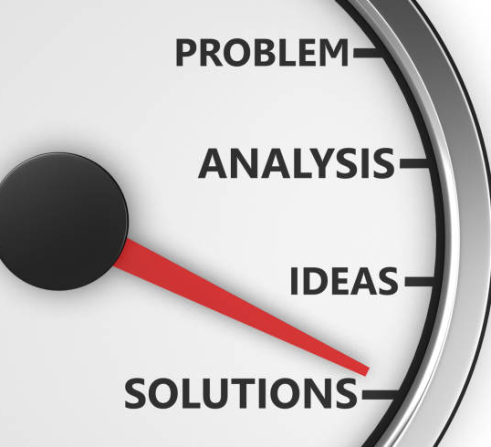
PROBLEM STATEMENT
Development of a personalized and real-time sign language interpreter and text interpreter.

Slide 3

ABSTRACT
Sign language plays an important part in the hearing/speech impaired person's life as it is the prime medium of communication for them. However, not everyone understands the sign language hence, it becomes difficult for the disabled to communicate in day-to-day life. The sign language constitutes of various hand gestures which can represent various words and expressions. In this project, the aim is to build a reliable communication interpretation program for interpreting sign language and converting it to a readable output. The task can be accomplished using image processing and deep learning. Our proposed project can find its applicability in the day to day lives of millions of people and allow for better communication.

Slide 4
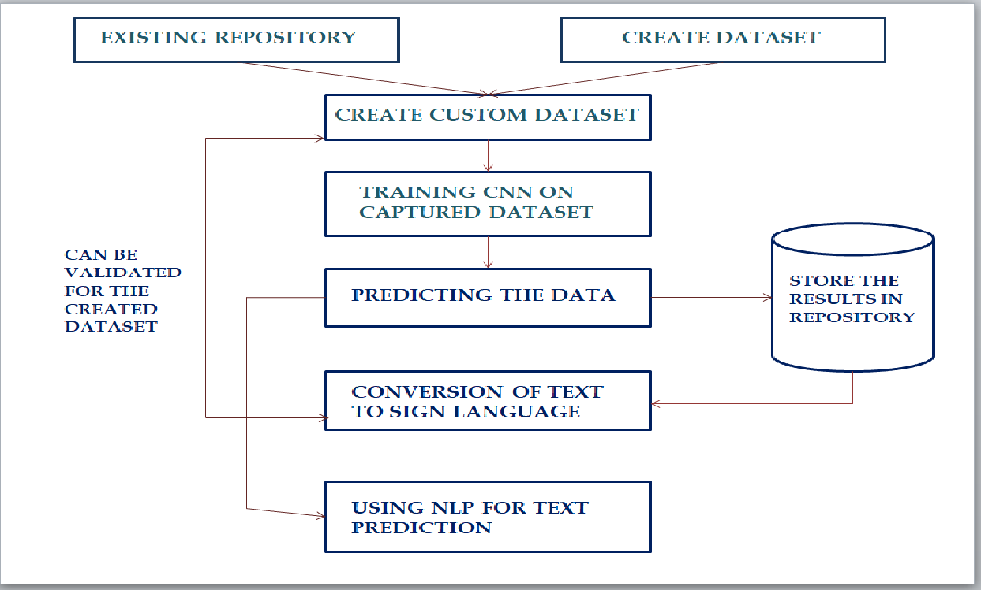
ARCHITECTURAL DIAGRAM

Slide 5

ALGORITHMS DEPLOYED
SIGN LANGUAGE TO TEXT CONVERSION – CNN
TEXT TO SIGN LANGUAGE CONVERSION – SEARCH ALGORITHM

Slide 6
STEPS INVOLVED IN CONVERSION OF SIGN-> TEXT
1. COLLECTION OF DATASET (CUSTOM DATASET INVOLVING LIVE CAPTURING OF IMAGES IN ADDITION TO EXISTING DATASET)
2. APPLYING CONTOURS TO DETECT THE IMAGE
3. SPLITTING THE DATASET INTO TRAIN AND TEST SETS
4. FITTING THE MODEL USING CNN
5. TRAINING THE MODEL

Slide 7

IMPLEMENTATION TOOLS FOR PHASE 1
LANGUAGE: Python
PLATFORM: TensorFlow
LIBRARY: Keras, OpenCV, Numpy
ALGORITHM : CNN

Slide 8
STEPS INVOLVED IN CONVERSION OF TEXT-> SIGN
1. CONVERSION OF INDIVIDUAL CHARACTERS INTO SIGN
2. FURTHER CONVERTING THE WORDS/PHRASES INTO ITS CORRESPONDING SIGN REPRESENTATION

Slide 9
IMPLEMENTATION TOOLS FOR PHASE 2
LANGUAGE : Python
PLATFORM: Tensorflow
LIBRARIES: Tkinter, OpenCV
ALGORITHM: Search and Retrieval

Slide 10
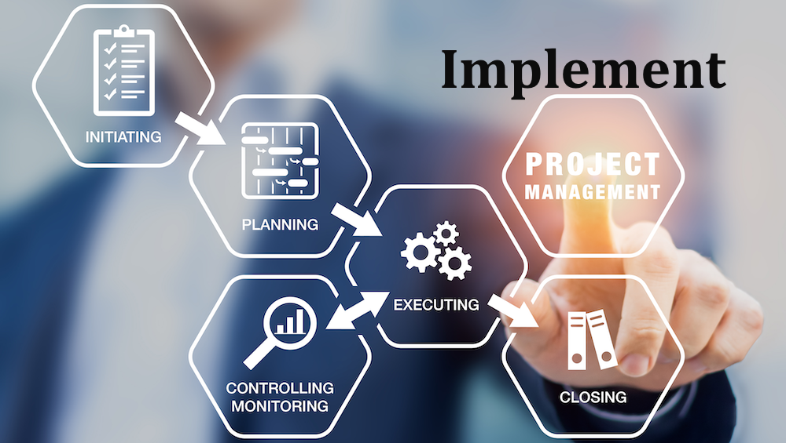
IMPLEMENTATION OF MODULES AT PRELIMINARY LEVEL

Slide 11
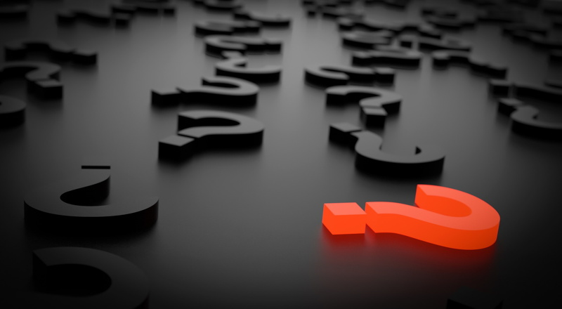
ANY QUERIES

Slide 12
