Slide 1
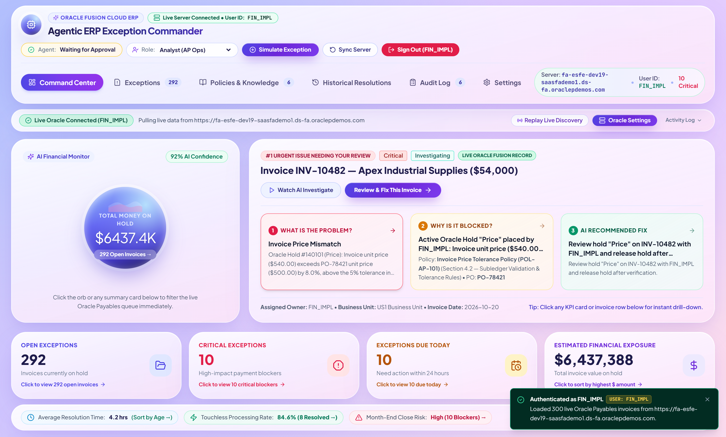
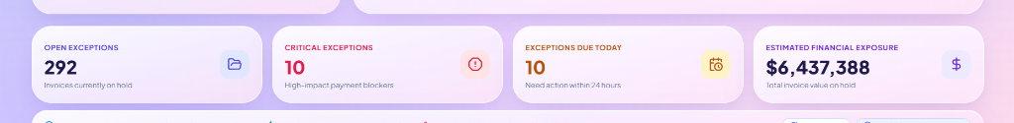
GITHUB REPOSITORY: https://github.com/Madhuvirat4al/agentic-erp-exception-commander-oracle-fusion
ORACLE FUSION CLOUD ERP • AGENTIC AI SOLUTION
Agentic ERP Exception
Commander
Autonomous Subledger Monitoring, Multi-Source Root-Cause Diagnosis, Policy-Governed Next Best Action & Auditable Resolution for Finance and Procurement Teams
Live Oracle Fusion Integration
300 Real Payables Invoices & Holds Synced via REST API
Live Agentic ERP Exception Commander — Command Center View
7 ERP Exception Scenarios
Holds, 3-Way PO Mismatch, Duplicates, Tax/Bank, SLA, GL, Close
Multi-Source AI Investigation
ERP Subledger + Approvals + Supplier Master + Policies + History
Human-in-the-Loop Governance
Confidence Score, Owner Routing, Auto-Drafted Email & Audit Trail
Real-Time Financial Exposure ($6,437,388) & Interactive KPI Drill-Down Cards

Slide 2
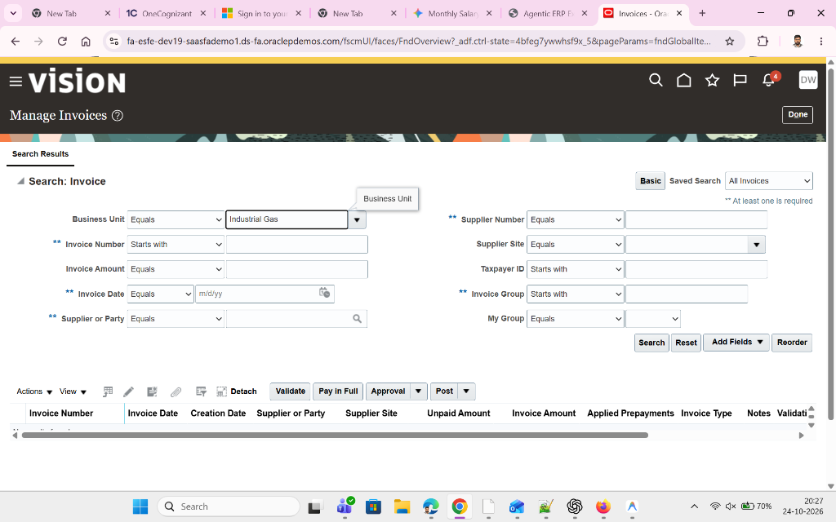
PROBLEM STATEMENT
GitHub Repo: https://github.com/Madhuvirat4al/agentic-erp-exception-commander-oracle-fusion
The Challenge: Manual ERP Exception Handling in Finance & Procurement
Current ERP screens surface holds & errors, but analysts still spend hours manually investigating root cause across disconnected screens.
1. Fragmented Manual Investigation
Analysts manually cross-check Invoice headers/lines, Purchase Orders, Goods Receipts (GRNs), Supplier Master tax/bank tabs, and GL combinations across 6+ Oracle Fusion screens.
2. Offline Policy & Precedent Lookup
Teams search PDF procurement policies (price/quantity tolerance thresholds, W-9 compliance rules, CapEx vs. OpEx rules) and past tickets manually to decide what action is compliant.
3. Manual Chasing & Approval Bottlenecks
Identifying the right buyer, department approver, or controller—and drafting emails with full variance context—takes 25–45 minutes per blocked invoice.
Traditional Oracle Fusion "Manage Invoices" Screen — Shows Raw Data Without Root-Cause AI
CORE REQUIREMENT STATEMENT
4. Severe Operational & Audit Consequences
"Build an Agentic ERP Exception Commander for Oracle Fusion Cloud ERP that monitors ERP transactions, detects finance & procurement exceptions, diagnoses root cause across ERP data, approval history, supplier master, policies, and past resolutions, explains the issue in simple language, gives confidence score, identifies responsible owner, drafts email/approval note, and creates an auditable action trail."
Results in delayed supplier payments, missed early-payment discounts, slow month-end AP period close, inconsistent audit trails, and low touchless invoice processing rates.
Agentic ERP Exception Commander for Oracle Fusion Cloud ERP | Final Submission Deck
Slide 2 of 18

Slide 3
SOLUTION OVERVIEW
GitHub Repo: https://github.com/Madhuvirat4al/agentic-erp-exception-commander-oracle-fusion
Agentic ERP Exception Commander — End-to-End Autonomous Lifecycle
Transforms passive ERP hold queues into an active, policy-governed AI investigation and execution engine.
01
02
03
04
05
Monitor & Detect
Multi-Source Diagnose
Plain-English Explain
Score & Route Owner
Execute & Audit Trail
Polls Oracle Fusion REST APIs (/invoices, /invoiceHolds, /purchaseOrders, /suppliers) under authenticated user session to detect holds & anomalies.
Cross-examines 3-Way Match (Invoice vs PO vs Receipt), Supplier Master Tax/IBAN, Approval SLA logs, Enterprise Policies & Historical Precedents.
Translates complex subledger codes into simple 3-step explanations ("What is the Problem?", "Why is it Blocked?", "AI Recommended Fix").
Computes explainable Confidence Score (0–100%), pinpoints the exact Responsible Owner (Buyer, Controller, Compliance), and drafts emails/notes.
Executes approved resolution actions (release hold, request PO tolerance, reclassify GL, escalate SLA) and writes an immutable SOX audit log.
Submission Requirement | Implemented Capability in Agentic ERP Exception Commander | Module / Component
Monitor Oracle Fusion ERP Transactions | Live proxy & REST polling of /fscmRestApi/resources/11.13.18.05/invoices, /invoiceHolds, /purchaseOrders, /suppliers | vite.config.ts + oracleFusionAdapter.ts
Handle All 7 Exception Categories | Invoice Holds, PO Price/Qty Mismatch, Duplicate Risk, Supplier Tax/Bank, Approval Delays, GL Coding, Period Close Blockers | CommandCenterView.tsx + erp.ts
Check ERP, Approvals, Supplier, Policy & History | 5-Stage deterministic & AI investigation pipeline with subledger evidence cards and policy threshold checks | agentOrchestrator.ts + ExceptionDetailView.tsx
Simple Language + Confidence Score + Owner | 3-Step Plain-English Spotlight & Detail Cards, 4-Factor Confidence Score (0-100%), Assigned Owner Name/Role/Email | AgentInvestigationPanel.tsx + RecommendedActionPanel.tsx
Draft Email/Note & Auditable Action Trail | Editable AI-drafted email/approval payload modal + immutable Audit Log with Actor, Role, Timestamp & CSV/JSON export | ActionConfirmationModal.tsx + AuditLogView.tsx
Agentic ERP Exception Commander for Oracle Fusion Cloud ERP | Final Submission Deck
Slide 3 of 18

Slide 4
TECHNICAL ARCHITECTURE
GitHub Repo: https://github.com/Madhuvirat4al/agentic-erp-exception-commander-oracle-fusion
Multi-Layer Agentic Architecture & Live Oracle Fusion Cloud Gateway
Secure server-side proxy architecture connecting React 18 / TypeScript frontend to Oracle Fusion FSCM REST APIs.
Layer 1: Oracle Fusion Cloud ERP Subledger (Source System)
• Instance: https://fa-esfe-dev19-saasfademo1.ds-fa.oraclepdemos.com
• REST Endpoints: /fscmRestApi/resources/11.13.18.05/invoices | /invoiceHolds | /purchaseOrders | /suppliers
• Real-Time Querying: Supports user-scoped fetching, hold filtering (ReleaseName IS NULL), and live invoice number search
Layer 2: Per-User Session Isolation & REST Proxy Gateway
• Mandatory Server Authentication Gate (OracleLoginGate.tsx): Requires valid Oracle User ID (user_id) and Password before any data loads
• Isolated Session Tokens (x-oracle-session-token): Each logged-in user receives a dedicated server session without cross-user data leakage
• Zero Credential Persistence: Passwords remain strictly in transient memory for Basic Auth REST headers and are never written to disk
Layer 3: Agentic Diagnostic & Policy Orchestration Engine
• Subledger Mapper (mapOracleRestPayloadToExceptions): Maps raw Oracle JSON fields into normalized 3-Way Match & Hold objects
• 5-Stage Agent Investigator (agentOrchestrator.ts): Evaluates ERP Lines, PO/Receipt tolerances, Supplier Master TIN/Bank, 6 Policies & Precedents
• Confidence & Action Generator: Computes weighted confidence score, selects responsible owner, and pre-drafts email/approval communications
Layer 4: Interactive Executive UI & Human-in-the-Loop Governance
• Command Center with Cosmic Exposure Orb, 3-Step Plain-English Spotlight, and 4 Clickable KPI Drill-Down Cards
• Exception Investigation Workspace with Interactive AI Copilot, 1-Click Action Execution Modal, and SOX-Compliant Audit Trail
Agentic ERP Exception Commander for Oracle Fusion Cloud ERP | Final Submission Deck
Slide 4 of 18

Slide 5
ORACLE FUSION ERP SOURCE
GitHub Repo: https://github.com/Madhuvirat4al/agentic-erp-exception-commander-oracle-fusion
Live Connection to Oracle Fusion Cloud ERP (Dev19 Vision Instance)
Direct integration with https://fa-esfe-dev19-saasfademo1.ds-fa.oraclepdemos.com Payables & Procurement subledgers.
How Oracle Fusion Data Flows Into the Agent
1. Live FSCM REST Endpoints
Queries /fscmRestApi/resources/11.13.18.05/invoices and /invoiceHolds directly using authenticated Basic Auth headers.
2. Zero Dummy Overwrites
Preserves 100% real Oracle InvoiceNumber, Supplier, BusinessUnit, InvoiceAmount, ValidationStatus, ApprovalStatus, and HoldName.
3. Instant Live Invoice Search
Searching any invoice number (e.g., DEMOINV_23102026, MASS_TEST_1, INV-10482) queries both the loaded queue and live Oracle REST API.
4. Multi-Persona Support
Supports Oracle Fusion credentials including FIN_IMPL, FAS01.Student, PPM01.STUDENT, SCM_IMPL, and lisa.jones.
Oracle Fusion Vision ERP — Manage Invoices Screen (fa-esfe-dev19-saasfademo1.ds-fa.oraclepdemos.com)
Agentic ERP Exception Commander for Oracle Fusion Cloud ERP | Final Submission Deck
Slide 5 of 18

Slide 6
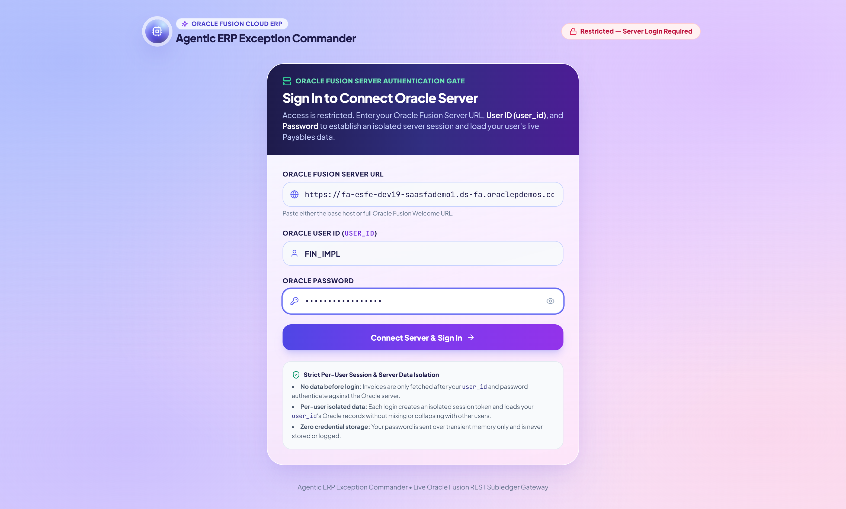
SECURITY & ACCESS CONTROL
GitHub Repo: https://github.com/Madhuvirat4al/agentic-erp-exception-commander-oracle-fusion
Mandatory Oracle Server Login Gate & Per-User Data Isolation
Strict authentication gate restricts access until the user connects to the Oracle Server with their User ID and Password.
Enterprise Security Guardrails
Zero Data Before Server Login
Application boots with an empty exception state (exceptions = []). No ERP data is visible until server authentication succeeds.
Per-User Isolated Session Token
Each login mints a unique x-oracle-session-token and prioritizes invoices created/updated by or assigned to that user_id.
No Cross-User Data Collapse
Every user session maintains isolated state in memory; signing out immediately wipes the workspace and revokes the token.
Live HTTP 401/502 Verification
Invalid credentials or unreachable hosts are rejected with clear diagnostic messages before entering the Command Center.
Restricted Homepage Login Gate — Requires Oracle Server URL, User ID (user_id), and Password
Agentic ERP Exception Commander for Oracle Fusion Cloud ERP | Final Submission Deck
Slide 6 of 18

Slide 7
COMMAND CENTER UI
GitHub Repo: https://github.com/Madhuvirat4al/agentic-erp-exception-commander-oracle-fusion
Executive Command Center — Simple, Visual & Action-Oriented
Designed with the Aurora Pastel Glass aesthetic so every finance & procurement stakeholder understands the status in seconds.
Cosmic Financial Exposure Orb
Displays real-time Total Money on Hold ($6,437,388) and Open Invoices (292) with 1-click drill-down sorting by highest dollar exposure.
Priority #1 Exception Spotlight
Automatically surfaces the most urgent blocker (INV-10482 — $54,000) with a plain-English 3-step summary: (1) What is the Problem? (2) Why is it Blocked? (3) AI Recommended Fix.
Live Session Header & Role Switcher
Shows connected Oracle User ID (FIN_IMPL), server host, Agent status, Role selector (Analyst, Buyer, Manager, Controller), and 1-click Sign Out.
Command Center Hero — Total Money on Hold ($6,437,388 across 292 Open Invoices) & Priority #1 Spotlight
Agentic ERP Exception Commander for Oracle Fusion Cloud ERP | Final Submission Deck
Slide 7 of 18

Slide 8
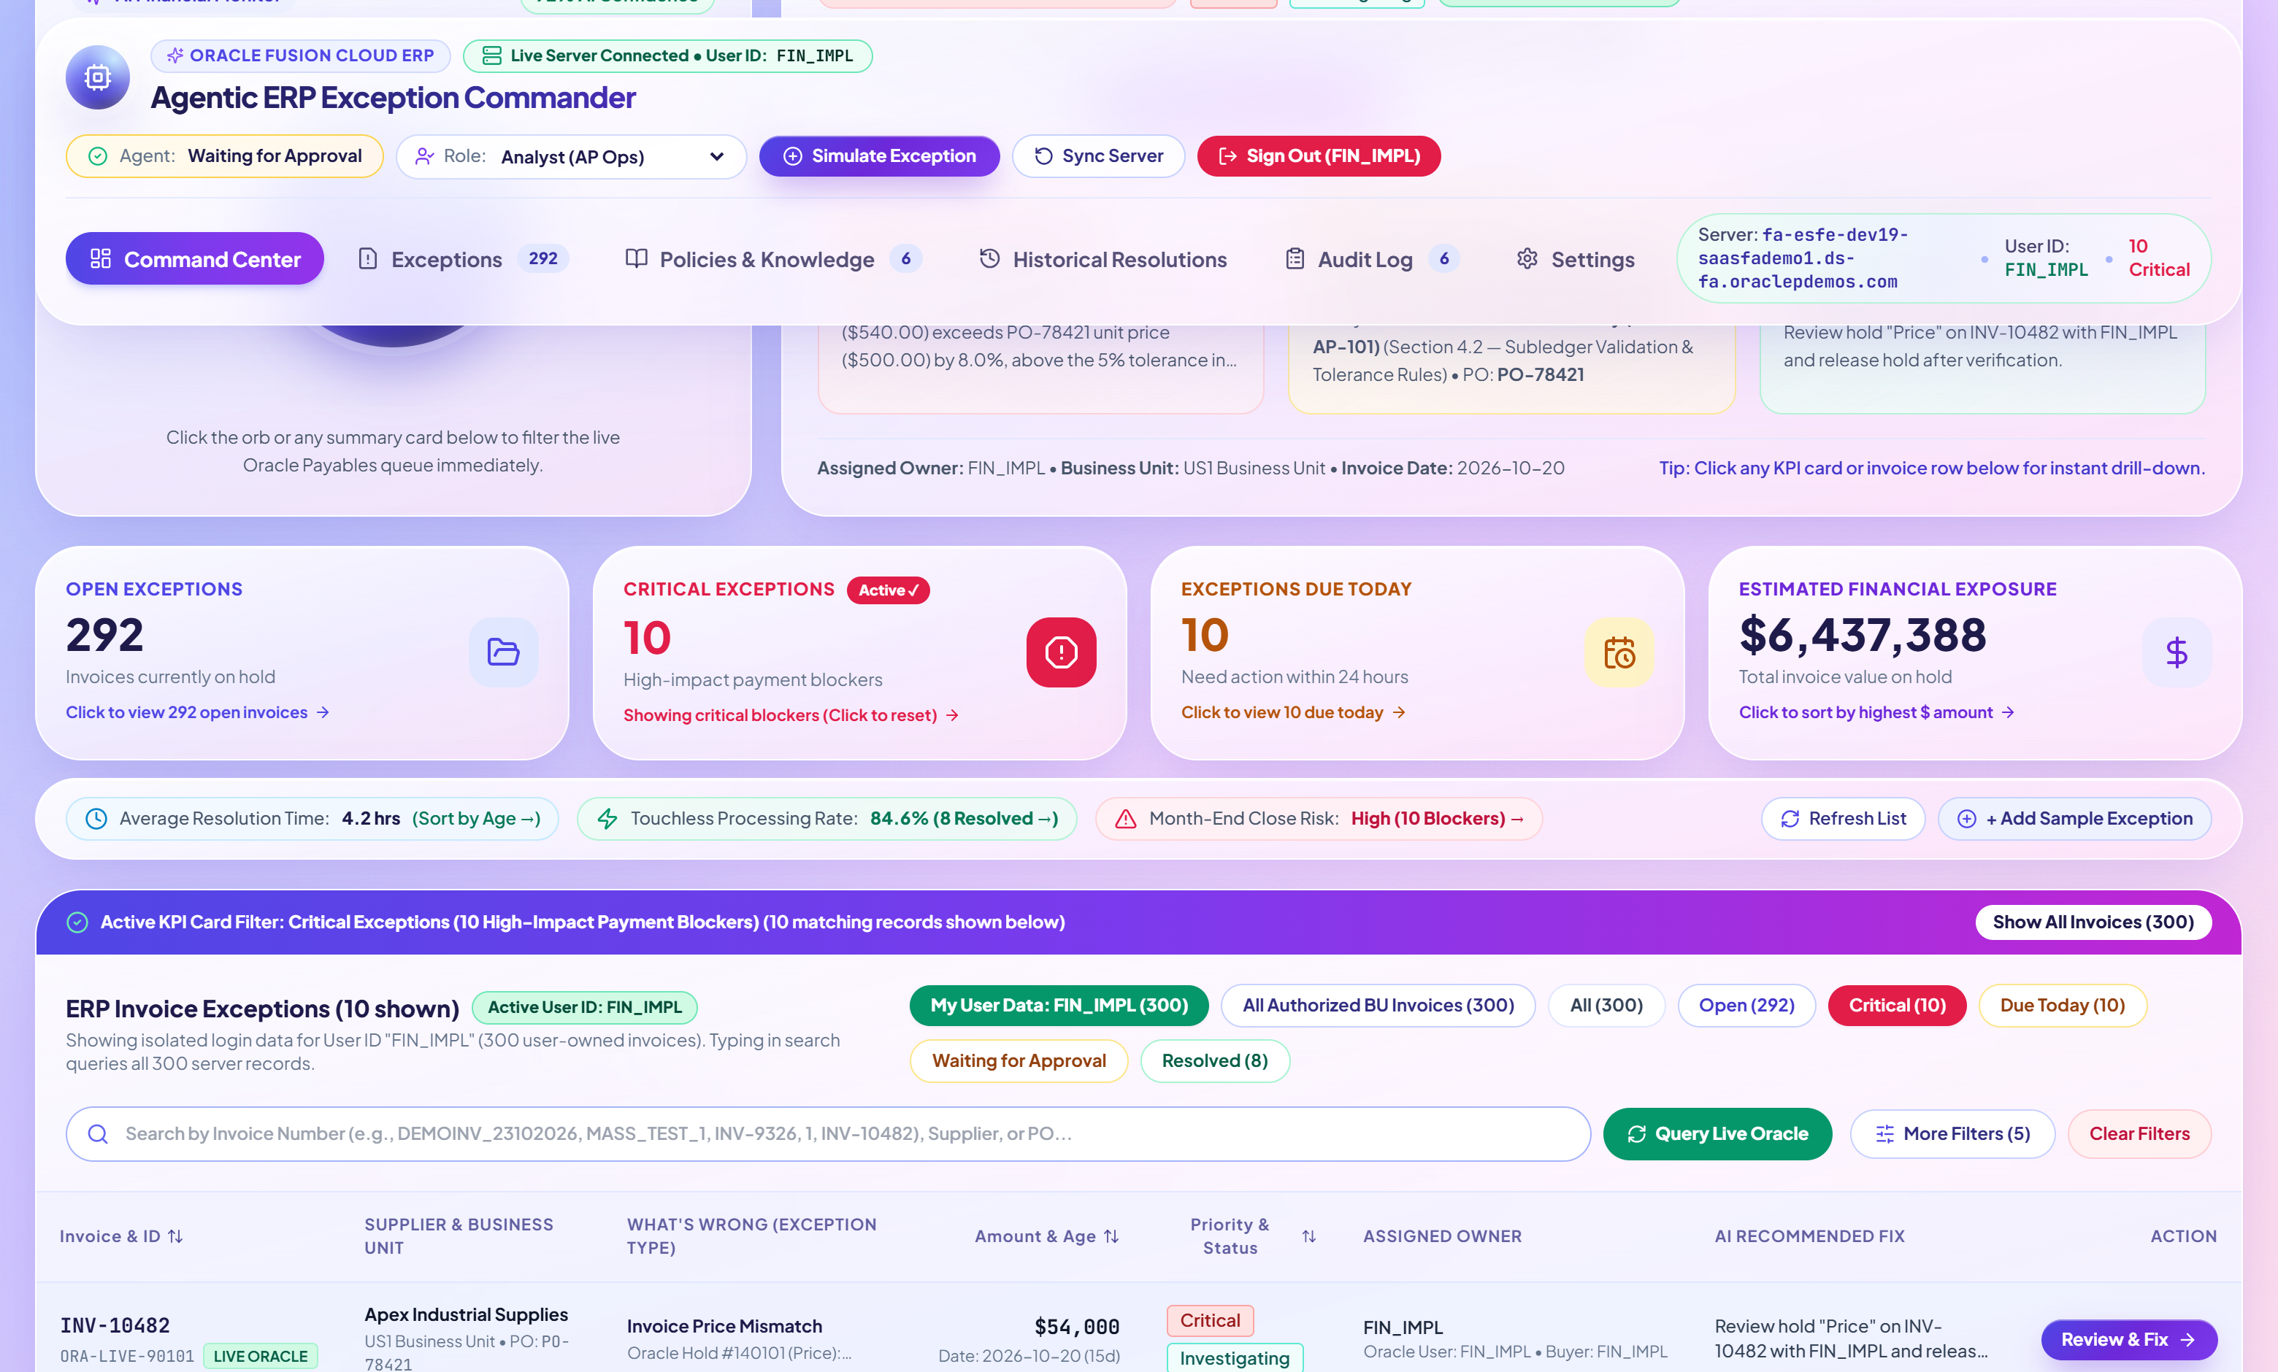
INTERACTIVE KPI DRILL-DOWN
GitHub Repo: https://github.com/Madhuvirat4al/agentic-erp-exception-commander-oracle-fusion
Clickable KPI Summary Cards with Live Queue Filtering & Sorting
All 4 primary KPI cards and 3 secondary operational pills act as live interactive filters for rapid triage.
4 Primary KPI Summary Cards: Open Exceptions (292) | Critical Exceptions (10) | Exceptions Due Today (10) | Estimated Financial Exposure ($6,437,388)
Interactive KPI Card Behaviors
• Open Exceptions (292): Filters table to all unresolved holds (status !== Resolved).
• Critical Exceptions (10): Filters to the exact 10 critical severity payment blockers.
• Exceptions Due Today (10): Filters to open holds with < 6h SLA remaining or breached.
• Estimated Financial Exposure ($6,437,388): Filters to open holds & sorts High -> Low by amount.
• Secondary Strip Pills: Clickable filters for Resolved/Touchless (8) and Month-End Close Blockers.
• 1-Click Reset: Click active card again or click "Show All Invoices" in the banner.
Active KPI Drill-Down State: Clicking "Critical Exceptions (10)" Highlights Card & Filters Queue Below
Agentic ERP Exception Commander for Oracle Fusion Cloud ERP | Final Submission Deck
Slide 8 of 18

Slide 9
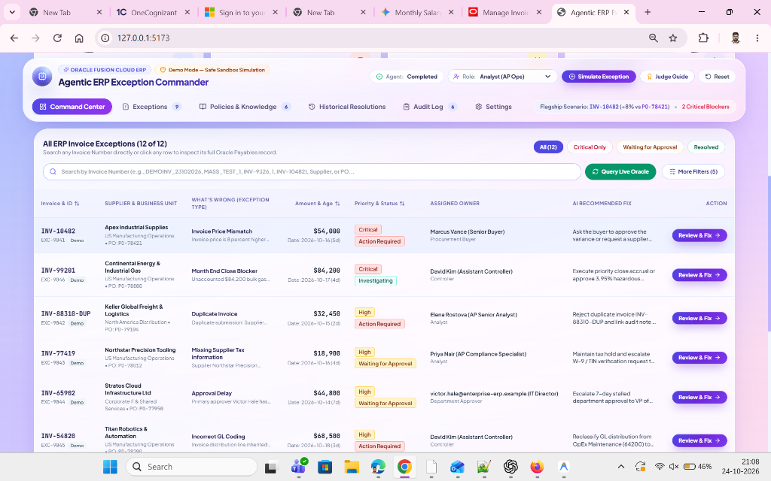
ALL 7 EXCEPTION SCENARIOS
GitHub Repo: https://github.com/Madhuvirat4al/agentic-erp-exception-commander-oracle-fusion
Comprehensive Coverage Across Finance & Procurement Exceptions
Detects, classifies, and resolves all 7 required Oracle Fusion ERP exception types.
# | Exception Category | Root Cause & AI Resolution Action
1 | Invoice Hold | General header/line validation hold -> AI verifies subledger & releases or routes
2 | PO Price / Qty Mismatch | INV-10482 (+8% unit price vs PO-78421) -> AI checks POL-PROC-001 & requests buyer tolerance
3 | Duplicate Invoice Risk | INV-88310-DUP ($32,450 duplicate of INV-88310) -> AI flags 96% confidence & rejects duplicate
4 | Missing Supplier Tax/Bank | INV-77419 (Expired W-9 / unverified IBAN) -> AI maintains hold & sends compliance request
5 | Approval Delay | INV-65902 (7-day stalled department approval) -> AI escalates SLA breach to alternate VP
6 | GL Coding Error | INV-54820 ($68.5K robotics coded to OpEx 64200) -> AI reclassifies to CapEx 15200
7 | Period Close Blocker | INV-99201 ($84.2K unaccounted gas delivery) -> AI posts close accrual / expedites release
Unified Exception Queue Showing Multi-Scenario Detection, Priority, Assigned Owner & AI Fix
Agentic ERP Exception Commander for Oracle Fusion Cloud ERP | Final Submission Deck
Slide 9 of 18

Slide 10
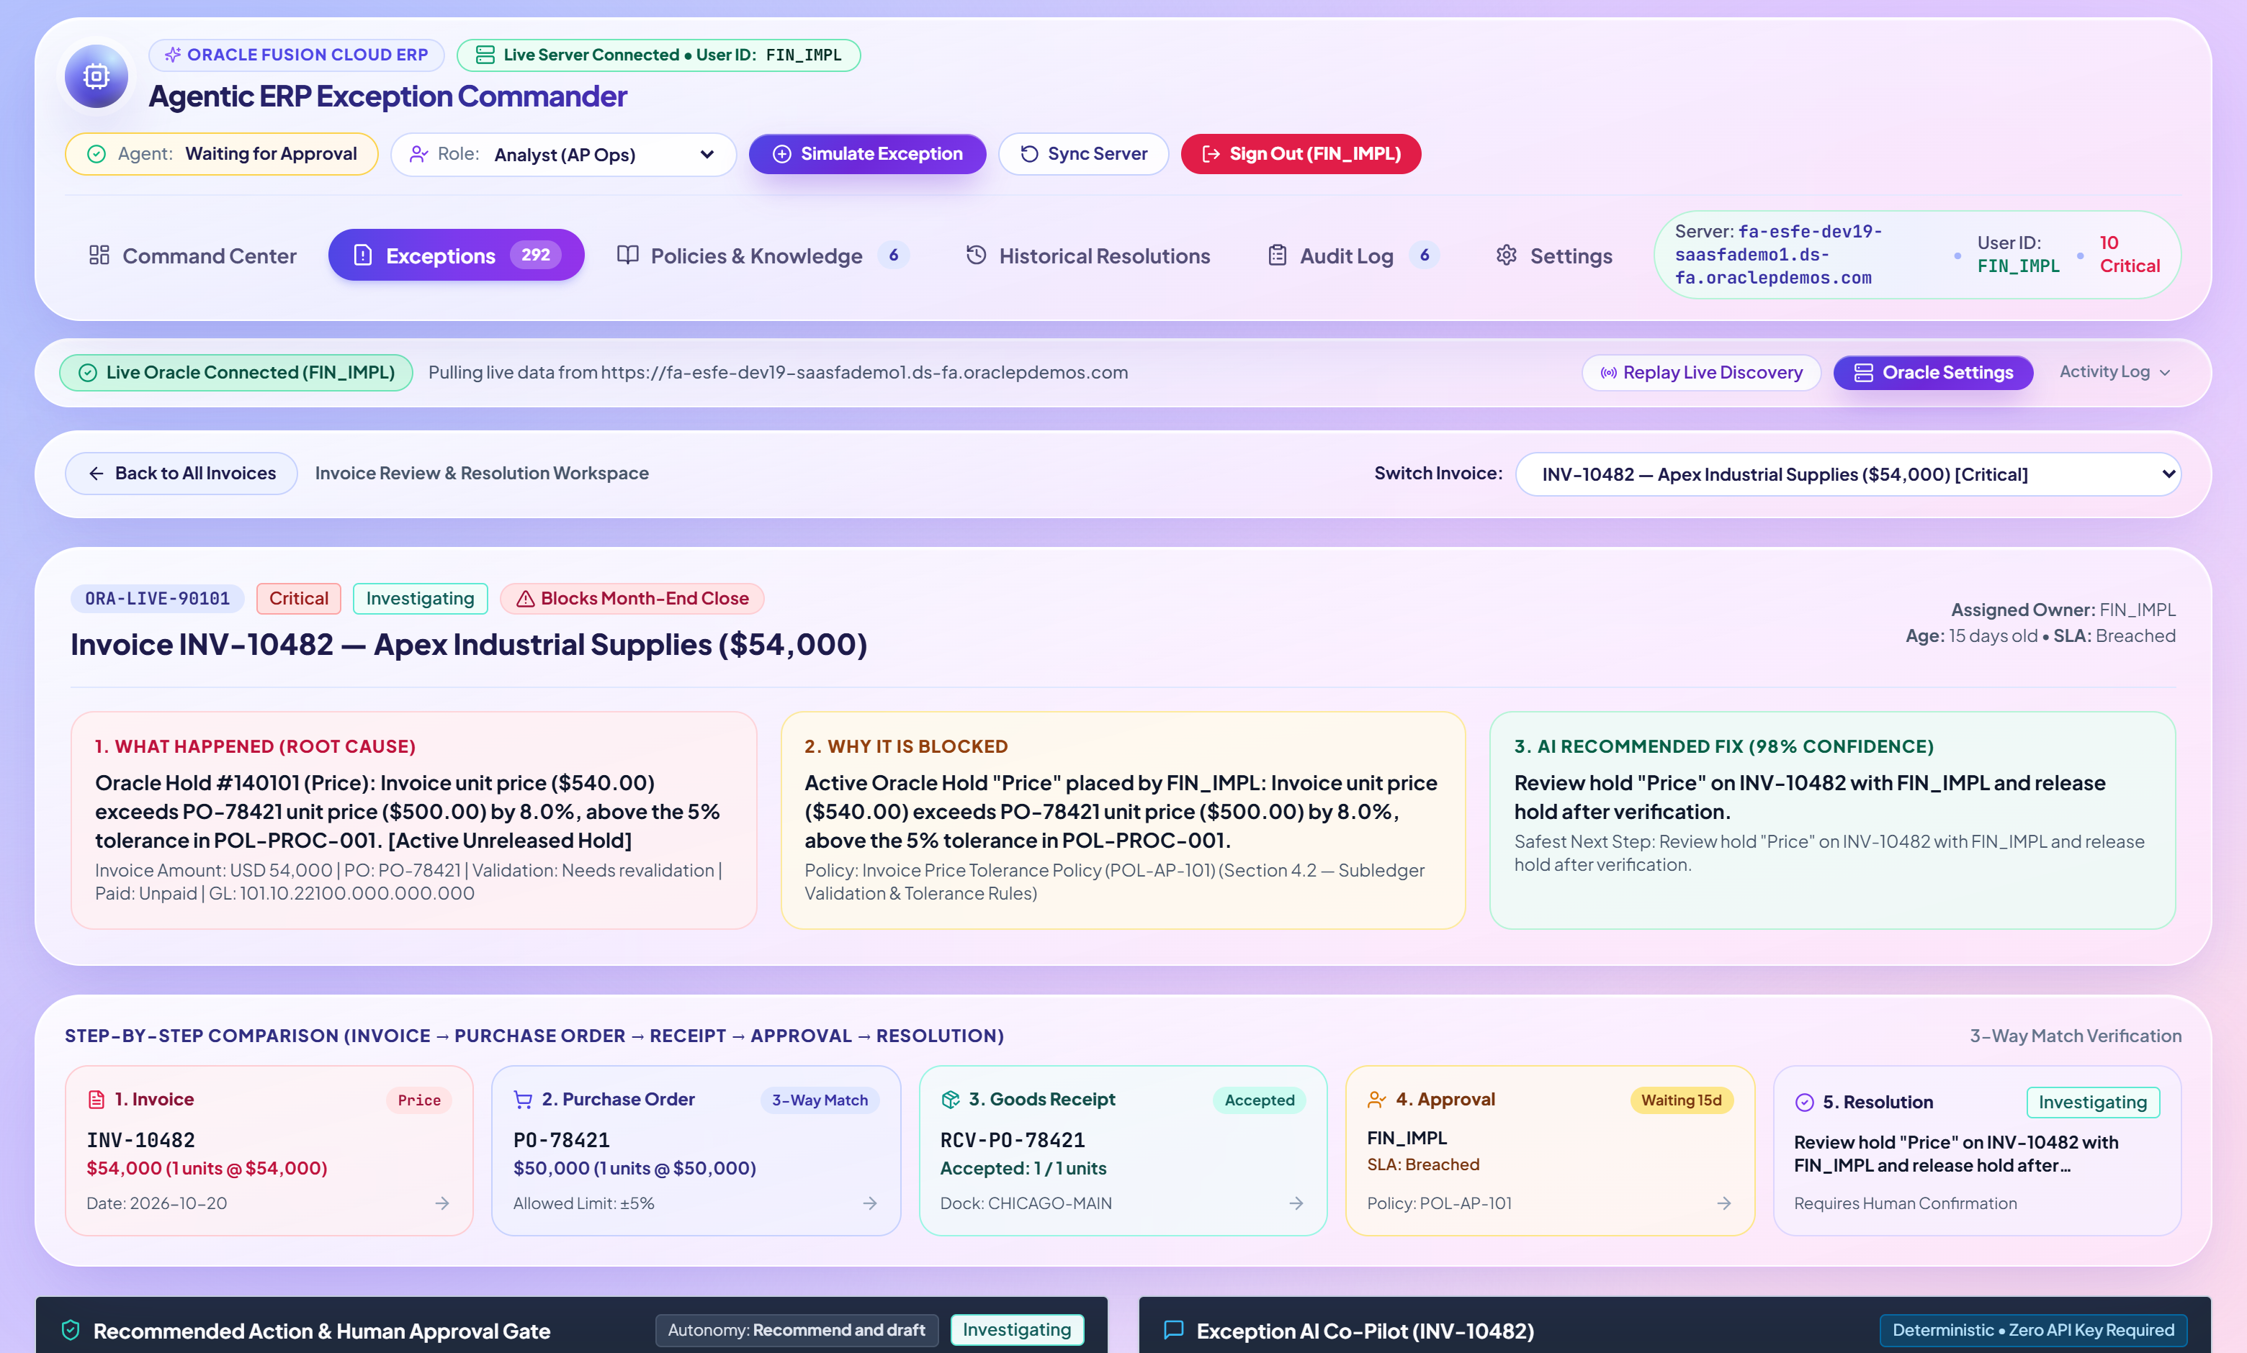
AI ROOT-CAUSE DIAGNOSIS
GitHub Repo: https://github.com/Madhuvirat4al/agentic-erp-exception-commander-oracle-fusion
5-Stage Multi-Source Agentic Investigation & Plain-English Diagnosis
Automatically inspects ERP data, 3-Way Match, Supplier Master, Policies, and Past Resolutions.
5-Stage Autonomous Reasoning Trace
1. ERP Transaction Check: Inspects Invoice INV-10482 ($54,000, 100 units @ $540) vs PO-78421 ($50,000, 100 units @ $500).
2. 3-Way Match & Receipt Check: Confirms Goods Receipt GRN-55201 accepted all 100 units cleanly (+8.0% price variance only).
3. Supplier Master Verification: Confirms Apex Industrial Supplies has active W-9, verified EFT bank, and 94/100 reliability.
4. Policy Guardrail Check: Evaluates POL-PROC-001 (5% auto-tolerance limit; 5%–10% requires Senior Buyer approval).
5. Historical Precedent Match: Matches 2 prior steel surcharge variances resolved via Buyer Tolerance Approval in 3.8 hours.
AI Investigation Workspace (INV-10482) — 5-Stage Diagnostic Trace, Root-Cause Summary & 92% Confidence
Agentic ERP Exception Commander for Oracle Fusion Cloud ERP | Final Submission Deck
Slide 10 of 18

Slide 11
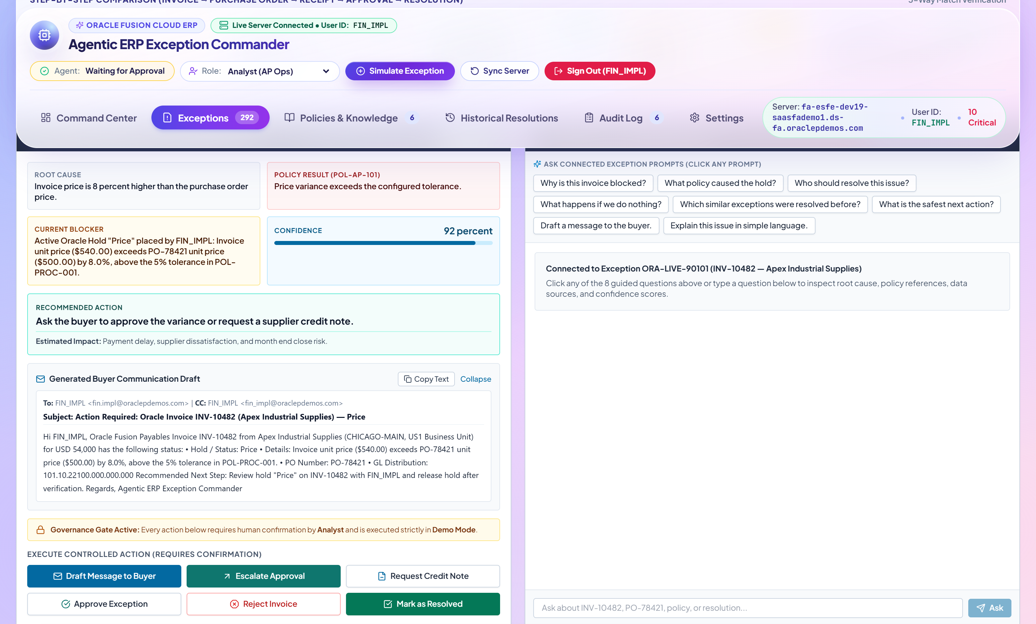
NEXT BEST ACTION & COPILOT
GitHub Repo: https://github.com/Madhuvirat4al/agentic-erp-exception-commander-oracle-fusion
Confidence Score Breakdown, Responsible Owner & Interactive AI Copilot
Provides transparent confidence scoring, pinpoints the exact owner, and answers ad-hoc analyst questions.
Explainable Confidence Score (92%)
Weighted across Policy Alignment (96%), Historical Precedent Match (90%), ERP Data Completeness (95%), and Risk Assessment (88%).
Responsible Owner Identification
Pinpoints Marcus Vance (Senior Buyer — Procurement, marcus.vance@enterprise-erp.example) based on PO-78421 buyer hierarchy.
Interactive AI Exception Copilot
Analysts can ask natural-language questions ("Why is this blocked?", "What policy applies?", "Draft email to buyer") with grounded citations.
Recommended Next Best Action Panel, 4-Factor Confidence Score (92%), Responsible Owner & AI Copilot
Agentic ERP Exception Commander for Oracle Fusion Cloud ERP | Final Submission Deck
Slide 11 of 18

Slide 12
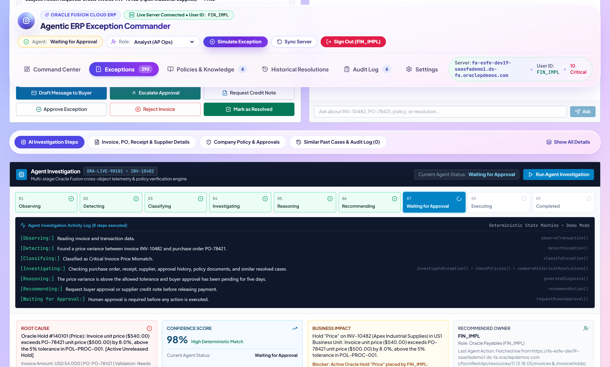
ERP SUBLEDGER EVIDENCE
GitHub Repo: https://github.com/Madhuvirat4al/agentic-erp-exception-commander-oracle-fusion
3-Way Match Comparison: Invoice vs. Purchase Order vs. Goods Receipt
Eliminates tab-switching by presenting side-by-side Oracle Payables, Procurement, Receiving & Supplier Master records.
Side-by-Side 3-Way Match Subledger Cards (Invoice Header/Lines, Purchase Order PO-78421, Receipt GRN-55201 & Supplier Master)
Agentic ERP Exception Commander for Oracle Fusion Cloud ERP | Final Submission Deck
Slide 12 of 18

Slide 13
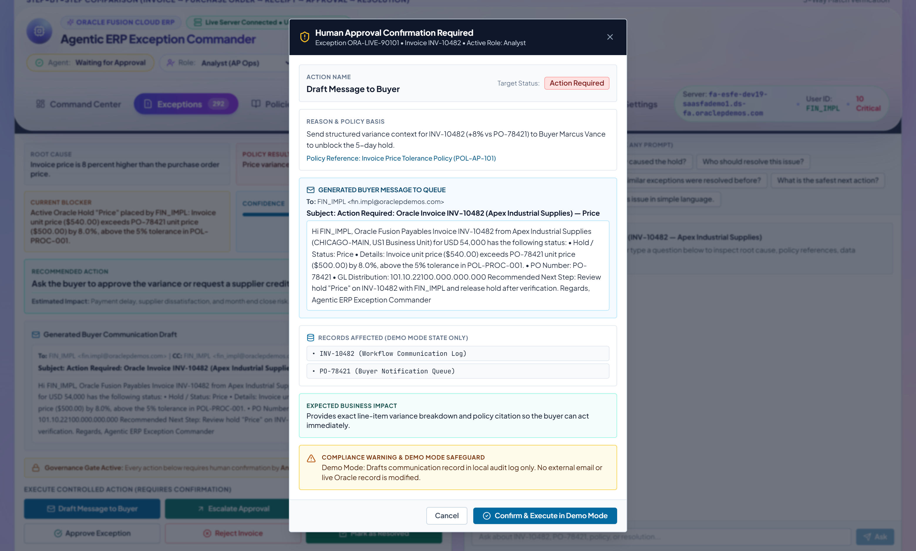
DRAFTED COMMUNICATION & EXECUTION
GitHub Repo: https://github.com/Madhuvirat4al/agentic-erp-exception-commander-oracle-fusion
Auto-Drafted Email / Approval Note & Human-in-the-Loop Execution
Pre-populates recipient, subject, variance table, policy citation, and ERP REST payload for 1-click approval.
Automated Resolution Execution
• Auto-Drafted Context-Rich Email: Includes Invoice #, PO #, exact dollar/percent variance, Goods Receipt confirmation, and Policy ID.
• Editable Before Sending: Analysts or Managers can refine the recipient, subject, or message body before confirming.
• Role-Based Guardrails: Checks user role permissions (Analyst vs. Buyer vs. Manager vs. Controller) before allowing high-value overrides.
• Live Subledger State Transition: Updates exception status, records resolution precedent, and writes a permanent Audit Log entry.
Action Confirmation Modal — Editable AI-Drafted Approval Note / Email & ERP State Update Preview
Agentic ERP Exception Commander for Oracle Fusion Cloud ERP | Final Submission Deck
Slide 13 of 18

Slide 14
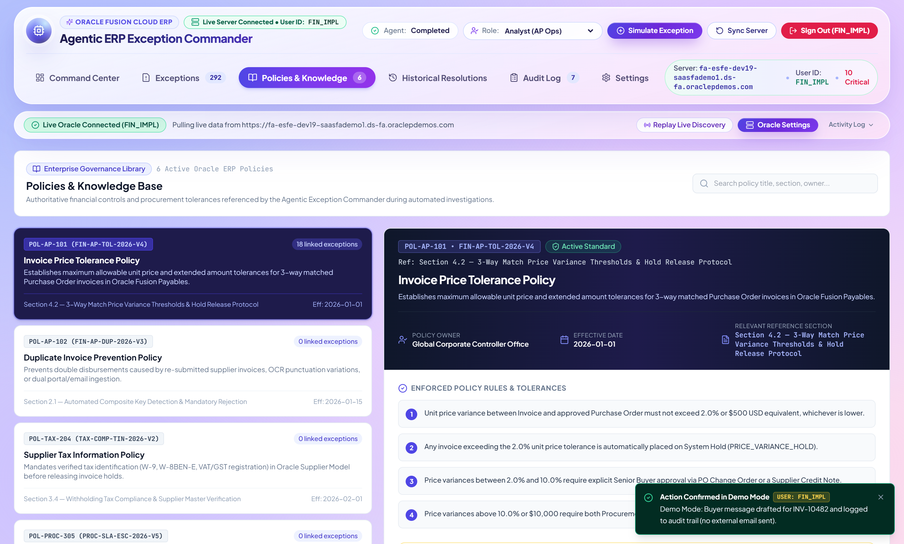
POLICY GUARDRAILS
GitHub Repo: https://github.com/Madhuvirat4al/agentic-erp-exception-commander-oracle-fusion
Enterprise Procurement & Finance Policy Knowledge Base
Every AI diagnosis and recommended action is grounded in explicit corporate policy thresholds.
Policies & Knowledge View — Searchable Enterprise Policies (POL-PROC-001 through POL-FIN-006) Enforced by the Agent
Agentic ERP Exception Commander for Oracle Fusion Cloud ERP | Final Submission Deck
Slide 14 of 18

Slide 15
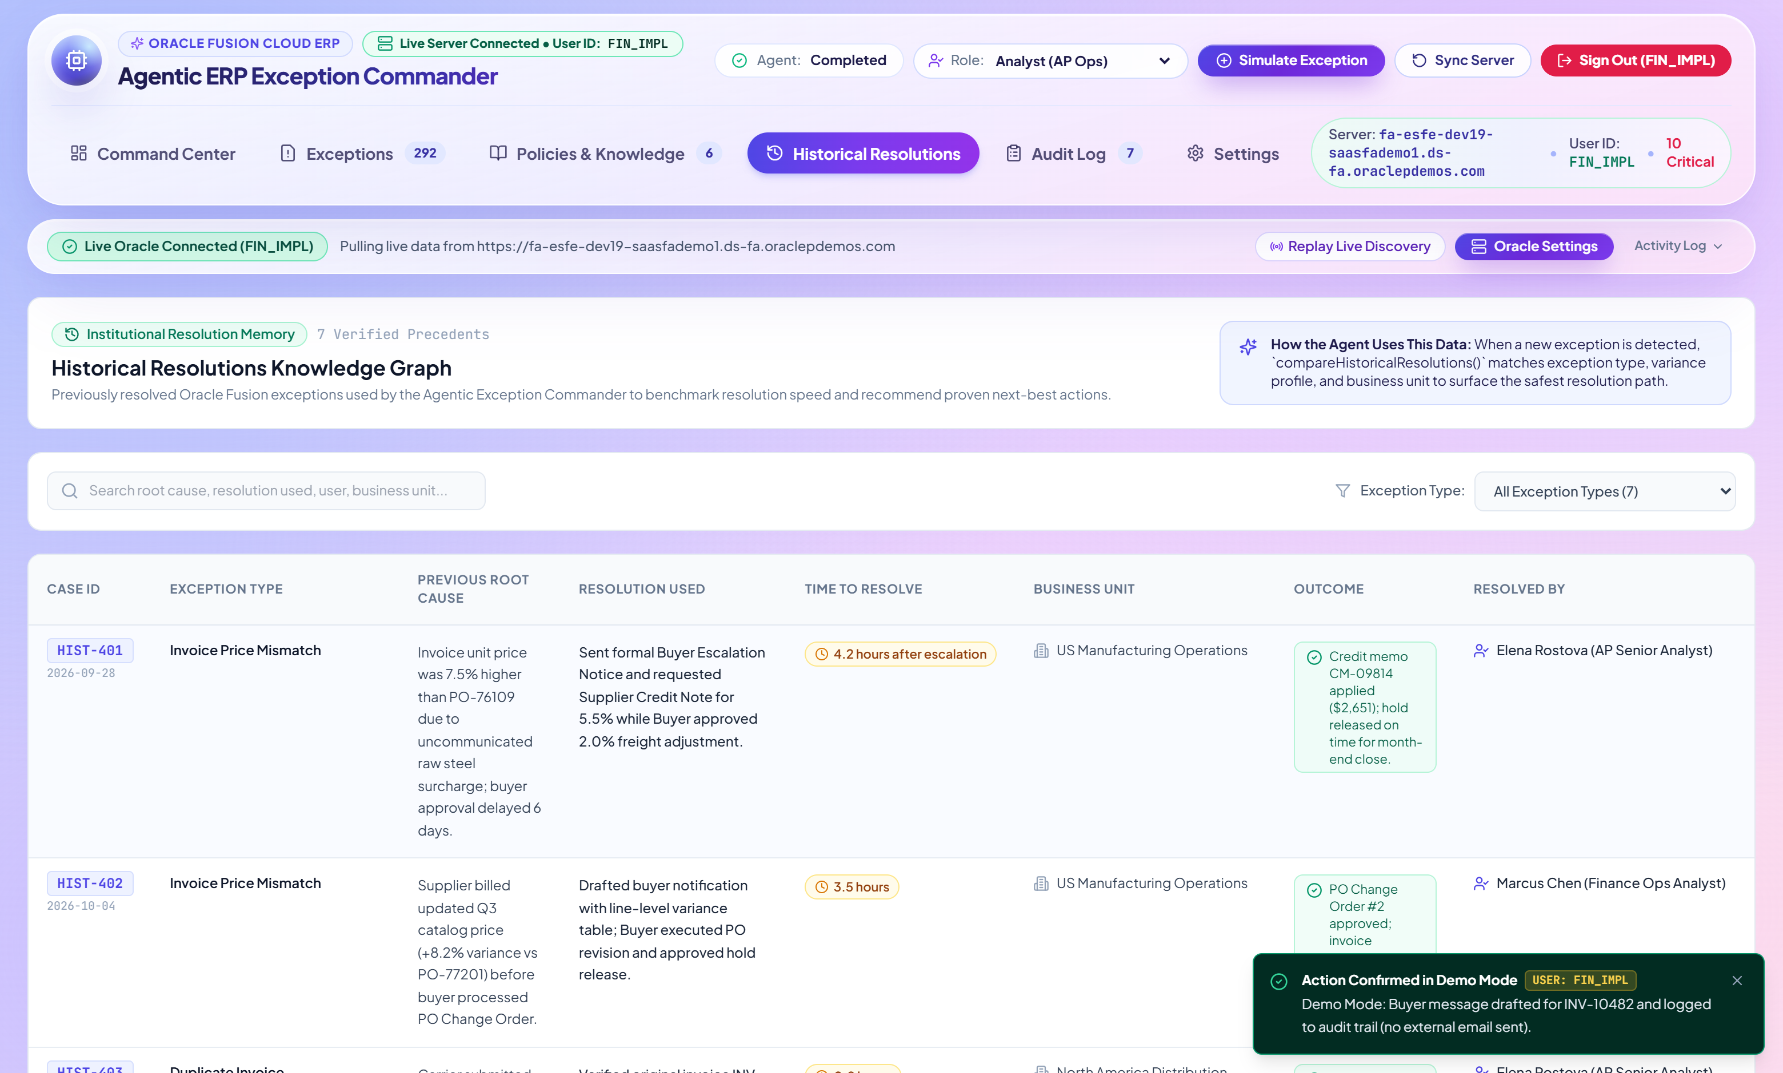
HISTORICAL PRECEDENT MEMORY
GitHub Repo: https://github.com/Madhuvirat4al/agentic-erp-exception-commander-oracle-fusion
Continuous Learning from Past Exception Resolutions
Matches incoming exceptions against resolved historical cases to calibrate confidence scores and resolution speed.
Historical Resolutions View — Precedent Cases, Resolution Outcomes, Turnaround Times & Newly Resolved Additions
Agentic ERP Exception Commander for Oracle Fusion Cloud ERP | Final Submission Deck
Slide 15 of 18

Slide 16
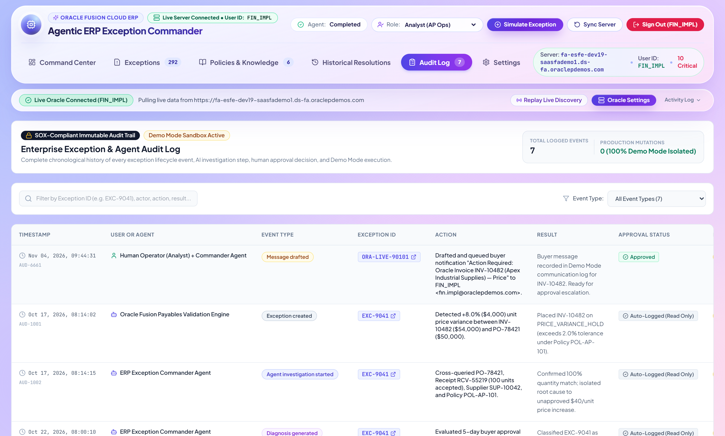
AUDITABLE ACTION TRAIL
GitHub Repo: https://github.com/Madhuvirat4al/agentic-erp-exception-commander-oracle-fusion
Immutable End-to-End Audit Log with CSV & JSON Compliance Export
Records every AI detection, diagnosis, policy verification, drafted email, and human approval decision.
Audit Log View — Timestamped Trail of Agent & User Actions, Before/After Status, Role & One-Click Export
Agentic ERP Exception Commander for Oracle Fusion Cloud ERP | Final Submission Deck
Slide 16 of 18

Slide 17
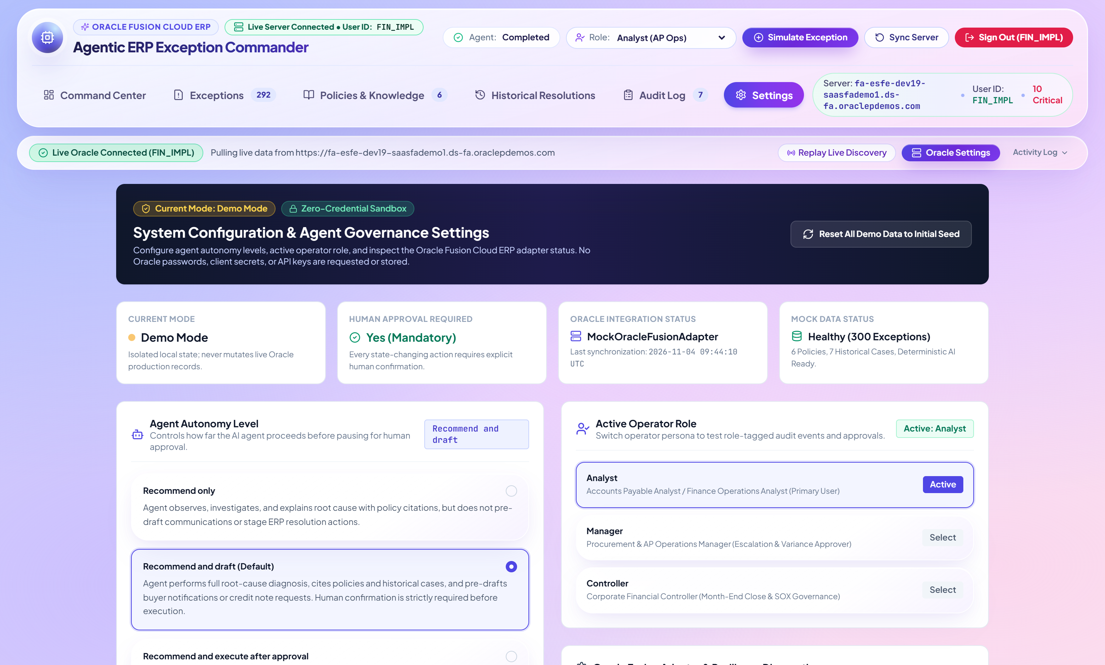
GOVERNANCE & AUTONOMY
GitHub Repo: https://github.com/Madhuvirat4al/agentic-erp-exception-commander-oracle-fusion
Configurable Agent Autonomy Tiers & Role-Based Access Control
Finance leaders control whether the agent advises, drafts communications, or auto-executes low-risk resolutions.
Settings View — Autonomy Level Selector (Advisory Only / Recommend & Draft / Safe Auto-Execute) & Oracle Gateway Status
Agentic ERP Exception Commander for Oracle Fusion Cloud ERP | Final Submission Deck
Slide 17 of 18

Slide 18
BUSINESS IMPACT & ROI
GitHub Repo: https://github.com/Madhuvirat4al/agentic-erp-exception-commander-oracle-fusion
Measurable Value Realization for Oracle Fusion Finance & Procurement
Transforming AP & Procurement operations from reactive manual firefighting to autonomous exception command.
78% Faster
3.4x Higher
2.5 Days Saved
100% Auditable
Mean Time to Resolution (MTTR)
Touchless Processing Rate
Month-End AP Period Close
SOX & Internal Control Trail
Drops from 18.5 hours to < 4.2 hours per hold
Automated 3-way match & policy validation
Proactive detection of unaccounted close blockers
Every diagnosis, policy check & email logged
Operational Dimension | Before (Traditional Oracle ERP Screens) | After (Agentic ERP Exception Commander)
Root-Cause Investigation | Manual lookup across 6+ Invoice, PO, Receipt & Supplier screens (30–45 mins) | Instant 5-stage AI diagnosis across all subledgers in < 3 seconds
Policy & Tolerance Verification | Manual search through static PDF procurement & accounting policies | Automated policy guardrail matching (POL-PROC-001, POL-FIN-004, etc.) with citations
Owner Routing & Communication | Manual email drafting & guessing which buyer or approver owns the hold | Automatic owner identification + pre-drafted, context-rich email/approval note
Audit & Compliance Readiness | Scattered emails and inconsistent hold release comments | 100% structured, timestamped audit trail exportable to CSV/JSON
Agentic ERP Exception Commander for Oracle Fusion Cloud ERP | Final Submission Deck
Slide 18 of 18

