Slide 1
CUSTOMER DEMOGRAPHICS STUDY USING POWER BI
Presented By : Gosala Madhvika
Intern ID: CITS1260
Data Analytics Intern

Slide 2
PROJECT OVERVIEW
* Customer demographic analysis using Power BI
* Interactive dashboard creation
* Visualization of customer characteristics
* Business insight generation

Slide 3
OBJECTIVES
* Analyze customer demographics
* Study gender distribution
* Evaluate income levels
* Analyze spending behavior
* Generate business insights

Slide 4
DATASET INFORMATION
Dataset Fields:
* Customer ID
* Gender
* Age
* Annual Income (k$)
* Spending Score

Slide 5
TOOLS USED
* Microsoft Excel
* Power BI Desktop
* GitHub
* Microsoft Word
* Microsoft PowerPoint

Slide 6
DASHBOARD FEATURES
* Total Customers
* Gender Distribution
* Annual Income Analysis
* Income vs Spending Score
* Customer Insights

Slide 7
KEY FINDINGS
* Female customers slightly outnumber male customers.
* Income levels vary across customer groups.
* Spending patterns differ among customers.
* Customer segmentation supports marketing decisions.

Slide 8
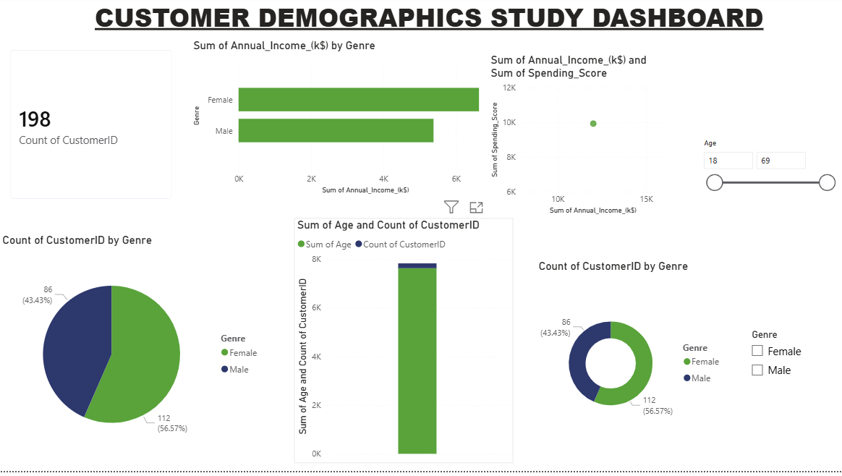
DASHBOARD SCREENSHOT

Slide 9
CONCLUSION
* Successfully analyzed customer demographic data.
* Created interactive Power BI dashboard.
* Generated valuable business insights.
* Demonstrated data-driven decision making.

