Slide 1
Online Drug Dictionary
Done by Yeszhanov Madi, Aripov Rasul
Group: CSSE-1815cco

Slide 2
Introduction
Medicines are a strategically important commodity and the health of the nation depends on their availability in the country in the required quantity and availability. It is no secret that people in our country quite often self-medicate at the same time people do not understand how or what many of the drugs they use for prophylactic purposes consist of. Many people don't realize that some drugs can have side effects or even substances that are harmful to some people.
In this regard, we decided that everyone needs a detailed database of drugs that will contain all the necessary information about drugs and their substitutes.
Notes:
Medicines are a strategically important commodity and the health of the nation depends on their availability in the country in the required quantity and availability. It is no secret that people in our country quite often self-medicate at the same time people do not understand how or what many of the drugs they use for prophylactic purposes consist of. Many people don't realize that some drugs can have side effects or even substances that are harmful to some people.
In this regard, we decided that everyone needs a detailed database of drugs that will contain all the necessary information about drugs and their substitutes.

Slide 3
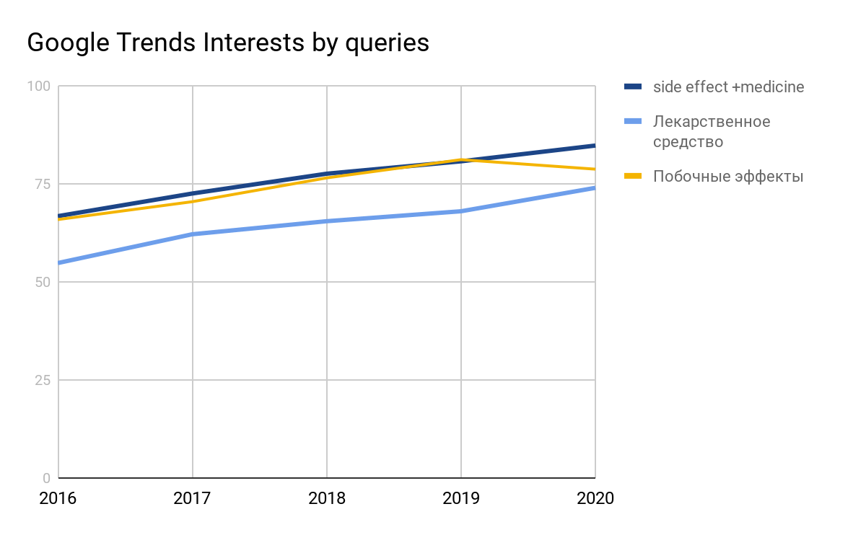
Analysis of the project relevance
We used the Google Trends service to determine how relevant the topic of drugs, self-medication is and, as you can see, people around the world are always looking for information about drugs.
Notes:
We used the Google Trends service to determine how relevant the topic of drugs, self-medication is and, as you can see, people around the world are always looking for information about drugs.

Slide 4
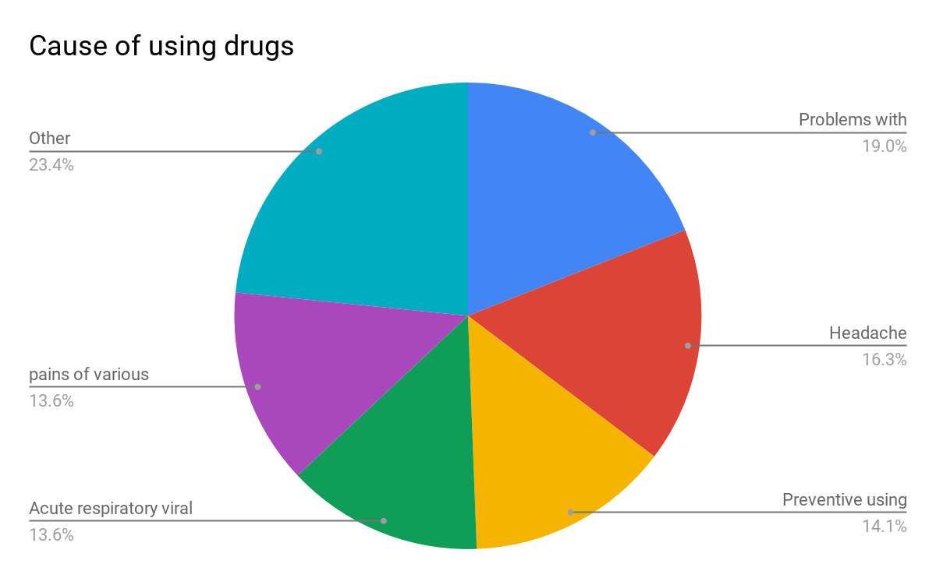
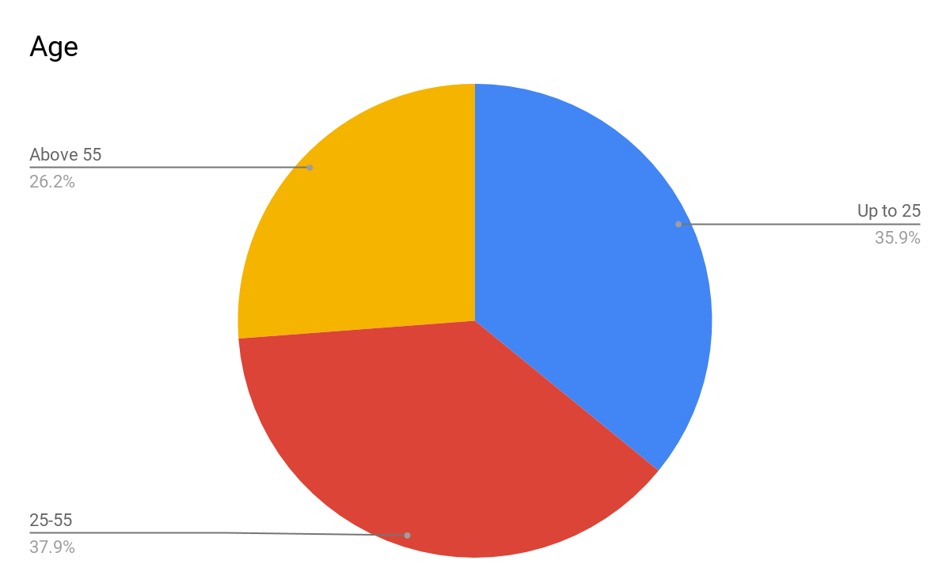
“ФарСаР*” Research of 2016 year in Russia
As you can see on the graph, the topic of self-medication is relevant for all ages.
*
ФарСар - Фармакоэпидемиологические аспекты самолечения населения городов России
Notes:
As you can see on the graph, the topic of self-medication is relevant for all ages.

Slide 5
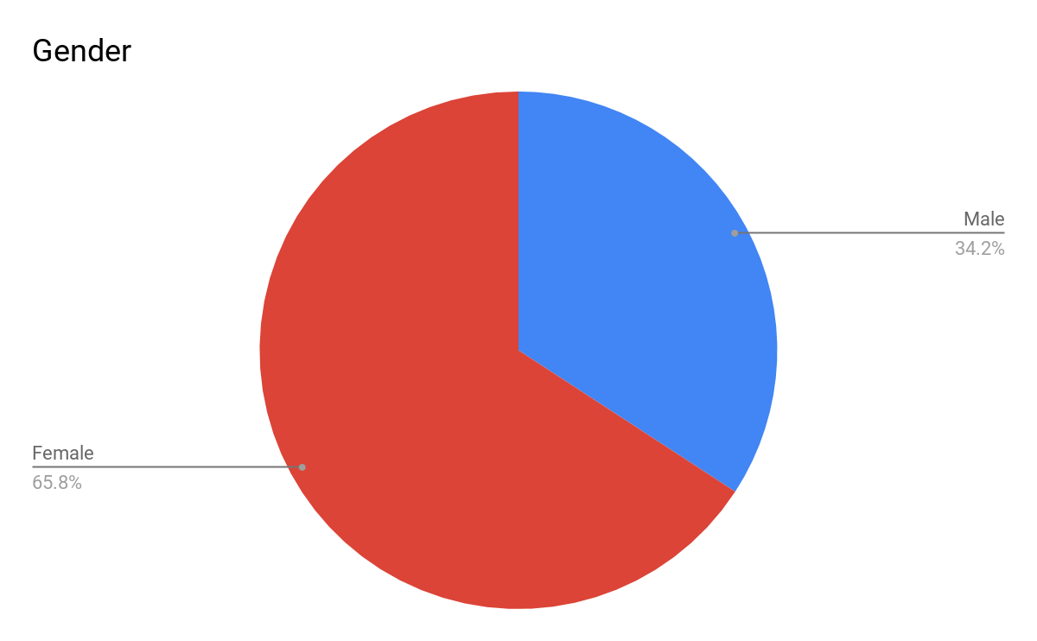
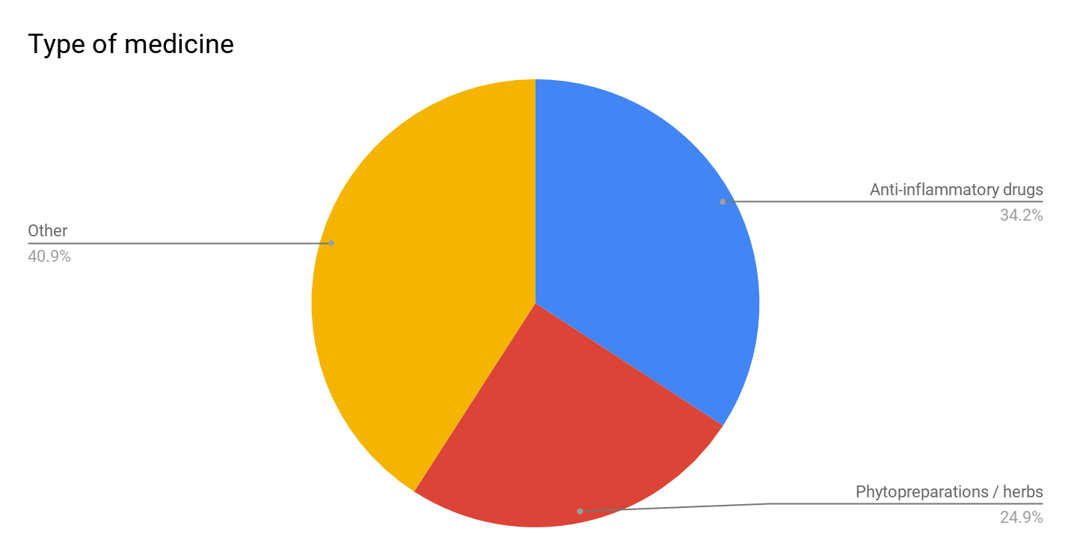
“ФарСаР*” Research of 2016 year in Russia
On this slide, we see that women are more interested in self-medication than men.
*
ФарСар - Фармакоэпидемиологические аспекты самолечения населения городов России
Notes:
On this slide, we see that women are more interested in self-medication than men.

Slide 6
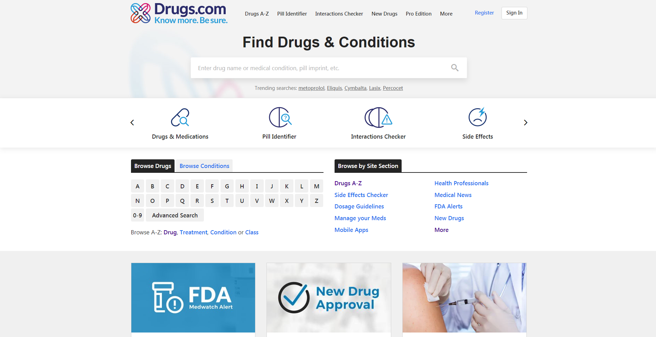
Examples of comparatives

