Slide 1



Superstore_sales
View in Power BI
Last data refresh:
12/08/2023 19:03:46 UTC
Downloaded at:
06/09/2023 02:30:42 UTC

Slide 2
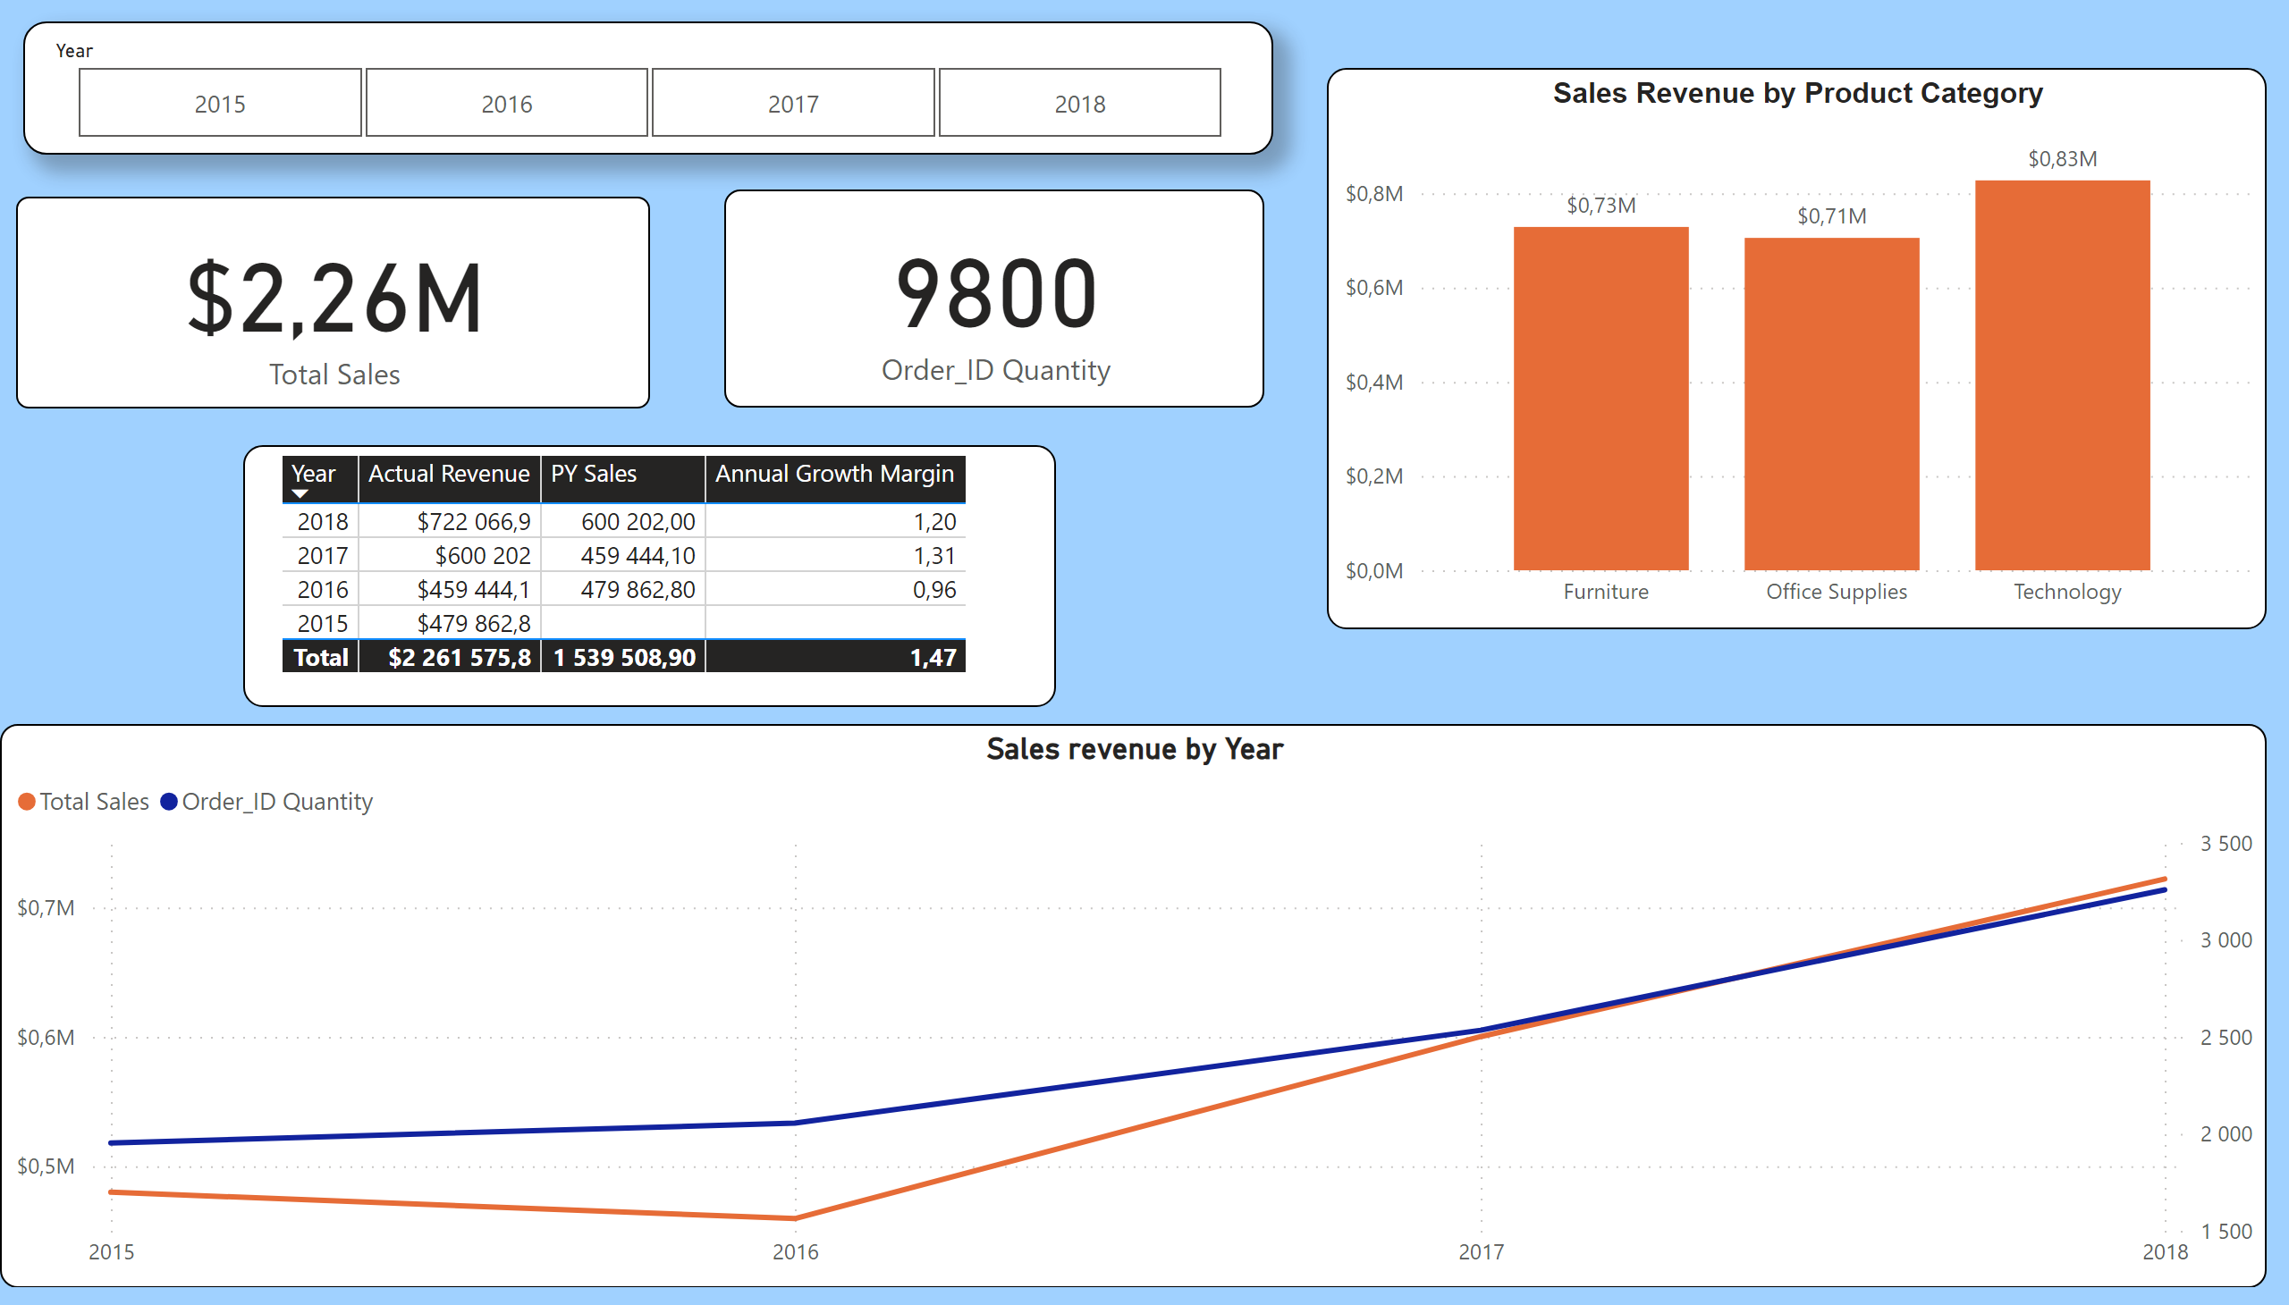
Sales Insights
Notes:
Sales revenue by Year
No alt text provided
Sales Revenue by Product Category
No alt text provided
card
No alt text provided
card
No alt text provided
slicer
No alt text provided
tableEx
No alt text provided

Slide 3
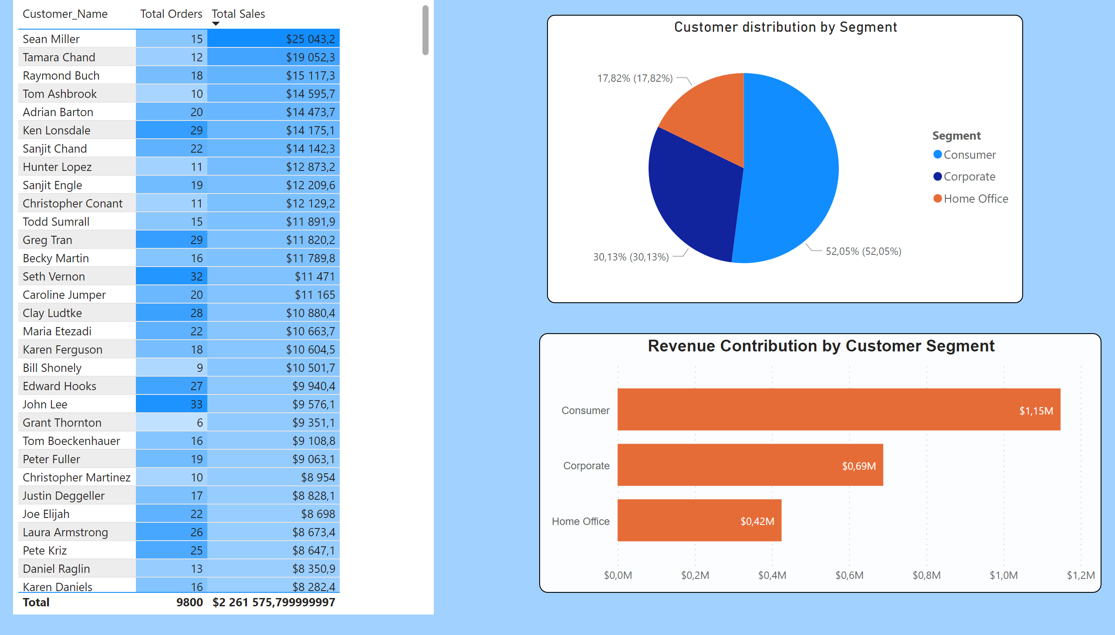
Customer Insights
Notes:
tableEx
No alt text provided
Customer distribution by Segment
No alt text provided
Revenue Contribution by Customer Segment
No alt text provided

Slide 4
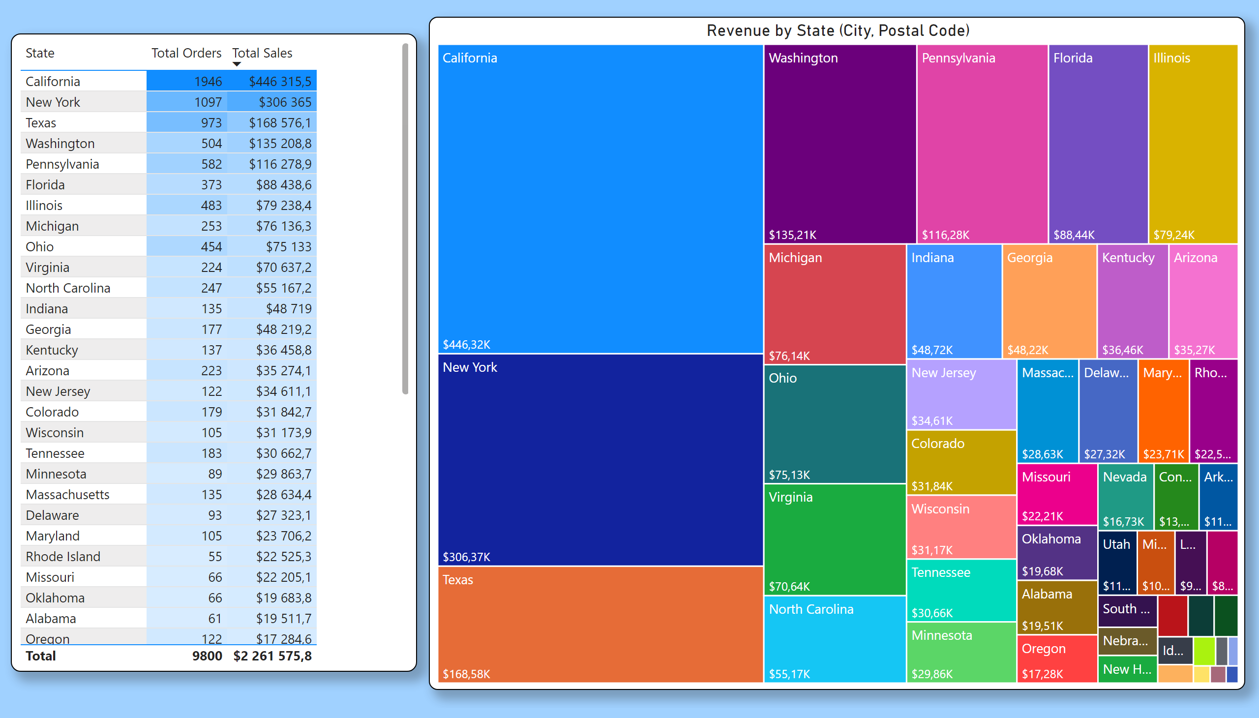
State Insights
Notes:
tableEx
No alt text provided
Revenue by State (City, Postal Code)
No alt text provided

