Slide 1
Making Sense of Blockchain through Grounded Theory
Scott Ruoti, Arkady Yerukimovich, Benjamin Kaiser, Jeremy Clark, Rob Cunningham
Meeting
Date
Notes:
1
1

Slide 2
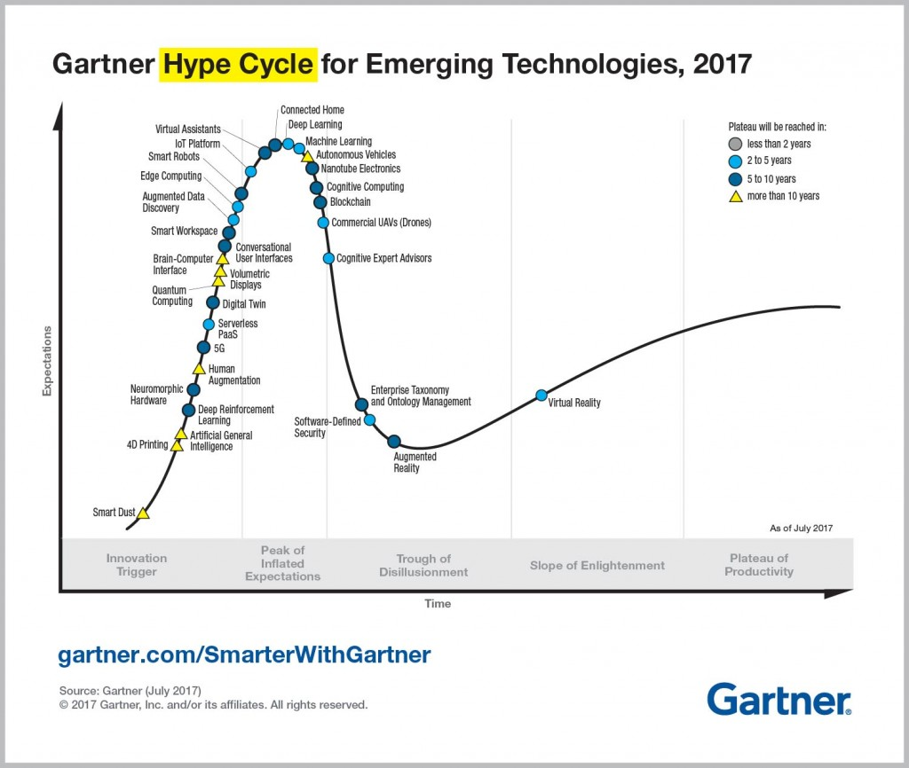
Blockchain technology comes with some hype…
“This Company Added the Word ‘Blockchain’ to Its Name and Saw Its Shares Surge 394%”¹
“Bitcoin [is] taking over the world, dominating the global economy, displacing fiat, and bringing down central banks.”
“I have been able to show how it can be used to eradicate poverty, and it doesn’t need to be politicized.”
¹This Company Added the Word ‘Blockchain’ to Its Name and Saw Its Shares Surge 394%, Lisa Pham, Bloomberg. Oct. 27, 2017 ²Blockchains in the Mainstream, Never Stop Marketing, 2017. Attributed to Erik Vorhees of Shapeshift.io. ²Blockchains in the Mainstream, Never Stop Marketing, 2017. Attributed to Tatiana Moroz

Slide 3

…but it’s not all hype
Bitcoin leverages a blockchain to provide real utility to the world
Remittance payments by immigrants
Bitcoin has fixed transaction fees, historically stable at < $1 (although higher lately)
Average global fee for such payments is 7.21% of the amount sent¹
Censorship-resistant payments and contracts for 2 billion “unbanked”²
Nonprofit Code to Inspire pays Afghan women in Bitcoin³
Anonymous payments or purchases
Donations to independent or censored organizations (Tor, Freedom of the Press Foundation, WikiLeaks)
¹Remittance Prices Worldwide, The World Bank. Issue 23, Sept. 2017 ² Measuring Financial Inclusion around the World, The World Bank. Global Findex Database, 2014
³Code to Inspire: Bitcoin Gives Afghan Women Financial Freedom, Rebecca Campbell, Bitcoin Magazine. Apr. 14, 2016
Notes:
It’s easy to be cynical of the hype, but the success of Bitcoin shows there’s something to the blockchain-mania.

Slide 4

Blockchain beyond Bitcoin
The billion-dollar question is: what is Blockchain technology beyond just Bitcoin?
Hundreds of whitepapers have been published in the last few years trying to answer this question.
Private industry (legacy and startup)
Governments
Blockchain enthusiast communities
Each identifies different features, potential use cases, surmountable challenges, and inherent limitations of the technology.
We wanted to parse this corpus and find out what the community talks about when it talks about Blockchain.
Notes:
Note the intentional exclusion of academia and explain why!!
We can’t treat industry whitepapers as typical research papers – they’re highly subjective and thus require qualitative analysis (transition to grounded theory)

Slide 5
Outline
Motivation
Methodology
Results

Slide 6
Grounded theory
Grounded theory: generate theories about patterns in qualitative data
1. Collect data gather papers to analyze
Benefits
Allows qualitative research
Allows for analysis of human phenomena (e.g., blockchain hype)
Identifies both popular and ”fringe” ideas
Limitations
Minimizes, but does not erase, researcher bias
May miss truly “one-off” ideas
2. Analyze “open code” – tag all observed ideas
5. Outline theories iterate on theories using concepts
After 1st iteration, terminate if saturation is reached
3. Memoize develop theories
4. Sort subsume codes into concepts
Notes:
Papers gathered through careful monitoring of possibly sources

Slide 7
Outline
Motivation
Methodology
Results
Theories
Graph analysis
Use case study

Slide 8
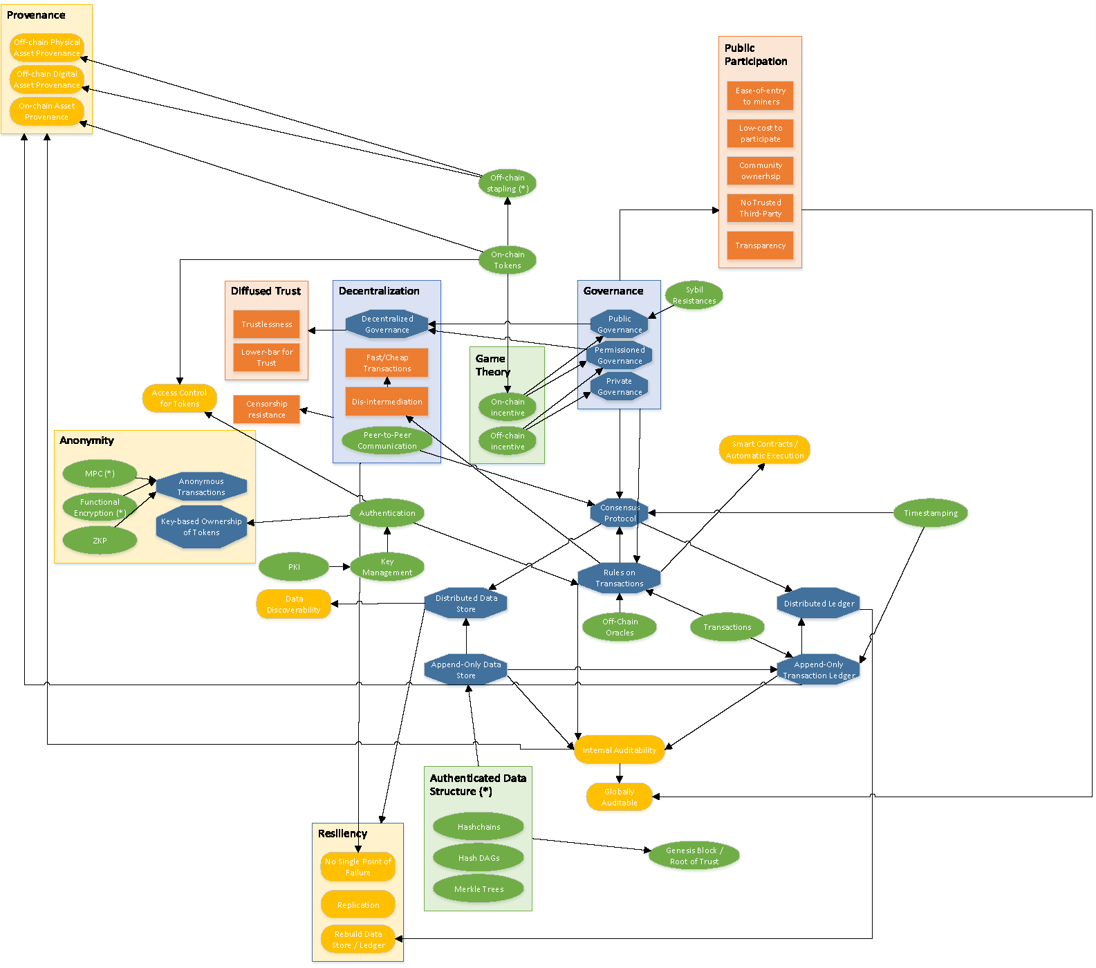
Results overview
>100 papers coded
>600 unique codes created
68 final concepts mapped into five categories

Slide 9
Some theories
A lack of shared taxonomy inhibits conversation
”Blockchain” vs “blockchain”
Shared public ledgers (SPL), distributed consensus ledgers (DCL), distributed ledger technology (DLT)
Misconceptions about the technical properties of blockchains are prevalent
Privacy is not protected by basic blockchains
Blockchains are not trustless – they diffuse trust
Ledgers don’t store state – they store state changes
Ideological and technical properties are often conflated
Technical capabilities are more nuanced than ideological claims
Ideology can cause suboptimal technical decisions

Slide 10
Lack of standardized terminology
When discussing blockchain technology, a variety of terms are used nearly interchangeably
This causes some confusion:
Each term includes and emphasizes different properties
The taxonomy is not clear, and some distinctions are marketing-driven
R3 Corda (which performs bank settlement and back office processes) has vacillated between the descriptors “blockchain-based”, “blockchain-inspired”, “distributed database”, and “distributed ledger”
It is impossible to objectively judge the strengths and weaknesses of a technology without clear classification.
Distributed consensus ledger
Distributed public ledger
Distributed ledger
“The” Blockchain
blockchain

Slide 11
Prevalent misconceptions
Blockchain technology is complicated, and many analysts do not understand it well.
Misunderstanding | Correction
User privacy and security are features of blockchain technology. | They are challenges, not features. Protecting user privacy and ensuring their security is non-trivial. Careful consideration must be applied before using a blockchain to handle private or sensitive data.
A blockchain does not require trust between parties: it is “trustless”. | A blockchain diffuses trust among many parties. Validators can be held to honest behavior through game theoretical or computational assumptions, but assumptions still require trust (and can be violated).
A blockchain is a data store. | A blockchain is a ledger, which is more than just a data store because it stores the history of state changes to the data. Using a blockchain for an application that only needs to store the current state is inefficient.
Users can be expected to safely store and manage private keys. | Key management is an immense challenge, and users will certainly make irreversible mistakes.

Slide 12
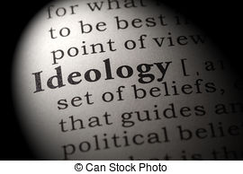
Ideology, design goals, and technical realities are blurred
Ideological beliefs and design goals shape how Blockchain technology is understood, but proper care is not taken to distinguish such beliefs and goals from technological facts.
Bitcoin is disintermediated, but the term “decentralized” (with its political connotations) is far more common. True ideologues may even call it “democratized”.
The efficiency of Bitcoin’s design could enable low-latency, low-cost payments, but this is an ideological property not yet actualized by the technology. Regardless, many authors discuss this ideal as if it were fact.
Similarly, certain blockchain designs could help resist censorship, but a design that does so on paper may well fail in practice, as miner centralization emerges, or as censorship regimes use side channels to unmask users and deanonymize transactions.
Notes:
Clearly link resisting censorship to anonymity

Slide 13
Graph analysis
There are five categories of concept nodes
We drew edges from each lower-level node to the higher-level nodes it supports
In the resulting graph:
Strongly connected nodes are foundational Blockchain concepts
Weakly connected nodes are orthogonal to core Blockchain principles or “extensions” to basic technology
Discovery of well-supported capabilities enables identification of appropriate applications for blockchains
Ideological Properties
Applications
Philosophical goals for Blockchain technology
Real-world problems that a blockchain can solve
Technical Properties
Capabilities
Ways in which blockchains can be used
Properties that make blockchains a desirable solution
Technological Primitives
Low-level components that build blockchains

Slide 14
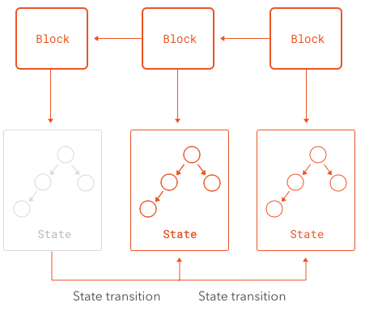

Insights from graph analysis
”Decentralized governance” is key
Decentralization:
Diffuses trust
Increases resiliency by removing single points of failure and enabling recovery
Governance:
Enforces rules on state changes
A ledger is not a data store
Promising applications of blockchains rely on an immutable history of state changes
There are better technologies for storing the current state of a data store
Anonymity is orthogonal
Many believe blockchains provide anonymity or “privacy”
In fact, key-based identities are not anonymous
Even the pseudonymity they provide is fragile
Advanced crypto is needed for true anonymity

Slide 15
Decentralized governance
The property of decentralization is enabled by shared governance.
This combination supports a capability – resiliency – and some important ideological properties.
Decentralization relies on two primitives: Sybil resistance and peer-to-peer communication.
Due to its singular importance, the choice of governance model largely controls the type of blockchain being built.
Diffuse trust
Censorship resistance
Efficient transactions
Resiliency
Disintermediation
Decentralization
Peer-to-peer communication
Shared governance (public / permissioned)
Sybil resistance
Game theory / incentives
Consensus protocols

Slide 16
Ledger, not data store
The majority of applications for blockchains rely on the properties of its ledger of state changes.
These stem from two important capabilities.
Provenance must be stored by an append-only transaction ledger, making blockchains a good choice.
The current state can be reconstituted from the ledger if it is lost, providing resilience.
Data Discoverability (few applications)
Resilience (many applications)
Provenance
(many applications)
Distributed data store
Distributed ledger
Consensus protocol
Append-only transaction ledger
Authenticated data structures
Timestamping
Transaction rules

Slide 17
Anonymity
Censorship resistance
The capability of anonymity is not strongly connected to the rest of the graph. It only ties into one ideological property: censorship resistance, and no other capabilities.
It requires the primitives of tokens and key-based authentication (as in Bitcoin). These are necessary but not sufficient.
Anonymizing transactions further requires advanced crypto like MPC, ZKPs, or functional encryption.
Anonymity
Zero-knowledge proofs
Multi-party computation
Anonymous transactions
Functional encryption
Key-based token ownership
PKI / Key management
Key-based authentication
Key-based authentication

Slide 18
Applications
We uncovered 16 classes of applications for blockchain technology.
Supply chain management | Asset tracking | Payments | Transaction processing
Identity management | Internet of Things / Smart property | Data sharing | Fine-grained access control
Interoperation between systems | Regulation / sanctions | Permanent record storage | Decentralized timestamping
Auctions | Voting | Gambling | Insurance

Slide 19
Promising Applications
Four classes of applications had requirements that were particularly well-matched to the capabilities of blockchain technology.
Asset Management
Identity Management
IoT / Smart Property
Regulation /
Law Enforcement
Both digital and physical assets can be managed on a blockchain, although physical assets must be carefully tracked.
The ledger stores the provenance of the assets, and automatic code execution can handle transfers of ownership or other operations.
A blockchain can manage identity as a digital asset.
Automatic code execution enables authentication to identities.
It also provides arbitrarily fine-grained access control for modifying and reading identity information.
A blockchain can serve as a tamper-proof, auditable store for sensor data from all kinds of smart devices.
Smart contracts can handle more advanced processes like authentication, command and control, and payments.
Systems managed on a blockchain produce an auditable ledger of transactions and can be regulated automatically through smart contracts.
The distributed ledger provides additional resilience for record storage in such systems.

