Slide 1
Multiple Withdrawal Attack in ERC20 Tokens
Presented by: Reza Rahimian
Supervised by: Dr. Jeremy Clark

Slide 2
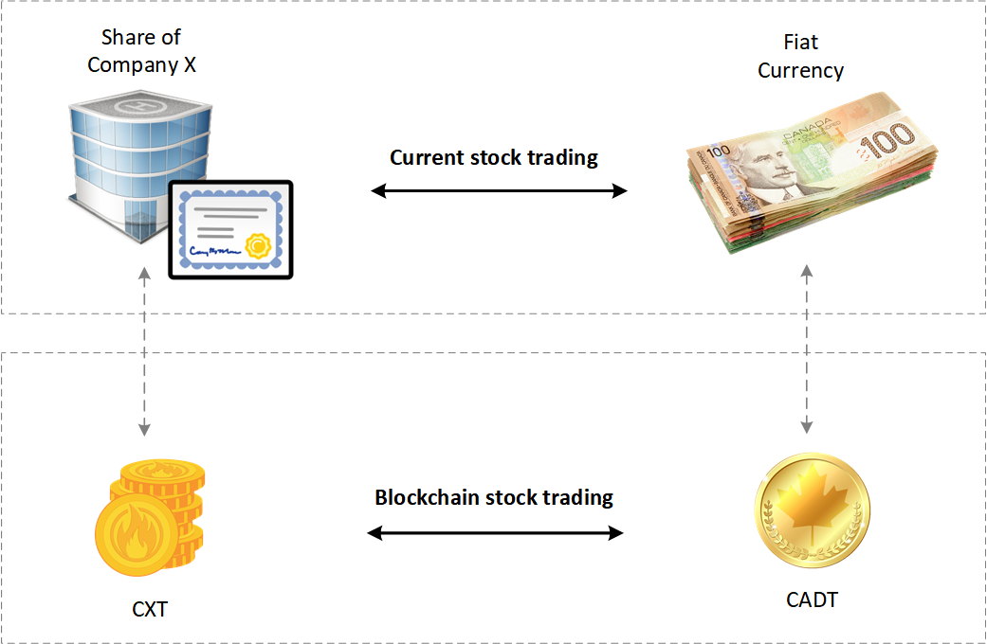
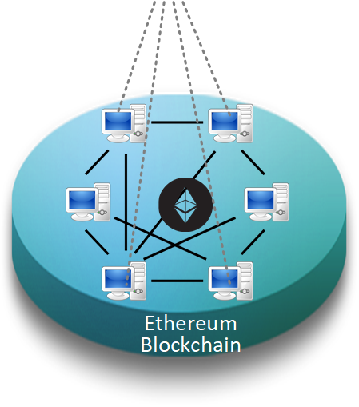
Introduction to ERC20 Tokens
Financial Assets
Blockchain representation
as
ERC20 Token

Slide 3
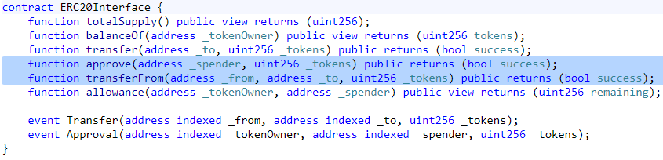
Specifications of ERC20 Standard
Calling approve function has to overwrite current allowance with new allowance.
approve method does not adjust allowance, it sets new value of allowance.
Transferring 0 values by transferFrom method MUST be treated as normal transfers and fire the Transfer event as non-zero transactions.
Introducing new methods violates ERC20 API and it MUST be avoided for having compatible token with already deployed smart contracts.
Spender will be allowed to withdraw from approver account multiple times, up to the allowed amount.
Transferring initial allowed tokens is considered as legitimate transfer. It could happen right after approval or before changing allowance.
Race condition MUST not happen in any case to prevent multiple withdrawal from the account.

Slide 4
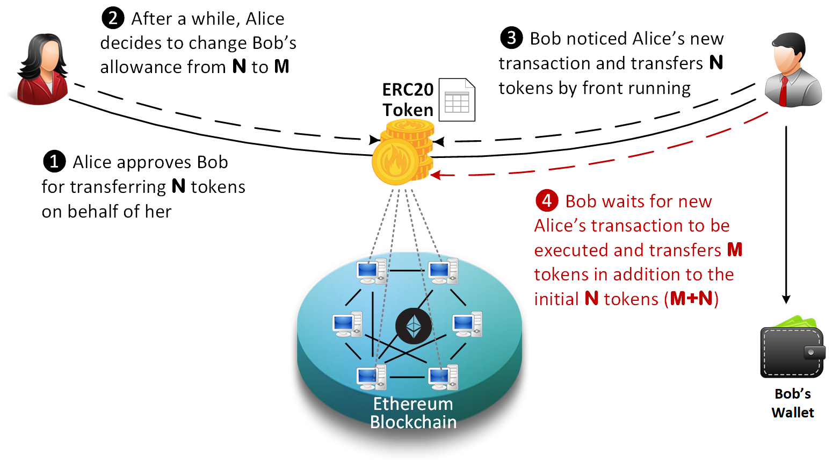
Multiple Withdrawal Attack
The goal is to prevent Bob from transferring more M tokens

Slide 5
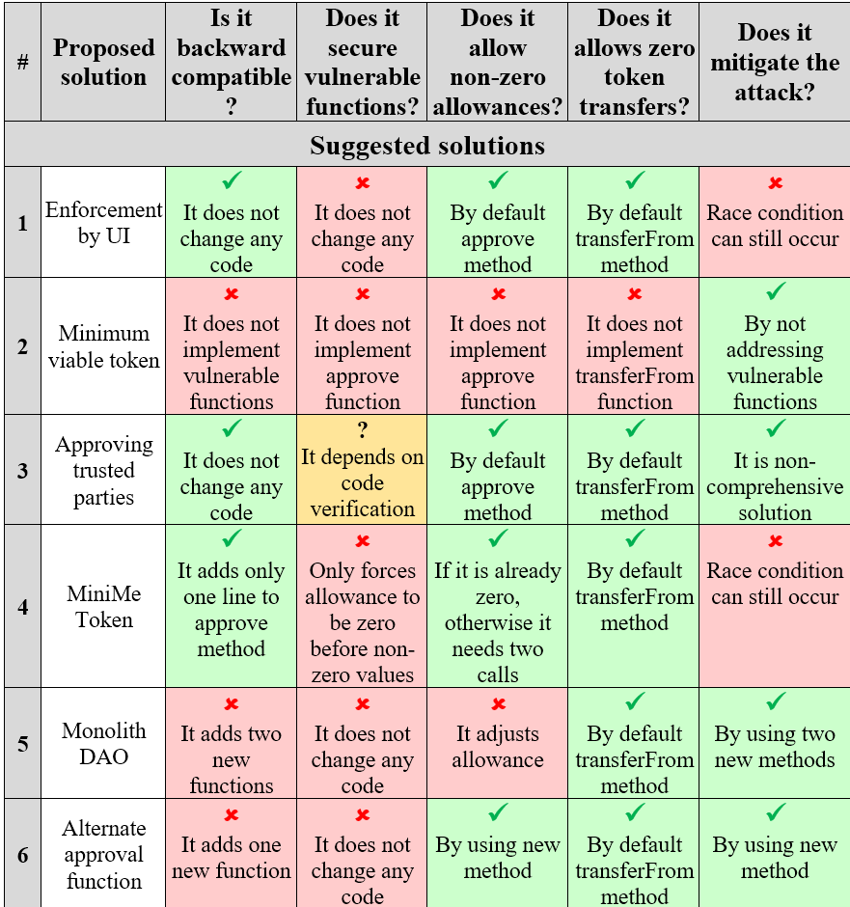
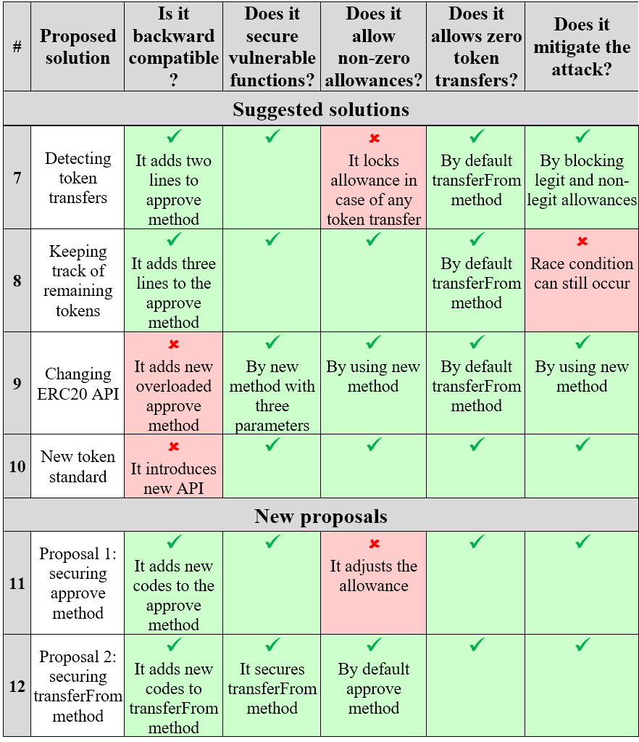
Evaluating Proposed Solutions
ERC20 specifications

Slide 6
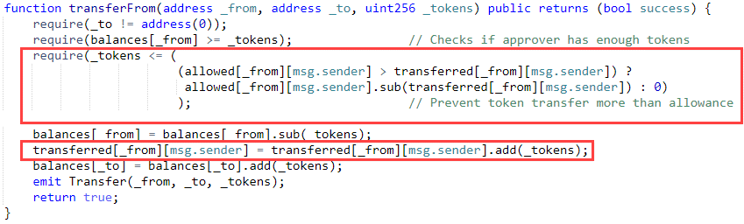
Proposed solution
Securing transferFrom method instead of approve method
Preventing more token transfer than allowed
Keep tracking of transferred tokens

