Slide 1
FIX Encryption Working Group
New York, Monday July 24
Facilitator: Ryan Pierce
Townsend Analytics Ltd. /
Archipelago LLC

Slide 2
Introductions

Slide 3
Outline
Overview
Deliverables
Concepts
Business Use Models of FIX
Past FIX Security
Where We’re Going
SSLv3 and TLS
Issues
Discussion
Soliciting Volunteers

Slide 4
Overview
We will design, test and create FIX security solutions as required by industry business needs.
Working Group must involve people with Business and Technical expertise.
Current business needs should drive the group, not technical capabilities.

Slide 5
Deliverables
Application Note(s) - Specifications
Case studies
Reference Implementation(s)
Research Cryptography Vendor Implementations

Slide 6
Concepts - Confidentiality
The message, when encrypted, should be readable only be the intended recipients; an intruder should not be able to read the message.

Slide 7
Concepts - Authentication
“It should be possible for the receiver of a message to ascertain its origin; an intruder should not be able to masquerade as someone else.”
Definition Source: Bruce Schneier, Applied Cryptography

Slide 8
Concepts - Integrity
“It should be possible for the receiver of a message to verify that it has not been modified in transit; an intruder should not be able to substitute a false message for a legitimate one.”
Definition Source: Bruce Schneier, Applied Cryptography

Slide 9
Concepts - Non-Repudiation
“A sender should not be able to falsely deny later that he sent a message.”
Digital signatures alone generally do NOT provide non-repudiation, but they are often good enough.
“Accidental” disclosure of private keys makes non-repudiation close to impossible to achieve.
Definition Source: Bruce Schneier, Applied Cryptography

Slide 10
Concepts - Algorithms
Mathematical functions
Algorithms can be evaluated on inherent strength, key length, etc.
Examples: DES, RSA, MD5

Slide 11
Concepts - Protocols
How algorithms are used
“Series of steps, involving two or more parties, designed to accomplish a task”
Examples: SSL, TLS, PGP-DES-MD5
Strong algorithms + weak protocols = low security
Protocols are often easier to attack than algorithms
Definition Source: Bruce Schneier, Applied Cryptography

Slide 12
Concepts - Design Criteria
When possible, don’t be original
  Massive peer review is best the assurance of security
  Choosing cross-industry standards means availability of 3rd party toolkits, fewer errors
Design by layers
  Firms can choose and selectively implement their level of security
Cost of breaking security vs. data value

Slide 13
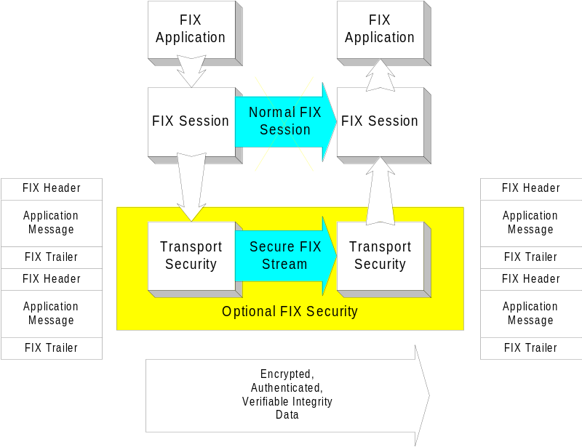
Concepts - Transport Level
Simple to implement via 3rd Party tools
Can be handled in engine or via an external proxy
Messages are NOT individually signed; trivial to repudiate a transaction
Example: SSL, TLS

Slide 14
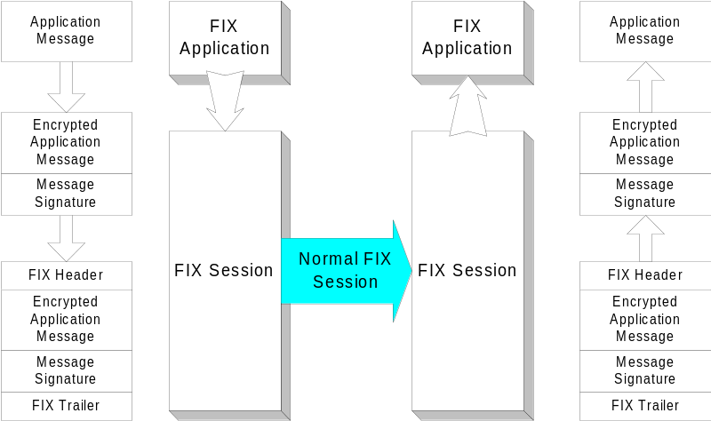
Concepts - Message Level
Intrusive to implement in engine, message ordering issues
Individually signed messages makes repudiation harder
Vulnerable to Traffic Analysis
Example: PGP-DES-MD5

Slide 15
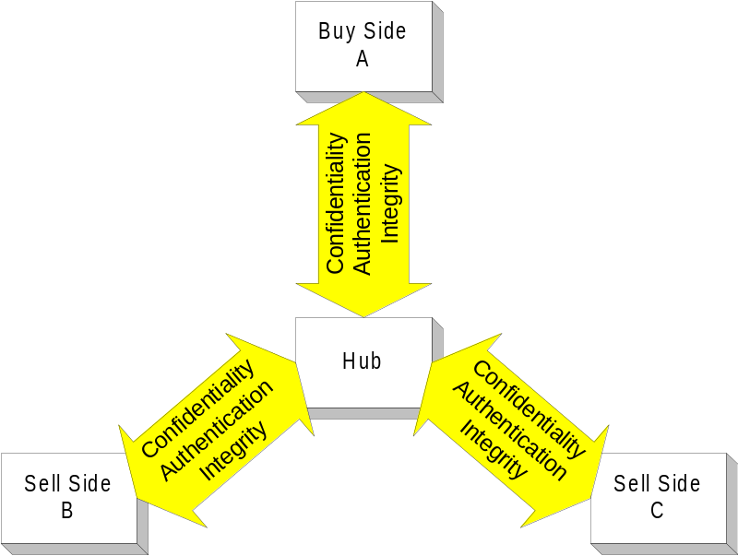
Concepts - Point to Point
Difficulty: Low
Can work at Transport level
Key management is easier
If a 3rd party is involved, trust / liability become issues

Slide 16
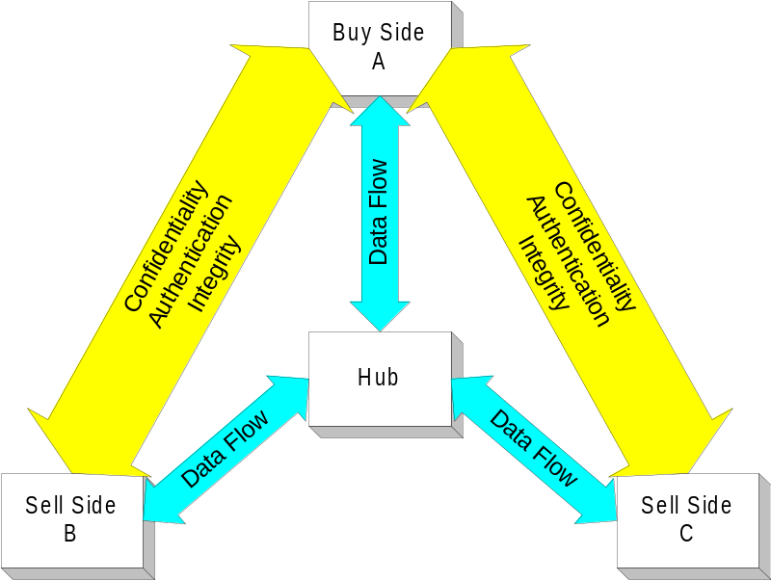
Concepts - End to End
Difficulty: High
Must work at Message level
Key management is harder
Better accountability through long-lasting signatures

Slide 17
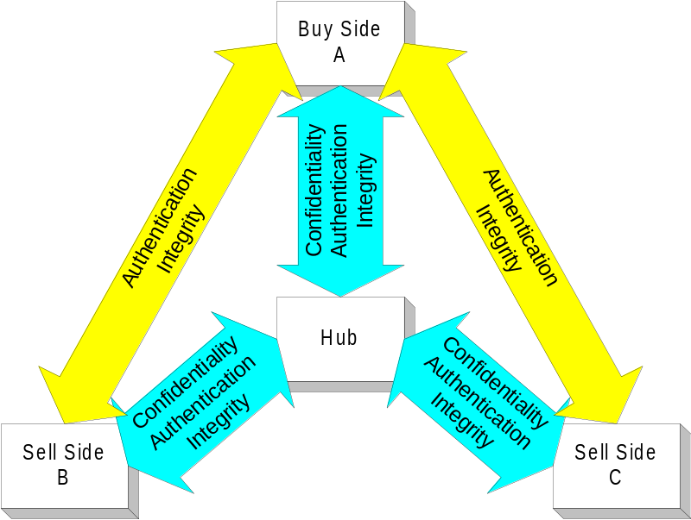
Concepts - Combining Point to Point, End to End
Difficulty: Medium
Confidentiality, (Authentication, Integrity) Point to Point via Transport
Additional Authentication / Integrity provided End to End via Message level signatures

Slide 18
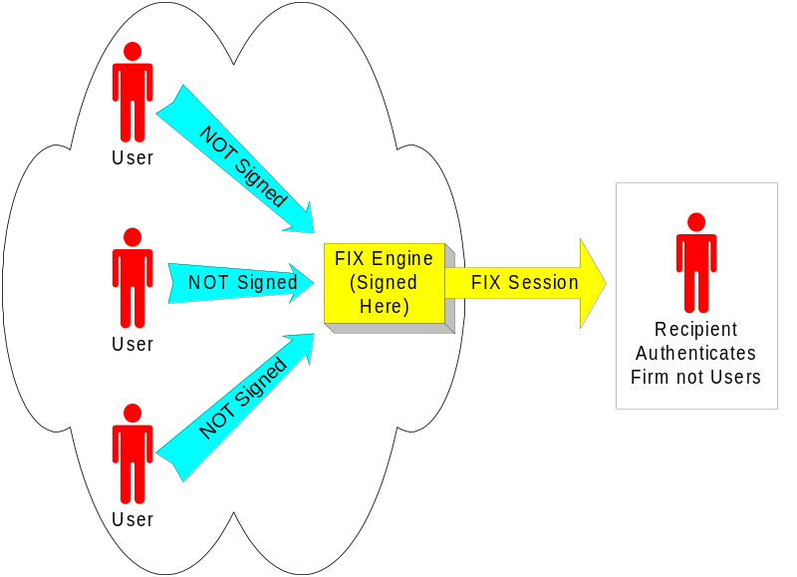
Concepts - Per Firm
Easier to implement
Firms must maintain tight internal security
Often models business contracts

Slide 19
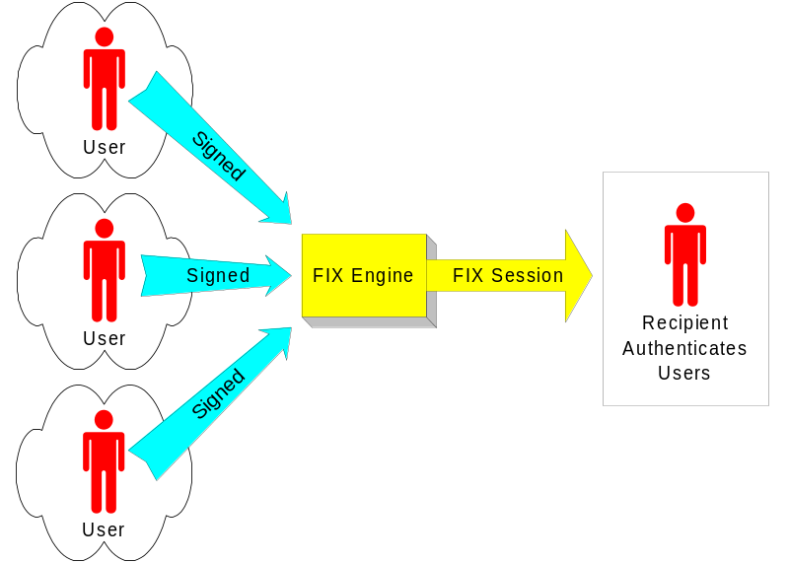
Concepts - Per User
More difficult to implement
Generally requires PKI
Provides accountability at the individual level
Can be problematic as signatures must extend to the trading station

Slide 20
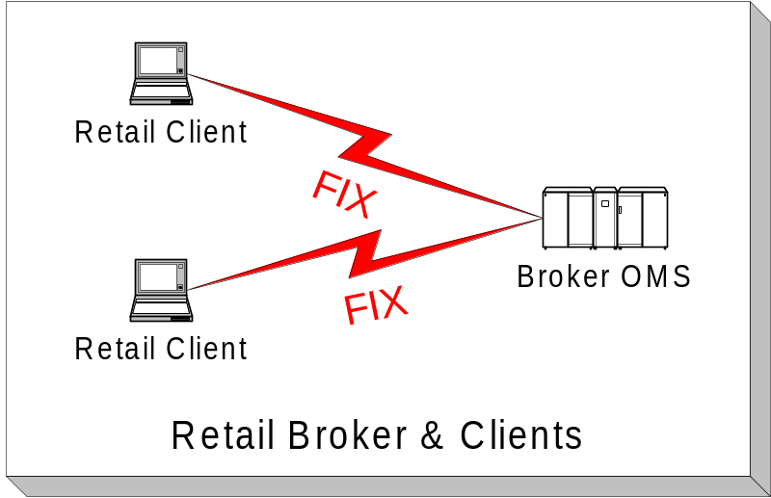
How FIX is Generally Not Used
Not a desktop protocol
Can be difficult to store state required for a FIX session
FIX protocol has no retail concepts of trading history, positions, account balances, margin

Slide 21
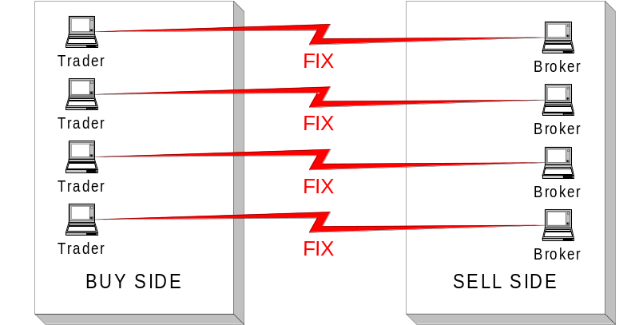
How FIX is Generally Not Used
Generally not Person to Person
Overhead of maintaining that many sessions is too much of a burden

Slide 22
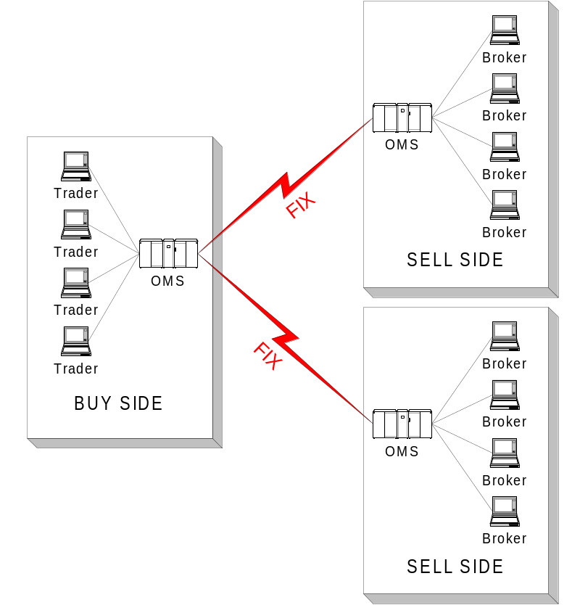
How FIX is Used
Business to Business
Contracts are often written on a firm to firm basis, so liability issues may be easier to control

Slide 23
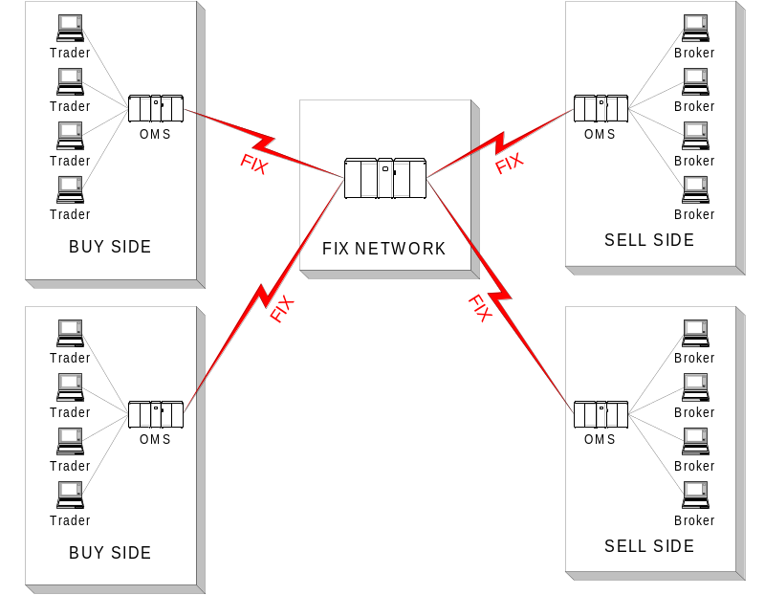
How FIX is Used
Firm to Hub
Hub might introduce liability issues
Rewriting, if done at the hub, makes message signatures difficult

Slide 24
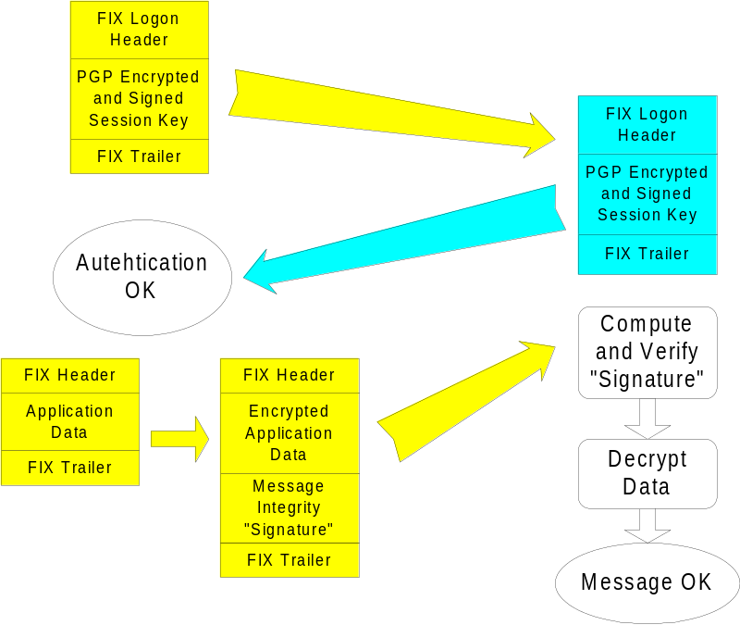
Past FIX Security - PGP-DES-MD5
Point to Point
PGP session key exchange / authentication in logon
DES data encryption
MD5 integrity checking “signature” based on message and session key

Slide 25
Strengths of PGP-DES-MD5
Currently is best of breed
Provides reasonable level of security
Widely implemented; has market share
Has reference implementation

Slide 26
Faults of PGP-DES-MD5
Implementation is very intrusive to the FIX engine
Repudiation is trivial; a shared secret “signs” the message
Depends on 56-bit DES which is weak
Message reordering issues (uses CBC)
Business needs could be handled by transport level security

Slide 27
Where We’re Going - First steps
FIX Engine to Engine Confidentiality / Authentication / Integrity
Business case: running FIX over the Internet without proprietary or hardware VPN
Technologies: SSLv3 / TLS
Replacement for PGP-DES-MD5
Existing SSLv3 Reference Implementation

Slide 28
Where We’re Going - Possible Next Steps:
Making repudiation of transactions harder
Firm-based message signatures
User-based message signatures, PKI
  Difficult due to the multitude of trading front ends which may not know anything about FIX
Do the business cases for these exist?

Slide 29
SSLv3 and TLS
SSL is the protocol used for WWW security
Authentication done via a certificate per server or client, signed by a CA
Both negotiate security based on capabilities of each side
SSL, TLS libraries talk to TCP sockets, verify certificates, handle security issues for you; library is largely a black box

Slide 30
Integrating SSLv3 or TLS in a FIX Engine
Note: It can be done via an external proxy.
Buy or acquire free library
Modify TCP session initiation code to verify identities of certificates
Modify socket read / write calls to use SSL or TLS library read / write calls
No FIX session or application logic changes

Slide 31
Issues to Address - SSLv3 vs. TLS
Both are nearly identical; differences are largely political
SSLv3 is a Netscape-owned protocol
TLS is an IETF protocol
TLS can negotiate down to SSLv3
SSL has buzzword status
Recommend one or both?

Slide 32
Issues to Address - RSA vs. Diffie-Hellman and DSS
Most CA infrastructure is based around RSA
RSA is covered by patent; Diffie-Hellman and DSS are public domain
DSS may enjoy special US Govt. status
RSA patent expires September 20, 2000
Recommend one or both?

Slide 33
Issues to Address - RC4 vs. 3DES
3DES needed if using Diffie-Hellman and DSS
3DES has effective key length of 112 bits, slower
RC4 generally used with a key length of 128 bits, faster
RC4 is an RSA-owned Trade Secret
What should we recommend?

Slide 34
Issues to Address - FIX vs. FIXML
How to handle message-level signatures?
Let FIX message signature work for embedded FIXML?
Define XML construct of FIX message signature?
Rely on other cross-industry E-Commerce initiatives to define standard for XML data signatures?

Slide 35
Issues to Address - Reference Implementations
Existing open source implementation: Poppy, written by Hugh Emberson of Westpac Banking Corporation, Australia
Available on FIX web site, Encryption working group Archives
Currently SSLv3 only, supports only one ciphersuite (RSA, RC4 128 bit)
Currently Unix C only

Slide 36
Issues to Address - Identifying Certificates
Use of Common Name in certificate
  Requires the CA to know FIX business rules and place the CompID in that field
  Largely incompatible with public CA’s
  Great for things like FIX routing networks where there is centralized assignment of CompIDs.
  Requires coordination of CompID which has never been done industry-wide

Slide 37
Issues to Address - Identifying Certificates
Use of Fingerprint, or Issuer and Serial Number
  Allows firms to use CA’s not knowledgeable of FIX
  Clients changing certificates must notify their trading partners

Slide 38
Issues to Address - CA Models
Central CA (or group of CA’s) issues certificates
One party in a FIX connection issues a certificate to the other
Each party in a FIX connection maintains their own CA
Many CA’s make verifying signatures and checking Certificate Revocation Lists hard

Slide 39
Discussion

Slide 40
Soliciting Volunteers

