Slide 1


Upgradeability Good, Bad, Ugly
Mehdi Salehi

Slide 2

Funding & Partners

Slide 3
Software Maintenance
1
2
Correct Faults Fixing a bug
Small Changes
Improve Performance New Functionalities
Upgrades
Updates

Slide 4
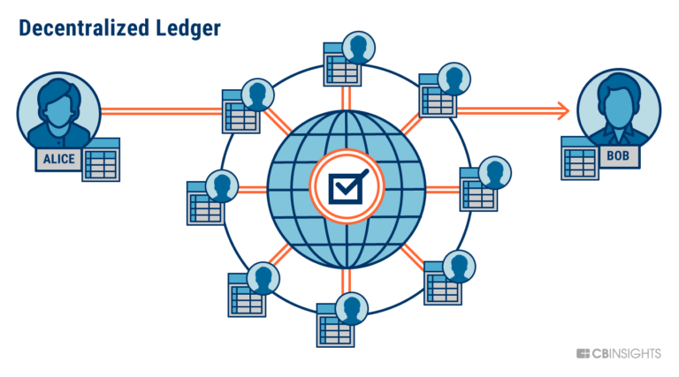


Smart Contracts
Pieces of codes
Better to say Bytecodes
Supposed to be immutable

Slide 5
Immutable
A piece of software that you cannot change it!!!

Slide 6

Immutable
A piece of software that you cannot change it!!!
It is worst in Blockchains Because codes are keeping money here

Slide 7

What if the code is Buggy!
Hacker will drain all the fund

Slide 8
What if the code is Buggy!
Hacker will drain all the fund
If possible

Slide 9


What if the code is Buggy!
DAO Hack

Slide 10
Upgradeability is a Bug!
How ?! (immutability)
No way! We need upgradeability
Who Is responsible?!

Slide 11

Upgradeability Patterns

Slide 12
Retail Changes
Parameter Change
Retail Changes

Slide 13
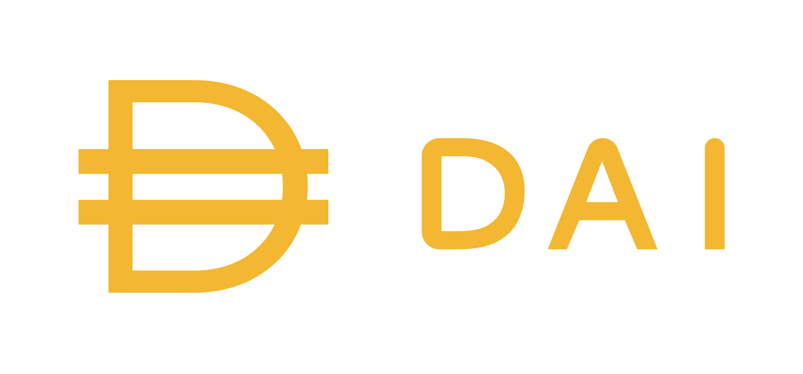
Parameter Change
Upgrade to control Demand and Supply of DAI
Stability Fee
Dai Saving Rate
Collateral Ratio

Slide 14
Upgradeability Patterns
Parameter Change
Retail Changes
Component Change

Slide 15
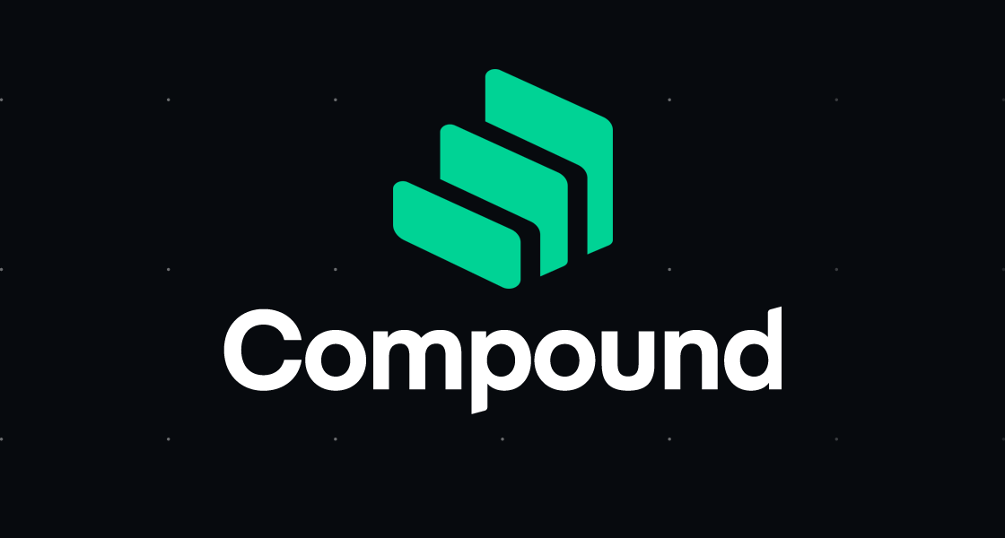
Component Change
contract for calculations
Assets to Borrow
Need a way to calculate interest rate

Slide 16
Component Change
Old contract
Assets to Borrow
Need a way to calculate interest rate
New contract

Slide 17
Pros and Cons
Pros
Simple to implement
Easy to audit
Cons
Cannot fix a bug
Cannot add/change Logic in Parameter Configuration
Cannot add new functionality in Component change

Slide 18
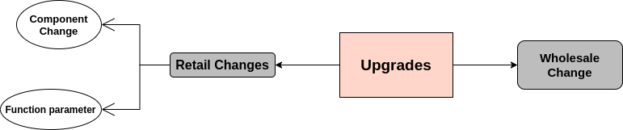
Upgradeability Patterns

Slide 19
Upgradeability Patterns
Migration
Wholesale Changes

Slide 20
Migration (Social Upgrade)
Deploy a new contract
Migration
Collecting data from old version
Push data in the newer version

Slide 21
Migration (Social Upgrade)
Deploy a new contract
Come up with 2 different versions
Migration
Collecting data from old version
Cannot Fix a Bug
Push data in the newer version
Costly

Slide 22
Upgradeability Patterns
Migration
Wholesale Changes
Data Separation

Slide 23
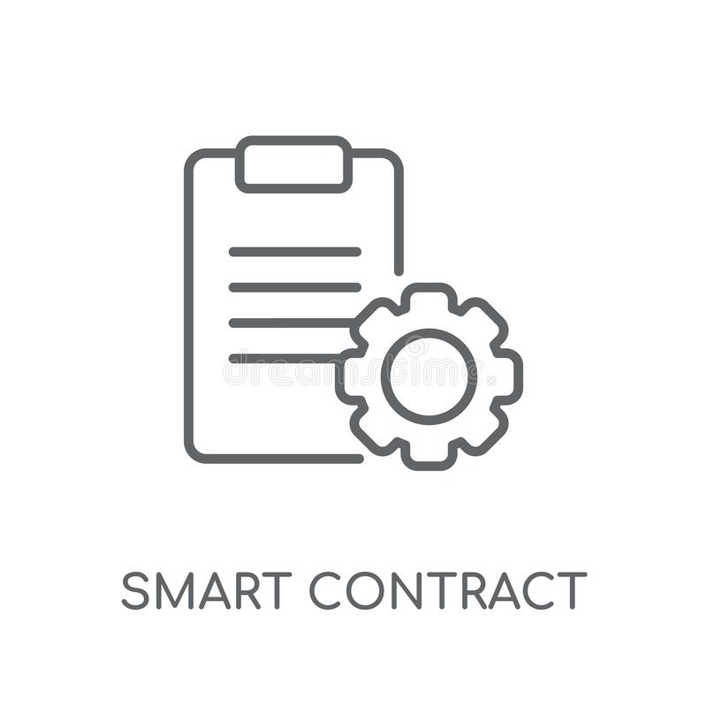

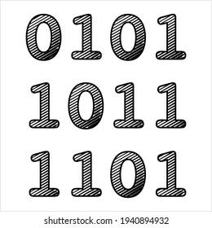

Data Separation
Logic
Storage

Slide 24
Data Separation
Logic
Storage
Change this part

Slide 25
Data Separation
Communicate?!
Logic
Storage
Call Opcode
DelegateCall Opcode

Slide 26
Upgradeability Patterns
Call-based
Data Separation

Slide 27

Call based pattern
Send transaction
Call
Getter function
Setter function
Ability to add new variables
Logic
Storage
Do the logic

Slide 28
Call based pattern
Change Logic address
Old Logic
Storage
New Logic

Slide 29
Call based pattern
No need for Data Migration
Hard for developers to change their codes and add this pattern
Hard to implement for complex data structures
The address will change
Break Composability
Not user friendly
Need to aware all services about the change
Deal with the old version

Slide 30
Upgradeability Patterns
Call-based
Data Separation
Delegate Call-based

Slide 31
Delegate Call based pattern
Send transaction
Delegate call
Storage (proxy)
Logic
(Implementation)
Delegate call preserves the context
Similar to copy pasting (not the same)
Needs some consideration
Storage structure should be the same
Don’t have similar functions

Slide 32
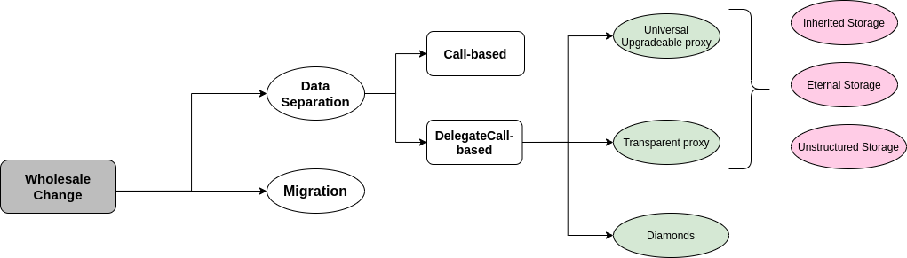
Upgradeability Patterns

Slide 33
Pros and Cons of Proxy patterns
Pros
Can update the whole logic
No need to migrate data
Easy to add this pattern to regular code (OpenZepplin OS)
User endpoint not changed
No downtime during upgrade
If contract is unpauseable
Very fast in upgrades
User friendly
No need to deal with two Dapps at the end

Slide 34
Delegate Call based pattern
Old Logic
Send transaction
Storage (proxy)
Change implementation address
New Logic

Slide 35
Delegate Call based pattern
Send transaction
Delegate call
Storage (proxy)
Logic
(Implementation)

Slide 36
Pros and Cons of Proxy patterns
Cons
Gas overhead for tx
Risks due to using Delegate Call opcode
Function selector clashes
Storage layout clashes
No constructor in Implementation contract
Cannot change the state layout (data layout)
Changing state of contract needs Migration plan

Slide 37
Delegate Call based pattern
Send transaction
Delegate call
Storage (proxy)
Logic
(Implementation)

Slide 38
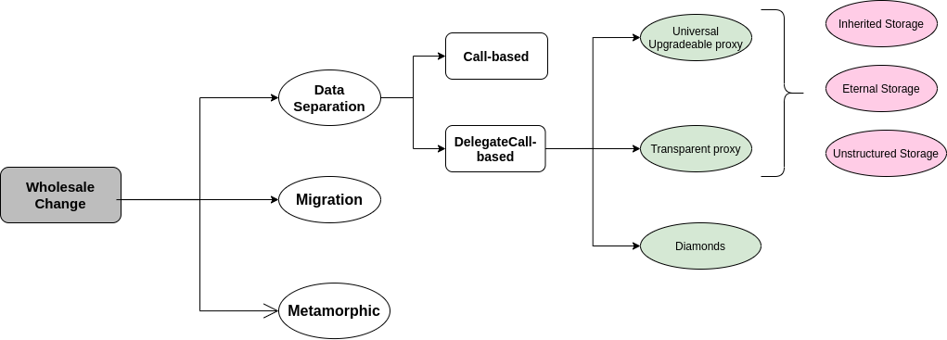
Upgradeability Patterns

Slide 39
Metamorphic
Contract
Is there a way to delete a contract

Slide 40
Metamorphic
Contract
Is there a way to delete a contract

Slide 41
Metamorphic
Contract
New
Contract
Is there a way to delete a contract
And then deploy another one on the same address

Slide 42
Metamorphic
Create a contract
Using Create
Opcode
& save its address
Deployer
Send transaction
Contain Bytecode
Factory
Contract

Slide 43
Metamorphic
Create a contract
Using Create
Opcode
& save its address
Send transaction
Contain Bytecode
Factory
Contract
5860208158601c335a63aaf10f428752fa158151803b80938091923cf3
Deploys specific code
Using Create2
Opcode

Slide 44
Metamorphic
Create a contract
Using Create
Opcode
& save its address
Send transaction
Contain Bytecode
Factory
Contract
5860208158601c335a63aaf10f428752fa158151803b80938091923cf3
Deploys specific code
Using Create2
Opcode
Why Create2 ?!
The deployed address depends on the deployer address & Bytecode
Re-deploying a contract in specific address

Slide 45
Metamorphic
Create a contract
Using Create
Opcode
& save its address
Send transaction
Contain Bytecode
Must have
self destruct
Factory
Contract
5860208158601c335a63aaf10f428752fa158151803b80938091923cf3
Deploys specific code
Using Create2
Opcode
Why Create2 ?!
But we want to change bytecode?! This way we just deploys the same bytecode?

Slide 46
Metamorphic
Create a contract
Using Create
Opcode
& save its address
Send transaction
Contain Bytecode
Factory
Contract
5860208158601c335a63aaf10f428752fa158151803b80938091923cf3
Deploys specific code
Using Create2
Opcode
This bytecode Is the key
Why Create2 ?!
But we want to change bytecode?! This way we just deploys the same bytecode?
NO

Slide 47
Metamorphic
Read the bytecode deployed in this contract & simply copy it to the deployed bytecode
Create a contract
Using Create
Opcode
& save its address
Send transaction
Contain Bytecode
Factory
Contract
5860208158601c335a63aaf10f428752fa158151803b80938091923cf3
Deploys specific code

Slide 48
Pros and Cons
Pros
Can change the whole logic
Can change the whole state
Just using a single address
No gas overhead
Nothing to change for deployers to add this pattern
User endpoint address is not changed
Cons
Self-destruct opcode removal
No way to keep state (self destruct deletes the state)
Downtime in upgrade events (because need to self destruct then deploy)

Slide 49
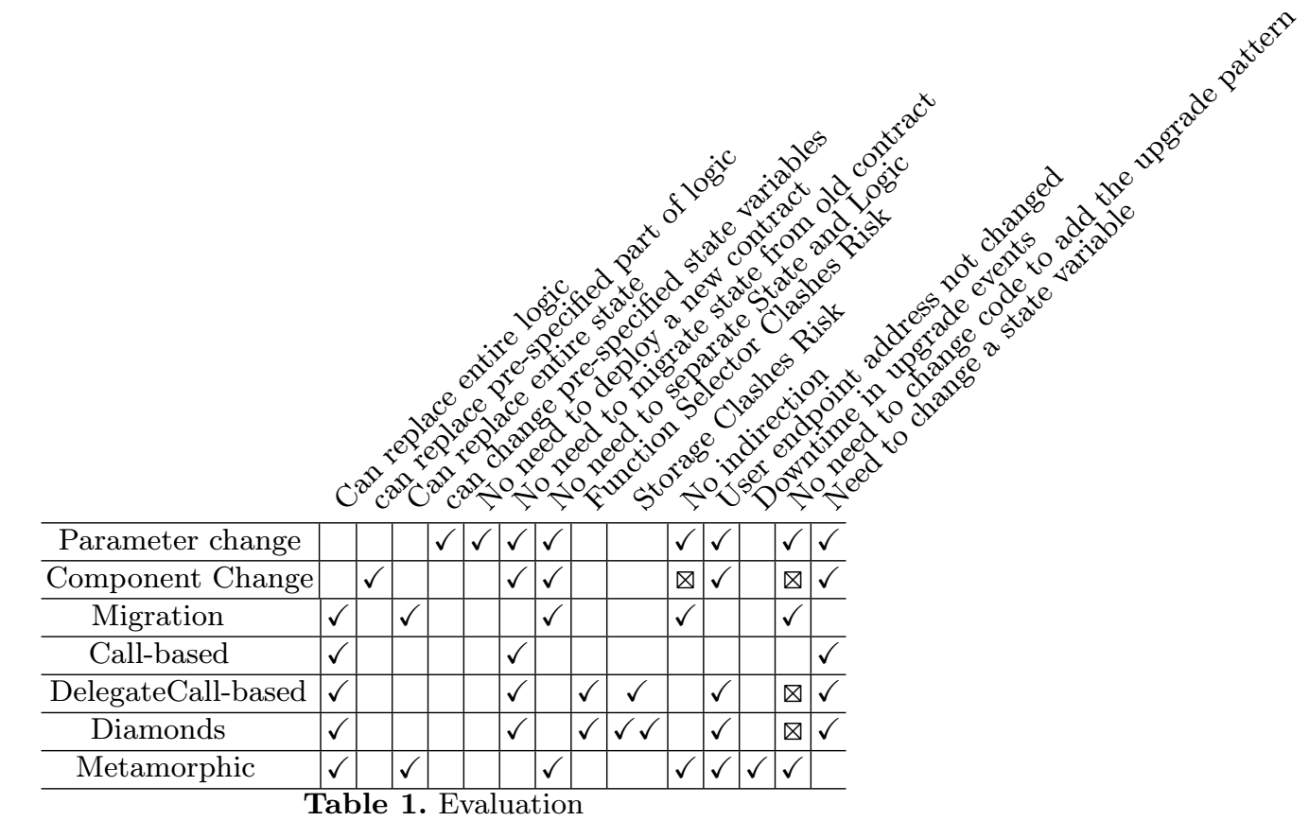
Evaluation of different methods

Slide 50
Upgradeability!
How ?! (immutability)
No way! We need upgradeability
Who Is responsible?!

Slide 51
Who is the decision maker?!
Externally Owned Address (EOA)
1 person decision
Multi Signature Wallet
M out of N person
Decentralized Governance
Governance token
Threshold on acceptance of a proposal

Slide 52
Who is the decision maker?!
Externally Owned Address (EOA)
1 person decision
Multi Signature Wallet
M out of N person
Decentralized Governance
Governance token
Threshold on acceptance of a proposal
Compromised/ Malicious
Rug pools

Slide 53
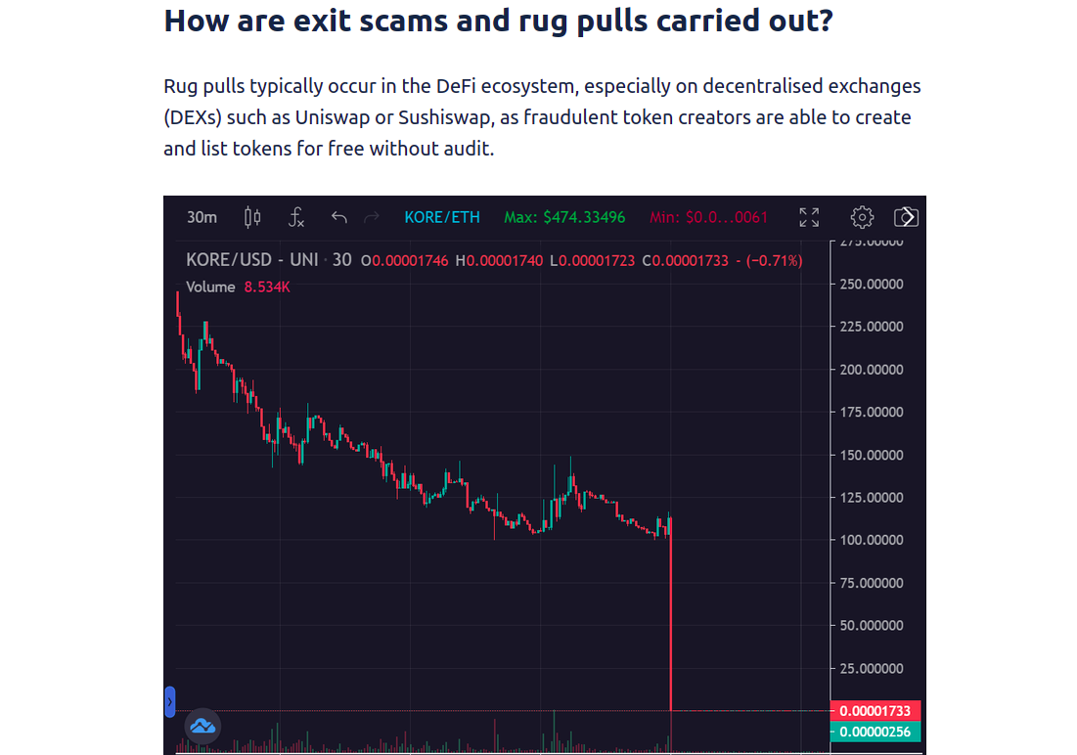
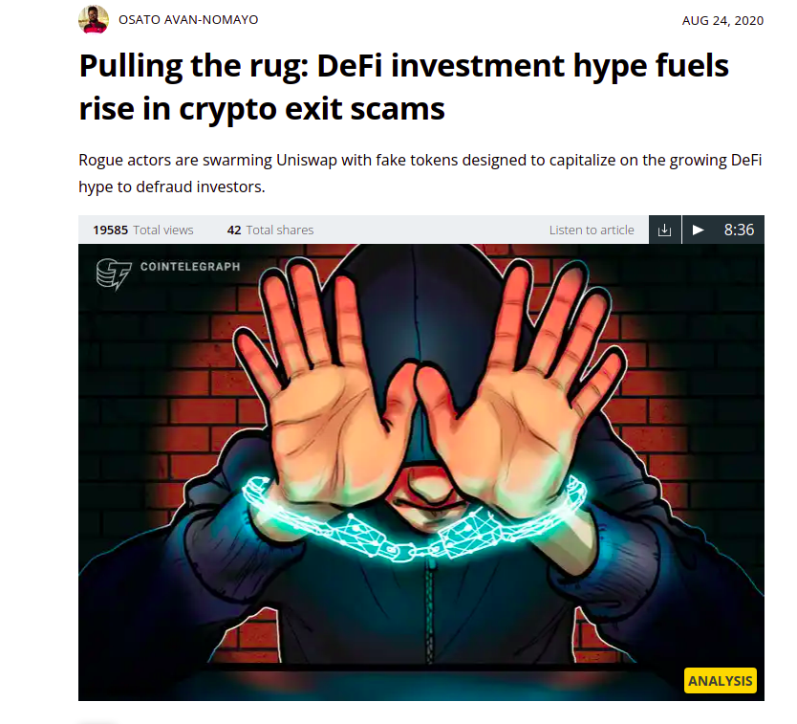
What’s Next?
Checking to Find the owners of the smart contract.

Slide 54
Measurement Study
Our Main Goal in this part is to find contracts that uses upgradeability patterns

Slide 55
Results
Number of Regular Upgradeable proxies:
7470 Unique contracts
Number of UUPS proxies:
403 Unique Contracts
Number of Beacon Proxies
352 Unique contracts

Slide 56


Thanks!
questions?
mehdi.salehi@concordia.ca
@Greatsaoshyant

Slide 57
Measurement Study
These patterns are more general and not just used for upgradeability

Slide 58

Measurement Study

Slide 59
Measurement Study
Three main ways of analysis on Ethereum
Source Code analysis
Limited because we don’t have the HLL code for majority of bytecodes on Ethereum
Etherscan Verified Contracts

Slide 60
Measurement Study
Three main ways of analysis on Ethereum
Smart Contract Code analysis
Etherscan Verified Contracts
Transaction-based Analysis
Bytecode-based Analysis

Slide 61
Measurement Study
Try to find contracts that used These patterns:
Call-Based
This pattern is almost dead. It proposed in early 2016 and devs do not use it right now
Delegate-Call Based
This is the most favorite pattern that people are using on their contracts
Metamorphic
This pattern is new and not tested yet. Also because of risks and limitations in this pattern it is not widely used (On the plan to measure them)

Slide 62
Call-based are dead?! Prove it!
Send transaction
Call
Ability to add new variable
Getter function
Setter function
Logic
Storage
Eternal Storage Pattern

Slide 63
Call-based are dead?! Prove it!
Find Eternal Storage Pattern
Ability to add new variable
Getter function
Setter function
Using Verified Contracts on Etherscan
Storage
Smart-Contract-Sanctuary Github repo dataset

Slide 64
Call-based are dead?! Prove it!
Regex
Filter
2018
93K Contracts
470 contracts uses Eternal Storage
170 contracts for Call-based pattern

Slide 65
Delegate proxy
Storage (proxy)
Implementation Contract
Send transaction
address imp;
Upgrade (new_address){
Imp = new_address;
}
Fallback () {
DelegateCall to imp Forward the message
}

Slide 66
UUPS Proxies
Storage (proxy)
Implementation Contract
Send transaction
address imp;
Fallback () {
DelegateCall to imp Forward the message
}
address imp;
Upgrade (new_address){
Imp = new_address;
}

Slide 67
Measurement Study
A hybrid analysis:
Transaction-based analysis
Bytecode-based analysis
Data of Transactions for 1 year (2 million Ethereum Blocks)

Slide 68
Measurement Study
Request to replay transactions inside each block
Data of Transactions for 1 year
Need to access to a full Archival Node
Transaction Traces

Slide 69
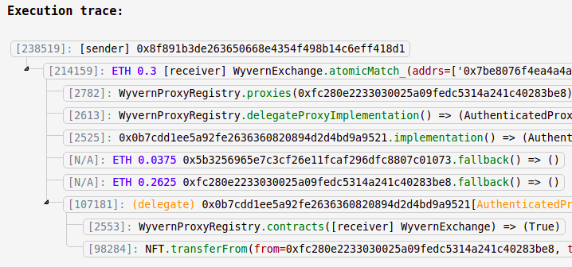
Measurement Study

Slide 70

Measurement Study
DelegateCall
Fall Back function
It’s a Proxy Contract

Slide 71
Measurement Study
DelegateCall
Fall Back function
It’s a Proxy Contract
Upgradeable?!

Slide 72
Delegate proxy
Storage (proxy)
Send transaction
address imp;
Upgrade (new_address){
Imp = new_address;
}
Fallback () {
DelegateCall to imp Forward the message
}
Yes
Upgradeable
Can we change Imp address?
No
Forwarder

Slide 73
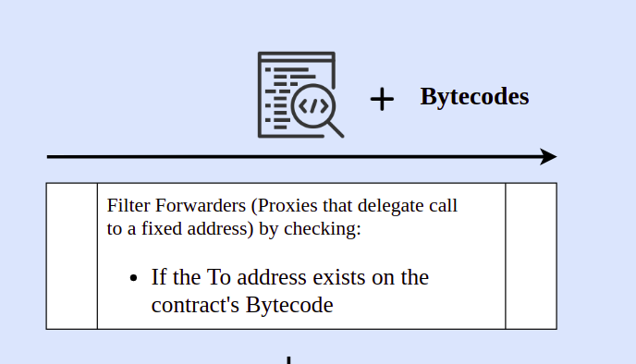
Measurement Study
If the target address is hardcoded in the Bytecode
Forwarders

Slide 74

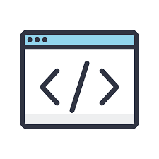

Measurement Study
Check to find the target address variable
Find storage slot of the Variable
Decompile
Check if anybody can change the Implementation address
Yes
No
Upgradeable

Slide 75
UUPS Proxies
Storage (proxy)
Implementation Contract
Send transaction
address imp;
Fallback () {
DelegateCall to imp Forward the message
}
address imp;
Upgrade (new_address){
Imp = new_address;
}

Slide 76

UUPS proxies
Check if anybody can change the storage slot of Implementation address inside Proxy using Implementation contract
Decompile
Implementation Contract
Yes
No
UUPS proxy

Slide 77
Beacon Proxies
Check if the target address comes from an External Call
Decompile
Proxy Contract
Yes
No
Beacon Proxy

Slide 78
Results
Number of Regular Upgradeable proxies:
7470 Unique contracts
Number of UUPS proxies:
403 Unique Contracts
Number of Beacon Proxies
352 Unique contracts

Slide 79
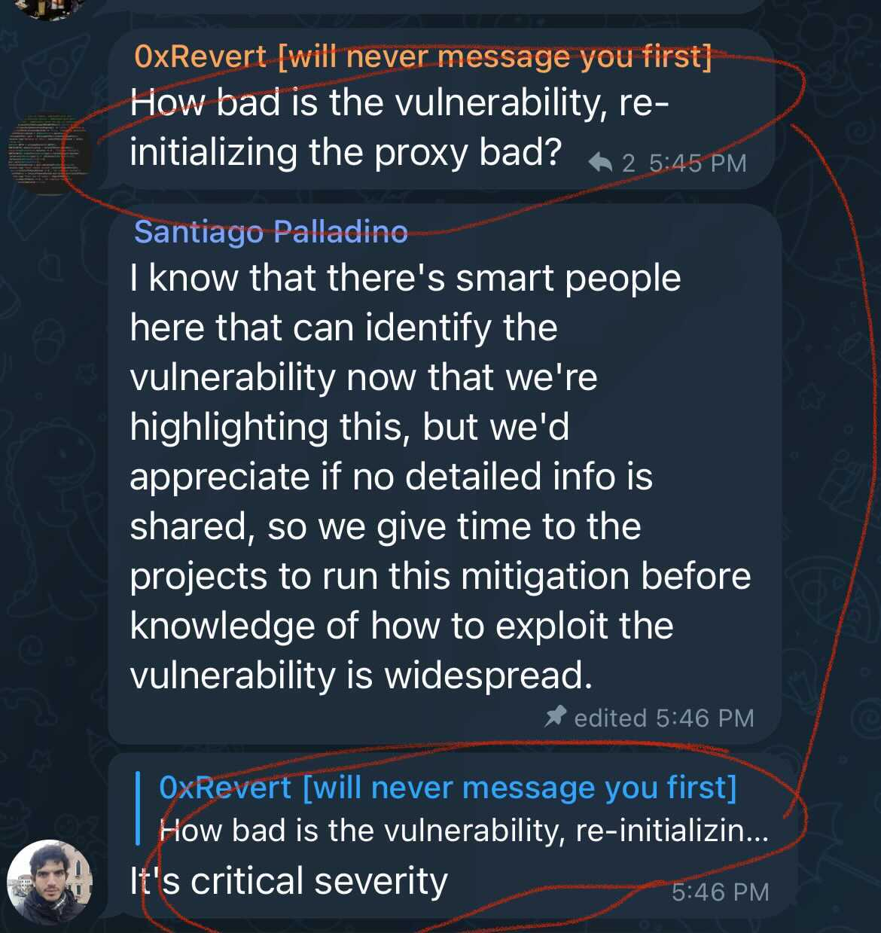
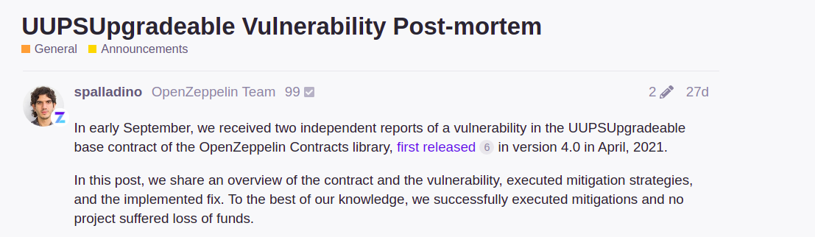
What’s Next?
Checks for possible Vulnerability
on UUPS proxies on my dataset

Slide 80
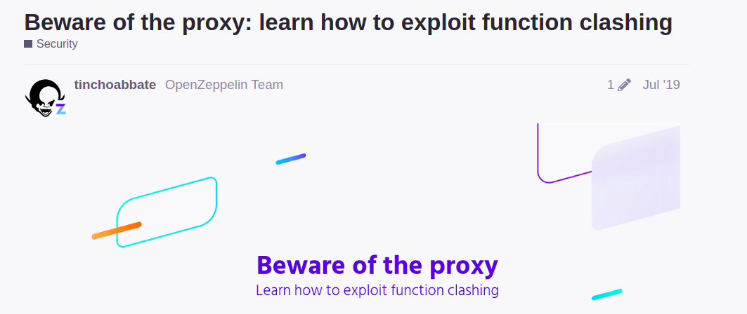
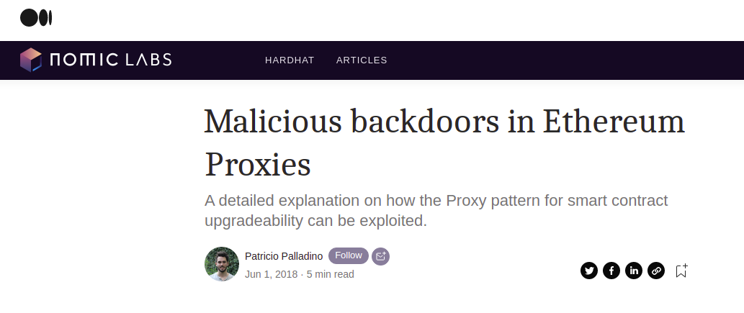
What’s Next?
Check to find contracts with known vulnerabilities Regarding the upgradeability patterns

Slide 81
Who is the decision maker?!
Externally Owned Address (EOA)
1 person decision
Multi Signature Wallet
M out of N person
Decentralized Governance
Governance token
Threshold on acceptance of a proposal

Slide 82
What’s Next?
Checking to Find the owners of the smart contract.

Slide 83
Thanks!
Do you have any questions?
@Greatsaoshyant

Slide 84
Search based on interface
Upgrade Events:
When implementation address changed
Upgraded event will be emitted
Find them based on Ethereum Logs
Querying a full node to get desired logs
Admin Change Events:
When Ownership address changed
AdminChanged event will be emitted
Find them based on Ethereum Logs

Slide 85
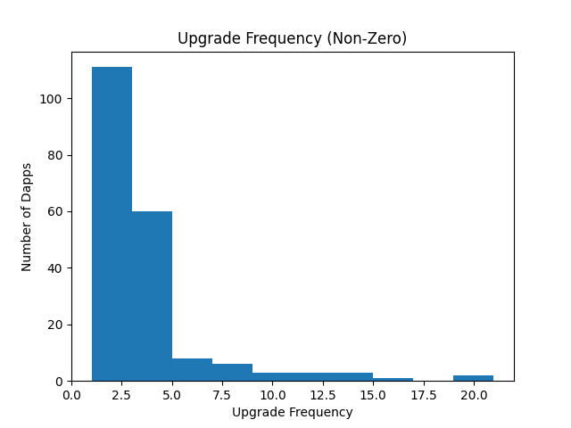
Results for Upgraded Events for V 2.6:
110 with One Upgrade
60 with Two Upgrade
2 with 20 upgrades
5 with Five upgrade
4 with 7 Upgrades
3 with 10,12,15,16 Upgrades
1 with 16 upgrades

Slide 86
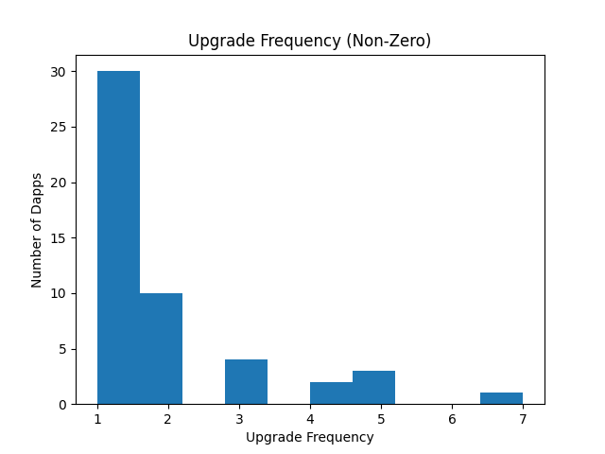
Results for Upgraded Events for V 3:
30 with One Upgrade
10 with Two Upgrade
4 with Three upgrade
2 with 4 Upgrades
3 with 5 Upgrades
2 with 7 Upgrades

Slide 87
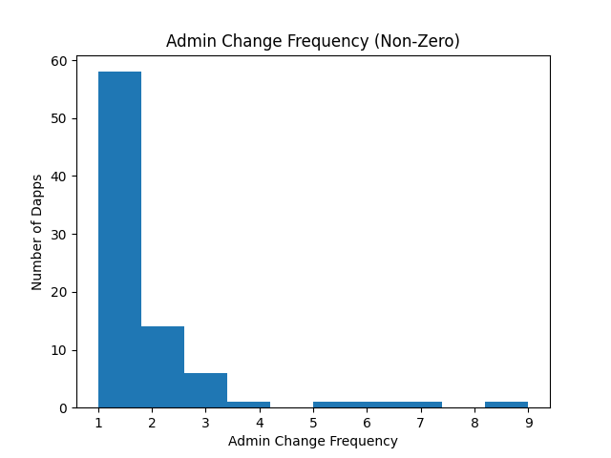
Results for AdminChanged Events for V 2.6:
57 with One Change
14 with Two change
4 with Three change
1 with 4 changes
1 Dapp with 5, 6,7,9 Changes

Slide 88
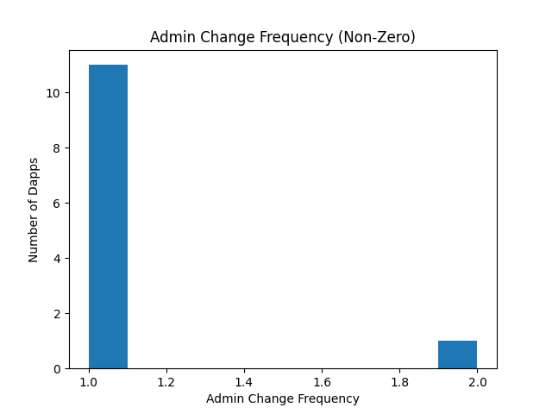
Results for AdminChanged Events for V 3:
11 with One Change
1 with Two change

Slide 89
Pauseability
Upgrading a Dapp is like changing Wings of an airplane in the sky
Because you cannot stop the network
So, we need a button to push and stop our Dapp?!
Who can push this button?
Pauseability

Slide 90
Pauseable Tokens
711 tokens that uses PauseableToken Library from OpenZepplin
Using AST tool

Slide 91
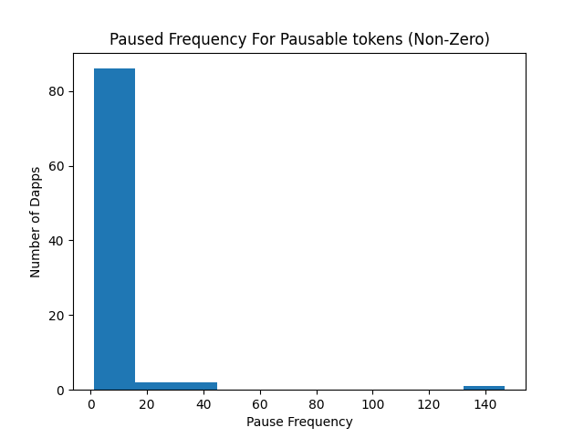
Results for Pause on PauseableToken Library
86 Dapps One time paused
2 Dapps Two time paused
2 Dapps 4 time paused
1 Dapps 14 time paused

Slide 92
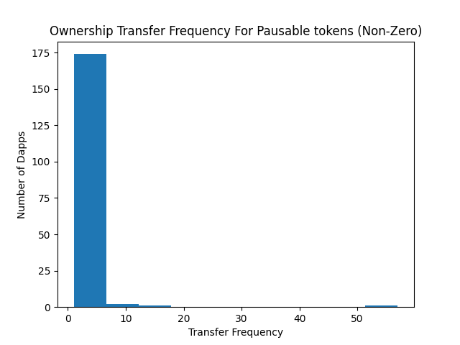
Results for Ownership transfer on PauseableToken
170 Dapps One time Changed
2 Dapps Two time changed
1 Dapps 3 time changed
1 Dapps 6 time changed

