Slide 1
Title
Design and Development of Brain-Computer Interface (BCI) for Navigating Drone

Slide 2
GROUP MEMBERS
Naneeta
Madiha
M Raheal Safdar
SUPERVISOR: DR. AHSANULLAH ABRO
Co-SUPERVISOR: AHMED ALI SHAH / RIAZ AFRIDI

Slide 3
Background
According to WHO data, over one billion people, out of seven billion world’s population, live with some form of disability.
Common diseases in disabled persons such as; spinal cord damage, brainstem stroke, loss of voluntary muscle control etc.
In recent years, cutting-edge technology such as the Brain-Computer Interface (BCI) has been more widely available to the general public.
Such technologies allow disabled persons to resume a normal life.

Slide 4
Introduction
Brain Computer Interfaces (BCI)
Electroencephalography (EEG)
EEG Headset (EMOTIV EPOC)
Unmanned Aerial Vehicle (UAV) OR Drone

Slide 5
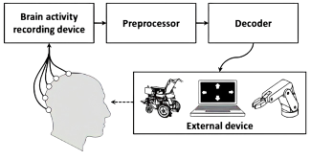
Introduction
Brain Computer Interfaces (BCI)

Slide 6
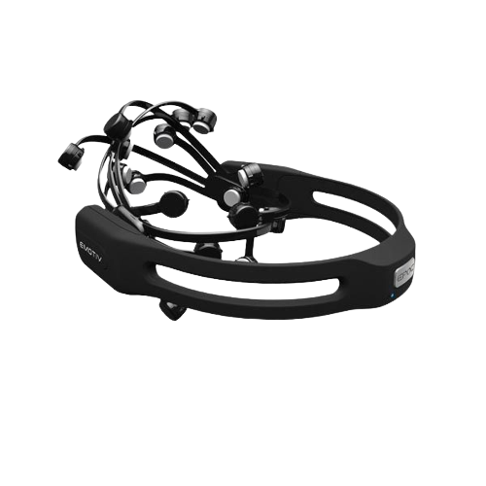
Introduction
EEG Headset (EMOTIV EPOC)

Slide 7
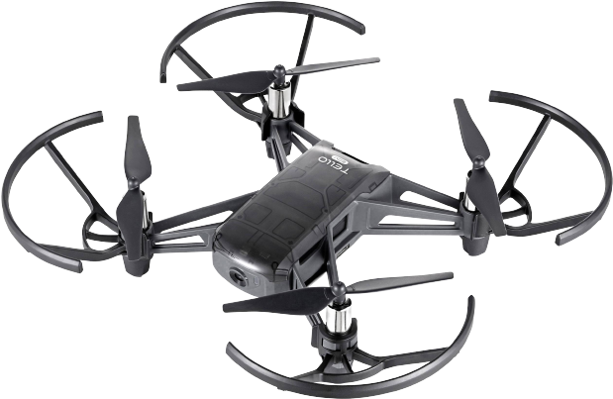
Introduction
Unmanned Aerial Vehicle (UAV) OR Drone

Slide 8
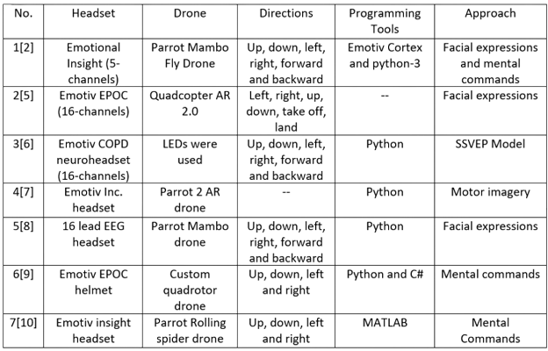
Literature Review

Slide 9
Problem Statement
There is a lack of navigational cues to detect user’s brain signals and to translate them into expected actions and activities accurately to control the navigational cues of drone.

Slide 10
Aims and Objectives
To make people able to control electric devices specifically Drone through Brain signals.
To control Drone movement through mental commands in six specific directions (left, right, forward, backward, takeoff, land).

Slide 11
Proposed Methodology
We will prefer the agile methodology for the development of this project.
It is iterative and incremental.
A strong communication and coordination is needed between team and project stakeholders.
Focuses more on development than documentation.

Slide 12
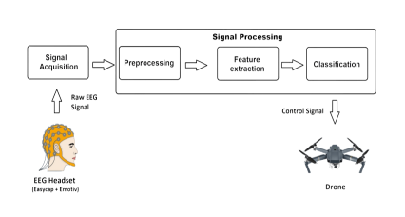
Proposed System Architecture

Slide 13
Tools and Technology
Tools
PyCharm IDE or Google Collaboratory
Visual Studio
Programming Languages
Python
C#

Slide 14
Timeline
Activity | 2022 |  |  |  |  |  |  |  |  |  | 2023
 | Mar | April | May | June | July | August | Sep | Oct | Nov | Dec | Jan
Literature Review (LR)
Problem Identification
System Requirements Specification
System Design Specification
System Development
System Testing

Slide 15
THANK YOU
ANY SUGGESTION?

