Slide 1

Final Year Project
Drone Navigation Using
Brain-Computer-Interface (BCI)
Group Members
Naneeta
Madiha
M Raheal Safdar
SUPERVISOR: DR. AHSANULLAH ABRO

Slide 2

TABLE OF CONTENT
Software Requirements Specification (SRS)
Software Design Specification (SDS)
30% implementation of the FYP

Slide 3

Software Requirements Specification
Functional Requirements
Functional Hierarchy
Use Case
Non-Functional Requirements
Performance Requirements
Safety Requirements
User Documentation

Slide 4




Functional Hierarchy
User will wear Open BCI headset
OpenBCI GUI should be connected with the headset through USB dongle
Turn on the OpenBCI cyton board
Drone setup will be done like turning it on and other required settings for the drone to fly smoothly
User will think of take-off command for the drone to start flying (for the next command user may think of any of the six commands/directions)
Signal acquisition from scalp through OpenBCI headset

Slide 5
Functional Hierarchy
Signal will be routed to computer via Bluetooth
Signal preprocessing
Signal classification via Machine Learning model (in Python)
Command generation for drone from received classified signal
Generated command will be routed to drone via Wi-Fi
Drone will start navigating in the desired direction

Slide 6

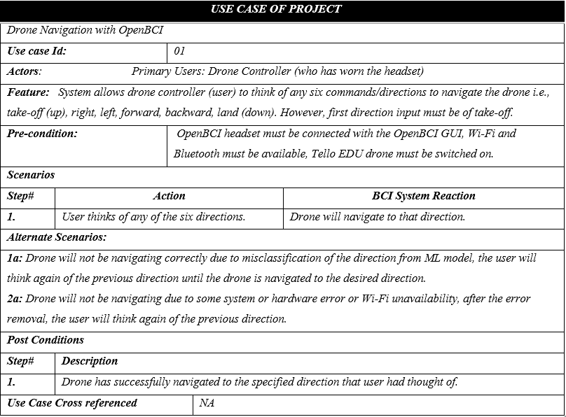
Use Case

Slide 7
Non-Functional Requirements
Performance Requirements
Safety Requirements
User Documentation

Slide 8
Software Design Specification
Use Case Diagram
Sequence Diagram
System Architecture

Slide 9

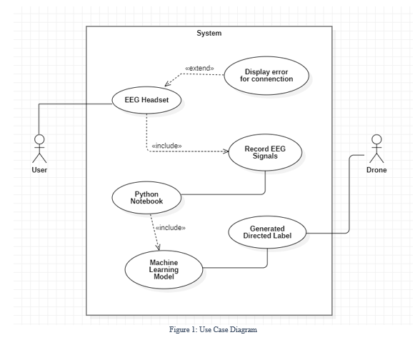
Use Case Diagram

Slide 10
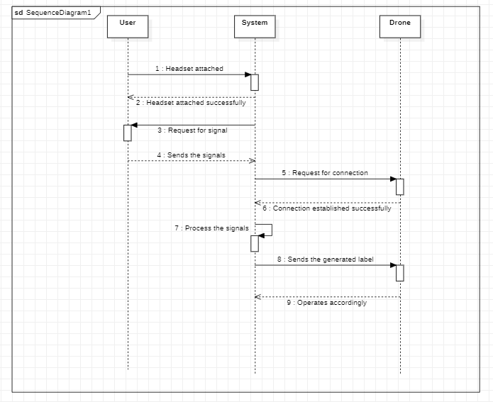
Sequence Diagram

Slide 11
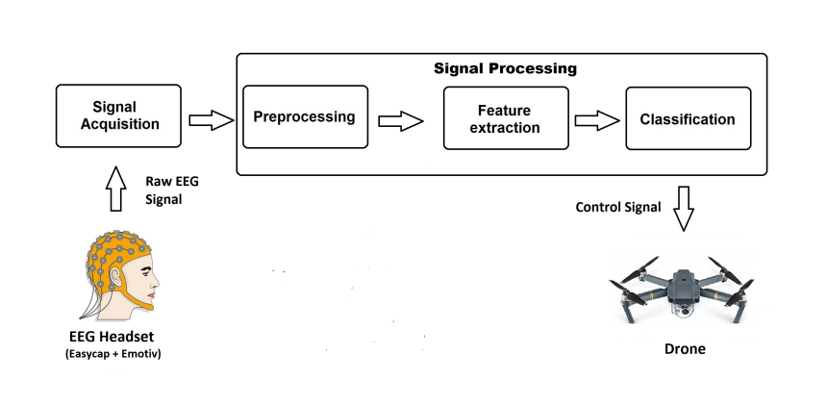
System Architecture

Slide 12
30% implementation of the FYP
Preliminaries
Data Recording Procedure
Data Cleaning

Slide 13

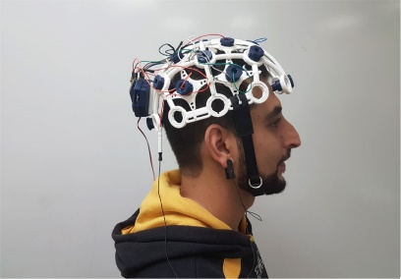
Preliminaries
Headset
OpenBCI headset should be turned on.

Slide 14
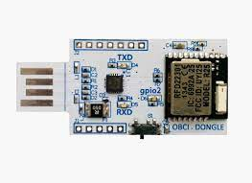
Preliminaries Cont.
USB Dongle
USB dongle should be inserted in the PC.

Slide 15
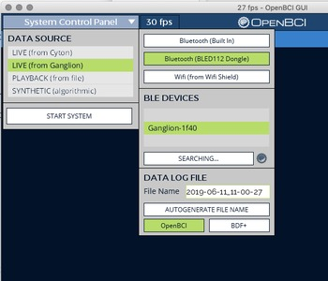
Preliminaries Cont.
OpenBCI GUI
The OpenBCI software should be installed on the laptop or PC.

Slide 16


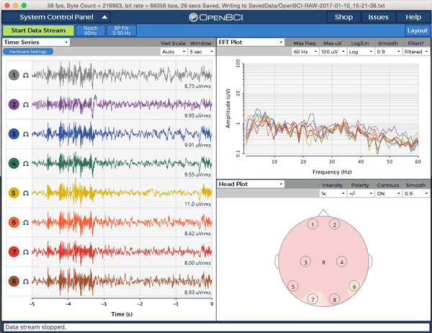

Data Recording Procedure
Selected 30 subjects for data collection, each called one-by-one.
Environment was noise-free.
Subject was directed to look on white wall presented in the controlled setup.

Slide 17

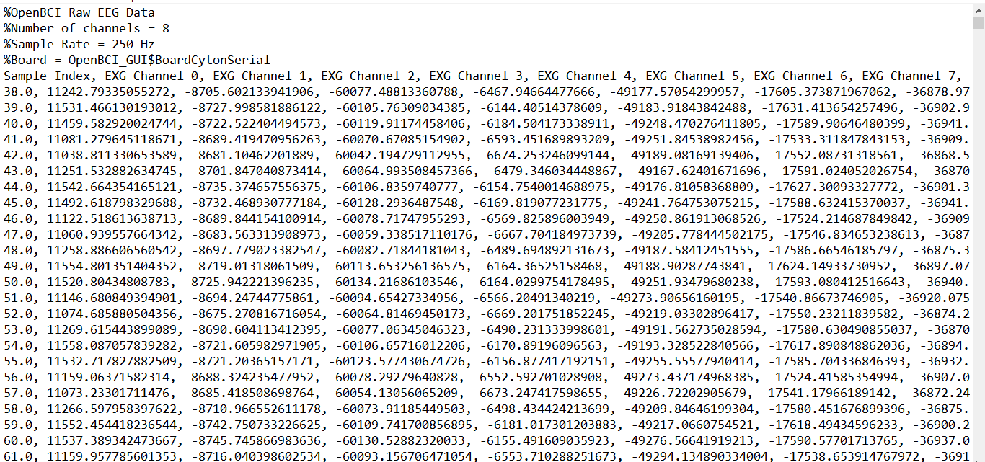
Raw Data File (.txt format)
Clean

Slide 18
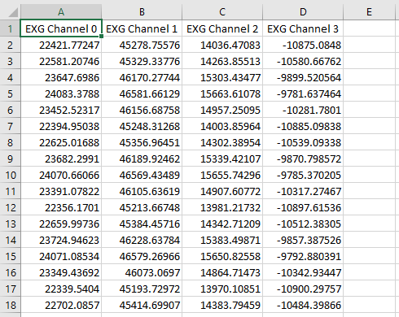
Cleaned Data File (.csv file)
Raw

Slide 19
THANK YOU
ANY SUGGESTION?

