Slide 1

Machine Learning
Madiha Hameed Awan

Slide 2

Introduction

Slide 3
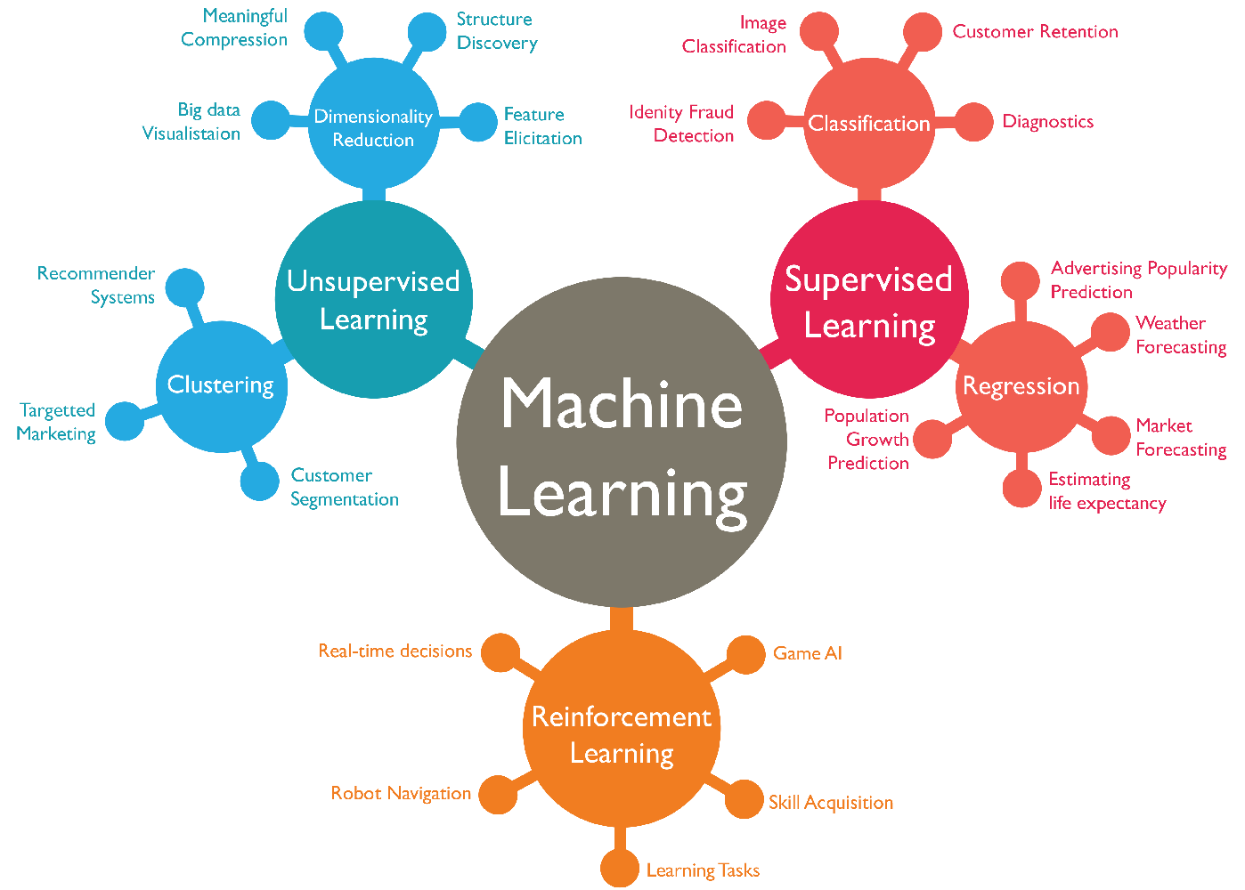
Types of ML

Slide 4
Classification
Classification is a fundamental concept in machine learning and statistics.
Where the goal is to categorize items into different classes or groups based on their characteristics.
There are several types of classification techniques, each suited for different types of data and problems.
Here are some common types of classification:
Binary Classification | Multi-Output Classification
Multi-Class Classification | Ordinal Classification
Multi-Label Classification | Anomaly Detection
Imbalanced Classification | Hierarchical Classification

Slide 5
Binary Classification:
Definition: In binary classification, the problem involves categorizing items into two classes.
Example: Email spam detection (spam or not spam), disease diagnosis (positive or negative), customer churn prediction (churn or not churn).

Slide 6
Multi-Class Classification
Definition: Multi-class classification involves classifying items into three or more classes.
Example: Handwritten digit recognition (0-9), language identification (English, French, Spanish), movie genre classification (action, comedy, drama, etc.).

Slide 7
Multi-Label Classification
Definition: In multi-label classification, each instance can be assigned to multiple classes.
Example: News categorization (a news article can belong to both "Politics" and "World News"), image tagging (an image can have tags like "beach," "sunshine," and "people").

Slide 8
Imbalanced Classification
Definition: Imbalanced classification occurs when one class in the dataset has significantly fewer instances compared to other classes.
Challenge: Traditional algorithms might be biased towards the majority class. Special techniques like resampling (over-sampling minority class, under-sampling majority class) and using different evaluation metrics are employed to handle imbalanced datasets.

Slide 9
Multi-Output Classification
Definition: Multi-output classification involves predicting multiple target variables for each input instance.
Example: Predicting both the type and color of an object in an image (object type: "car," color: "red").

Slide 10
Ordinal Classification
Definition: In ordinal classification, the classes have a specific order or ranking.
Example: Customer satisfaction levels (low, medium, high), star ratings (1 star, 2 stars, 3 stars, etc.).

Slide 11
Hierarchical Classification
Definition: Hierarchical classification organizes classes into a tree-like structure, where classes at higher levels are more general, and classes at lower levels are more specific.
Example: Species classification in biology (kingdom, phylum, class, order, family, genus, species).

Slide 12
Anomaly Detection
Definition: Anomaly detection involves identifying rare items, events, or observations that deviate significantly from the majority of the data.
Example: Fraud detection in banking, network intrusion detection, quality control in manufacturing.

Slide 13
Questions?
End of Lecture 1

