Slide 1

Machine Learning
Madiha Hameed Awan

Slide 2
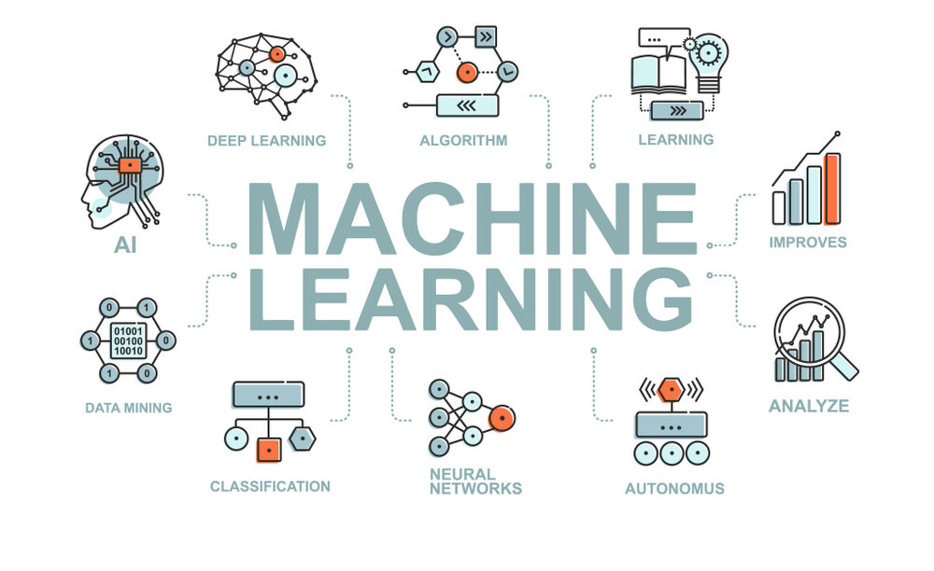
Introduction

Slide 3
ML Classifiers
Machine learning models are designed to learn patterns from data and can be used for various tasks, including classification, regression, clustering, and recommendation, among others.
Linear Regression | Logistic Regression
Decision Trees | Random Forest
Support Vector Machines (SVM) | Naive Bayes
K-Nearest Neighbors (KNN) | Gradient Boosting Machines (e.g., XGBoost, LightGBM)

Slide 4
Logistic Regression
Simple and fast for binary classification.
Can be extended for multi-class classification.
from sklearn.linear_model import LogisticRegression
model = LogisticRegression()

Slide 5
Decision Trees
Can handle both numerical and categorical data.
Easy to understand and interpret.
from sklearn.tree import DecisionTreeClassifier
model = DecisionTreeClassifier()

Slide 6
Random Forest
Ensemble learning method based on decision trees.
Generally more accurate than individual decision trees.
from sklearn.ensemble import RandomForestClassifier
model = RandomForestClassifier()

Slide 7
Support Vector Machines (SVM)
Effective for high-dimensional spaces.
Can handle non-linear decision boundaries.
from sklearn.svm import SVC
model = SVC()

Slide 8
K-Nearest Neighbors (KNN)
Instance-based learning algorithm.
Classifies a data point based on how its neighbors are classified.
from sklearn.neighbors import KNeighborsClassifier
model = KNeighborsClassifier(n_neighbors=3)

Slide 9
Naive Bayes
Based on Bayes' theorem and assumes independence between features.
Particularly good for text classification tasks.
from sklearn.naive_bayes import GaussianNB
model = GaussianNB()

Slide 10
Gradient Boosting Machines (e.g., XGBoost, LightGBM)
Ensemble learning method that builds multiple decision trees sequentially.
Often used in Kaggle competitions due to its effectiveness.
import xgboost as xgb
model = xgb.XGBClassifier()

Slide 11
Questions?
End of Lecture 1

