Slide 1

Smart Food Waste Analytics
Department of Computer Science and Engineering
Review – 2 (Batch – 2)
Team Members
Roll No Name
2420030353 Madini Ramyasri
2420030369 Avadhari Sahithya
2420090011 Chillancherila Lasya
Under the Guidance of :
Dr. N. Shirisha

Slide 2
OUTLINE
Abstract
Introduction
Objectives
Literature Survey
Research Gap
System Architecture

Slide 3
Abstract
The Smart Food Waste Analytics Platform is a data-driven solution designed to monitor, analyze, and reduce food waste in college canteens, hostels, restaurants, and other food service environments. The system collects data related to food preparation, consumption, and waste from different sources and processes it through an ETL pipeline using Python. The data is cleaned, transformed, and stored in a structured data warehouse for efficient analysis. Data analytics are used to identify waste patterns, frequently wasted food items, meal-wise waste, and financial losses. An interactive Power BI dashboard presents key performance indicators, trends, and insights in an easy-to-understand manner. Predictive analytics can also be integrated to forecast future food waste based on historical data. The platform helps organizations make data-driven decisions, improve food preparation and resource utilization, reduce unnecessary waste and costs, and promote sustainable and responsible food management practices.

Slide 4
Introduction
Food waste is a major problem in hostels, restaurants, canteens, and food service organizations.
Large amounts of food are wasted due to over-preparation, low consumption, and inefficient planning.
Traditional methods of recording food waste are often manual, time-consuming, and difficult to analyze.
There is a need for a data-driven system that can collect, process, and analyze food-waste data.
Our project uses Data Engineering and Analytics to transform raw food-waste data into meaningful insights.
The platform helps organizations identify waste patterns, reduce food waste, and minimize financial loss.

Slide 5
Introduction
Collects food preparation, consumption, and waste data from different sources.
Uses an ETL pipeline to extract, clean, transform, and load the data.
Stores processed data in a structured data warehouse.
Uses SQL and analytics to identify high-waste foods, meals, and locations.
Provides an interactive Power BI dashboard for monitoring key metrics.
Predictive analysis can help estimate future food waste and improve preparation planning.
Supports better decision-making and promotes sustainable food management.

Slide 6
Objectives
To build a centralized platform for managing food preparation, consumption, and waste data.
To ensure data quality and consistency through preprocessing and validation of raw food-waste data.
To analyze historical food-waste trends and identify key factors contributing to waste.
To develop scalable data-processing workflows for handling data from multiple food-service environments.
To generate actionable insights for optimizing food preparation and resource utilization.
To forecast future food-waste levels using historical data and predictive models.
To provide an interactive decision-support dashboard for monitoring performance and waste reduction.

Slide 7
Literature Survey
S.No | Link | Authors | Demerits | Future Direction
1. | https://www.researchgate.net/publication/363421551_An_Apache_Spark_Framework_for_IoT-enabled_Waste_Management_in_Smart_Cities | Gerasimos Vonitsanosl | Requires IoT infrastructure and continuous sensor data; mainly targets smart-city environments. | Integrate more real-time data sources, advanced analytics, and scalable waste-management applications.
2. | https://link.springer.com/article/10.1007/s43621-024-00483-0 | Jacintha Menezes | Hyperspectral imaging requires specialized equipment and can be costly and complex. | Develop low-cost sensing methods and integrate real-time Big Data analytics for waste classification.
3. | https://doi.org/10.1007/s13762-025-06488-0 | S. Alam, Md. Rokonuzzaman, K. S. Rahman, W. S. Tan. | The prediction accuracy can be affected by seasonal changes, population growth, and economic conditions. | Use more diverse and accurate datasets and develop forecasting models that can adapt to changing conditions.

Slide 8
Literature Survey
S.No | Link | Authors | Demerits | Future Direction
4. | https://www.sciencedirect.com/science/article/pii/S0959652623044232 | Miguel Rodrigues | Focuses on food-catering demand rather than municipal solid waste. | Apply forecasting techniques to municipal waste generation and integrate additional environmental factors.
5. | https://www.sciencedirect.com/science/article/pii/S0956053X25001072 | Evangelia G. Sigala | Requires specialized AI tracking devices and focuses on HORECA environments. | Expand AI-based tracking to larger waste-management systems and integrate predictive analytics
6. | https://link.springer.com/article/10.1007/s10479-023-05272-y | Mehrbakhsh Nilashi | Provides a broad industry-level perspective rather than a complete technical implementation. | Develop real-time Big Data platforms and integrate predictive analytics with waste-management operations.

Slide 9
Literature Survey
S.No | Link | Authors | Demerits | Future Direction
7. | https://www.mdpi.com/2071-1050/15/4/3482 | Sahar Ahmadzadeh Ghahnaviehei | Review-based study; mainly focuses on food waste and not general MSW implementation. | Develop food/waste-specific IoT solutions and investigate suitable sensors for different waste categories
8. | https://doi.org/10.1145/3549737.3549764 | Gerasimos Vonitsanos | The system depends on IoT sensors and real-time data, which may require additional infrastructure and maintenance. | Test the system using real-world datasets and explore more machine learning algorithms to improve prediction accuracy.
9. | https://doi.org/10.18280/ijei.080105 | Vaishnavi Jayaraman | The model is mainly focused on predicting municipal waste generation and is evaluated using data from Singapore. | Include socio-economic factors such as population, income, and education to improve waste-generation predictions.

Slide 10
Literature Survey
S.No | Link | Authors | Demerits | Future Direction
10. | https://www.nature.com/articles/s41598-026-53202-2 | Prakhash Neelemagam | Mainly focuses on waste-generation prediction; does not provide a complete end-to-end data pipeline | Integrate real-time data, improve local-level prediction, and extend the model to waste-management operations.

Slide 11
Research Gap
Existing studies mainly focus on individual aspects such as waste prediction, IoT-based monitoring, waste classification, or demand forecasting.
Many existing approaches depend on specialized sensors, IoT infrastructure, or costly technologies, which can limit practical implementation.
Data quality issues such as missing values, duplicate records, inconsistent formats, and incomplete data remain challenges in waste-data analytics.
Existing solutions require more scalable and efficient data processing to handle data collected from multiple food-service sources.
Limited work provides a fully integrated and automated pipeline connecting data collection, preprocessing, scalable processing, data storage, predictive analytics, and visualization.

Slide 12
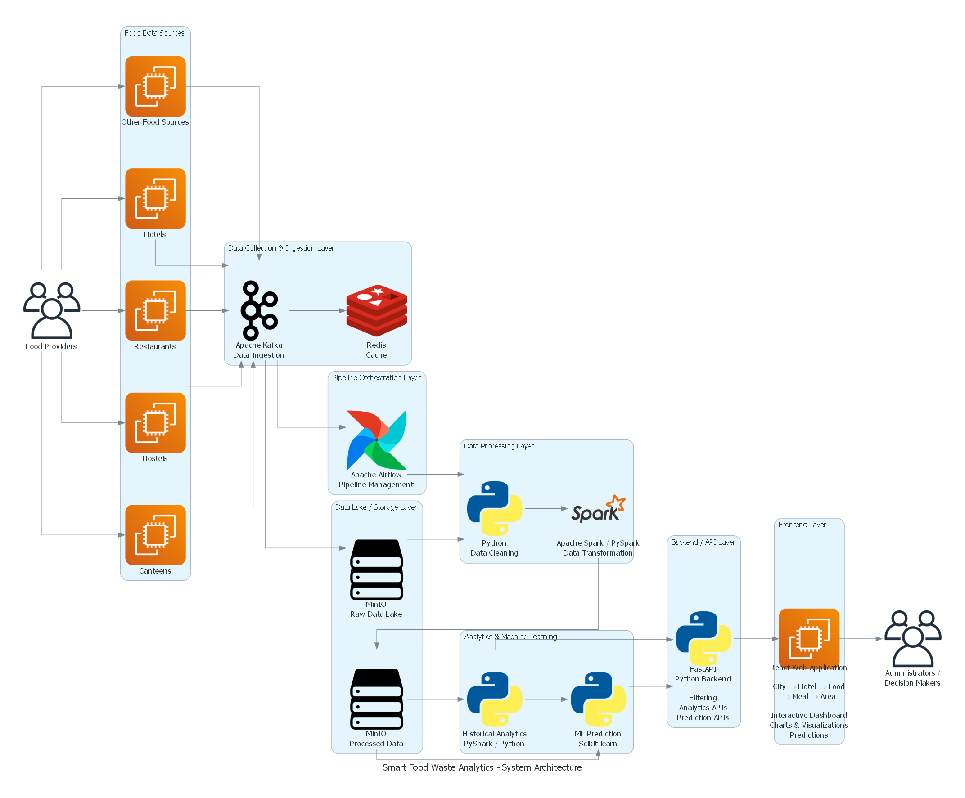
System Architecture

Slide 13
THANK YOU

