Slide 1

Smart Food Waste Analytics
Department of Computer Science and Engineering
Review – 3 (Batch – 2)
Team Members
Roll No Name
2420030353 Madini Ramyasri
2420030369 Avadhari Sahithya
2420090011 Chillancherila Lasya
Under the Guidance of :
Dr. N. Shirisha

Slide 2
Introduction
Food waste is a major problem in hostels, restaurants, canteens, and food service organizations.
Food is wasted due to over-preparation, low consumption, and inefficient planning.
Traditional recording methods are manual, time-consuming, and difficult to analyze.
The system collects and processes food preparation, consumption, and waste data.
ETL, SQL, and analytics identify high-waste foods, meals, and locations.
Dashboards and predictive analysis help monitor waste and improve future planning.
The platform supports better decisions, reduces financial loss, and promotes sustainable food management.

Slide 3
Existing System
The existing system mainly uses manual or fixed-format data input, which makes handling different datasets difficult.
Analysis is mainly based on predefined data and basic reports, with limited city-wise and food-wise insights. The system does not provide integrated food-waste prediction, making future waste estimation difficult.
Anomaly detection is limited or unavailable, so unusual food-waste patterns may not be identified effectively.
Recommendations are mostly generated manually, which makes the decision-making process less automated.

Slide 4
Proposed System
Automated Data Processing – Uses PySpark to clean, validate, transform and prepare food-waste data efficiently.
Waste Prediction – Uses a Random Forest ML model to predict expected food waste based on historical and operational data.
City & Food Analytics – Provides city-wise and food-item-wise analysis to identify the major sources of food waste.
AI-Based Recommendations – Generates actionable suggestions such as adjusting preparation quantities and improving meal planning.

Slide 5
Objectives
Develop an automated PySpark pipeline to clean, validate, transform, and prepare large-scale food-waste data for analysis.
Build a machine-learning model to predict food waste using factors such as city, hotel, food type, meal, people served, and preparation quantity
Identify major food-waste patterns through city-wise and food-item-wise analytics to determine where waste is highest.
Generate AI-based recommendations to support better food preparation, demand planning, and reduction of waste and cost loss.
Provide an integrated analytics dashboard that enables dataset upload, waste analysis, predictions, and actionable insights in one platform.

Slide 6
Literature Survey
S.No | Link | Authors | Demerits | Future Direction
1. | https://www.nature.com/articles/s41598-026-53202-2 | Prakhash Neelemagam | Mainly focuses on waste-generation prediction; does not provide a complete end-to-end data pipeline | Integrate real-time data, improve local-level prediction, and extend the model to waste-management operations.
2. | https://www.researchgate.net/publication/363421551_An_Apache_Spark_Framework_for_IoT-enabled_Waste_Management_in_Smart_Cities | Gerasimos Vonitsanosl. | Requires IoT infrastructure and continuous sensor data; mainly targets smart-city environments. | Integrate more real-time data sources, advanced analytics, and scalable waste-management applications.
3. | https://link.springer.com/article/10.1007/s43621-024-00483-0 | Jacintha Menezes | Hyperspectral imaging requires specialized equipment and can be costly and complex. | Develop low-cost sensing methods and integrate real-time Big Data analytics for waste classification.

Slide 7
Literature Survey
S.No | Link | Authors | Demerits | Future Direction
4. | https://www.sciencedirect.com/science/article/pii/S0959652623044232 | Miguel Rodrigues | Focuses on food-catering demand rather than municipal solid waste. | Apply forecasting techniques to municipal waste generation and integrate additional environmental factors.
5. | https://www.sciencedirect.com/science/article/pii/S0956053X25001072 | Evangelia G. Sigala | Requires specialized AI tracking devices and focuses on HORECA environments. | Expand AI-based tracking to larger waste-management systems and integrate predictive analytics
6. | https://link.springer.com/article/10.1007/s10479-023-05272-y | Mehrbakhsh Nilashi | Provides a broad industry-level perspective rather than a complete technical implementation. | Develop real-time Big Data platforms and integrate predictive analytics with waste-management operations.

Slide 8
Literature Survey
S.No | Link | Authors | Demerits | Future Direction
7. | https://www.mdpi.com/2071-1050/15/4/3482 | Sahar Ahmadzadeh Ghahnaviehei | Review-based study; mainly focuses on food waste and not general MSW implementation. | Develop food/waste-specific IoT solutions and investigate suitable sensors for different waste categories
8. | https://doi.org/10.1145/3549737.3549764 | Gerasimos Vonitsanos | The system depends on IoT sensors and real-time data, which may require additional infrastructure and maintenance. | Test the system using real-world datasets and explore more machine learning algorithms to improve prediction accuracy.
9. | https://doi.org/10.18280/ijei.080105 | Vaishnavi Jayaraman | The model is mainly focused on predicting municipal waste generation and is evaluated using data from Singapore. | Include socio-economic factors such as population, income, and education to improve waste-generation predictions.

Slide 9
Literature Survey
S.No | Link | Authors | Demerits | Future Direction
10. | https://doi.org/10.1007/s13762-025-06488-0 | S. Alam, Md. Rokonuzzaman, K. S. Rahman, W. S. Tan. | The prediction accuracy can be affected by seasonal changes, population growth, and economic conditions. | Use more diverse and accurate datasets and develop forecasting models that can adapt to changing conditions.

Slide 10
Requirements
Software Requirements
Programming Language: Python 3.11
Data Processing: Pandas
Data Storage: MinIO
Backend: FastAPI
Machine Learning: Scikit-learn
API Testing: Postman

Slide 11
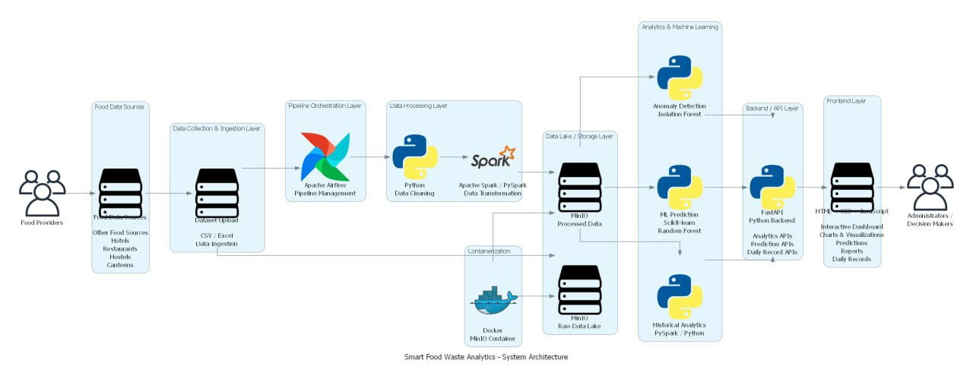
System Architecture

Slide 12
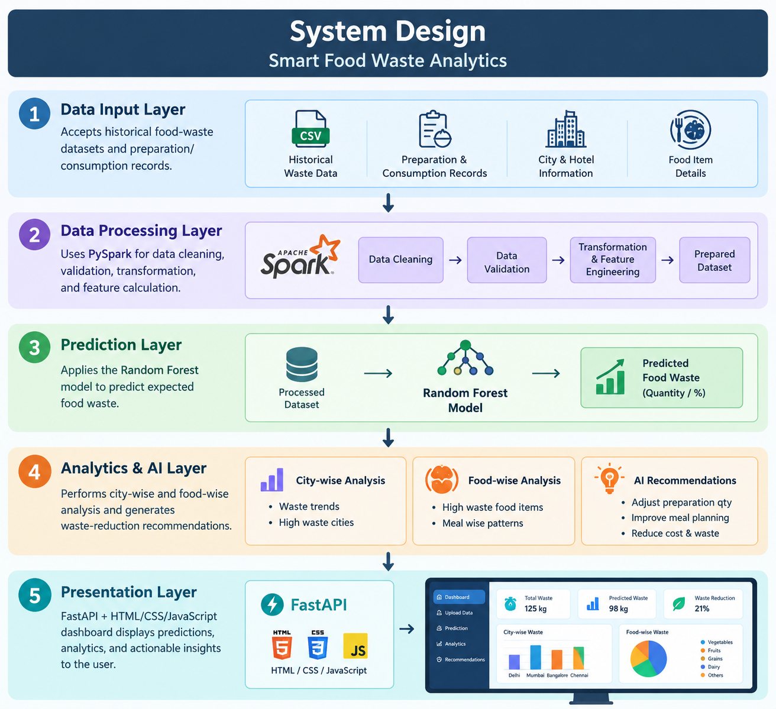
System Design

Slide 13
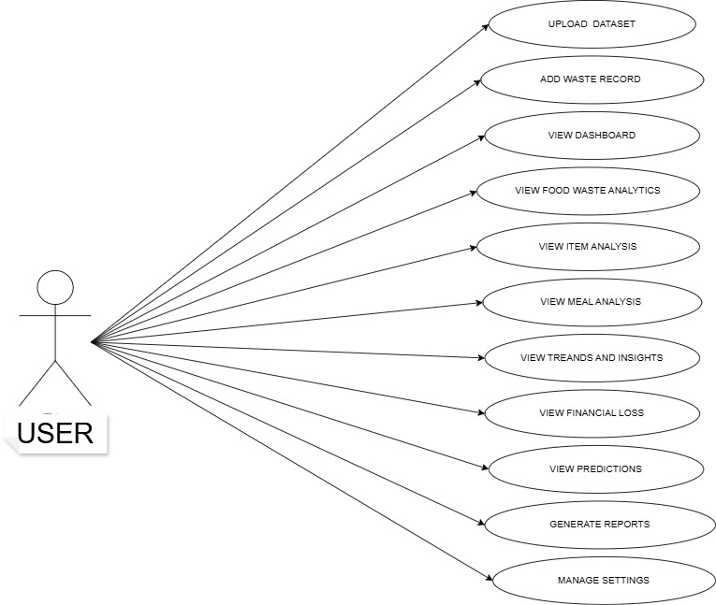
UML DIAGRAMS

Slide 14
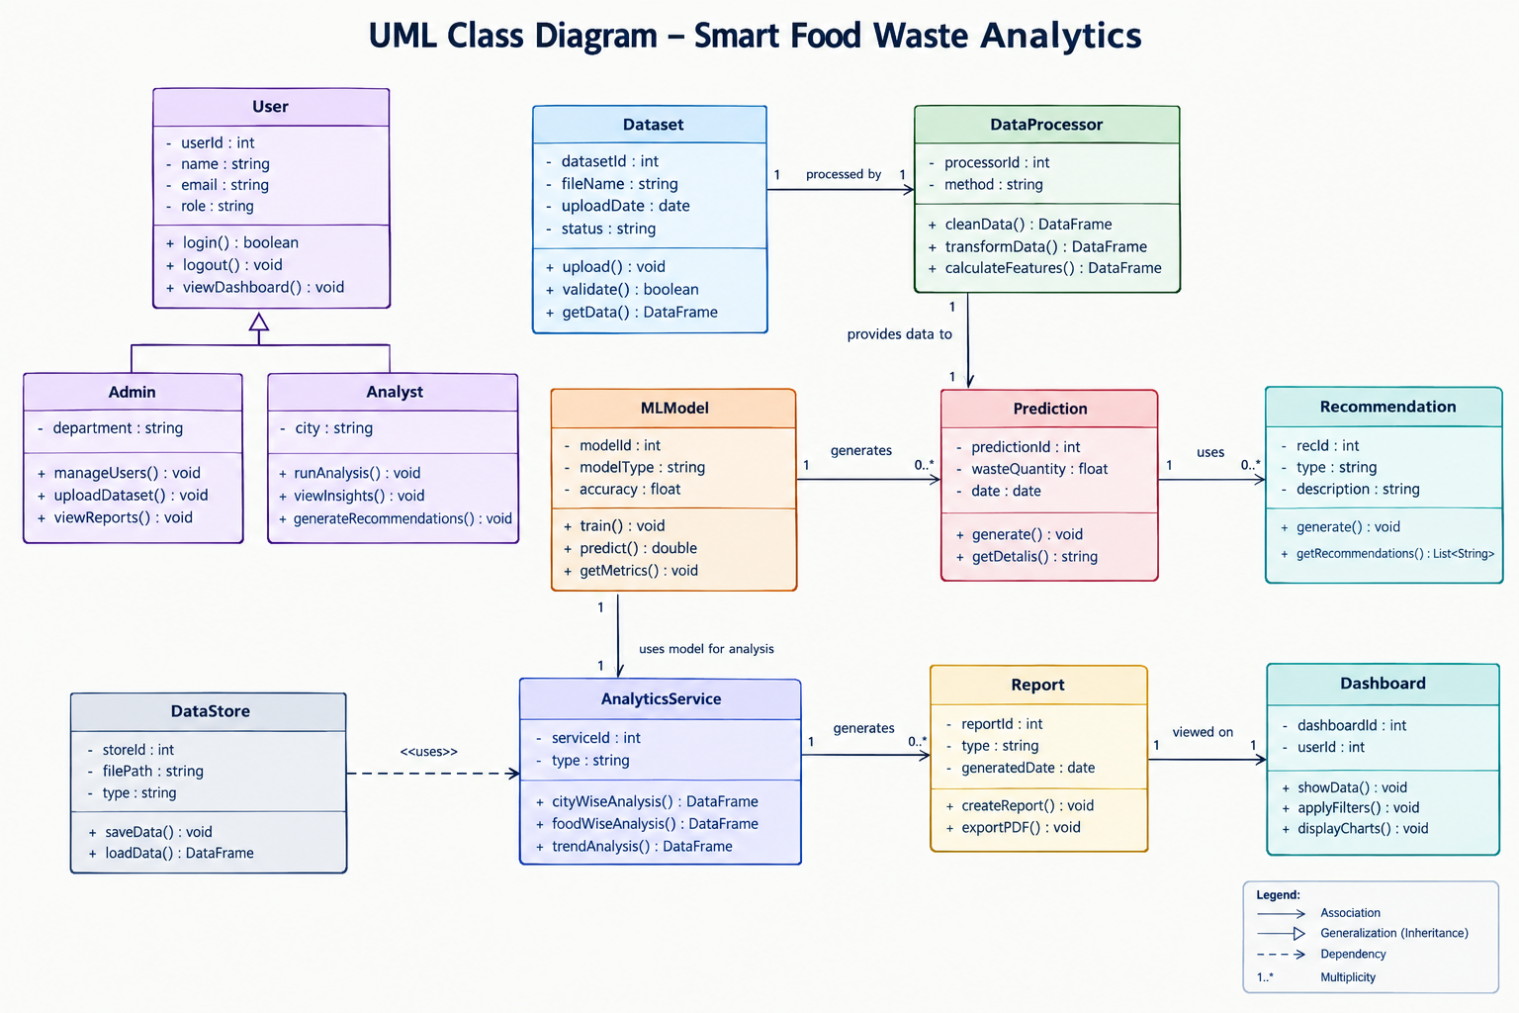

Slide 15
Methodology
Data Collection – Collect historical food-waste data containing city, hotel, food item, meal, preparation, consumption and waste details.
Data Preprocessing – Use PySpark to remove duplicates, handle invalid values, calculate waste percentage and prepare the dataset.
ML Prediction – Train a Random Forest model on processed data to predict food waste quantity.
Analytics & Insights – Perform city-wise and food-wise analysis and identify high-waste patterns and financial loss.
Recommendation & Dashboard – Generate AI-based waste-reduction recommendations and display predictions, analytics and insights through the web dashboard.

Slide 16
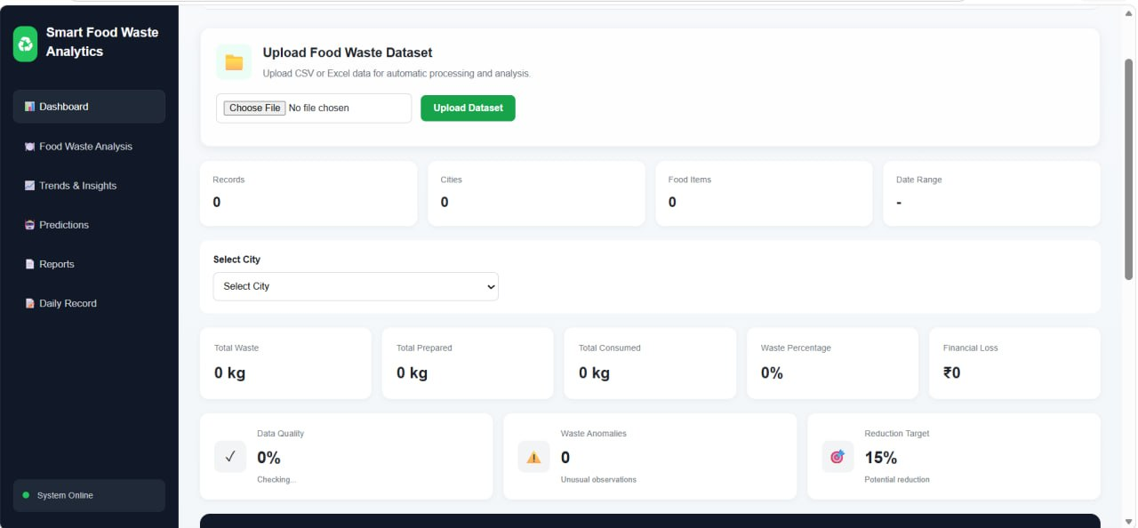
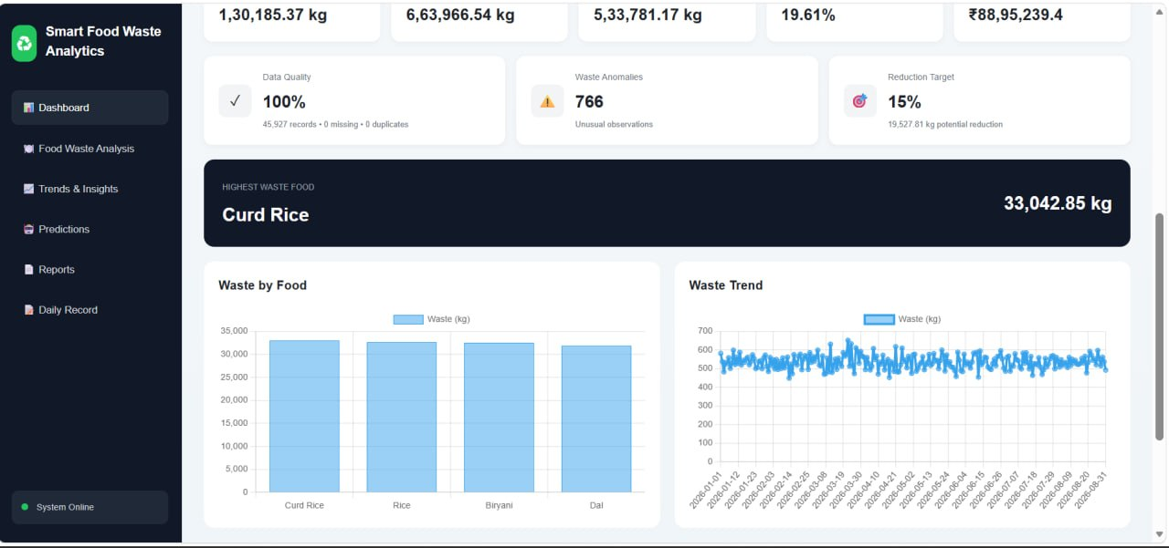
Implementation

Slide 17
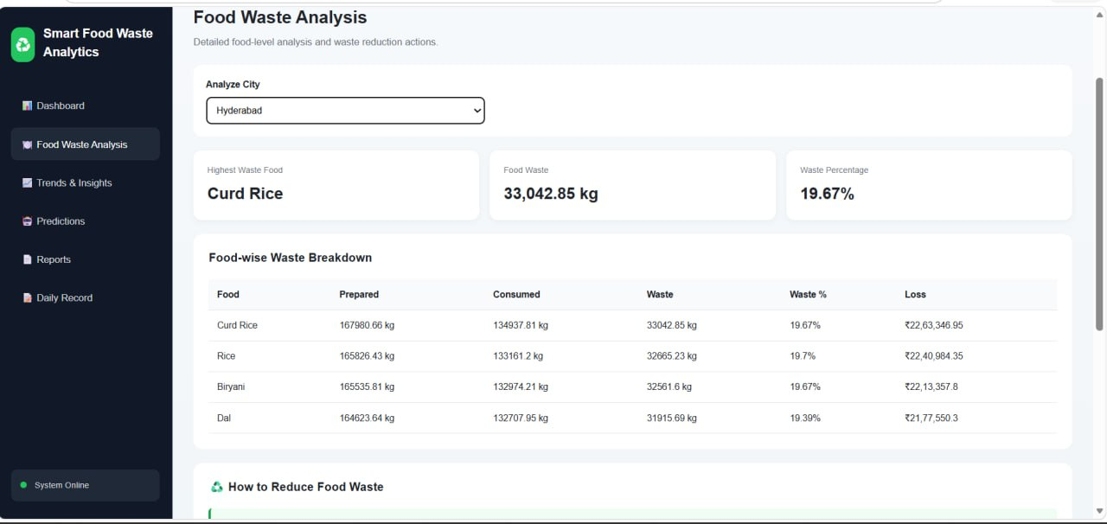
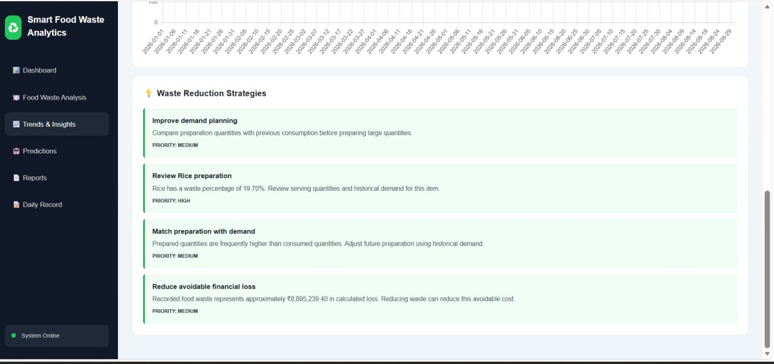
Implementation

Slide 18
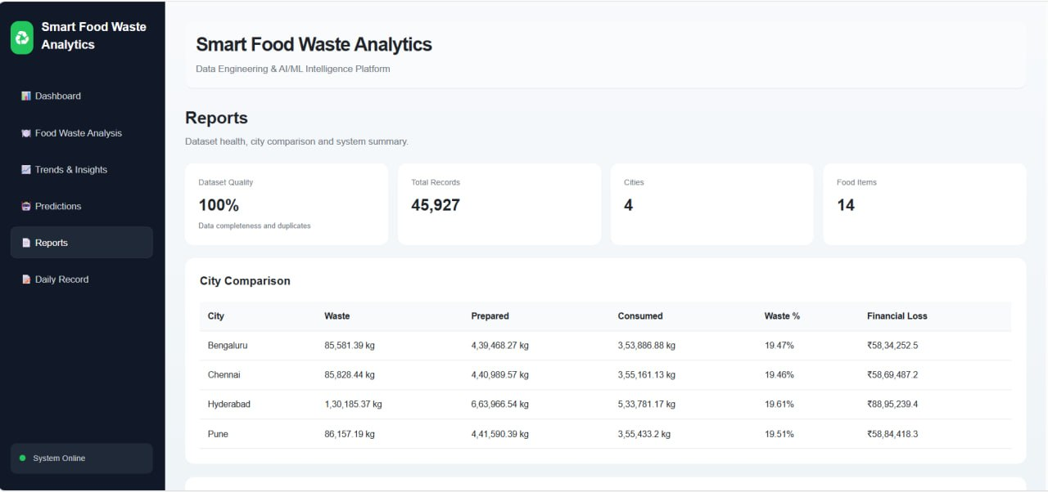
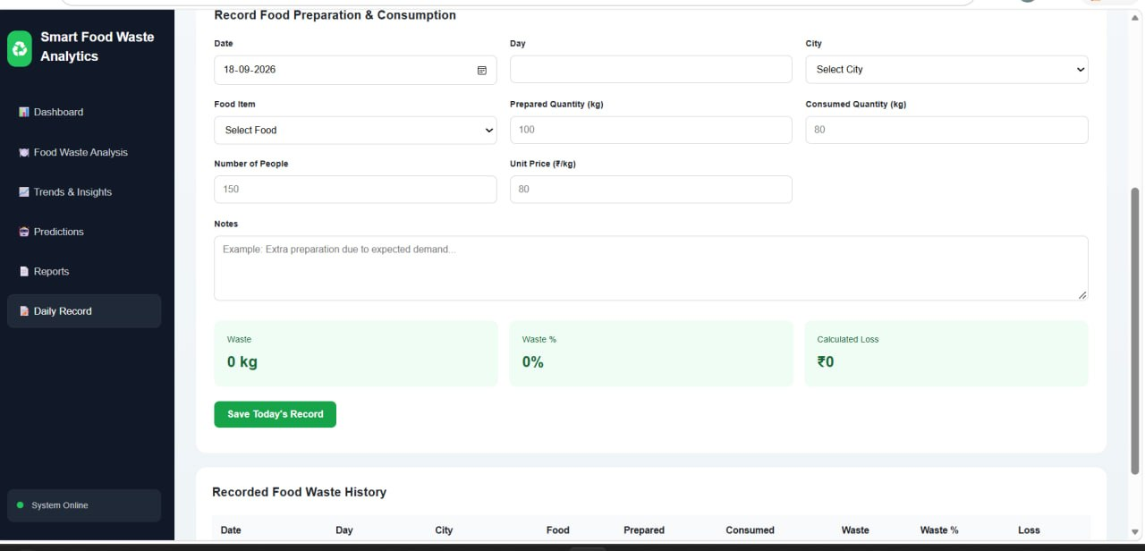
Implementation

Slide 19
RESULTS AND CONCLUSION
Data Processing: Successfully cleaned and transformed the uploaded food-waste dataset using PySpark.
Data Quality: Removed duplicate and invalid records and calculated the Waste Percentage feature.
AI Insight: The system identified 22% prepared food waste in the tested case and generated a recommendation to improve meal planning.
Conclusion: The system successfully integrates data engineering, ML prediction, analytics, and AI recommendations to support food-waste reduction.

